Slide 1

ACT Score Sheet
June 01, 2015

Slide 2
Agenda:
Work Plan
New Behavioral Map
ACT Score sheet
Call Calibration
Coaching Effectiveness Tracking Report

Slide 3
QM Work Plan

Slide 4
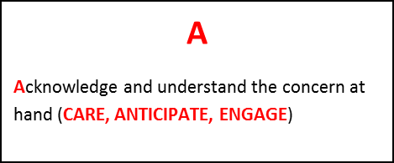
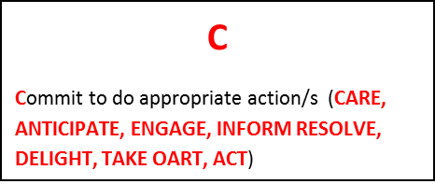
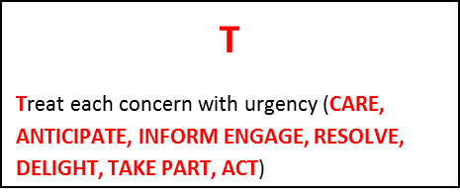
New Behavioral Map – As Customer….
As a CUSTOMER, I want you to:
1. Recognize me at once
2. Immediately identify and acknowledge what matters to me
3. Verify my account thoroughly
As a CUSTOMER, I want you to:
4. Provide me relevant solutions to address all concerns raised to you
5. Provide me with complete and accurate information
6. Confirm and record what was discussed and our agreement of what will happen and when the request will be processed
As a CUSTOMER, I want you to:
7. Deal with my concern efficiently
8. Ensure that your actions will mean , I only have to contact you once
9. Execute correct and complete resolution (Not Wrong or incomplete action)
10. Update me on the status if there will be any changes or delays

Slide 5
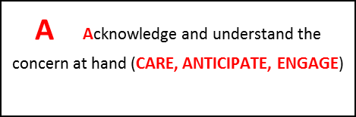
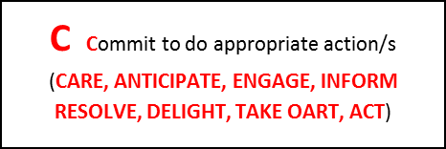
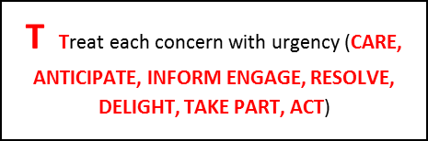
New Behavioral Map – As Agent….
As a CUSTOMER REPRESENTATIVE, you have to:
1. Answer the call within standard time (8 seconds)
2. Have a full understanding of what the customer is contacting us for, by being mindful of his verbatim. Effectively probe to determine the root cause of the concern
3. Ensure efficient account verification
As a CUSTOMER REPRESENTATIVE, you have to:
4. Ensure that all communication/actions taken to address the customer’s concern is accurate and applicable
5. Have full knowledge on our products and services
6. Obtain customer's agreement and/or understanding on solution offered. Do necessary contact tagging
As a CUSTOMER REPRESENTATIVE, you have to:
7. Provide correct information at the onset of the call and refrain from unnecessary holding and/or efficiently utilze standard holding procedures (with music and TAT of 2 mins)
8. Avoid the possibility of a follow up from the customer
9. Practice total contact ownership (TCO) by strictly monitoring the committed action to be fulfilled
10. Be committed in providing feedback once promised (within TAT/as committed by the agent)
11. Understand that as the customer had a "not so wonderful" experience, it is expected that we will be engaged in a much higher level in terms of our commitment to resolve their complaints ; thus, enrolling it to Service Recovery program.

Slide 6
ACT Score Sheet

Slide 7
Basic Guidelines – Agent Level
Recognize me at once…
Able to deliver the opening spiel within 8 seconds for the Customer to be assured that she will get help
Immediately identify and acknowledge what matters to me…
Able to grasp customers needs at the onset

Slide 8
Basic Guidelines – Agent Level
Provide me relevant solutions to address all concerns raised to you…
Best solution should be offered
Response/question should be appropriate to the customer's question/statement
Agent should have full control of the call; hence, should not take an action based on customer’s perception
Provide me with complete and accurate information…
All web tools should be utilized to be able to provide complete and accurate information

Slide 9
Basic Guidelines – Agent Level
Confirm and record what was discussed and our agreement of what will happen and when the request be processed…
Do necessary contact tagging
Deal with my concern efficiently…
Correct information/resolution/option should be provided a the onset of the call
Never prolong the call by resolving without probing
Agent should not use the mute button or simply put the customer in limbo (cannot be monitored for long holding time)
Never commit unnecessary holding

Slide 10
Basic Guidelines – Agent Level
Ensure that your actions will mean I only have to contact you once …
First Call Resolution (FCR)
Accurate resolution of concern
This should also apply to effective transfer of calls (be mindful of cold and warm transfer guidelines)
Accurately deliver the promises you made and update me on the status if there will be changes or delays…
Resolution should be provided within TAT
It is expected that timely feedback will be given based on what has been committed

Slide 11
Coaching Opportunity – Courtesy and Empathy

Slide 12
Coaching Opportunity – Tone of Voice and Eloquence
Service Principle | Component | Coaching Opportunity | Comments
 | Tone of voice and eloquence
Care / Anticipate / Engage /Delight (esp for complaints) | Sounded helpful and accomodating | Coaching Rating 1. Unintentional monotone, bedroom, and sleepy voice No Rating 1. Agent sounded/expressed disinterest in assisting the customer 2. Sleepy, bored monotone, bedroom voice with customer reaction
Care / Anticipate / Engage / Act | Maintained professionalism | Coaching Rating 1. Correct grammar and pronunciation of words 2. Prolonged pronunciation of syllables 3. Mouthpiece too near or far (causing high pitch sound, heavy breathing or subs can't hear agent's voice) 4. Agent stutters (to speak with involuntary disruption) 5. Agent keeps on using the fillers 6. Unnecessary words/sounds 7. Able to adapt to customer's language NO Rating 1. If the agent was mindful of his/her grammar and pronunciation of words 2. Agent sounded unsure of the info given 3. If the agent failed to adjust the mouthpiece despite customer request, with or without customer reaction 4. Excessive use of po and opo (per word/sentence) 5. Use of uncertain words like "baka", "siguro", "pwede" 6. Giggling, humming, flirting with subscriber, sneezing without apology 7. Agent must adopt to subs language (If foreigner but agent speak tagalog)
Care / Anticipate / Engage | Observe proper pace | Coaching Rating 1. Agent spoke too slow/fast for the customer No Rating 1. Rushing to end the call

Slide 13
Coaching Effectiveness Report
Coaching Opportunities
IP (Improvement Plan) – duly signed
(Action/Exit Plans) – metrics to be determined upon calibration

Slide 14


