Slide 1

Samsung Galaxy S6
and
S6 Edge
March 2015 Cascade
Notes:
Please coordinate with traffic partners re: schedules

Slide 2
Course Outline
I. Product Highlights: Galaxy S6 & S6 Edge
II. Launch Timeline
III. Customer Journey
V. OM Handling
VI. Recontracting Handling
IV. Recontracting Call-out Team Handling
Notes:
2

Slide 3
Status Update: Pending Items as of March 19, 2015
Pricing → Closed (Go to Slide 13)
Plans → Closed (please check S6 Queries Tracker)
EPC Codes → Pending (please check S6 Queries Tracker for updates)
Queue Name for MYBSS Assignment* → Pending
Hooq Free Content EPC Tagging – available March 24 x 25
Globe Online Portal (AlphaOne Form) → will go live March 20
*Applicable to Recontracting only

Slide 4
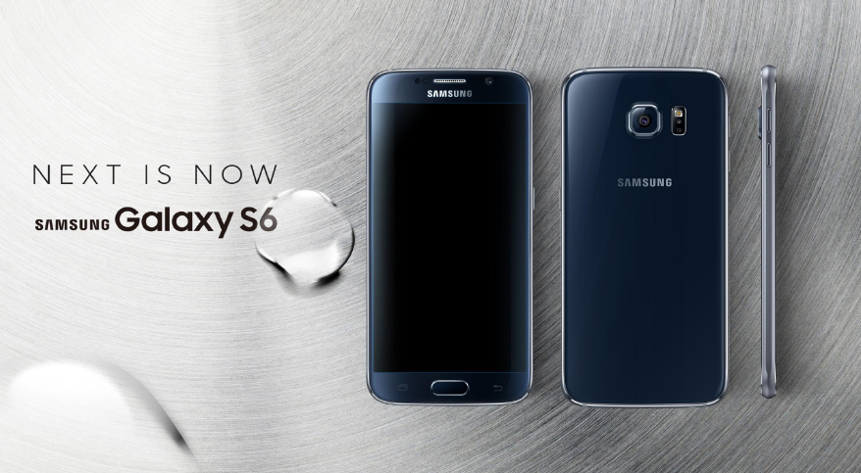

Slide 5

Handling for Inquiries prior to Launch
KMS Article: 2218763
Samsung Galaxy S6 is Coming Soon
Notes:
As a countermeasure to the competitor’s S6 launch, refer to this KMS article for handling customer inquiries.

Slide 6

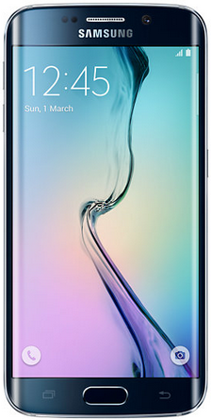
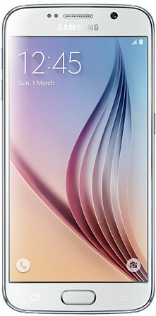
Next is Now!
The Galaxy S6 and S6 Edge are the newest flagship devices from Samsung to be offered to our customers!
Wonderful Network
Fastest LTE Network
Wonderful Content
All-you-want premium apps and content
(Spotify, NBA & Hooq)
Wonderful Device
Wide QHD Screen
Fast charging
Fast processor

Slide 7
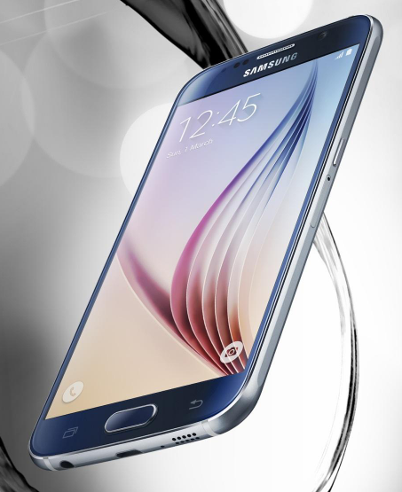
Beautiful Outside, Powerful Inside
Galaxy S6
Design
Dynamic optical feel
Precise glass and metal cutting – gives you the perfect grip
Camera
Fast-launching camera (.7 seconds)
1.4 aperture wider for bright & brilliant pictures
Optical Image Stabilization and Video Digital Image Stabilization for clear, professional-looking pictures and videos
Notes:
Highlight: Made of glass and metal compared to the previous models
Design:
Samsung started from ground-zero by ditching the plastic material we associated with Samsung in favor of premium-feeling glass and metal.
With Jewel-toned colors (white pearl, black sapphire, gold platinum)
Both the front and the non-removable back are covered with Gorilla glass 4, metal bands all around the side, drilled holes for the speakers
Retained the 5.1 screen size (Same with S5) for easier one-handed use
Bumped up the resolution of its Super Amoled display to Quad HD → 30% higher than the S5 and 76% higher than the iPhone 6 → for super sharp and super crisp visuals
Camera
Same 16MP resolution as the S5 but don’t let that fool you into thinking that the quality of the camera hasn’t changed.
The S6’s sensor and lens was improved to a 1.4 aperture lens for better quality photos and videos in lowlight conditions
Optical Image Stabilization and Video Digital Image Stabilization for clear, professional-looking pictures and videos → less blur for shaky hands

Slide 8
Beautiful Outside, Powerful Inside
Galaxy S6
Battery Life
Super-charging – in 10 minutes you can have four hours of usage
Takes 80 minutes to fully charge
Wireless charging – no longer messy
Processor
64 bit processor – dual quadcore (Octacore) – performance goes up to 30%
Power consumption goes down by 35%
LPDDR4 memory
UFS 2.0 internal storage
Notes:
Battery Life
Supercharging (for regular usage: call, text, occassional browsing) → no historical data for all-day data
Lower mAH → low power consumption due to the processor
Solid State Devices (SSD) → newer, faster processing time
Wireless charging → w/o the need for any special cases, built-in; available in selected coffee shops (Starbucks and McCafes)
Processor
Processor → Samsung Exynos 64-bit Octa-Core (14 nm process), 2.1 GHz Quad + 1.5 GHz Quad coupled with 3GB of DDR4 RAM and a UFS 2.0 storage (Simply put, it’s fast.)

Slide 9
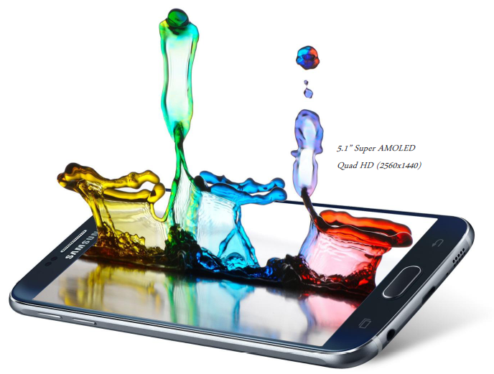
Beautiful Outside, Powerful Inside
Display
Brilliant, lifelike images to astonish your eyes
600 candela – Adjusts to make sure it is not painful to the eyes
Audio
Speaker is 50% louder than the one on the S5
Moved the speaker from the back of the phone
Notes:
600 Candela screen → unit of measure for brightness → intelligent bright

Slide 10
Beautiful Outside, Powerful Inside
Security
Smart Manager – Samsung has teamed up with McAfee
My Knox – Easy-to-use isolated space for work
Fingerprint scanner – accurate and quick from any angle
Notes:
Security
Smart Manager → McAfee –built in
My Knox → work data is stored separately
*not your typical storage (different storage allocation)
Fingerprint scanner → The S5’s fingerprint scanner was swipe-based, but with the S6 Samsung has upgraded its fingerprint scanner to a touch-based sensor which should translate to a more convenient and more accurate fingerprint scanner
Note to Trainer: If a trainee or a customer asks about the Samsung Pay (use of the fingerprint scanner and unique transaction tokens for more secure payments), say that the feature is available, but very few establishments in the country is compatible with that technology (similar to the Apple Pay)

Slide 11
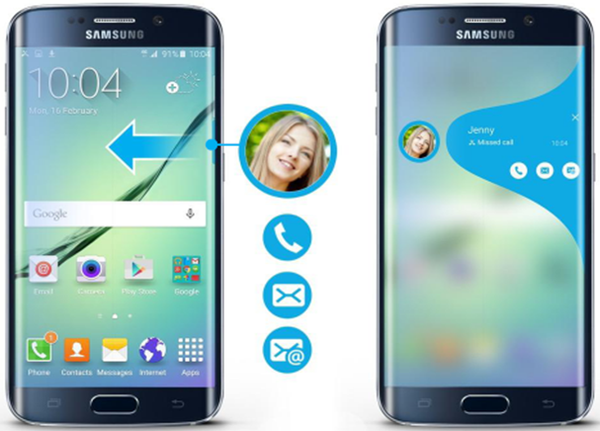
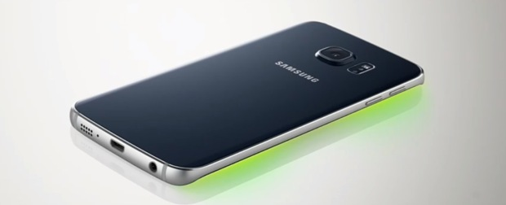
Beautiful Outside, Powerful Inside
Notification even when phone is off
Emits light with different colors that can be assigned to different contacts
Notes:
S6 Edge comparison with Note Edge

Slide 12
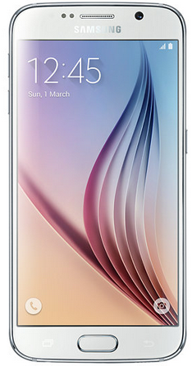
Beautiful Outside, Powerful Inside
Samsung Galaxy S6
Samsung S6 Edge
Memory
32GB, 64GB*
Black*, White*, Blue (32G only)** Gold**
5.1” QHD Super Amoled Glass and Metal Gemstone Finish
143.4 (H) x 70.5 (W) x 6.8 (T) mm, 138g.
64-bit Octacore Processor
2,550mAh Fast charging; Wireless Charging
32GB, 64GB*
Black*, White*, Green (32G only)**, Gold**
5.1” QHD Super Amoled Glass and Metal Gemstone Finis
142.1 (H) x 70.1 (W) x 7.0 (T) mm, 132g
64-bit Octacore Processor
2,550mAh Fast charging; Wireless Charging
Color
Display
Dimension
Processor
*Available come launch
** Wait for further notice
Battery
Notes:
128 Memory (?) → no for the launch, waiting for the pricing, possible after the launch
Card Slot → No, to be confirmed with Marketing
Confirmation re: dual sim version? → The S6 Edge will come in a single sim variant, S6 dual-sim, training to confirm with Marketing
LTE for both sims
Built-in battery

Slide 13
Pricing
Device | Plan 599 | Plan 999 | Plan 1499 | Plan 1999 | Plan 2499
Samsung Galaxy S6 32GB | 24,200 | 19,800 | 15,600 | 10,800 | FREE
Samsung Galaxy S6 64GB | 27,900 | 23,400 | 19,200 | 15,000 | 4,800
Samsung Galaxy S6 Edge 32GB | 29,400 | 25,200 | 20,400 | 16,200 | 7,200
Samsung Galaxy S6 Edge 64GB | 33,100 | 28,800 | 24,000 | 20,400 | 16,800
*MyBSS upload still pending

Slide 14

Launch Timeline
20Mar
05Apr
12Apr
18Apr
Begin
Day 1
Place orders to be valid for April 18 (Day 1)
Pre-payment must be posted on or before April 12
Customers who ordered from March 20 to Apr 5
Payment posted on or before April 12 can get their unit from designated event hubs
For OM → Advance MSF, Handset cashout, historic/overdue balance if applicable
For Recontracting → Overdue balance, historic & payoff fee, handset cashout
Notes:
CTB – charged to bill
EC – emerging channel
Pre-payment for OM (advance MSF and handset cashout, historic or overdue balance if applicable → for new line
Pre-payment for Recontracting: Overdue Balance, historic, payoff fee (for early recontracting)
Encourage customer to pay at a Globe Store (for real-time posting), other payment channels are available
CVG Shaw: Recontracting does the customer has to settle cashout

Slide 15
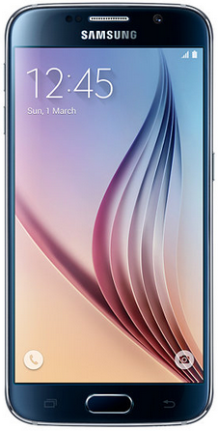
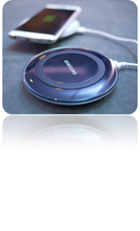


Mainstream Offer
From March 20 to April 5
(Pick up Date on April 18)
From April 6 onwards
(Pick up Date on April 19 onwards)
Free Content
Free Content
FREE 3 months via Go Surf 299*
FREE 3 months via Go Surf 299*
Samsung Galaxy S6
Samsung Galaxy S6
Free Samsung Wireless
Charger
AND
AND
*minimum
FREE 3 months
FREE 3 months
Notes:
*Raise order as it is, back up team will tag free content for Hooq, but come March 25 agent should be able to tag Hooq in the order
Charge to bill is applicable → one time
Samsung Wireless Charger → SRP (selling point)

Slide 16


Blue and Platinum Offers
Blue (Plan 2499)
Platinum (Plan 3799 and up)
Level-up Offer for Blue and Platinum Subs!
Mainstream Offer
Mainstream Offer
Guaranteed Special Block Screening of Avengers for two*
Guaranteed Special Block Screening of Avengers for two*
Guaranteed
Wanderland Tickets for two!
* Inform customer of a Wonderful surprise if they avail of the offer, refer to KMS for the final confirmation on Avengers & Wanderland tickets

Slide 17




Customer Journey: Recontracting Call-out
1
2
3
Call-out team advises customer on eligibility, Arrow plans and upsell. Informs customer to wait for an email and SMS for pick-up schedule.
Customer pre-pays at any Globe-owned Store or online
Customer receives an email and SMS on schedule for pick-up

Slide 18
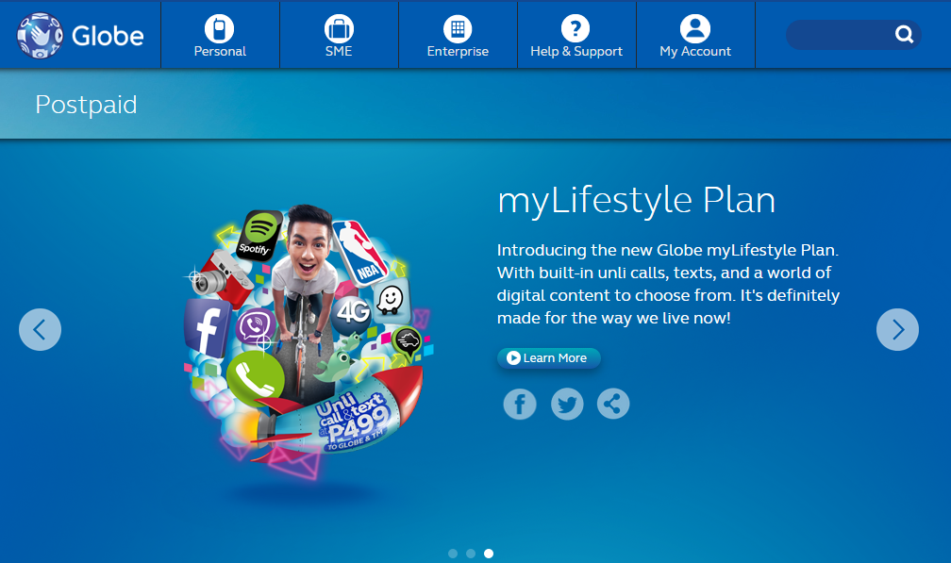



Customer Journey: New Acquisition
1
Customer fills-out registration form via Globe website
4
Customer pre-pays at any Globe-owned Store or online
Customer receives a call from Globe about the approval of his/her application and the need to pre-pay
3
2
Customer receives confirmation email on the registration
5
Customer receives an email and SMS on schedule for pick-up
Notes:
Globe Online Portal – screenshot to follow (refer to KMS)

Slide 19


Customer Journey: Recontracting
1
2
3
Customer calls the hotline to recontract
Agent advises customer on eligibility, Arrow plans and upsell. Informs customer to wait for an email and SMS for the schedule of pick-up
Customer receives an email and SMS on schedule for pick-up

Slide 20



Customer Journey: Launch Event
1
2
3
Customer presents ID and official receipt and picks up the phone at the event. An authorized representative* may also pick the items up.
Customer is advised on on-site surprise via pick-a-prize (Avengers tickets or Avengers exclusive bag tag set)
Customer is advised that he and his family may participate in the myLifestyle plan hubs to get instant prizes
*New line – authorization letter
Recontracting – signed recontracting form
For new sub/recon who walks-in, front liner to accept application for processing. No releasing of handsets on-site
Notes:
* An authorized may pick the items up as long as they present a copy of their ID and the customer’s ID, as well as a letter of authorization. If a customer has prepaid for the handset, they need to present the OR

Slide 21

Recontracting Call out Team
    Follow existing handling in KMS: Consumer Wireless Postpaid Recontracting Program Handling
    (ID: 62886)

Slide 22
OM Handling
Refer to KMS

Slide 23
Recontracting Handling
Follow BAU process in KMS except pre-payment requirements & event pick-up
Notes:
By March 23, EPC is available/uploaded in MyBSS.

Slide 24
Follow Existing Handling for the Following scenarios:
For line application follow up:
MyBSS Process: New Line Application Follow Up for Care and Tech (ID:68722)
For Follow-up on line activation:
MyBSS Process: Activation Follow up for Newly Applied and Additional Postpaid Line (ID 105480)
For inquiries on Handset/Gadget repair or replacement:
MyBSS Process: Handset Repair and Replacement (ID 146071)
For Defective/Lost SIM:
MyBSS Process: Change SIM for Postpaid (ID 160608)

Slide 25
Follow Existing Handling for the Following scenarios:
For inquiries on pre-termination:
Process: Termination, Downgrade & Transfer of Ownership Policy for Wireless (ID 19849)
For inquiries on gadget care:
Process: Process: Globe Gadget Care Aftersales Handling (ID 79775)
For unposted payment inquiries:
Unposted Payment (Wireless Postpaid)Handling (ID 88107)

Slide 26
Exclusive Platinum First Look Event

Slide 27

Exclusive Platinum First Look Event
Preview Weekend Schedule & Venues
Refer to KMS Article: Samsung Galaxy S6 Private Viewing (2233690)

Slide 28

Notes:
OM Handling → after verification & approval (separate session), price bulletin (expect an updated)

