Slide 1
Universal Systems Model

Slide 2
Technology System
What is the Universal Systems Model?
A Flow Map used to describe how processes work. Has 5 parts: Goal, Input, Process, Output, & Feedback
The complete process of designing, creating, using a tool and the result of its use.

Slide 3
Technology Systems Are:
Created from human need or want
Designed and developed by people
Modified and/or abandoned over time

Slide 4
Universal Systems Model
Five parts of the Universal Systems Model
Goal
Input
Process
Output
Feedback

Slide 5
Universal Systems Model
Goals- the objective, what you want the system to do
Students discuss some IDEAS

Slide 6
Universal Systems Model
2. Inputs – resources that go into the system.
7 different inputs
People
Materials
tools or machines
Energy
information
Finances
Time

Slide 7
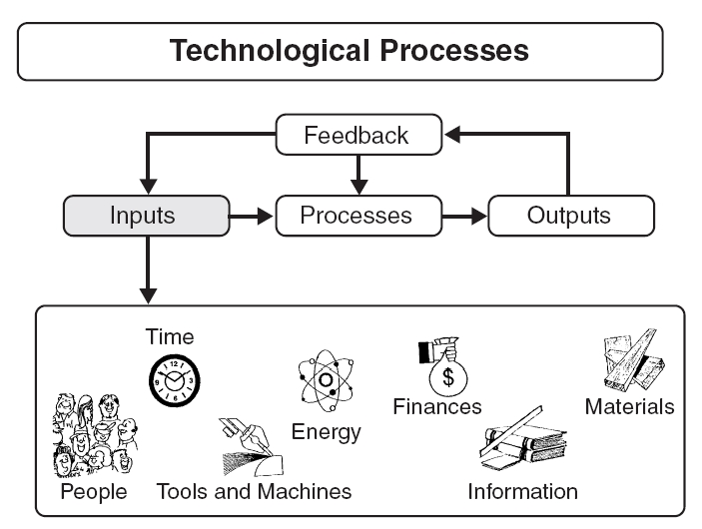
© From Technology by R. Thomas Wright, 2004

Slide 8
Universal Systems Model
Processes - the steps that lead to a result
3 Different Types
Processes
Problem Solving
Production
Management

Slide 9
Universal Systems Model
PROBLEM SOLVING PROCESS
Identifying the problem
Developing solutions to the prob.
Isolating and detailing the best solution
Modeling and evaluating the chosen solution
Pictorial or physical models
Selecting final solution and preparing for production

Slide 10
Universal Systems Model
PRODUCTION PROCESS
Actions completed to produce the product, structure or service
MANAGEMENT PROCESS
Controlling and supervising the people, materials, and the production of the output.

Slide 11
Universal Systems Model
Outputs – the result that comes out of the system
Students discuss different OUTPUTS

Slide 12
Universal Systems Model
Feedback- Comparing the results to the goal: adjustments are made to the input & process if needed
Students discuss FEEDBACK

Slide 13
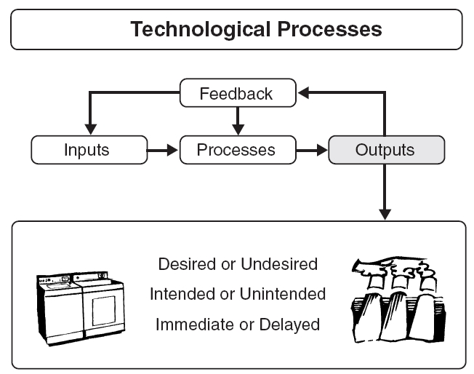
© From Technology by R. Thomas Wright, 2004

Slide 14
Universal Systems Model
GOAL:
What you want the system to do
INPUT:
Resources that go into the system
PROCESS:
Steps that lead to a result
OUTPUT:
The result that comes out of the system
FEEDBACK:
Comparing the results to the goal: adjustments are made to the input & process if needed

