Slide 1
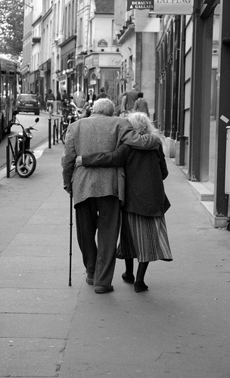
PSYC 1120 Summer 2012 Day 5 -- Adulthood

Slide 2

Agenda
Complete answer sheets for test
Finish book reviews
Kohlberg’s Stages of Moral Development
Menu activity
Schaie’s Adult Stages
Group Activity
Review games
Test
Go over grades -- end

Slide 3

Fill Out your Answer Sheet You have 10 minutes

Slide 4
Book Reviews
Be sure to introduce yourself
Use buttons in ZOOM on front right corner to adjust the camera…. TELE increases image size for small books and WIDE brings it back to full page size

Slide 5
Remember Piaget’s Stages
Sensorimotor
Preoperational Thinking
Concrete Operational Thinking
Formal Operational Reasoning – late adolescence and adulthood

Slide 6
Cognitive Development
Formal Operational Thought
In Piaget’s theory, the fourth and final stage of cognitive development, characterized by more systematic logic and the ability to think about abstract ideas.
Hypothetical thought
Reasoning that includes propositions and possibilities that may not reflect reality.

Slide 7
Cognitive Development
Deductive reasoning
Reasoning from a general statement, premise, or principle, through logical steps, to figure out (deduce) specifics. (Sometimes called top-down reasoning.)
Inductive reasoning
Reasoning from one or more specific experiences or facts to a general conclusion; may be less cognitively advanced than deduction. (Sometimes called bottom-up reasoning.)

Slide 8
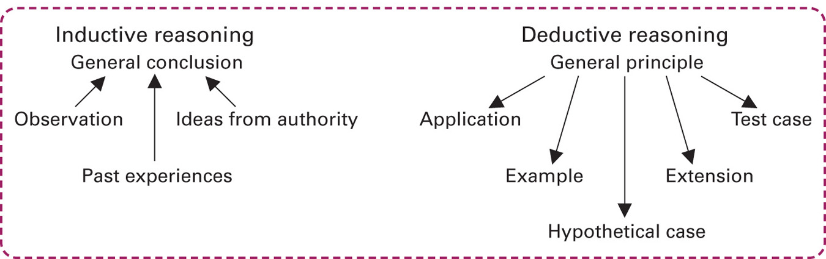
Cognitive Development

Slide 9
Development of Morality
KOHLBERG’S LEVELS OF MORALITY
Lawrence Kohlberg (1963): Described stages of morality that stem from three levels of moral reasoning, with two stages at each level
Preconventional moral reasoning: Emphasizes rewards and punishments (early childhood)
Conventional moral reasoning: Emphasizes social rules (middle childhood – adolescence)
Postconventional moral reasoning: Emphasizing moral principles (adolescence – adulthood)

Slide 10
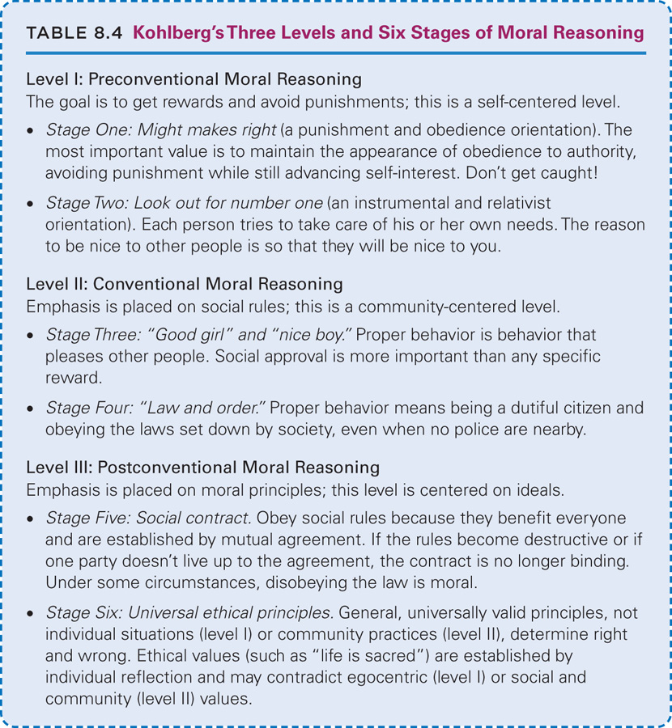

Slide 14
Criticisms of Kohlberg
Kohlberg ignored culture and gender.
Kohlberg’s levels could be labeled personal (preconventional), communal (conventional), and worldwide (postconventional) → family is not included.
The participants in Kohlberg’s original research were all boys.

Slide 15

Carol Gilligan
American feminist ethicist
claimed that the results of Kohlberg’s studies were biased because the participants in the basic study were largely male
Females reason differently than males in making moral decisions

Slide 16
10 Minute Break

Slide 17
What can be done to avoid waste of cafeteria food?
What goes in a good lunch?
Pre-schooler
Grade school
High school
Adults at work

Slide 18

Plan a school lunch menu
Plan a healthy school hot lunch
Plan a healthy school sack lunch
Plan a healthy fast food lunch
What can be done to encourage children to consume full lunches at school?
How can parents be involved?
Consider a full day on the pyramid worksheet – your lunch should include at least 1/3 of the recommended portions
How would lunch plans differ for adolescents?

Slide 19
What can be done to help obese grade school children?
1.
2.
3.
4.

Slide 20
Film
It Won’t Happen to Me.

Slide 21
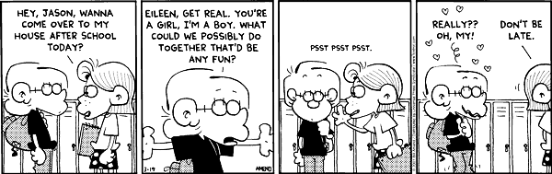

Slide 22
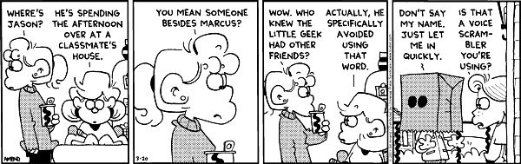

Slide 23
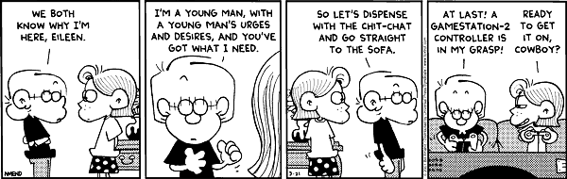

Slide 24
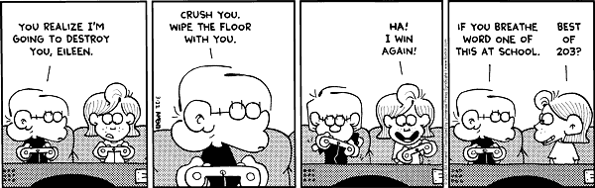

Slide 25
Stages of Adult Development
G. Warner Schaie

Slide 26
Schaie’s views on adult development
Compared with adolescent, adults become more self- motivated, broader, reasonable, and practical in relation to adult responsibilities

Slide 27
Adult Development
Stages of adult development correspond with patterns of commitment and social emphasis of adult life.
Adult stages begin after childhood and adolescence.

Slide 28
Period of Acquisitions
Childhood and adolescence
Learning basic skills
Information is absorbed indiscriminately without regard for its practical significance.

Slide 29
Achieving Stage
Late teens and early 20’s
Learning becomes more goal directed; entrepreneurial style
Building job-related skills and reputation

Slide 30
Responsible Stage
Approaching middle adulthood
More job stability
Pattern integrates personal and family goals

Slide 31
Executive Stage
Middle adulthood
Job security
Attainment of many goals; mentoring others
Usually develops a broad sense of social responsibility

Slide 32
Reintegrative Stage
Late adulthood
Thoughts turn to making sense of life as a whole
Retirement and/or “passing the torch” to the next generation

Slide 33
Group Assignments
Group 1
Cheryl
Craig
Jeni
Group 2
Candy
Angela
Jisike
Amber

Slide 34
Group Discussion Project on Adulthood

Slide 35
Group Assignments
Group 1 ages 18 - 40
Group 2 ages 40 – retirement (age 65)
Group 1 retirement to 75 (early old age)
Group 2 75 to death (the old-old)

Slide 36
Questions for each Group
Gains, strengths or advantages of being in this age group
Pitfalls, drawbacks or challenges of being in this age group

Slide 37
Instructions
Get into your group
Get 2 sheets of flip chart paper; 3 pens each a different color
Make 1 sheet for advantages/strengths and the second sheet for challenges/pitfalls
Appoint a recorder or two
Brainstorm issues in answer to the two questions for your first age group

Slide 38
Biosocial or Physical Domain
Overall growth
Health issues
Sensory information
Sleep and wakening
Dietary issues
Motor skills and abilities
Nervous system development

Slide 39
Cognitive Domain
Information-processing
Memory
Intelligence
Learning and thinking
Language
Moral development and values
Theories of Piaget, Kohlberg, Chomsky, Pavlov, Skinner, Bandura

Slide 40
Psychosocial Domain
Social life
Emotional development and temperament
Cultural influences
Relationships with parents, family members, teachers, peers, and others
Self-concept and self-awareness
Psychological development
Freudian and Eriksonian Developmental Theories

Slide 41
On your sheets make lists
Gains or advantages of being in this age group
Aim for at least 15 for biological/physical domain
Aim for at least 15 for cognitive domain
Aim for at least 15 for psychosocial domain
Pitfalls, drawbacks or challenges of being in this age group
Aim for at least 15 for biological/physical domain
Aim for at least 15 for cognitive domain
Aim for at least 15 for psychosocial domain
Note: There will be some overlapping among items on the lists

Slide 42
You now have 20 minutes to work on your lists for your first age group

Slide 43
Before Reporting Out
Using a color pen you have not used yet, indicate whether it is an issue of the
Biosocial Domain B
Cognitive Domain C
Psychosocial Domain P

Slide 44
Break
When we return, we will do the second age categories for each group

Slide 45
Questions for each Group
Gains, strengths or advantages of being in this age group
Pitfalls, drawbacks or challenges of being in this age group

Slide 46
Instructions
Get into your group
Get 2 sheets of flip chart paper; 3 pens each a different color
Make 1 sheet for advantages/strengths and the second sheet for challenges/pitfalls
Appoint a recorder or two
Brainstorm issues in answer to the two questions for your second age group

Slide 47
On your sheets make lists
Gains or advantages of being in this age group
Aim for at least 15 for biological/physical domain
Aim for at least 15 for cognitive domain
Aim for at least 15 for psychosocial domain
Pitfalls, drawbacks or challenges of being in this age group
Aim for at least 15 for biological/physical domain
Aim for at least 15 for cognitive domain
Aim for at least 15 for psychosocial domain
Note: There will be some overlapping among items on the lists

Slide 48
You now have 20 minutes to work on your lists for your second age group

Slide 49
Report Out
Present your list to the class
Recorder, add any additional issues suggested by class members to the list

Slide 50
Casting your Ballot
Carefully consider the lists presented in each age group
Each student will be given some dots
Using 3 of your dots, choose the 3 most important issues, concerns, gains, pitfalls, etc. for each stage
You will place 3 dots on each of the lists –including your own

Slide 51
Next step for groups
Reform in your groups and count the votes on your sheets
On new sheets record the top 6 - 8 vote getters from each list
Be sure to indicate the domain for each (B,C, or P)
Post your signs on the side wall and leave them

Slide 52
Basic Presentation Plan
B = bridge into the presentation – have some sort of introductory statement, question, picture, etc.
O = objective – what is it you hope to accomplish with your information
P = present the information
P = post test or pull it together - ask for questions, summarize, wrap it up, etc. You might ask participants to share how they will use your information.

Slide 53
Group Presentation Assignment
Your group will be responsible for a 5 - 10 minute presentation.
Each member must contribute to the research and to the presentation.
Find websites, do a powerpoint or make some pages to show on the Elmo, use the flip chart sheets, etc.
Your presentation needs to have something visual!
Try to involve the audience in some way.

Slide 54
Work Time
Looking at the strengths, develop a plan or strategy to make the most of three of the main points cited in your final vote
Be sure address the biological, cognitive and psychosocial domains

Slide 55
Looking at the pitfalls, develop a plan or strategy to achieve or compensate for three of the main points cited in your final vote
Be sure address the biological, cognitive and psychosocial domains

Slide 56
Go over tests
Test #2
Test #3

Slide 57
Review the Stages
http://www.quia.com/rd/41147.html
Erikson
http://www.quia.com/rd/44247.html
Piaget
http://www.quia.com/rd/44246.html
Freud
http://www.quia.com/rd/59008.html
Schaie

Slide 58
Remaining Activities
Take Group Test
Return
Go over grades
Wrap up! We’re done!

