Slide 2
Techno Teaching For Champions
Let’s Blast Off!

Slide 3
Course Objectives
Demonstrate examples of uses of technology in the learning environment
Discuss activities incorporating student group participation or study activities
Demonstrate examples of course webpage using expression web or Quia software
Explore examples of online tools, surveys, movies, etc. as classroom tools
Talk about some strategies that work and some that do not work well in the learning environment

Slide 4
Promote active student learning
Pursue active innovation
Achieve active integration
Develop an active faculty
Build an active infrasturcture
Active Campus Playbook
http://campustechnology.com/whitepapers/2014/07/dell_industryperspective_072914.aspx?pc=e842em06&utm_source=webmktg&utm_medium=E-Mail&utm_campaign=e842em06

Slide 5
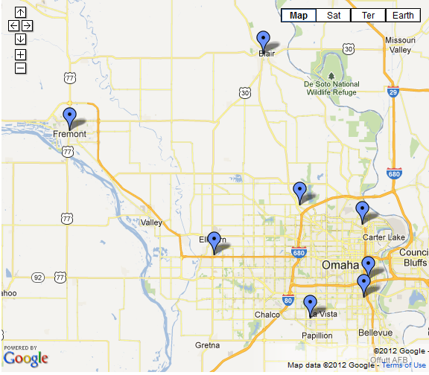
Learning Environments
On-Campus Technology Classrooms
Blackboard LMS (Online, Hybrid, Enhanced)
Course Conferencing
http://www.mccneb.edu/campuslocations/

Slide 6
Technology Classrooms
Computer (DVD, Internet)
Projectors or large-screen televisions
DVD / VHS combo
Specialized equipment, i.e., closed captioning and hand-held video cameras, available by special arrangement
www.mccneb.edu/ids
Orientation and training as needed may be arranged or scheduled during faculty development
Telephone to call Help Desk 457-(2900)

Slide 7
Mobile Device Usage for School Work

Slide 8
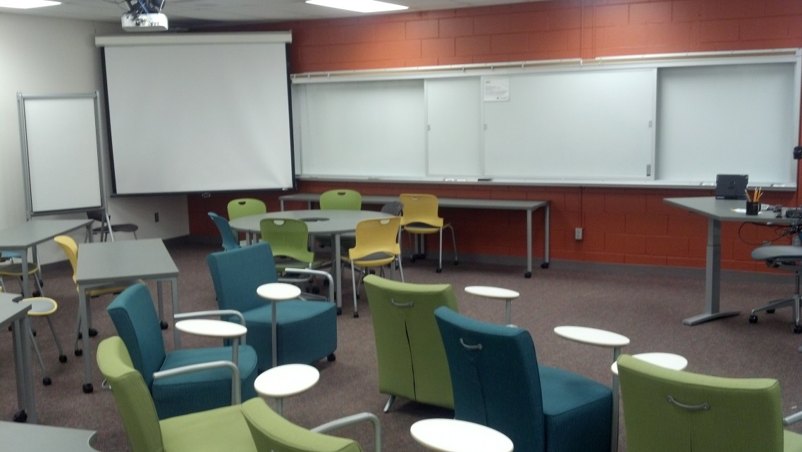
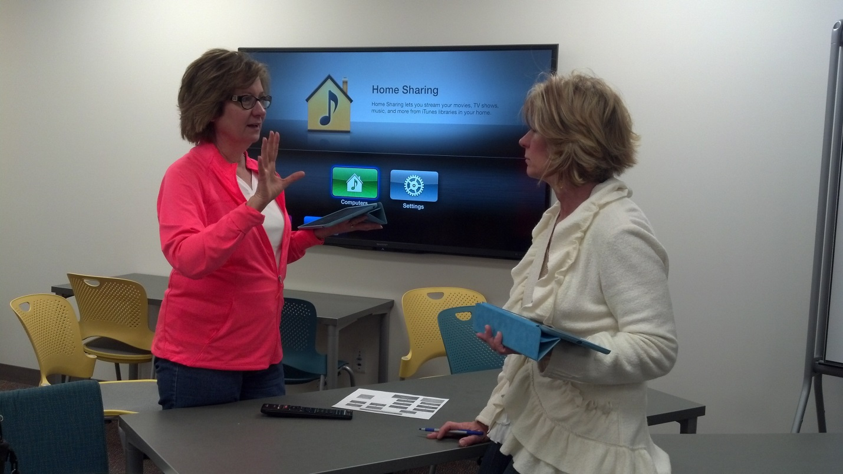
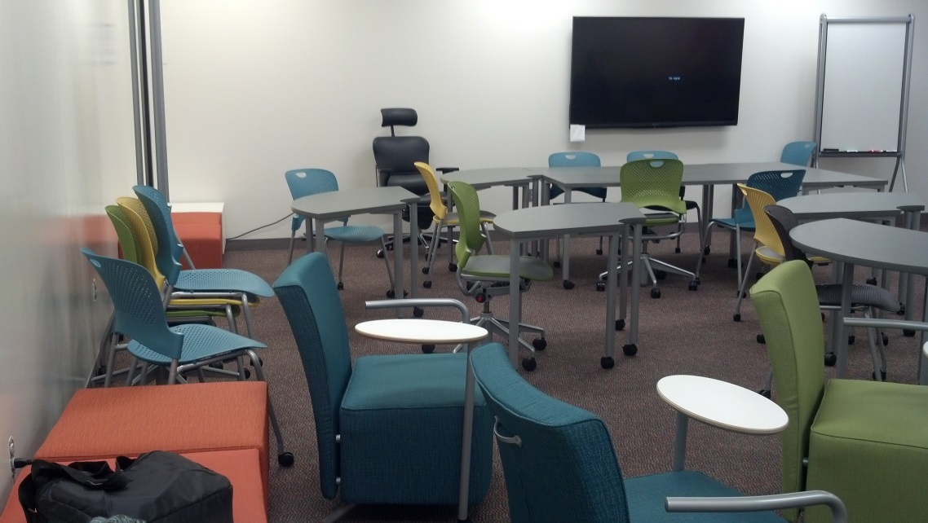
Pilot Collaboration Classrooms 2014

Slide 9
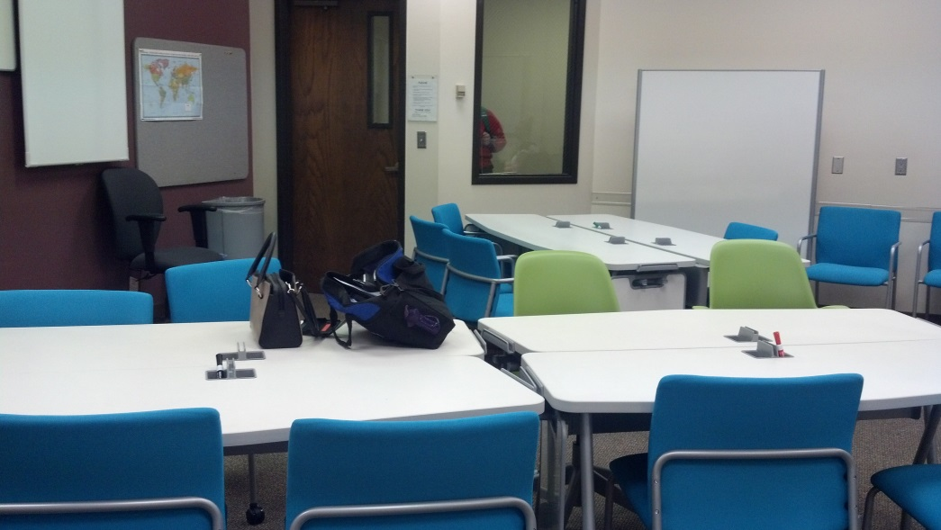
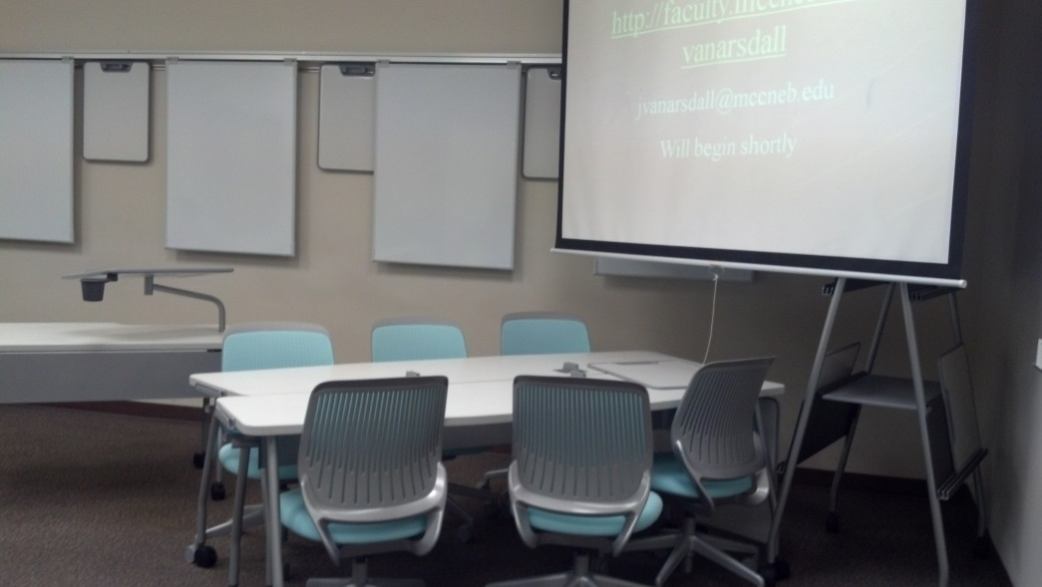
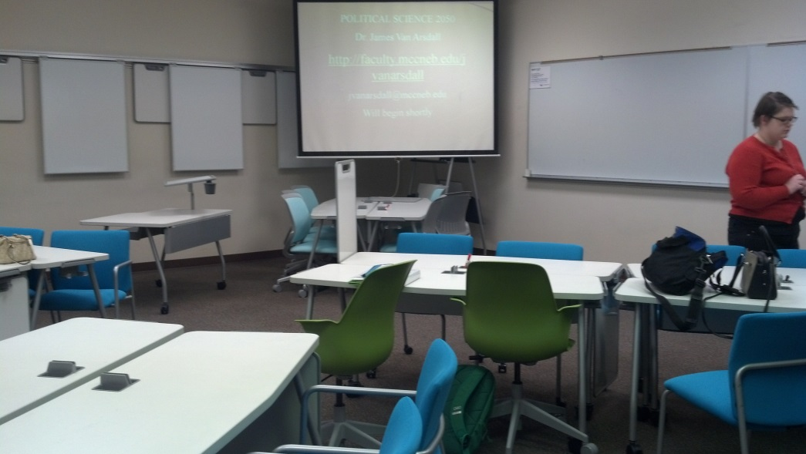
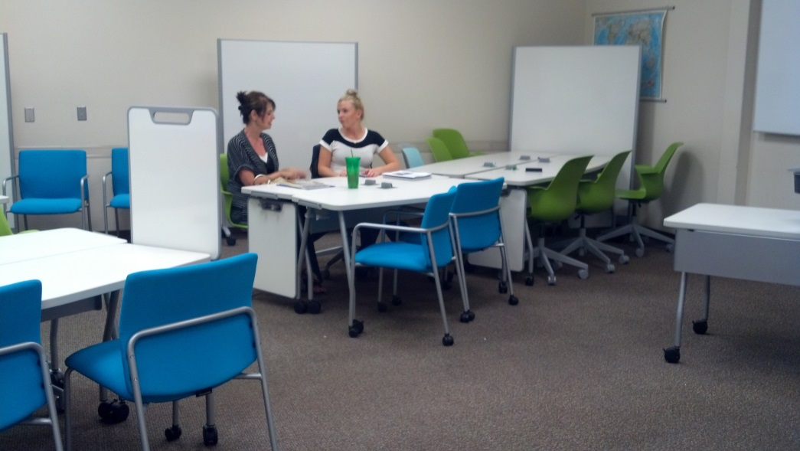

Slide 10
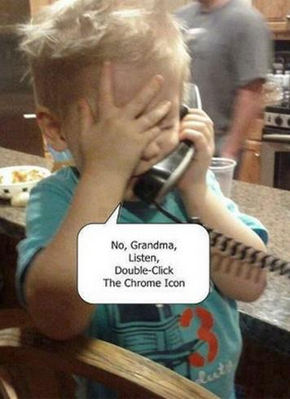

Slide 11
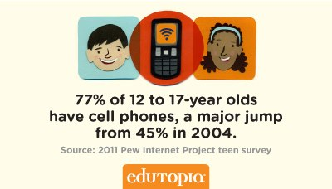

Slide 12


Slide 13

Students with Mobile Devices | K-2nd grade | 3rd-5th grade | 6-8th grade | 9-12th grade
Cell Phone (w/o Internet Access) | 18% | 29% | 59% | 67%
Smartphone (with Internet Access) | 14% | 17% | 24% | 31%
Laptop/Tablet PC | 27% | 32% | 53% | 60%
Netbook or mini notebook | n/a | n/a | 11% | 10%
MP3 player | 36% | 55% | 80% | 85%
Hand-held game player | 47% | 60% | 64% | 48%

Slide 14
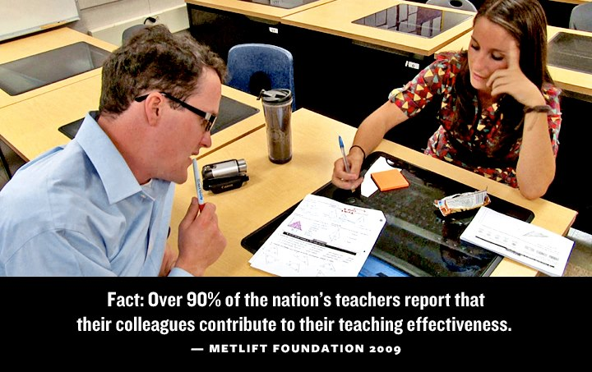

Slide 15
Go digital
Go mobile

Slide 16
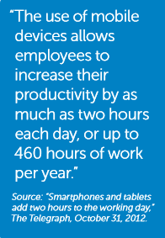

Slide 17
Collaborative Discussion
todaysmeet.com
www.padlet.com http://padlet.com/sleigh/MCC_IDS
www.wonderopolis.org

Slide 18
Blogs
http://ideasfromthesandbox.wordpress.com
http://wordpress.com

Slide 19
BlackBoard
https://blackboard.mccneb.edu/ Online, hybrid, enhanced
Quia http://www.quia.com/pages/jfauchier/maltomedia
SharePoint
https://sp.mccneb.edu/sociology/SitePages/Home.aspx
MyWay
faculty.mccneb.edu/
Mike Flesch – Math
JoAnne Garvey – CHRM

Slide 20

http://www.wordle.net/
Word clouds
Free

Slide 21

http://www.wordle.net/show/wrdl/7535875/Malt-o-Media

Slide 22


http://www.tagxedo.com/
Word clouds with shape
free

Slide 23
PowerPoint®
Presentation of Content
Save paper…save your pptx handouts as pdfs.
Office PowerPoint 2010 – overview
Create original pptxs into ‘timers’ by setting timings and transitions.
Sample activity timer http://www.quia.com/files/quia/users/jfauchier/15minactivitydragons.ppt
See Quia class page for instructions to create your own.

Slide 24
http://prezi.com/
cloud-based presentation software and storytelling tool that lets teachers share ideas on a virtual canvas.
Price: Free license for teachers with education email address; “EDU Pro” license is $4.92/month and $59 annually
Election Prezi

Slide 25
Video
Just-in-Time flip cams
Level 2 production
Student shot videos / Ensemble Media server
Lecture Capture
http://www.mccneb.edu/ids/instructionalmedia/origvideo.asp

Slide 26

iPad
Smartphones
Minimal Edits
Ensemble
QR code
http://www.racoindustries.com/barcodegenerator/2d/qr-code.aspx

Slide 27
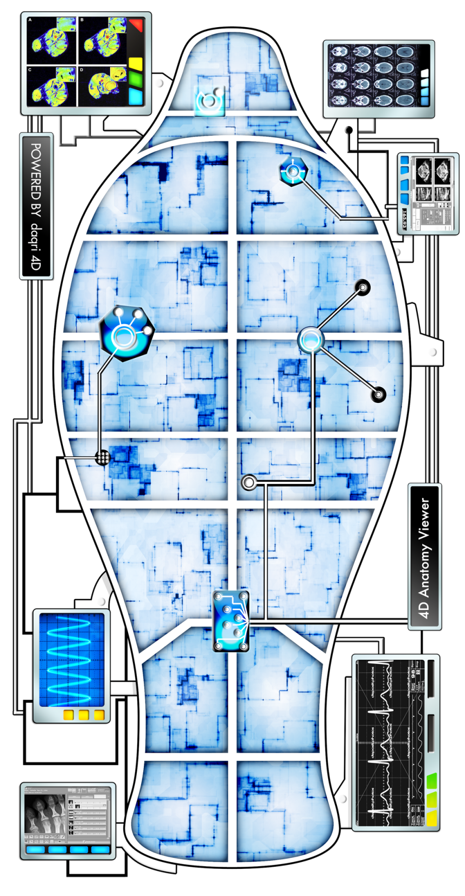

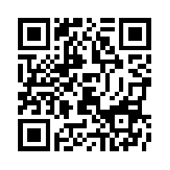
Anatomy 4d http://daqri.com/project/anatomy-4d

Slide 28

Edutopia and
http://www.edutopia.org/technology-integration
http://pinterest.com/
Pinterest is a social photo-sharing site where teachers and students can organize and share theme-based image collections in the form of an online pinboard.
Price: Free
http://www.edutopia.org/google-educators

Slide 29

Online flashcards
Free to educators with .edu email
Free app for ipad and Android

Slide 30
Searching the WEB
Search engines
Google.com
www.Bing.com
http://www.wolframalpha.com/
http://www.thesearchenginelist.com/
http://www.youtube.com/watch?v=27e0iDQFnCU

Slide 31
http://www.google.com/earth/educators/
A virtual globe that maps out Earth online, providing geographical information, satellite images, aerial photography and more.
Price: Free
Google Lesson Plans
http://www.google.com/enterprise/apps/education/resources/lesson-plans.html
https://docs.google.com/document/d/1fLQH4JKQcj35sAvAqphSWdimzcFQ69DXBV8IISHmUs4/preview?pli=1

Slide 32
PhotoStory 3
www.microsoft.com free download
http://faculty.mccneb.edu/JFAUCHIER/
Resource.mccneb.edu/cca

Slide 33
http://www.xtranormal.com/
Animated video creation tool that gives you the option to choose from a library of different characters and backgrounds and allows you to type or record dialogue.
Price: Free. Additional features at a fee. Educational subscriptions available starting at $10/month.
http://www.youtube.com/watch?v=27e0iDQFnCU
http://www.xtranormal.com/
http://www.xtranormal.com/watch/12557550

Slide 34
https://www.dropbox.com/
Online storage
2 GB free
Sync to many devices

Slide 35
Join.me
Browser based screen sharing
Basic version is free

Slide 36
…tubes
Youtube.com
YouTube is a popular video-sharing website that lets you upload, watch, and share videos online. Free
Teachertube.com
A YouTube for educators, TeacherTube is a video-sharing website for free educational videos. Free
Schooltube.com
SchoolTube is a teacher-moderated video-sharing site for K-12 students. For sites where normally blocked

Slide 37
audacity.sourceforge.net
Audacity is free, open source, cross-platform software for recording and editing sounds.
Record, edit and master sound files
free

Slide 38
Pre- and Post-testing and Demonstrating
Traditional paper and pencil tests
Student presentations
Poster sessions
Quiz sessions made with Quia or from textbook websites; web-enhanced classes
Microsoft template
Lab or clinical demonstration
http://www.youtube.com/watch?v=R_LUJSqeSrI

Slide 39
Support for Faculty
Metro Help Desk 457-2900
Instructional Design Services www.mccneb.edu/ids 457-2883
IFEX team – Cindy Catherwood, Lynn Bradman, Michelle Rule
Quia license – Lynn Bradman 457-2217 or hbradman@mccneb.edu

Slide 40

https://twitter.com/
140 characters
also http://tweetdeck.com/
Consolidation of what you want to follow

Slide 41
http://www.polleverywhere.com/
Don’t forget: You can copy-paste this slide into other presentations, and move or resize the poll.
Notes:
Press F5 or enter presentation mode to view the poll In an emergency during your presentation, if the poll isn't showing, navigate to this link in your web browser: http://www.polleverywhere.com/multiple_choice_polls/NDcyNjkzMQ
If you like, you can use this slide as a template for your own voting slides. You might use a slide like this if you feel your audience would benefit from the picture showing a text message on a phone.

Slide 42
Mentimeter.com
Also an online audience response site

Slide 43
Article on Technology Use in Teaching
Check out an article related to use of technology in teaching in your field.
Send the url for your article and provide a brief synopsis to Jfauchier@mccneb.edu and sleigh@mccneb.edu

Slide 44
Final Reflection
Send via email
Due October 31, 2014

Slide 45
We’re all in this together
http://animoto.com/play/nuuEuxkFlw3Qp1Z3J4BiyQ#

Slide 46


Save the Earth – it is the only planet with chocolate!

