Slide 1
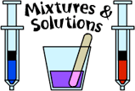

Slide 2
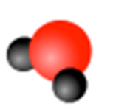
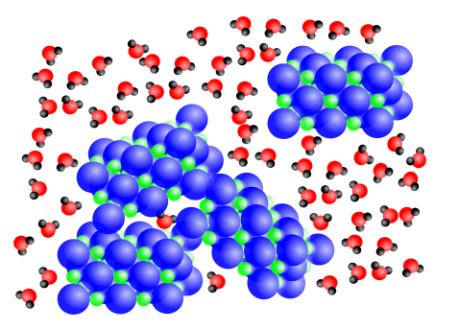



A suspension is a mixture in which the solute particles (the substance that gets dissolved) are large enough to be seen by the naked eye. In addition, the particles are large enough for gravity to cause them to settle.

Slide 3
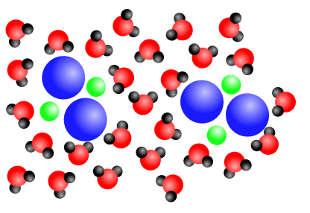
A colloid is a mixture in which the solute is broken down into pieces that are too small to see with the naked eye, but are large enough to interfere with visible light. As a result, colloids are cloudy.

Slide 4
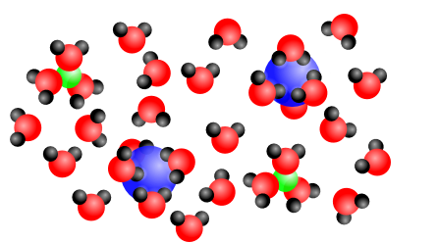
A solution is a mixture in which the solute is broken down by the solvent (the substance that “does” the dissolving) into its smallest constituent parts. In other words, the solute is entirely broken down into individual ions or molecules.

Slide 5
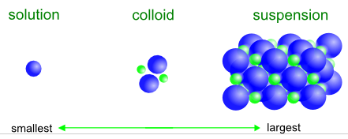
So, in simplest terms, the difference between
solutions, colloids and suspensions is the size
of the solute particles:

Slide 6
SOLUTIONS

Slide 7
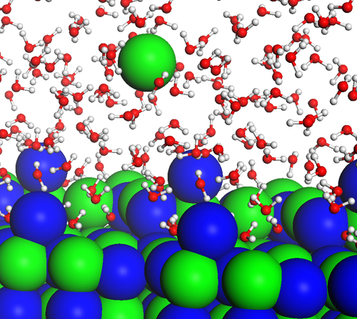
Dissolving- A physical process where a solvent breaks up particles into smaller pieces into a solution.

Slide 8
The process of dissolving produces a solution:
Examples of solutions:
  Gatorade
  Saline solution (for contact lenses – “salt water”
  Sugar in water/coffee/tea
  Salt in water
  Lemondade
  Powdered drink mixes in water
  Hot cocoa

Slide 9
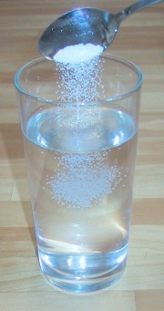
Solution: A mixture that appears to be a single substance but is composed of particles of two or more substances that are evenly distributed amongst each other.
Solute: The substance that is dissolved.
Example - salt
Solvent: The substance doing the dissolving. Example - water

Slide 10
Soluble – A substance that can be dissolved.
Insoluble – A substance that cannot be dissolved.

Slide 11
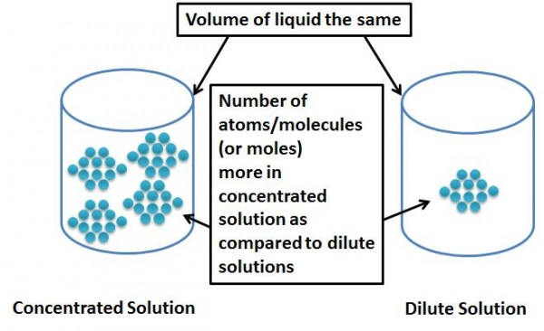
Concentration – The measure of the amount of dissolved material (solute) in a solution. Usually expressed in g/100cm3

Slide 12
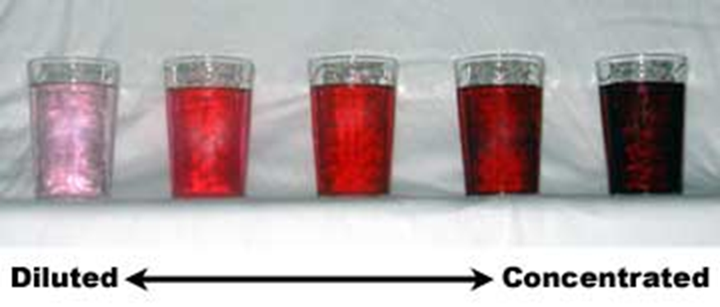
Dilute - Thinner or less concentrated, containing more solvent.
Concentrated – Thicker or containing more solute.

Slide 13
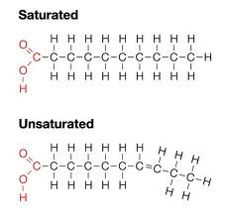
Saturated – A solution containing the maximum amount of solute.
Unsaturated – A solution that has the ability to dissolve more solute.

Slide 14
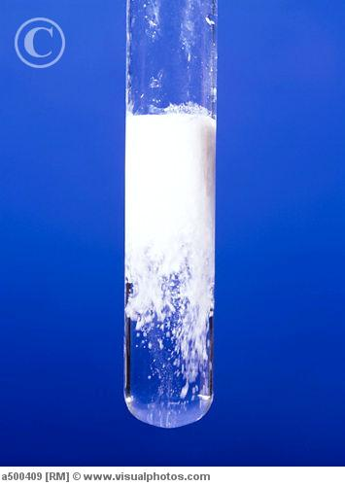
Precipitate – The term used when a substance comes out of solution because the solution is saturated.

Slide 15
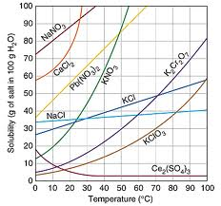
Solubility – The ability of a solute to dissolve in a solvent. The solubility of a substance is the amount of a substance that can dissolve at a given temperature.

