Slide 2
Why Take PLAN?
PLAN shows your strengths and weaknesses in English, mathematics, reading, and science.
PLAN lets you know if you’re on target
for college.
PLAN helps you find careers that match
your interests.
PLAN helps you prepare for the ACT.

Slide 3
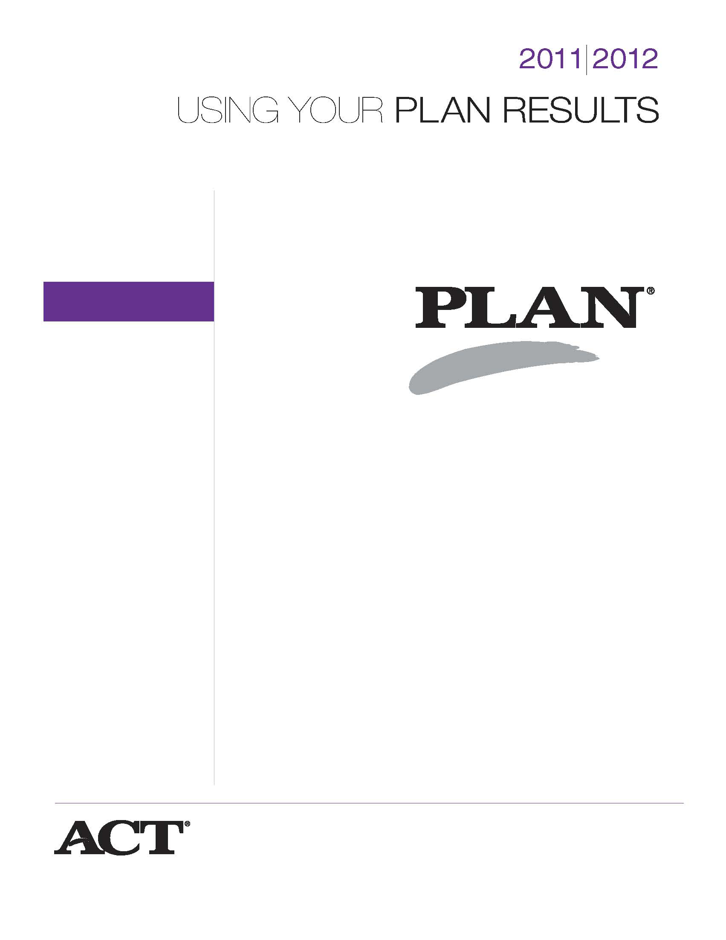
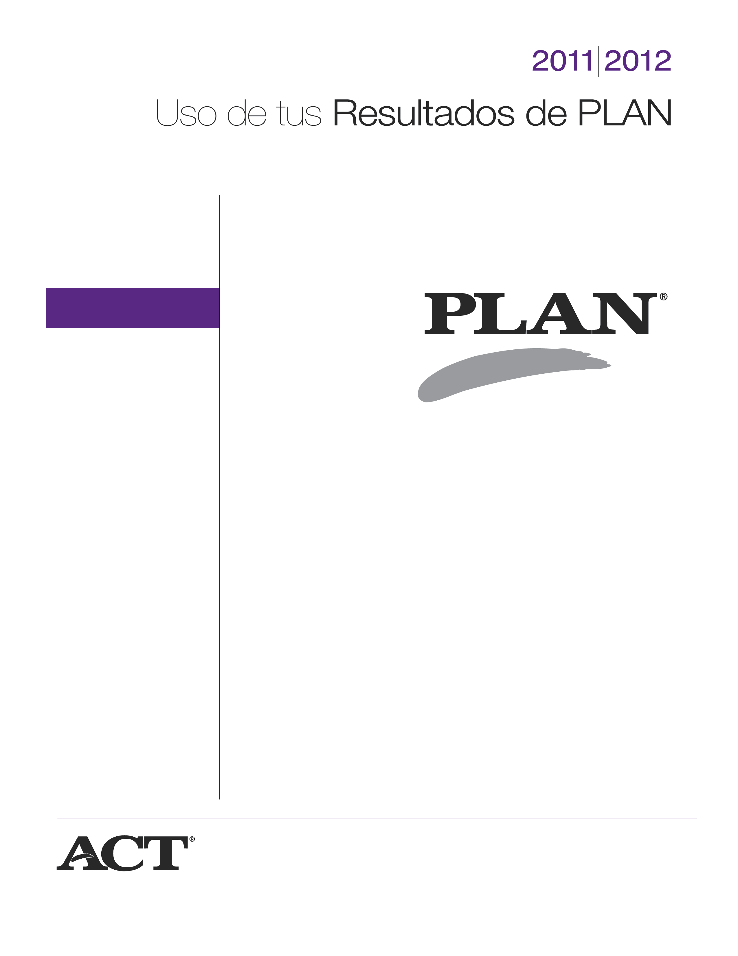
Using Your PLAN Results
Student Guide to PLAN

Slide 4
Student Score Report
What is the Student Score Report?
This individualized report details scores
received on the assessment and the career plans and needs indicated by the student.
What does the Student Score Report provide?
  Suggestions for improving student academic skills
  Careers that match student interests
  Indicators of college readiness

Slide 5
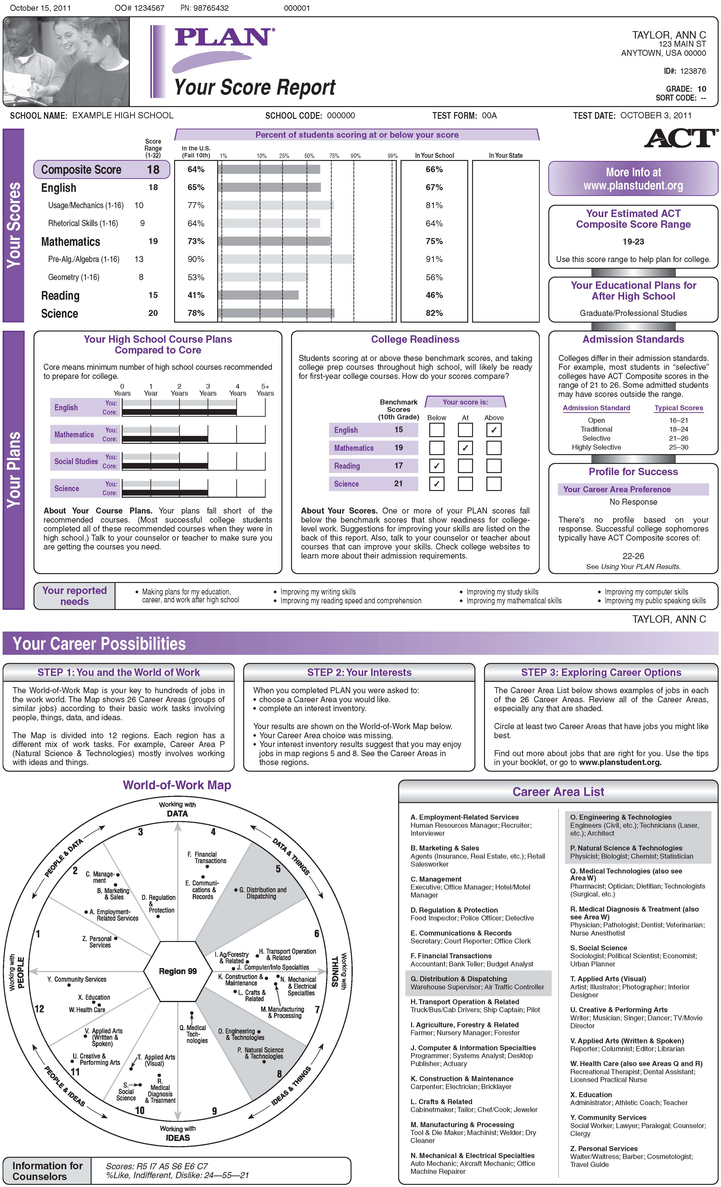
PLAN
Score
Report
Side 1

Slide 6
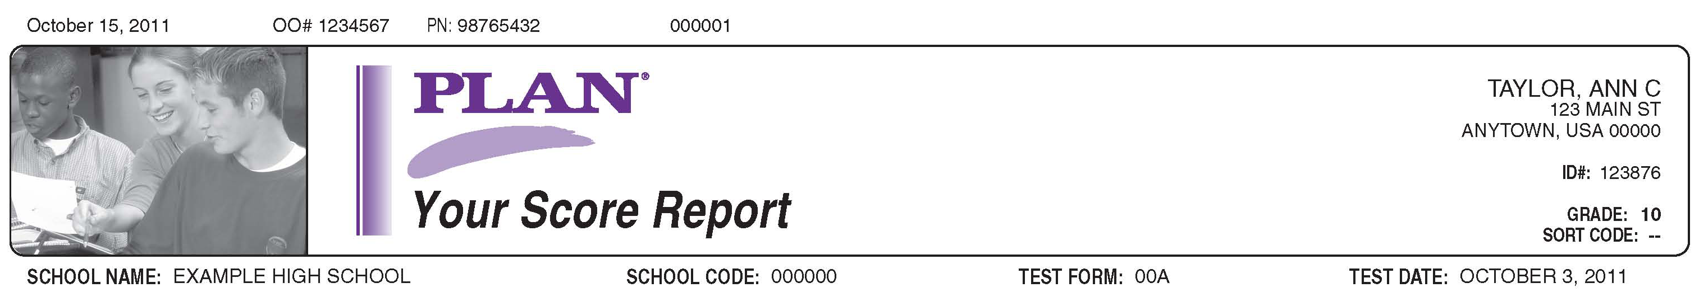
Student/School
Information

Slide 7
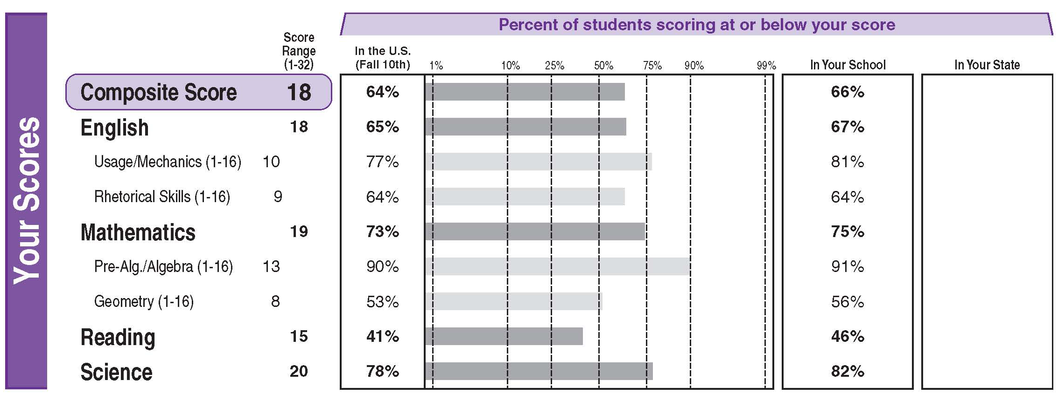
Your Scores

Slide 8
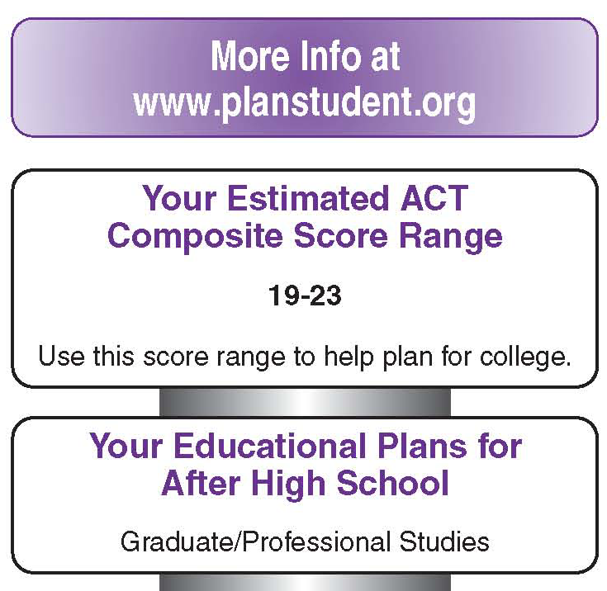
Your Estimated ACT® Composite Score Range

Slide 9
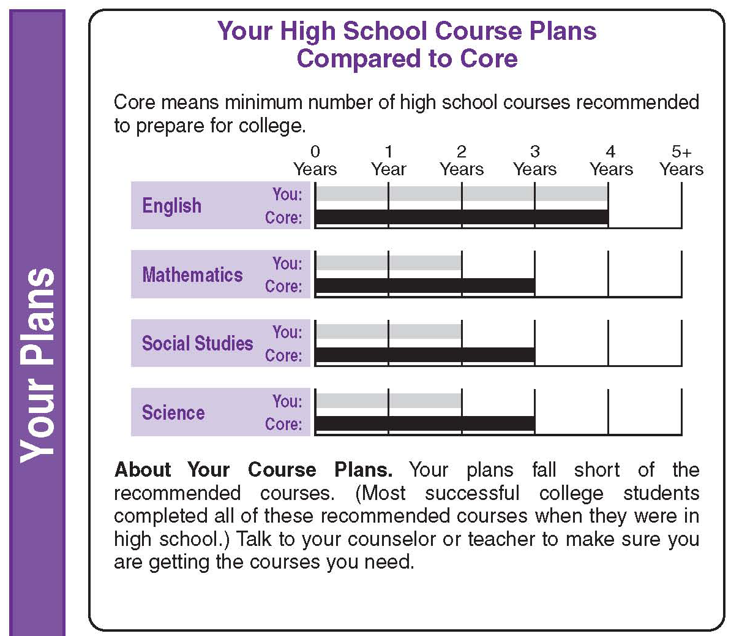
Your High School Course Plans Compared to Core

Slide 10
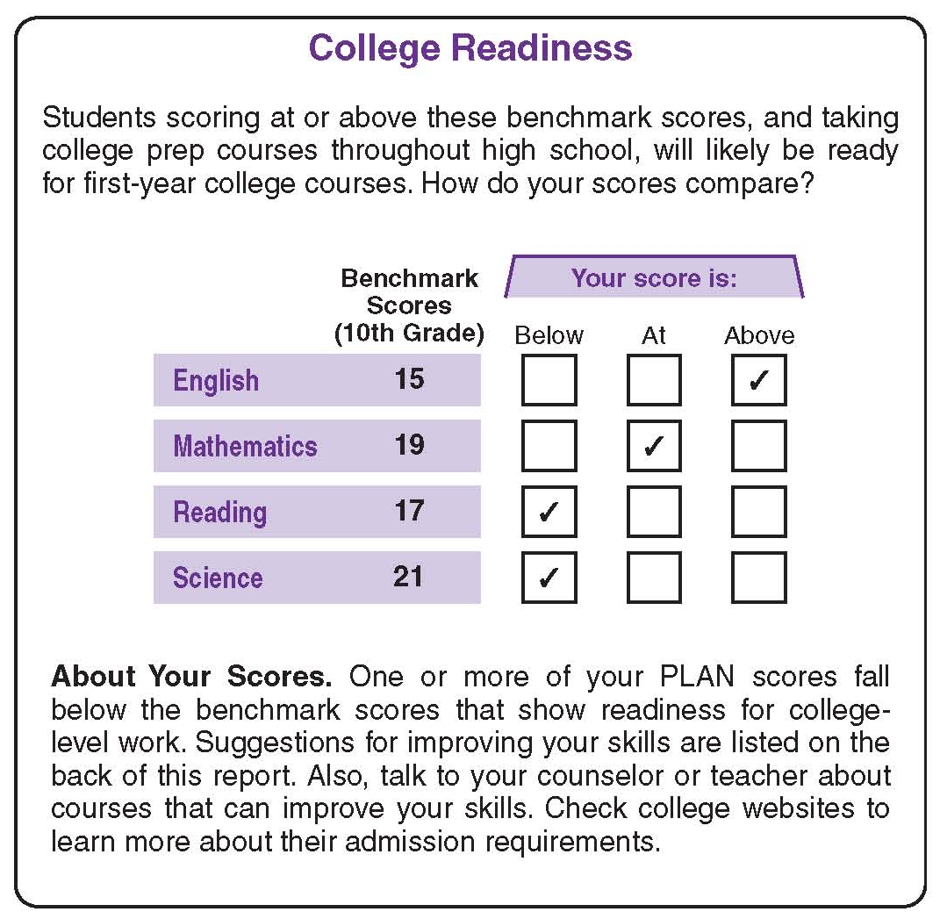
College Readiness

Slide 11

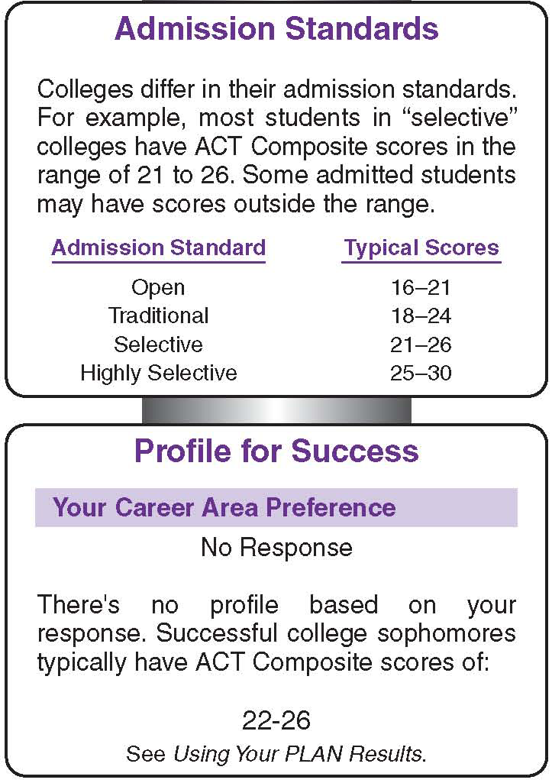
Profile for Success

Slide 12
Areas in Which You Would
Like Additional Help

Slide 13
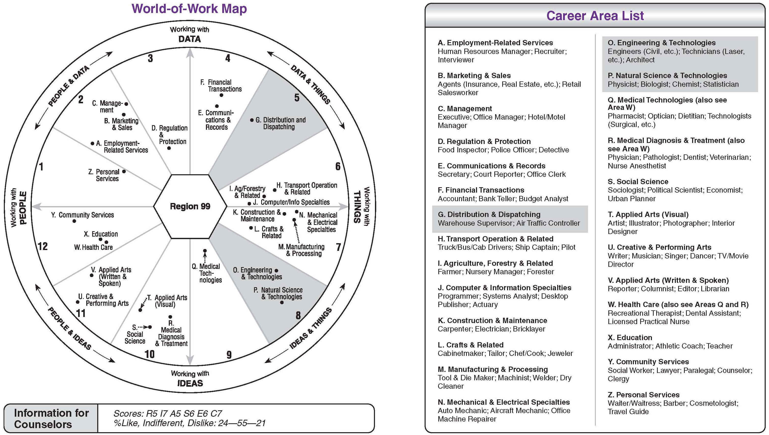
Your Career Possibilities

Slide 14
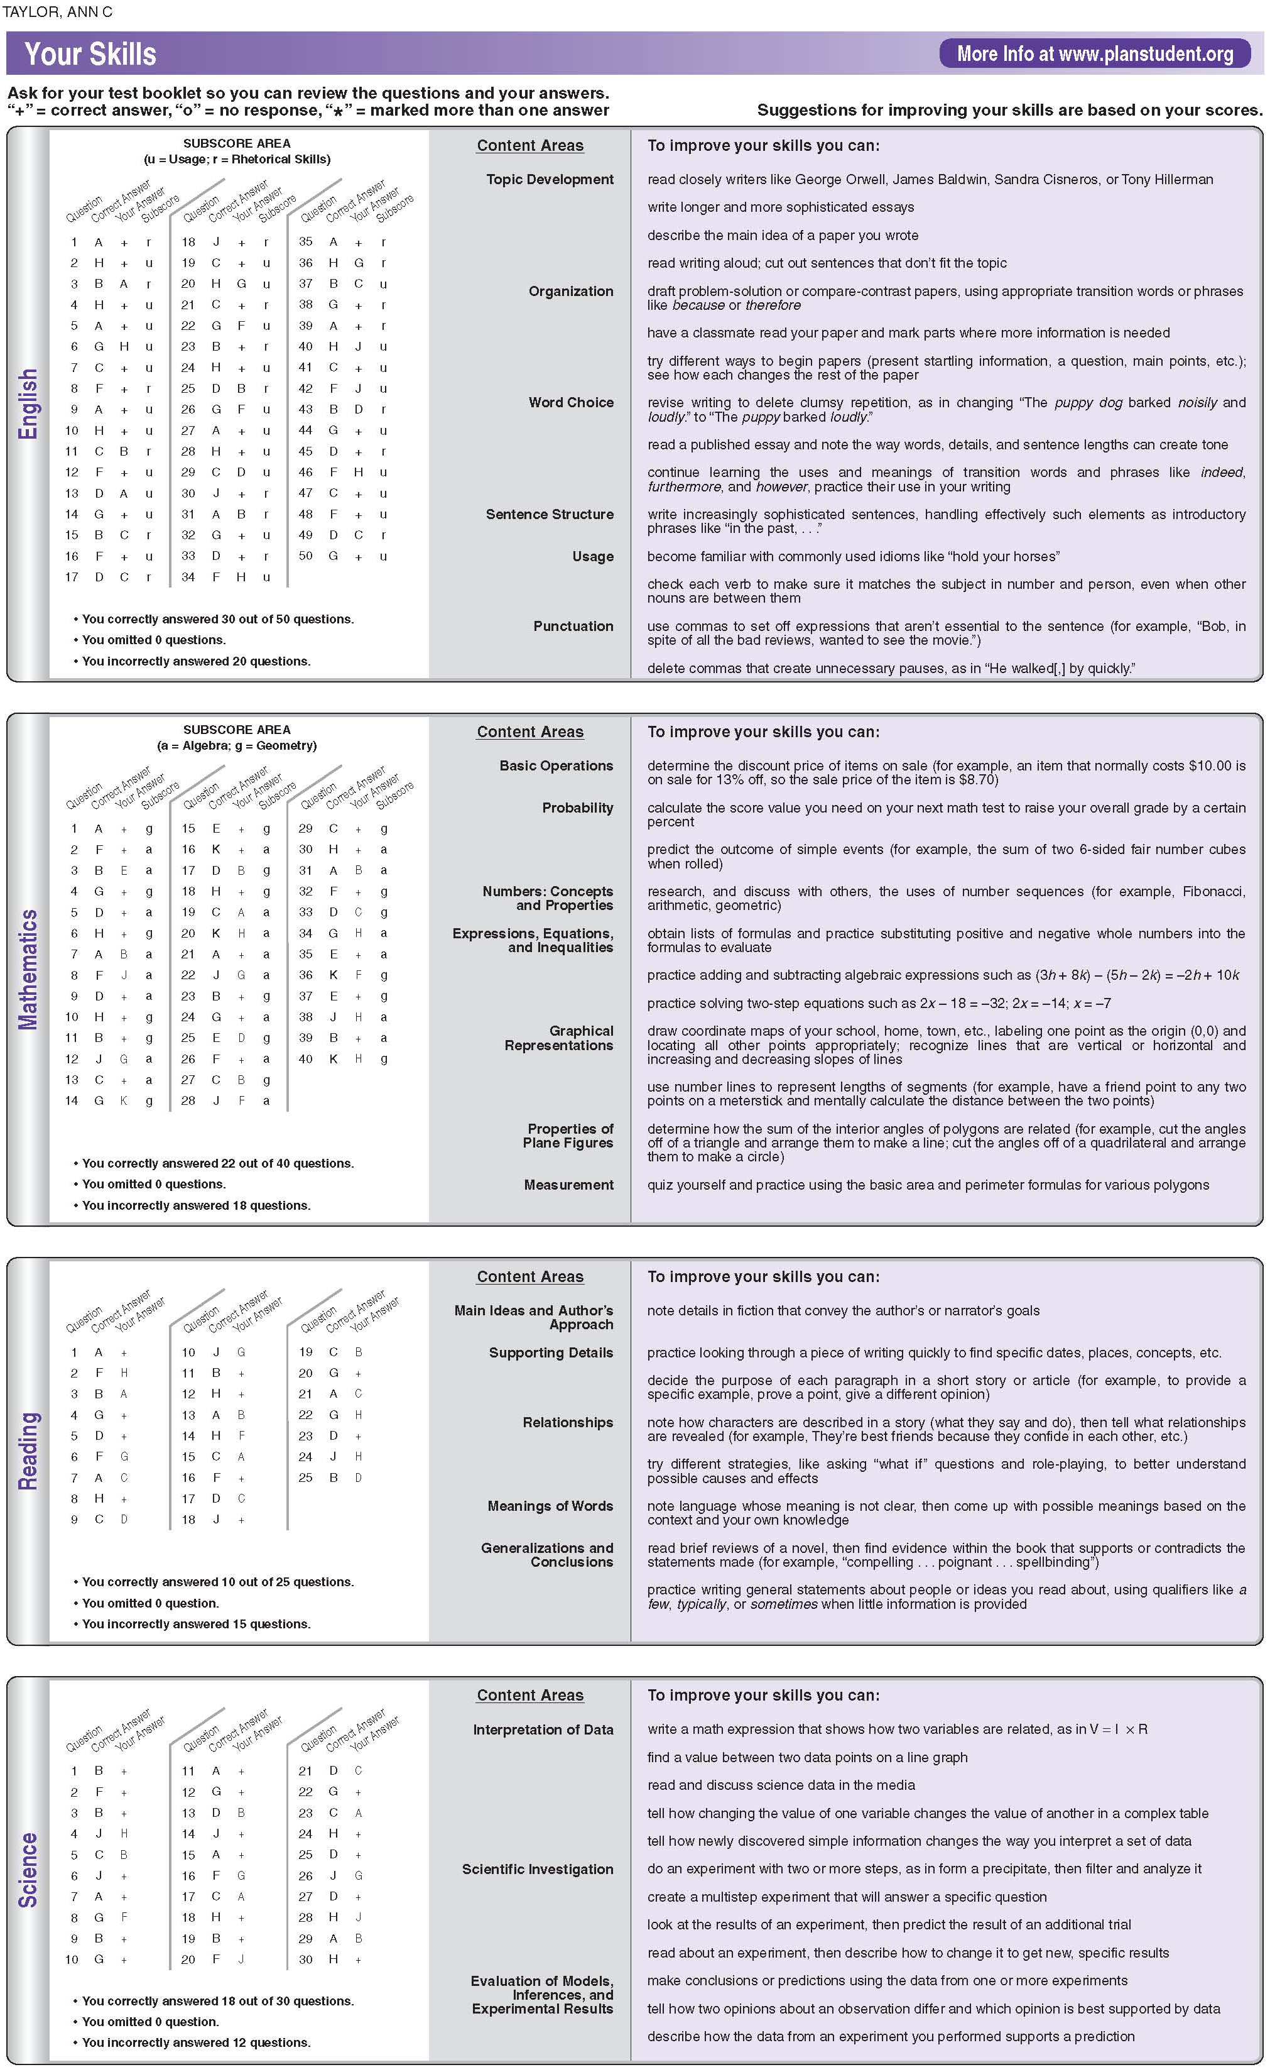
PLAN
Score
Report
Side 2

Slide 15
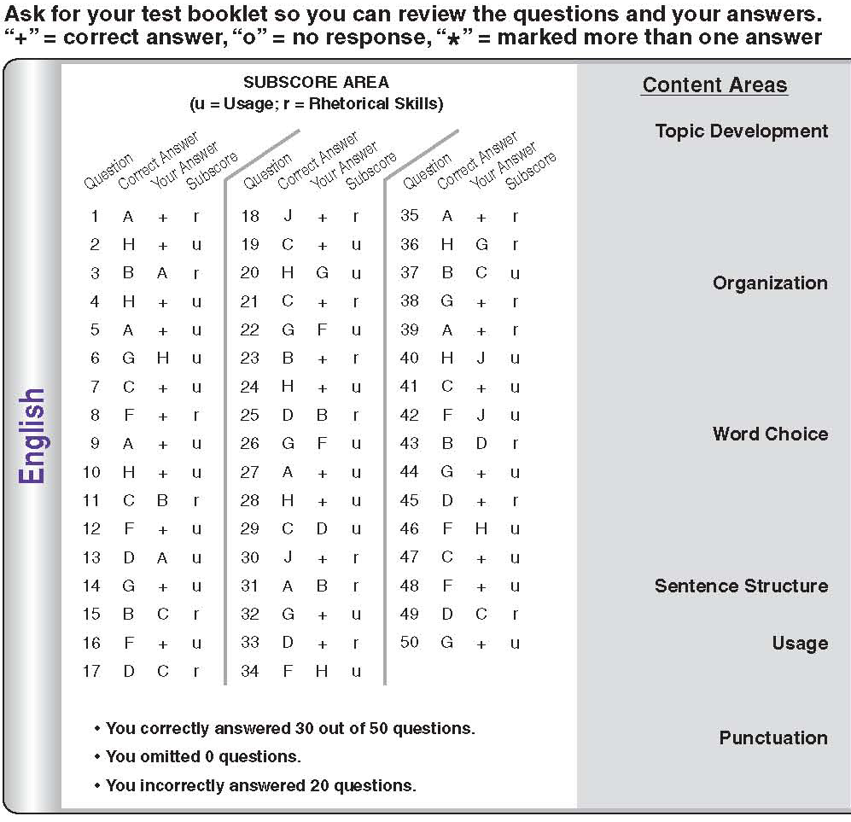
Review Your Answers

Slide 16
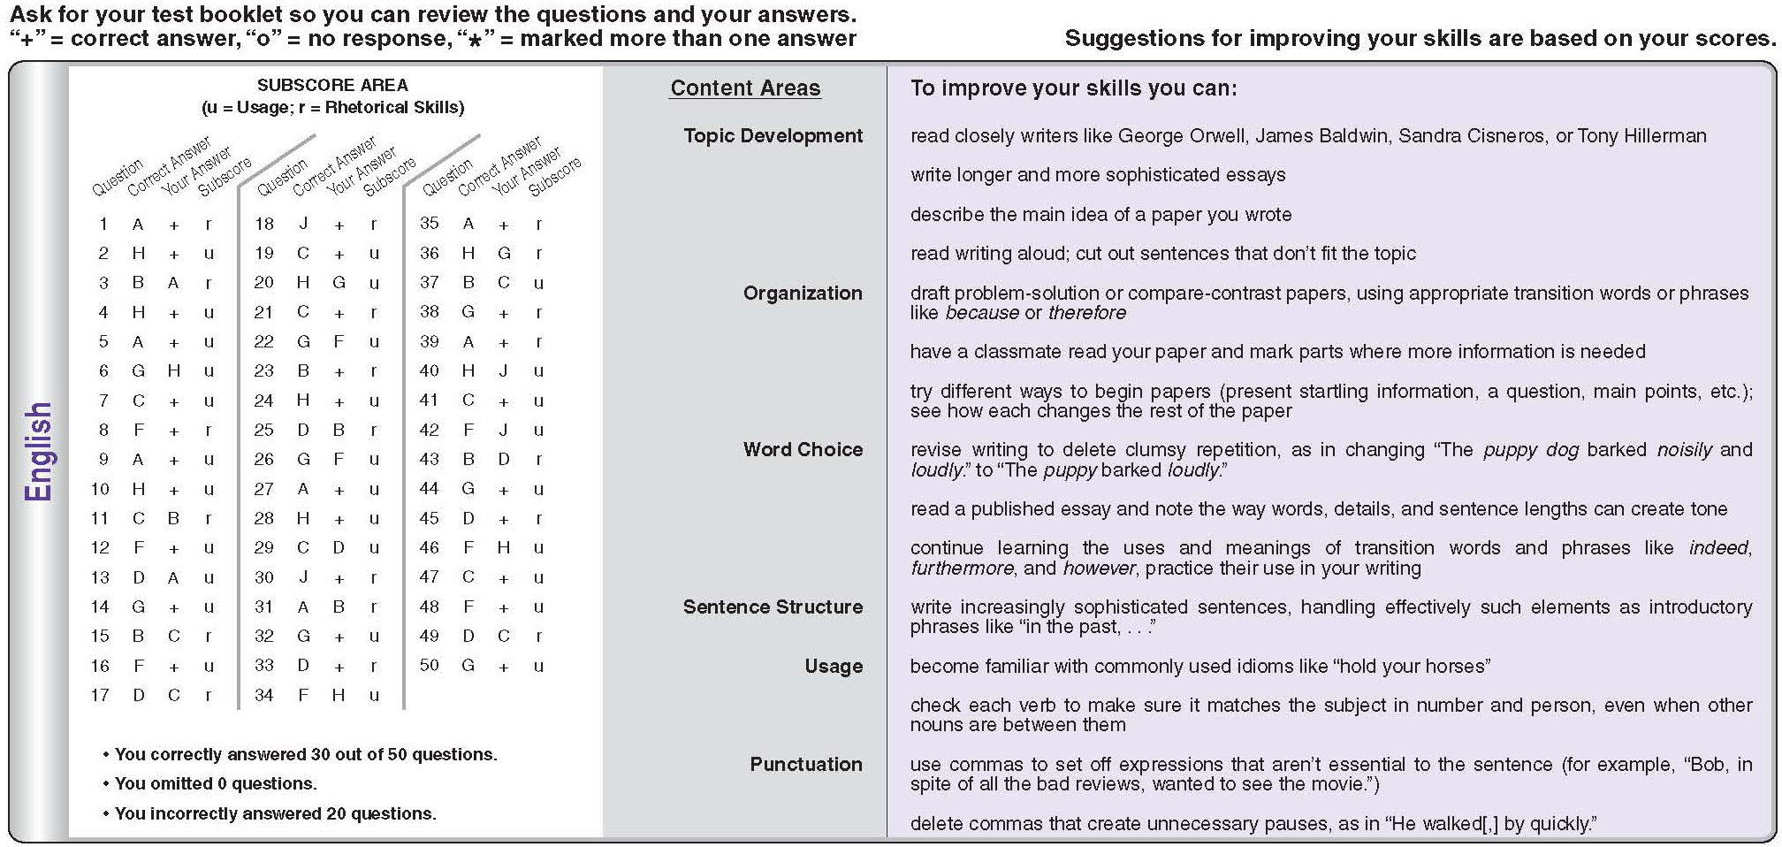
Your Skills

Slide 17
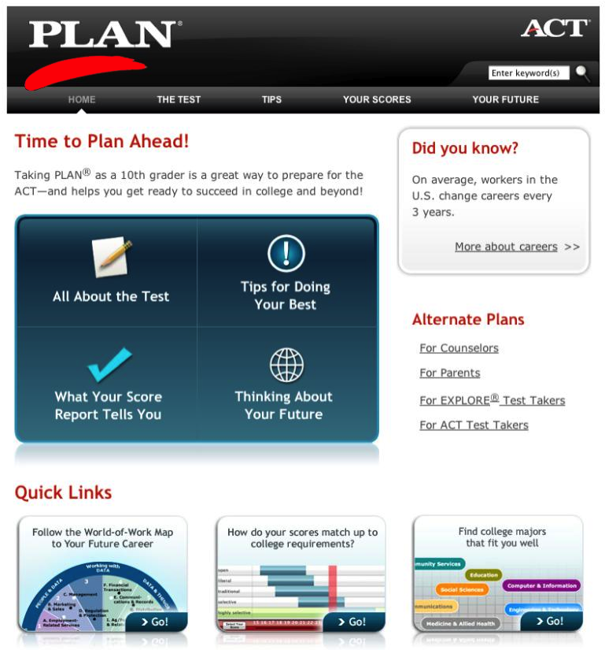
www.planstudent.org

Slide 18
What Do I Do Now?
When using your PLAN Score Report, ask yourself some questions:
Am I on target for college?
What skills do I need to improve to be
ready for college?
Am I taking a rigorous core curriculum
What careers interest me most?

Slide 19
Study Skills Checklist for Students
Set a regular time and place to study
each day and throughout the week.
Keep a daily “to do” list.
Set goals for yourself.
Do your reading assignments before
the material is discussed in class.
Pay close attention and take good
notes in class.
Prepare for tests during your regular study times instead of cramming at
the last minute.

Slide 20
Keys to Good Educational and Career Planning
Take challenging college prep
courses in high school.
Explore the many career options available and think about how
your career choices will affect
your future.
Set career goals and develop an educational plan to achieve them.

