Slide 1
Reactive Attachment Disorder
Signs and Symptoms
Janice R. Morabeto M.Ed. L.S.W. C.H.T.
Morabeto Mind Legacy Assoc. Inc.
www. Mindlegacy.com e-mail:Info@mindlegacy.com

Slide 2
Reactive Attachment Disorder
Signs and Symptoms
Objectives
Identify the critical nature of early attachment and bonding.
Identify how attachment in bonding during the first 5 years of life sets the stage for future mental health
Identify the signs and symptoms for Reactive Attachment Disorder in children according to the DSM IV.

Slide 3
Elements of Infant/Caretaker Bonding
Arousal
Nurturance
Relaxation
Reciprocity

Slide 4
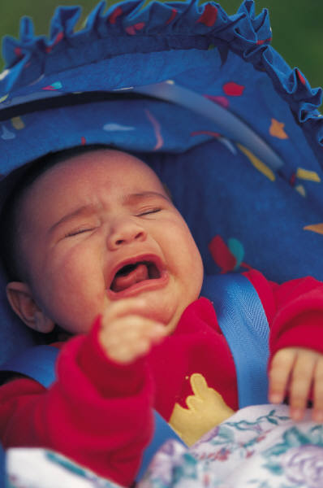

Arousal

Slide 5
Can happen hundreds of times per day
Crying, Fussing Due to:
  Hunger, Thirst
  Physical Discomfort, Sickness
  Colic
  Fear, due to confusion, transitioning, separation from primary caregiver
  Frustration, anger
  Excitement, Fatigue

Slide 6
Nurturance
Webster defines Nurturance as:
  Warm and affectionate physical and emotional support and care.
  The providing of loving care and attention.
  Physical and emotional care and nourishment

Slide 7
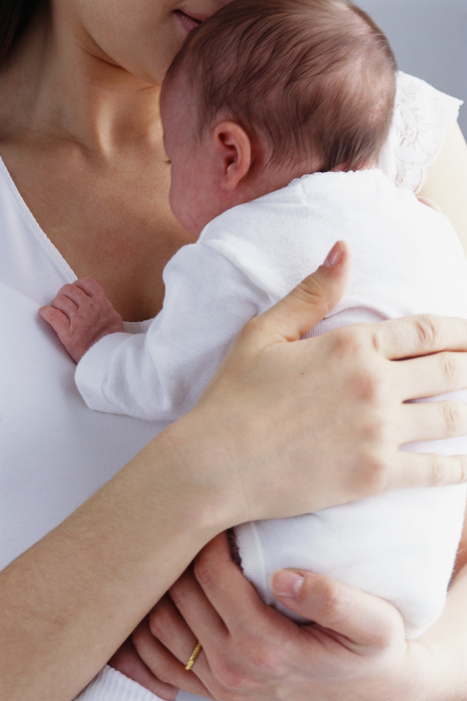
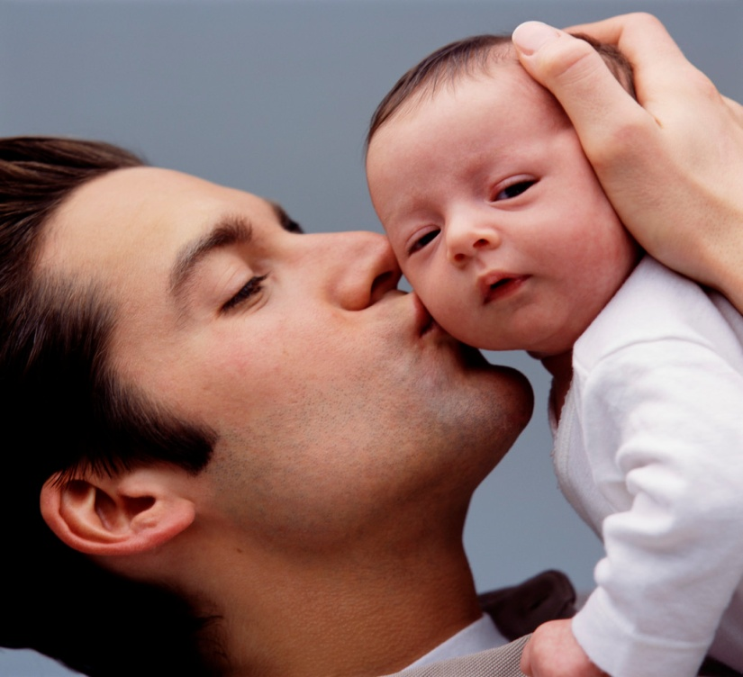

Parents and other caregivers do this in hundreds of ways

Slide 8




Hour after hour, day after day, year after year

Slide 9

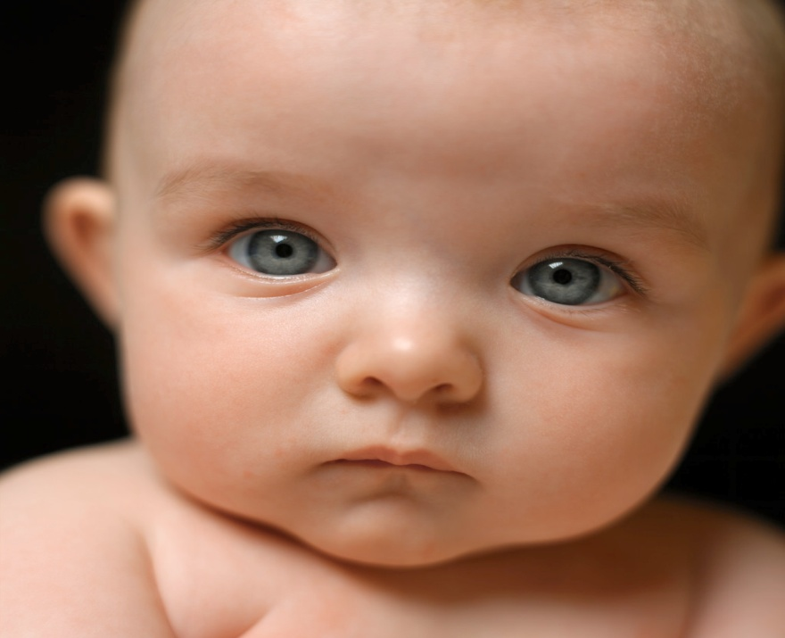
Relaxation
The child regains a sense of composure,
homeostasis, balance and genuinely feels soothed and cared for

Slide 10


Reciprocity
Webster refers to Reciprocity as:
  a reciprocal state or relation
  mutual exchange
  a relation of mutual dependence, action or influence

Slide 11
First Year of Development
Freud:
  Oral Stage of Development
Erik Erickson
    Trust vs. Distrust

Slide 12
1st Year of Life
Child Needs
Wails, Cries, Rages
Parent Nurtures
Through rocking, holding, feeding, cooing, soothing.
Child Establishes Trust
Child Reciprocates
Eye contact
Cooing
Nuzzling

Slide 13
2nd Year of Life
Freud:
  Anal Phase of Development
Erick Erikson
  Autonomy Vs. Shame and Doubt

Slide 14
2nd Year of Life
Child Needs
Wails, Cries, Rages, Demands
  “Healthy testing of limits”
Parent Nurtures
  Through Limit setting
  Establishment of healthy boundaries
    Right/Wrong
    Appropriate/Inappropriate behavior
    Child learns frustration tolerance
    Emotional Control

Slide 15
2nd Year of Life
Achieves Homeostasis
Learns to Trust Others
Learns Special Relationship Hierarchy between parent and child

Slide 16
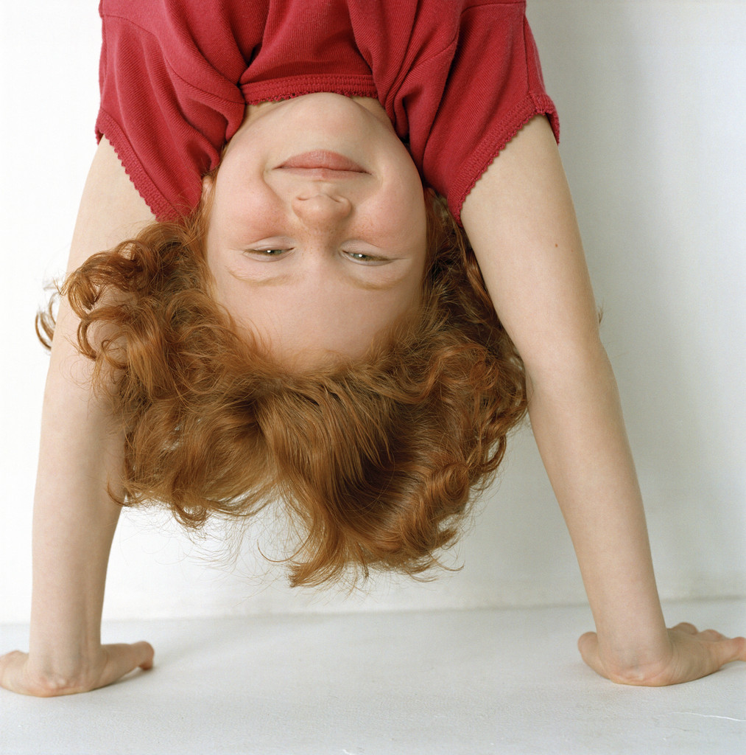
Attachment Helps The Child To:
Reach his/her full intellectual capacity
Think in a logical fashion
Develop a conscience; an internal morality monitor
Become self-sufficient
Manage strong emotions such as anger, anxiety and guilt
Develop future relationships that are meaningful and lasting and based on a sense of interdependency and love
Reduce jealousy

Slide 17
The Cycle of Abuse and Neglect
Arousal or Child Wants
Child Rages
Parent Silences through Abuse
  Physical, verbal, emotional, neglect
Gratification
  Defensiveness
  Self-Abuse
  Lack of Trust

Slide 18

Disruption to Attachment Process Can be due to a variety of issues

Slide 19
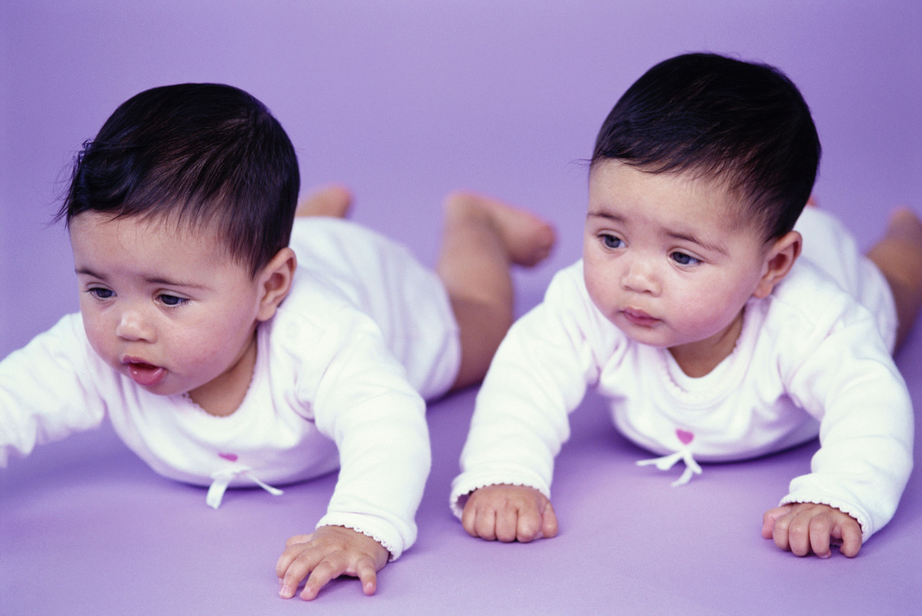
Child Risk Factors
Medically Fragile
  Or sickly from birth
Drug or Alcohol Affected
Birth Trauma
Temperamental Difficulties
  Raging/Fits/Difficulty soothing
Genetic Predisposition

Slide 20
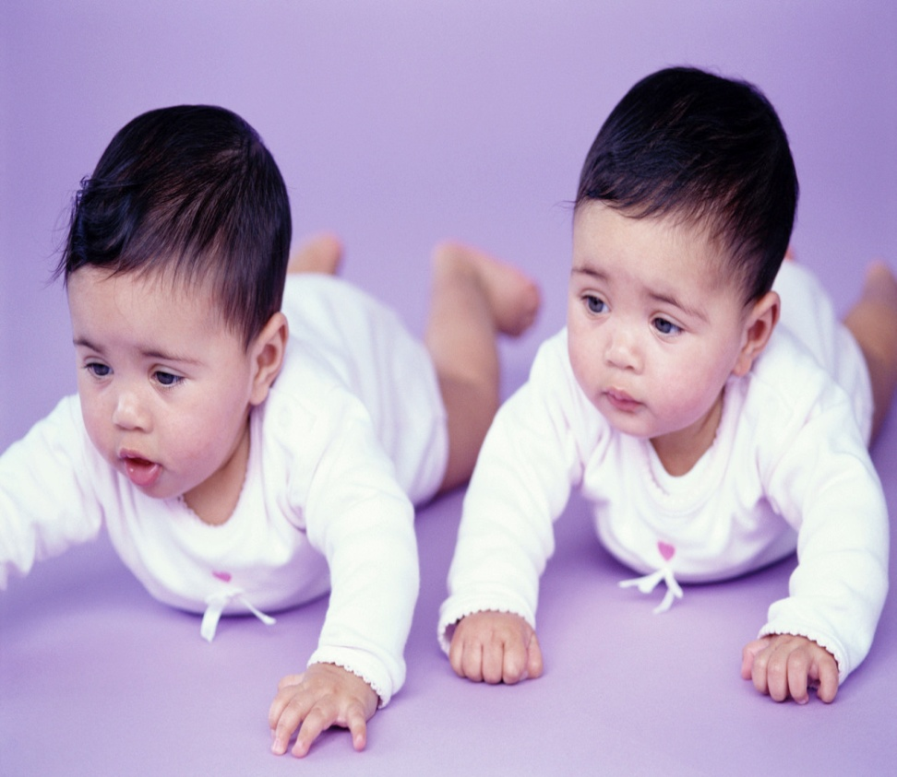
Extreme resistance to cuddling; is stiff and unresponsive or explosive when touched
Poor eye contact
Poor sucking/Ramped sucking
Lacks age appropriate reciprocity in communication

Slide 21
Parental Risk Factors
Mental Illness
Unwanted or ambivalent about pregnancy
Youth with no support
Postpartum Depression
Victims of Abuse/Neglect
Perpetrators of Abuse/Neglect

Slide 22
Sociological Risk Factors
Crowded, understaffed day cares
Changes and disruptions in caregivers for any reason
Lengthy Illness or death of mother
Moves from caregiver to caregiver
Financial Problems
Divorce and Single parenthood

Slide 23
Reactive Attachment Disorder
Major Impact is in the realm of Relationships
Relation to Self
Relation to Others
  Boundaries
    Too Concrete/Inflexible: Defensive
    Too Permeable: Indiscretitionary
Show impaired ability to initiate and maintain developmentally appropriate relationships
Beginning before 5 years old

Slide 24
Reactive Attachment Disorder
Two Types
Inhibited Type
Disinhibited Type

Slide 25
Inhibited Type
highly ambivalent and contradictory
hyper-vigilant, (watchful and guarded )
excessively inhibited; shy and withdrawn
Initiations and responses to relationships are

Slide 26
Disinhibited Type
Difficult attachments as manifest by:
indiscriminate sociability
inability to exhibit appropriate selective attachments.

Slide 27
Pathogenic care as evidenced by at least one of the following:
  Persistent disregard of the child’s basic emotional needs for comfort, stimulation, and affection.
  Persistent disregard of the child’s basic physical needs.
  Repeated changes of primary caregiver that prevent formation of stable attachments (e.g., frequent changes in foster care).

Slide 28
Reactive Attachment Disorder
Inhibited Type/Disinhibited Type
Inability to have developmentally appropriate social relatedness in most contexts, beginning before age 5 years as evidenced by either (1) or (2):
  Persistent failure to initiate or respond in a developmentally appropriate fashion to most social interactions, as manifest by excessively inhibited, hyper-vigilant, or highly ambivalent and contradictory responses.
  Difficult attachments as manifest by indiscriminate sociability with marked inability to exhibit appropriate selective attachments.

Slide 29
R. A.D. continued
The symptoms in A are not accounted for solely by developmental delay (as in Mental Retardation) and does not meet criteria for a Pervasive Developmental Disorder.
Pathogenic care as evidenced by at least one of the following:
  Persistent disregard of the child’s basic emotional needs for comfort, stimulation, and affection.
  Persistent disregard of the child’s basic physical needs.
  Repeated changes of primary caregiver that prevent formation of stable attachments (e.g., frequent changes in foster care).

Slide 30
Incapable of caring about selves and others
Unable to distinguish right from wrong
Unable to form loving relationships and may have been unable to show or desire affection from others at a very early age
Unable to accept responsibility
Displays and feels no remorse at wrong-doing
Want what they want, when they want it, without regard to the pain or inconvenience it causes others or the consequences for themselves

Slide 31
Deal with relationships in the only fashion they know how: Rage, Manipulation, Violence
Self-destructive and totally lacking in self-control
Often are cruel to others smaller and more vulnerable, as well as to animals
Display the “mask of sanity:” a veneer of sweetness, humility, and innocence

Slide 32
3. “I didn’t know what made things tick. I didn’t know what made people want to be friends. I didn’t know what made people attractive to one another. I didn’t know what underlay social interactions.” (Michaud & Aynesworth, 1983… The only living witness) Quote from Ted Bundy

Slide 33
Causes of R.A.D.
Drug or alcohol use by mother during pregnancy.
Unwanted pregnancy.
Caring for the infant on a timed schedule, or other self-centered parenting.
Sudden abandonment or separation from mother (death of mother, illness of mother or child, or adoption).
Physical, sexual or emotional abuse.
Neglect of physical or emotional needs.
Several family moves and/or daycare or foster placements.
Inconsistent/inadequate care or daycare.
Unprepared mothers, poor parent skills, inconsistent responses to child.
Mothers with depression.
Undiagnosed or painful illnesses (ear infections, colic, surgery).

Slide 34
Causes of R.A.D. continued
Deborah Hage, a therapist specializing in attachment disorder, adds:
"Traditionally it has been believed that children who have been orphaned or abused and neglected are the primary victims of poor bonding and attachment in the early years. In our two income society, however, a new phenomenon has emerged. Children are being overindulged by parents who have more money then time to spend with them. The result is that children are being raised in financially secure, but emotionally empty environments, with little discipline and structure. Currently this most common form of neglect is also the most socially acceptable. The societal ramifications of children who are overindulged and often emotionally left can be as severe as children who are considered attachment disordered due to abuse, neglect, abandonment, and multiple moves."

