Slide 1
Waves

Slide 2
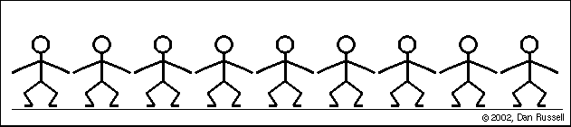
What is a wave
A wave is a disturbance or variation that transfers energy progressively from point to point.
Waves are created by vibrations (back and forth movement) of particles

Slide 3
Types of Waves
Mechanical Waves
  Waves that require a medium to carry energy from one point to another.
  Water, sound, and seismic waves are examples of mechanical waves.
Electromagnetic Waves
  Do not require a medium to transport energy.
  Visible light, microwaves, UV rays, and Infrared radiation are examples of Electromagnetic waves.

Slide 4
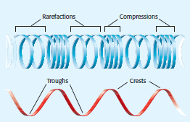
Mechanical Wave Motion
Longitudinal Wave
  In a longitudinal wave the particle displacement is parallel to the direction of wave motion.
Transverse Waves
  In a transverse wave the particle displacement is perpendicular to the direction of wave motion.
In both types of mechanical waves, the particles do not move with the wave but oscillate (vibrate) back and forth around a rest position.

Slide 5
Properties of a Wave
All waves have amplitude, frequency, wavelength, and wave speed.
Longitudinal Wave
Transverse Wave

Slide 6
Describe the Properties
Amplitude – the distance from the rest position to highest point of the wave
Frequency – the number of waves that pass a set position in one second. Measured in Hertz.
Wavelength- the distance from crest to crest on a transverse wave
Wave speed- how fast the wave moves. Equals the frequency times the wavelength.

Slide 7

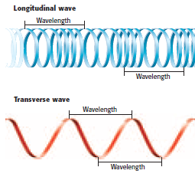
Properties of Waves

Slide 8

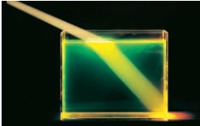
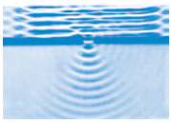
Waves Interact With Matter
Reflection- wave bounces back when it strikes a barrier.
Refraction- wave passes through a barrier but bends when changing from one medium to the other.
Diffraction- wave bends around a barrier or through an opening

Slide 9
Waves Interact With Waves
Constructive Interference- when waves combine so that the crests and troughs overlap resulting in a wave of higher amplitude.
Destructive Interference- when waves combine so that the crest of one wave overlaps the trough of another resulting in a wave of lower amplitude.

Slide 10
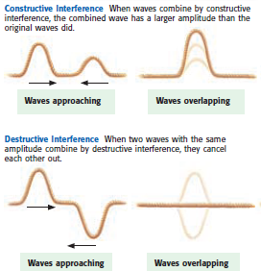
Constructive v. Destructive

Slide 11
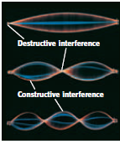
Standing Wave – when waves combine with both destructive and constructive interference in such a way that it appears that the wave is standing still.

Slide 12
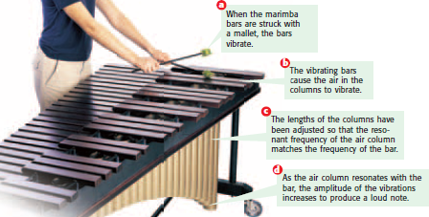
Resonance
Resonance occurs when two objects naturally vibrate at the same frequency so that a sound produced by one makes the other vibrate.

