Slide 1

Learning Objectives
LO8 Journalize and post the adjusting entries for supplies and prepaid insurance.
© 2014 Cengage Learning. All Rights Reserved.

Slide 2
Adjusting Entry for Supplies
Lesson 6-4
LO8
Journal entries recorded to update general ledger accounts at the end of a fiscal period are called adjusting entries.

Slide 3
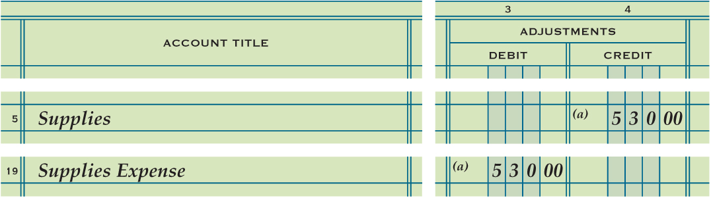
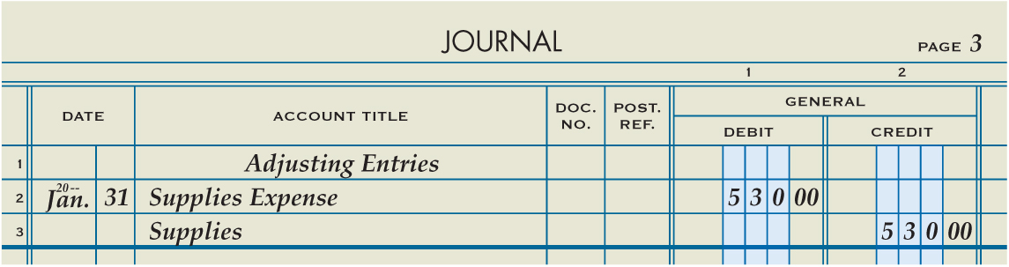
Adjusting Entry for Supplies
Lesson 6-4
LO8
Supplies Expense
Adj. (a) 530.00
Supplies
Jan. 31 Bal. 620.00
Adj. (a) 530.00
(New Bal. 90.00)
1
Heading
3
Debit
2
Date
4
Credit

Slide 4
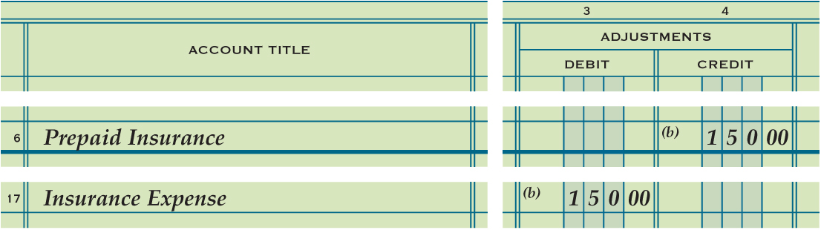
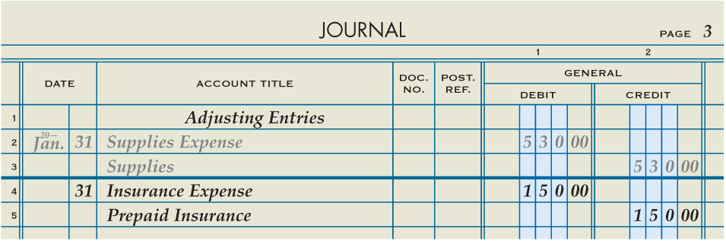
Adjusting Entry for Prepaid Insurance
Lesson 6-4
LO8
Insurance Expense
Adj. (b) 150.00
Prepaid Insurance
Jan. 31 Bal. 900.00
Adj. (b) 150.00
(New Bal. 750.00)
1
Heading
3
Debit
2
Date
4
Credit

Slide 5
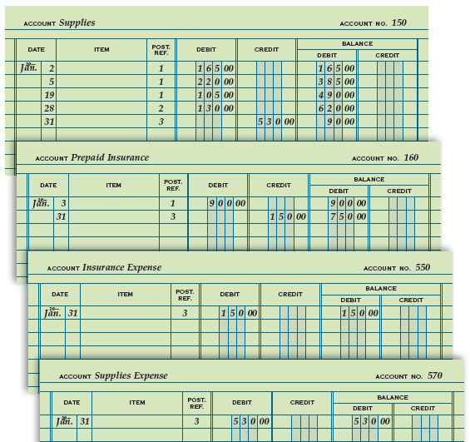
Partial Ledger Accounts after Posting Adjusting Entries
Lesson 6-4
LO8

Slide 6

Lesson 6-4 Audit Your Understanding
Lesson 6-4
1. Why are adjusting entries journalized?
ANSWER
To update general ledger accounts at the end of a fiscal period

Slide 7
Lesson 6-4 Audit Your Understanding
Lesson 6-4
2. Where is the information obtained to journalize adjusting entries?
ANSWER
Balance Sheet Credit column

Slide 8
Lesson 6-4 Audit Your Understanding
Lesson 6-4
3. Which accounts are increased from zero balances after adjusting entries for supplies and prepaid insurance are journalized and posted?
ANSWER
Supplies expense
Insurance expense

