Slide 1

A First Book of C++
7.1 One-Dimensional Arrays

Slide 2
Objectives
In this chapter, you will learn about:
  One-Dimensional Arrays
  Array Initialization
  Arrays as Arguments
  Two-Dimensional Arrays
  Common Programming Errors
  Searching and Sorting Methods

Slide 3
One-Dimensional Arrays
One-dimensional array (single-dimension array or vector): a list of related values
  All items in list have same data type
  All list members stored using single group name
Example: a list of grades
  98, 87, 92, 79, 85
  All grades are integers and must be declared
    Can be declared as single unit under a common name (the array name)

Slide 4
One-Dimensional Arrays (cont'd.)
Array declaration statement provides:
  The array (list) name
  The data type of array items
  The number of items in array
Syntax
  dataType arrayName[numberOfItems]
  Common programming practice requires defining number of array items as a constant before declaring the array

Slide 5
One-Dimensional Arrays (cont'd.)
Examples of array declaration statements:
  const int NUMELS = 5; // define a constant // for the number of
  // items
  int amts[NUMELS]; // declare the array
  const int NUMELS = 4;
  char code[NUMELS];
  const int SIZE = 100;
  double amount[SIZE];

Slide 6
One-Dimensional Arrays (cont'd.)
Each array allocates sufficient memory to hold the number of data items given in declaration
Array element (component): an item of the array
Individual array elements stored sequentially
  A key feature of arrays that provides a simple mechanism for easily locating single elements

Slide 7
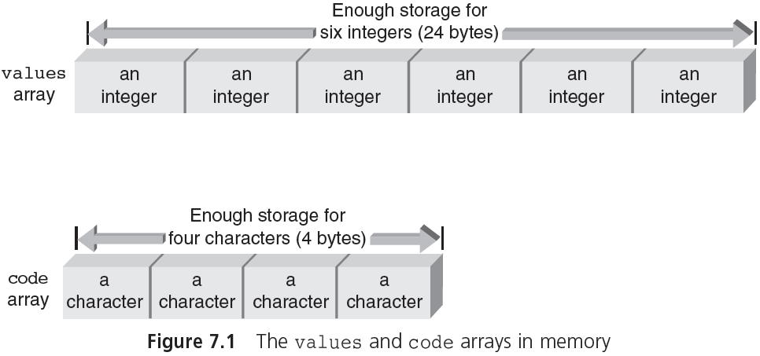
One-Dimensional Arrays (cont'd.)

Slide 8
One-Dimensional Arrays (cont'd.)
Index (subscript value): position of individual element in an array
Accessing of array elements: done by giving array name and element’s index
  grade[0] refers to first grade stored in grade array
Subscripted variables can be used anywhere that scalar variables are valid:
  grade[0] = 95.75;
  grade[1] = grade[0] - 11.0;

Slide 9
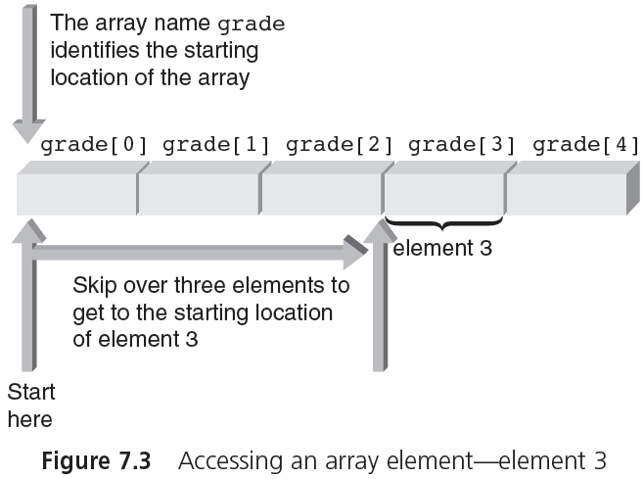
One-Dimensional Arrays (cont'd.)

Slide 10
One-Dimensional Arrays (cont'd.)
Subscripts: do not have to be integers
  Any expression that evaluates to an integer may be used as a subscript
  Subscript must be within the declared range
Examples of valid subscripted variables (assumes i and j are int variables):
    grade[i]
    grade[2*i]
    grade[j-i]

Slide 11
Input and Output of Array Values
Individual array elements can be assigned values interactively using a cin stream object
    cin >> grade[0];
    cin >> grade[1] >> grade[2] >> grade[3];
    cin >> grade[4] >> prices[6];
Instead, a for loop can be used
    const int NUMELS = 5;
    for (int i = 0; i < NUMELS; i++)
    {
    cout << "Enter a grade: ";
    cin >> grade[i];
    }

Slide 12
Input and Output of Array Values (cont'd.)
Bounds checking: C++ does not check if value of an index is within declared bounds
If an out-of-bounds index is used, C++ will not provide notification
  Program will attempt to access out-of-bounds element, causing program error or crash
  Using symbolic constants helps avoid this problem

Slide 13
Input and Output of Array Values (cont'd.)
Using cout to display subscripted variables:
  Example 1
    cout << prices[5];
  Example 2
    cout << "The value of element " << i << " is " << grade[i];
  Example 3
    const int NUMELS = 20;
    for (int k = 5; k < NUMELS; k++)
    cout << k << " " << amount[k];

Slide 14
Input and Output of Array Values (cont'd.)
Program example of array I/O (Program 7.1):
    #include <iostream>
    using namespace std;
    int main()
    {
      const int NUMELS = 5;
      int i, grade[NUMELS];
      for (i = 0; i < NUMELS; i++) // Enter the grades
      {
      cout << "Enter a grade: ";
      cin >> grade[i];
      }
      cout << endl;
      for (i = 0; i < NUMELS; i++) // Print the grades
      cout << "grade [" << i << "] is " << grade[i] << endl;
      return 0;
    }

Slide 15
Input and Output of Array Values (cont'd.)
Sample run using Program 7.1:
        Enter a grade: 85
        Enter a grade: 90
        Enter a grade: 78
        Enter a grade: 75
        Enter a grade: 92
        grade[0] is 85
        grade[1] is 90
        grade[2] is 78
        grade[3] is 75
        grade[4] is 92

