Slide 1

A First Book of C++
7.3 Arrays as Arguments

Slide 2
Arrays as Arguments
Array elements are passed to a called function in same manner as individual scalar variables
  Example:
    findMax(grades[2], grades[6]);
Passing a complete array to a function provides access to the actual array, not a copy
  Making copies of large arrays is wasteful of storage

Slide 3
Arrays as Arguments (cont'd.)
Examples of function calls that pass arrays:
int nums[5]; // an array of five integers
char keys[256]; // an array of 256 characters
double units[500], grades[500];// two arrays of // 500 doubles
The following function calls can then be made:
    findMax(nums);
    findCharacter(keys);
    calcTotal(nums, units, grades);

Slide 4
Arrays as Arguments (cont'd.)
Suitable receiving side function header lines:
    int findMax(int vals[5])
    char findCharacter(char inKeys[256])
    void calcTotal(int arr1[5],
    double arr2[500],
    double arr3[500])

Slide 5
Arrays as Arguments (cont'd.)
Example of passing arrays as arguments (Program 7.4):
  Constant MAXELS is declared globally
  Prototype for findMax() uses constant MAXELS to declare that findMax() expects an array of five integers as an argument
  As shown in Figure 7.5, only one array is created in Program 7.4
    In main(), the array is known as nums
    In findMax(), it is known as vals

Slide 6
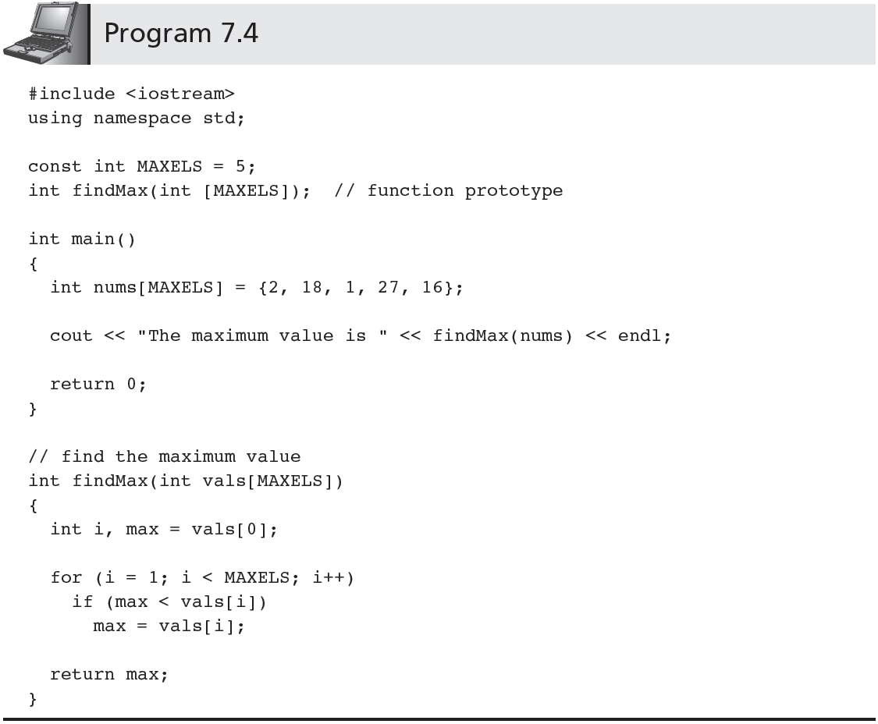

Slide 7
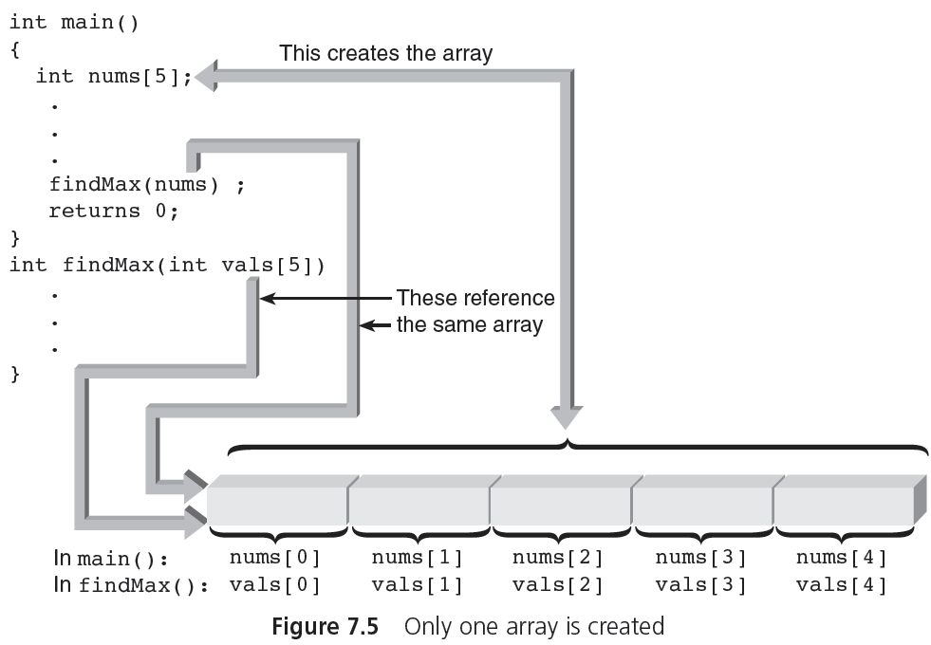
Arrays as Arguments (cont'd.)

