Slide 1

A First Book of C++
7.4 Two-Dimensional Arrays

Slide 2
Two-Dimensional Arrays
Two-dimensional array (table): consists of both rows and columns of elements
Example: two-dimensional array of integers
      8 16 9 52
      3 15 27 6
      25 2 10
Array declaration: names the array val and reserves storage for it
    int val[3][4];

Slide 3
Two-Dimensional Arrays (cont'd.)
Locating array elements (Figure 7.7)
  val[1][3] uniquely identifies element in row 1, column 3
Examples using elements of val array:
      price = val[2][3];
      val[0][0] = 62;
      newnum = 4 * (val[1][0] - 5);
      sumRow = val[0][0] + val[0][1] + val[0][2] + val[0][3];
  The last statement adds the elements in row 0 and sum is stored in sumRow

Slide 4
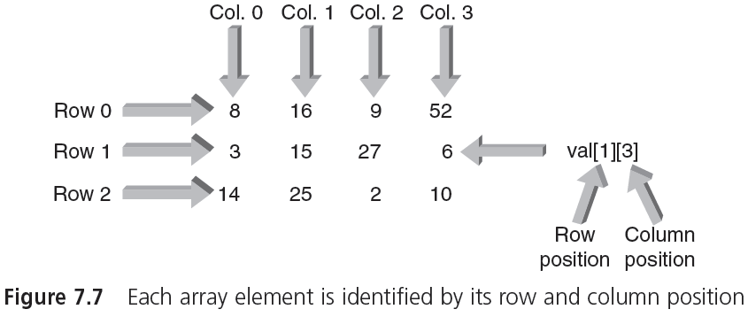
Two-Dimensional Arrays (cont'd.)

Slide 5
Two-Dimensional Arrays (cont'd.)
Initialization: can be done within declaration statements (as with single-dimension arrays)
Example:
      int val[3][4] = { {8,16,9,52},
      {3,15,27,6},
      {14,25,2,10} };
  First set of internal braces contains values for row 0, second set for row 1, and third set for row 2
  Commas in initialization braces are required; inner braces can be omitted

Slide 6
Two-Dimensional Arrays (cont'd.)
Processing two-dimensional arrays: nested for loops typically used
  Easy to cycle through each array element
    A pass through outer loop corresponds to a row
    A pass through inner loop corresponds to a column
  Nested for loop in Program 7.7 used to multiply each val element by 10 and display results
Output of Program 7.7
    Display of multiplied elements
    80 160 90 520
    30 150 270 60
    140 250 20 100

Slide 7
Two-Dimensional Arrays (cont'd.)
Prototypes for functions that pass two-dimensional arrays can omit the row size of the array
  Example (Program 7.8):
    display (int nums[ ][4]);
  Row size is optional, but column size is required
    The element val[1][3] is located 28 bytes from the start of the array (assuming 4 bytes for an int)

Slide 8
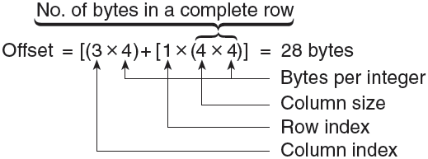
Two-Dimensional Arrays (cont'd.)
Determining offset of an array
  Computer uses row index, column index, and column size to determine offset

Slide 9
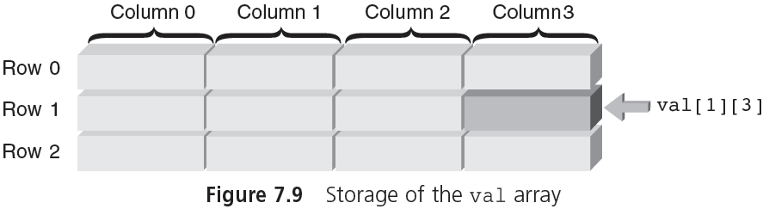
Two-Dimensional Arrays (cont'd.)

Slide 10
Larger Dimensional Arrays
Arrays with more than two dimensions allowed in C++ but not commonly used
Example: int response[4][10][6]
  First element is response[0][0][0]
  Last element is response[3][9][5]
A three-dimensional array can be viewed as a book of data tables (Figure 7.10)
  First subscript (rank) is page number of table
  Second subscript is row in table
  Third subscript is desired column

Slide 11
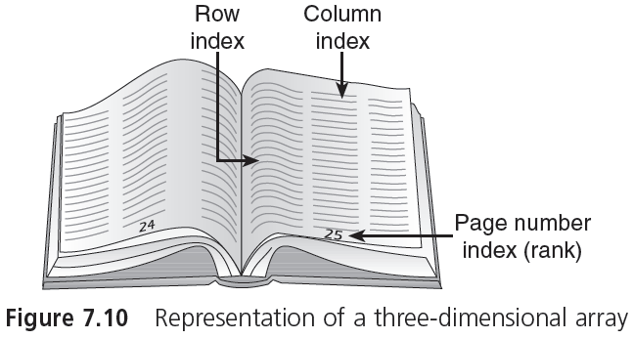
Larger Dimensional Arrays (cont'd.)

