Slide 1
Exercise 24 – Software Skills
The color and style you choose for your Web page background can liven up your page or make it stand out among other pages in a site.
You can also add horizontal rules to divide pages so that certain parts of a page are emphasized.
You can use Dreamweaver’s palette of Web-safe colors or create your own.

Slide 2
Design Skills
Creating an appealing background for your page helps ensure that your site visitors will like your overall page design.
Adding rules on your pages helps group information so that readers can clearly understand how your page content is organized.

Slide 3
Terms
Rules – Horizontal lines added as a design element to page to help organize the content and add a design element.
Web-safe colors – A palette of 216 colors that will display the same in any browser, regardless of the operating system.

Slide 4
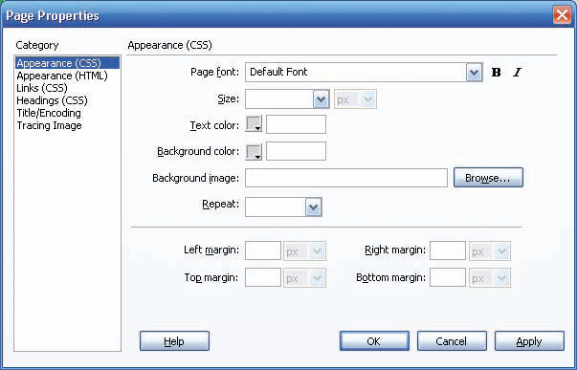
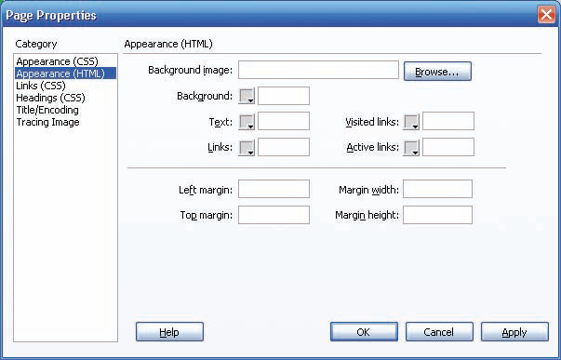
Changing Background Color
Page Properties dialog box for Appearance (CSS)
Page Properties dialog box for Appearance (HTML)
A simple way to add graphic interest to a Web page is to change its background color. By default, the Web pages you create in Dreamweaver have a white background. You don’t have to leave them white, however; you can use any of the colors in the Dreamweaver color palette as a page background color—but Web-safe colors are recommended.
Work with Graphic Elements and Templates: Lesson 4, Exercise 24
Notes:
The Page Properties dialog box can be opened by either:
Clicking on the Page Properties Button on the property inspector
Choosing Modify → Page Properties on the Menu Bar.

Slide 5
Change the Page Background Color
By default, the Web pages you create in Dreamweaver have a white background.
To change page background color, use the Modify>Page Properties command to open the Page Properties dialog box.
To create styles, choose the Appearance (CSS) category; the Page Properties dialog box appears. When you make changes in the dialog box, the styles are added to the head section of the Web page.
You can also apply margin settings from this dialog box.

Slide 6
Horizontal Rules
You can insert horizontal rules on your Web pages to separate sections of text. Position the cursor at the beginning or end of a paragraph and use the Insert > HTML > Horizontal Rule command.
You can change horizontal rule formats by selecting the horizontal rule and changing settings in the Property inspector.
By default, the rule runs the full width of the Web page. You can specify a width in the W text box using either a pixel measurement or a percentage of the page width. If you specify a width less than the full page, you can choose an alignment option of left, center, or right to tell Dreamweaver how you want the rule positioned on the page.
Use the H box to specify a height for the rule in pixels. Select the Shading checkbox to add shading to the rule that makes it look three-dimensional. Deselect this checkbox to make the rule a solid color.
The Properties panel does not have a feature to change the horizontal rule’s color. However, you can change the color of the horizontal rule by editing the HTML <hr> tag in the Tag inspector’s property sheet or in Code view, as follows: <hr color=“009999”>
Work with Graphic Elements and Templates : Lesson 4, Exercise 24

Slide 7
Insert Horizontal Rules
The rule color does not display in Design view.
The color attribute for horizontal rules may not displayed correctly in all browsers.
Although horizontal rules are easy to insert, you may want to consider using CSS styles to apply them because you have many more options about where to position rules and how to format them.

Slide 8
Use Web-Safe and Custom Colors
The 216 color blocks in the color pallet display the same way, regardless of the browser or operating system you are using.
When the Web-safe color palette was developed, most computers could display a maximum of 256 colors. Now that many systems are capable of 16-bit and 32-bit display, which enables them to display millions of colors.

Slide 9
One exception to free expression of color occurs when designing cell phones and PDA’s, you need to check your colors with Adobe’s Device Central.
To choose a color outside the Web-safe palette, click the System Color Picker icon at the upper-right corner of the color palette to open the Color dialog box.
You can add the custom color you create to the Custom colors palette so it will be available for future use.

Slide 10
ASSIGNMENT
Page 123
Gardenscape
Page 124
java2go

