Slide 1
Exercise 26 - Skills
Fireworks provides a full set of professional tools you can use to create, modify, and enhance bitmap objects for your Web pages.
The Brush tool, Pencil tool, and the bitmap selection tools are important tools you will use often as you work with bitmap images.
Being able to open, work with, and enhance bitmap images for your Web pages is a specialized skill that can help you create a professional look for your Web pages.

Slide 2
Exercise 26 - Terms
Anti-aliasing – A technique that smoothes the rough edges of a bitmapped image by adding transitional colors to the pixels along the edges.
Fill – The color, pattern, or texture used in the interior of a shape, arc, or text.

Slide 3
Exercise 26 - Terms
RGB – A common color model that uses a hexadecimal value to communicate a color by the amount of Red, Green, and Blue used to create the color.
Stroke – The outline of an object, including characteristics such as weight, color, style, and more.

Slide 4
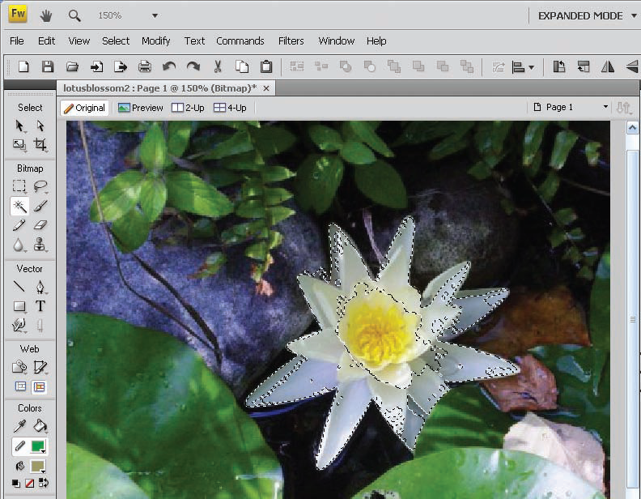
Working with Bitmap Tools
The three bitmap selection tools are the Marquee tool, the Lasso tool, and the Magic Wand.
Use the Marquee tool when you want to select a rectangular area of a bitmap image.
Use the Lasso tool when you need to select an irregularly shaped area. You use the Lasso to draw around the edges of the area you want to select.
Use the Magic Wand tool when you want to select all contiguous pixels in a specific color. For example, in the image shown in the following illustration to the right, the Magic Wand tool has been used to select the white color on the petals of the lotus blossom.
Work with Graphic Elements and Templates : Lesson 4, Exercise 26

Slide 5
Learn About Bitmap Objects
Bitmap objects are made up of colored dots called pixels.
When you enlarge a bitmap image, you can see the individual pixels.
Fireworks includes a full set of bitmap tools you can use to edit bitmap objects.

Slide 6
Selecting the Drawing Colors
Because you use Fireworks to create and modify objects for the Web, the program uses the RGB color model, a common color model used in Wen design.
Two different tools in the Tools panel enable you to select colors easily for both bitmap and vector images.
You can click the System color Picker to choose you own custom color if the one you want doesn't appear in the selection panel.

Slide 7
Draw with the Brush Tool
The Brush tool paints a stroke onto an image. The stroke consists of individual pixels that are placed in specific locations in the image, according to where you drag the mouse.
You use the Property Inspector to adjust the setting of the Brush tool.
You can create many different effects with the Brush tool.

Slide 8
Draw with the Pencil Tool
The Pencil Tool draws a line that is one-pixel wide, using the selected color stroke.
The pencil tool offers fewer options than the Brush tool because it cannot use texture or an adjustable size.
You can use the anti-aliasing option to make your pencil lines look smother.

Slide 9
Select Bitmap Objects
Because bitmap objects are actually collections of pixels, you need to use a bitmap selection tool to select items you want to copy, cut, or move.
The three bitmap selection tools are:
Marquee tool – when you want to select a rectangular area of a bitmap image.
Lasso tool – when you need to select an irregular shaped area
Magic Wand tool – when you want to select all contiguous pixels in a specific color.

Slide 10
To use one of the selection tools, click the one you want and drag the area on the image you want to select.
After you use the bitmap selection tools to select the portion of the bitmap image you want to work with, you can click a tool in the Selection area if needed.
To add another item (or selection) to the current selection, press and hold Shift when you click the item.
To subtract from the item (or selection) press and hold ctrl while you click the item.

Slide 11
Copy and Paste Bitmap Objects
When you copy a bitmap object, an exact duplicate of the selected item is placed on the clipboard. The original is left intact on the page.
The clipboard holds only one object at a time, so the next time you copy an item, the existing item is replaced on the clipboard.
You can copy a selected item by right-clicking it and choosing Copy, by choosing the Edit>Copy menu command or pressing Ctrl + C.
When you paste a selected object, Fireworks places on the page the copied selection that was saved to the clipboard.

Slide 12
After you paste an object, you can drag it to the place you want it to appear on the image. Click outside the selection to position the item in place.
You can paste the same object as many times as needed. The selected item remains on the clipboard until you replace it by copying another selection.
You can also cut a bitmap object to remove it form the Fireworks document.

Slide 13
ASSIGNMENT
Page 137 – 138
26_tree.png
Page 139
SO_26_gslogo_xx.png

