Slide 1
Exercise 28 - Skills
Vector tools enable you to create perfectly formed shapes and lines of all sorts. What’s more the vector objects keep their shape – and their quality – no matter how many times you may change them.

Slide 2
Exercise 28 - Terms
Bounding box – A rectangular shape that completely encloses a shape and defines the total height and width of the shape.
Group – Joining two or more objects so they function as a single object.

Slide 3
Exercise 28 - Terms
Points – Places where vector paths change direction.
Transform – To modify by scaling, skewing, rotating, or distorting.

Slide 4
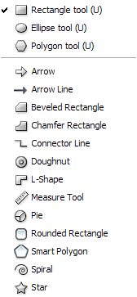
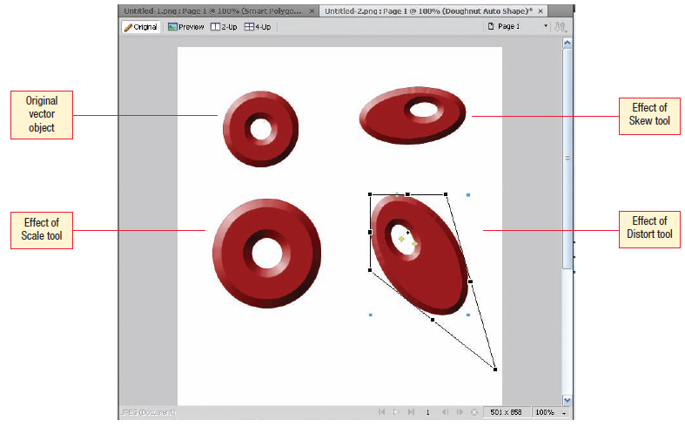

Vector Objects
Vector Drawing Tools
The Scale tool enables you to quickly change the size of any object regardless of its type.
You can use the Scale tool to rotate an object.
You can also use the Skew tool and the Distort tool to change the shape of an object by dragging the handles that appear around the edges of a selected vector object. These tools are called transform tools.
Transform Tools
Work with Graphic Elements and Templates : Lesson 4, Exercise 28
Notes:
Press and hold Shift while using the Rectangle tool to draw a perfect square. To draw the shape from the center outward, press and hold ALT while drawing. (The Shift key works for constraining most shapes to their “perfect” shape and the ALT key works to draw from the inside out on all shapes.)
One important difference between lines drawn using the Line tool and one of the bitmap tools is that you cannot erase any part of a vector-based line using the Eraser tool.

Slide 5
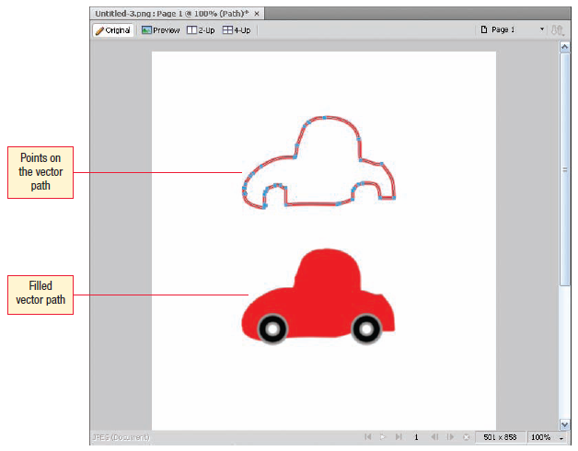
Vector Objects
When you draw a vector path with the Pen tool, points are added only at the places you click the mouse button. The tool connects the points smoothly as you draw.
Handles appear automatically on the vector path you create with the Pen tool. You can drag the handles to control the distance, arc, and direction of the path.
Move points on a line by choosing the Subselection tool and dragging the points where you want them on the line.
To delete a point using the Subselection tool, choose the point and press Del.
To delete a point using the Pen tool, position the tool on a point and click the point to delete it.
To add a point using the Pen tool, position the tool on the line away from a point and click to add a point.
Work with Graphic Elements and Templates : Lesson 4, Exercise 28

Slide 6
Vector Objects
Vector images are created by mathematical calculations that draw the object on the screen.
You can resize vector images without any loss of quality because vector images are scalable.

Slide 7
Vector Objects
Vector images include one or more objects that you can:
    select and resize
    drag
    scale
    skew
    rotate
    copy
    paste

Slide 8
Vector Objects
When you select a vector image in the document, handles appear around the outer edges of the object.
You can resize the object by dragging a handle.
You can move the vector object by positioning the pointer on the object and, when the pointer changes to a four sided arrow, click and drag the object to a new location on the page.

Slide 9
Vector Objects
Vector objects are different from bitmap objects in that you cannot edit the individual pixels when you are working with a vector image.

Slide 10
Vector Objects
Draw Lines
Draw Rectangles
Draw Ellipses
Create polygons
Scale Vector Objects
Draw using the Vector path tool
Use the Pen Tool to create paths
Add, Change, and Delete Points
Apply a Stroke to a Vector Path
Add a Fill to a Path
Read Pages 146 – 150 for how to use.

Slide 11
ASSIGNMENT
Page 150
S_28 javalogo_xx.png
Page 151
S0_28_javalogo_xx.png

