Slide 1
Exercise 29 - Skills
The text tools in Fireworks enable you to add special graphic touches to your design.

Slide 2
Exercise 29 - Terms
RTF – Rich Text Format, a text file format that includes formatting information such as font name, size, and attributes like bold.
Text blocks – Groups of editable text used in Fireworks documents.

Slide 3
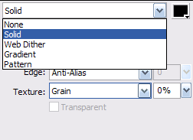
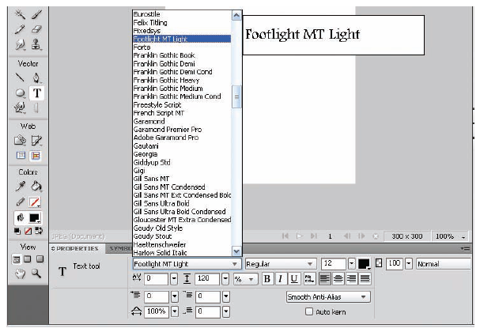
Working with Text
In a Fireworks document, all text is contained in text blocks. You use the Text tool to create text blocks.
You can edit the text in a text block at any time.
You can change the properties of text blocks in much the same way you change the properties of vector objects. You can, for example, change the fill and stroke colors. You can also apply filters to text blocks to create special effects.
You can create a text block two ways:
  Click once with the Text tool to create an auto-sizing text block that expands as you type.
  Drag the Text tool to create a fixed-width text block that expands vertically as you type.
Fill Options for text
Text font samples
Work with Graphic Elements and Templates : Lesson 4, Exercise 29

Slide 4
Add Text
The most common way to add text to a text block is simply to type the text directly into the text block.
You can also use text from another application in a Fireworks text block by following one of three methods:
Drag and Drop text from another open program in Fireworks.
Use Edit>Copy and Edit>Paste
Use the File>Import menu

Slide 5
Choose a Font
Most computers have a variety of different fonts installed and available for use in your documents.
To choose a font, click the font list box in the Property Inspector.
You can use more than one font in a text block if needed, but be careful not to overdo it.
Using too many fonts or selecting novelty fonts can make content hard to read.

Slide 6
Set Text Size
In the Property inspector, click the size box to choose the point size for text.
You can use the size slider to choose a value between 8 points and 96 points. 72 points equals 1 inch.
You can type point sizes directly into the size box.
Fro most text blocks, a size between 10 and 14 points is adequate. Smaller sizes may be hard to read, and larger sized can take up too much room.

Slide 7
Add Fills to Text
Fireworks automatically applies a solid, single color fill to text.
When you click the Fill Options button in the Fill Color Selector, the fill options pop-up.
You can choose none, solid, Web dither, gradient, or pattern files.
The fill options pop-up displays additional choices related to the type of fill you selected.
You can apply strokes and fills together or individually.
You can change the text at any time after you apply fills.

Slide 8
Make Text Follow a Path
Normal text by default follows a straight horizontal line. You can attach a path to make the text twist and curve in interesting ways.
When you attach text to a path, any stroke, fill, or , filter properties that have been applied to the path are hidden.
If you want the path to be visible after the text has been attached to the path, you can use the Edit>Clone menu command to create an exact duplicate of the path.
For best results, keep the text on a single line; that is, don't press enter when you are entering the text.

Slide 9
ASSIGNMENT
Page 155 – 156
29_gslogo_xx.png
Page 156
29_javalogo.png

