Slide 1
Exercise 30 - Skills
Fireworks uses layers to help you organize and work with the various elements in your drawings. You can us layers to keep objects independent of each other and to make it appear as though your document has depth.

Slide 2
Exercise 30 - Skills
Masks and blends add further design options by enabling you to change the overall appearance of the object.

Slide 3
Exercise 30 - Skills
Mastering the concept of layers is a great benefit for any serious Web designer, because in order to put objects together professionally on the page, you need to be able to position, overlap, and work with them as objects in their own right. A good designer knows how to use layers, masks, and blends to create the best possible effect in a drawing.

Slide 4
Exercise 30 - Terms
Mask – An object that influences the display of other objects by applying a form or shape through which the object is viewed.
Thumbnail – A small picture that represents the contents of each layer in the Layers panel.

Slide 5
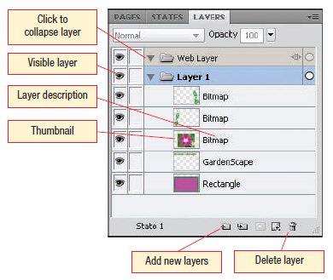
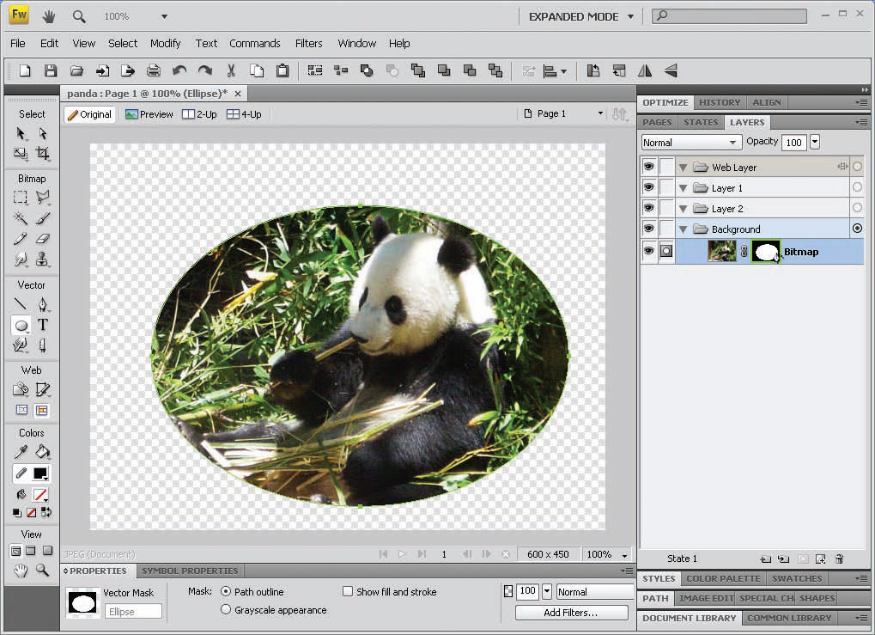
Working with Layers
Each vector or path object you create is automatically placed on its own layer.
You can add layers to add to the level of control you have over the way objects are organized in your document.
You can use a mask to change how much of an object is visible in a Fireworks document.
Masking an object is similar to cropping, but you are not limited to a rectangular area as you are when you crop an image.
You can use any vector object to create a mask in Fireworks.
Work with Graphic Elements and Templates : Lesson 4, Exercise 30
Notes:
Creating a mask is as simple as creating the shape you want, choosing the Edit > Cut menu command to place the shape on the clipboard, and then clicking the layer of the object you want to mask and choosing Modify > Mask > Paste as Mask.

Slide 6
Add Layers
You use the Layers panel to add remove, move, hide, or lock layers in Fireworks.
Each vector or path object you create is automatically placed on its own layer.
The Web Layer is a special layer that sits above all other layers in a fireworks document.

Slide 7
You can add layers to add to the level of control you have over the way objects are organized in your document.
Fireworks automatically create a layer called Layer 1. When you add layers, they will be numbered sequentially. You can rename a layer by double-clicking its name in the Layers panel and entering the new name.

Slide 8
The Layers panel shows you the content of each layer and provides information about each object.
You can add a layer using several different methods:
Select the Edit>Insert>Layer menu command.
Click Options in the upper-right corner of the Layers panel to display the menu, and click New Layer.
Click the New/Duplicate Layer button at the bottom of the Layers panel.
When you add a new layer, the layer is inserted above the currently selected layer.

Slide 9
Place Objects on Layers
Fireworks handles bitmap and vector objects differently. The Layers panel is no exception. When a bitmap object layer is selected and you draw another bitmap object, the new object is added to the same layer the existing object occupies.
When a vector layer is selected and you add a bitmap object, a new bitmap object layer is automatically corrected and the new bitmap object is added to that layer.

Slide 10
The vector remains on its own layer, alone.
You can tell whether a layer is a vector or a bitmap layer by looking for the identifier to the right of the layer's thumbnail.
It's a good idea to pay careful attention to the way you organize your layers when you just getting started.

Slide 11
Hide and Display Layers
You can hide a layer completely to see how your drawing will look without it.
You can alternately show and then hide each item so that you can easily choose between them.
To hide a layer, click the eye for that layer in the first column of the Layers panel.
To display the layer, click the first column again.

Slide 12
Hiding a Layer does not affect objects on any of the other layers in your Fireworks document.
Once a layer is hidden, the objects on that layer cannot be selected.
Similarly, when you print or export your Fireworks document, any hidden layers will not be included in the print or export procedure.
When you get your layers just the way you want them, protect them by adding inadvertently changing by locking them.
To lock a layer, click in the second column of the Layers panel.

Slide 13
Create a Vector Mask
You can use a mask change how much of an object is visible in a Fireworks document.
Masking an object is similar to cropping, but you are not limited to a rectangular area as you are when you crop an image.
You can use any vector object to create a mask in Fireworks.
It is easiest to create the object you want to mask first and then create a mask.

Slide 14
Creating a mask is as simple as creating the shape you want, choosing the Edit>Cut menu command to place the shape on the clipboard, and then clicking the layer of the object you want to mask and choosing Modify>Mask>Paste as Mask.
Masks and the objects are grouped together on the same layer after you apply the mask.

Slide 15
Create a Bitmap Mask
A bitmap mask is similar in that it influences the display of the object to which it is applied, but it goes about the process differently.
A bitmap mask in effect masks every pixel instead of applying an object mask to the drawing.
The bitmap mask overlays the object you want to mask, and the underlying objects shows through.

Slide 16
To create a new bitmap mask from scratch, select the object you want to mask and then click the Add Mask button along the bottom of the Layers panel.
Then select the Brush tool to draw the mask and use the Property Inspector to set the attributes.

Slide 17
Convert an Object to a Mask
To convert an object into a mask, place the mask object over the object you want to mask and then group the objects. This places both objects onto the same sublayer in the Layers panel and links them so they function as a single unit.
If you previously placed an object on the clipboard and want to turn it into a mask, you can choose Modify>Mask>Paste as Mask menu command.

Slide 18
To turn off a mask, choose the Modify>Mask>Disable Mask menu command. A red X appears across the mask's thumbnail to show it is not in use.
To delete a mask, choose the Modify>Mask>Delete Mask command and click Discard.

Slide 19
Add a Blend
A blend is created when you overlap two objects and join the two colors to produce a mixture of both.
Fireworks includes more than 20 different blending modes.
You choose a blend using the blend mode list box in the Property Inspector or in the Layers panel.
You can apply a blend that adds, subtracts, multiplies, or otherwise combines the colors and brightness levels of the two images.

Slide 20
Each blending mode combines these elements in different ways to produce variety of effects.
In the default Normal mode, no blending occurs; when objects are overlapped, one object appears in front, and the other behind.

Slide 21
Set Opacity
The opacity of an image is the degree to which the object is transparent.
When an object is transparent, the opacity is set to 0%.
When an object is solid and you cannot see through it, the opacity is set to 100%.You will often work with opacity while you're creating blends because the two are related. When you change opacity, you change the strength of a blend.

Slide 22
Setting a Blended Mode
After you have added the objects you want to blend, select the top object and then choose the blending mode in the Property Inspector or the Layers panel.
To set the blending mode before you create an object, choose the blending mode in the Property inspector before you draw.
Only one blending mode can be active at any one time.

Slide 23
ASSIGNMENT
Pages 162 – 164
SO_30_tierraverde.png
Page 164
Classroom connections

