Slide 1
Exercise 31 - Skills
Adobe Bridge enables you to view and organize images on your computer and import them easily into Dreamweaver. You can place images on your page to illustrate or emphasize text, position them so that the text wraps to the left or right.

Slide 2
Exercise 31 - Skills
Adobe Bridge also enables you to use Fireworks tools to modify and enhance your images without ever leaving Dreamweaver and insert and optimize Fireworks images.

Slide 3
Exercise 31 - Terms
Adobe Bridge – A file management application included with the applications that are part of Adobe Web Design, enabling you to view and manage image files.

Slide 4
Exercise 31 - Terms
GIF (Graphics Interchange Format) – A bitmapped image format designed for on-sceen viewing of images.
JPEG – (Joint Photographic Experts Group) – A file format particularly suited for Web graphics, such as photos.

Slide 5
Exercise 31- Terms
PNG ( Portable Network Graphic) – A bitmapped image format designed for easy use of images on the internet.

Slide 6
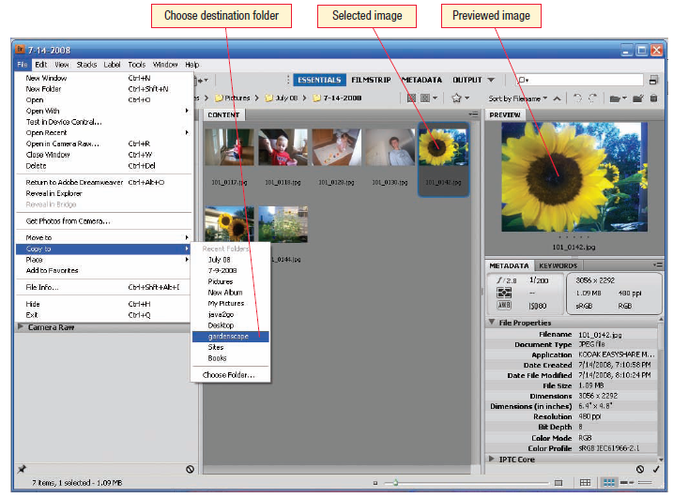
Adobe Bridge
You can access Adobe Bridge from within Dreamweaver (File → Browse in Bridge) to import your Fireworks images and other media files you plan to use on your Web pages.
To make sure others will be able to see the images you place on your pages, save the files in one of three formats: JPG, GIF, or PNG.
Work with Graphic Elements and Templates : Lesson 4, Exercise 31
Notes:
GIF (Graphics Interchange Format) A bitmapped image format designed for on-screen viewing of images.
JPEG (Joint Photographic Experts Group) A file format particularly suited for Web graphics, such as photos.
PNG (Portable Network Graphic) A bitmapped image format designed for easy use of images on the Internet.

Slide 7
About Adobe Bridge
The Content area in the center of the Bridge window displays thumbnails of each of the files in the current folder.
The right panel displays a Preview tab where you can see a preview of the selected file(s).
The images you add to your Web sites are an important part of the overall design.
You can easily insert an image from Bridge to a Dreamweaver Web site.

Slide 8
Insert an Image on a Page in Dreamweaver
The images you add to your Web sites are an important part of the overall design.
Images illustrate ideas in your text, welcome the visitor to the page, or simply provide something beautiful or interesting that connects to your site content in some way.
To make sure others will be able to see the images you place on your pages, save the files in one of three formats: JPEG, GIF, or PNG.

Slide 9
Dreamweaver will not automatically convert image files in other formats such as BMP or TIFF, so you will need to convert the files before you can add them to your pages.
To add an image to your page, you can use the Insert>Image menu command to open the Select Image Source dialog box.
If the file you select is not currently saved in the current site, Dreamweaver will prompt you to save the file in the root directory of the site.
Read pages 167 – 169.

Slide 10
Modify Image Properties
Click an image and its properties appear in the Property inspector.
Notice that a thumbnail-size version of the image appears at the left side of the Property inspector.
Next to the thumbnail is the Name text box, which by default is empty. You can supply a name for the image if you need to refer to the image in script.
You can use the image to link to other pages or sites in the same way you use text.

Slide 11
Resize Image
You can use the sizing handles on the picture to adjust the size.
To resize an image to exact measurements, use the W and H text boxes on the Property inspector. You must supply BOTH a width and height.
If you need to go back to the original proportions click the Reset Size symbol to the right of the W and H text boxes.
The Width and Height boxes show the size of the image in pixels (72 pixels to 1 inch).

Slide 12
About Image Borders
By default, an image does not display a border. Use the Border text box on the expanded area of the Property inspector to specify a border width.
Border measurements are in pixels.

Slide 13
Position a Standalone Image
You can use the alignment buttons or settings in the Align List.
If the image appears on a line by itself, (not on the same line with text), you can use the Align Left, Align Center, or Align Right text alignment options to position like you would a text paragraph.
Select the image and use the alignment buttons that appear in the expanded area of the Properties inspector to left, center, or right align the image.

Slide 14
Wrap Text around an Image
When an image is inserted in the same line as text, you use the options on the Align list in the Property inspector to position the image.
Dreamweaver selects the default position for a new image. This setting positions the image at the left edge of the page with the bottom of the picture aligned with the baseline of text.
The align list offers nine other alignment options, but be careful when you make your choice.

Slide 15
Valid XHTML alignments include Top, Bottom, Middle, Left, and Right.
Top aligns the top of the image with the top of the text's largest letters.
Bottom aligns the image and text the same way as Default.
Middle aligns the middle of the image with the text baseline.
Left positions the image at the left margin and wraps the text around it on the right.
Right positions the image at the right margin and wraps the text around it on the left.

Slide 16
The Align list also includes Text Top, Baseline, Absolute Middle, and Absolute Bottom, but you will probably find that you can achieve the desired alignment effect using one of the prior options, with added security of knowing these alignments will display correctly in all browsers.
When you apply Left or Right alignment options, Dreamweaver places an anchor at the location where the image was inserted.
You can drag and drop the anchor to pinpoint the image file's position in the text and change the way text wraps around the image.

Slide 17
Use Rulers and Guides to Help Position Graphics
As you arrange objects on a page, you may want to display rulers and guides to help you position the page content.
If the rulers are not already displayed, you can show them using View>Rulers menu command. You have the option of setting the unit of measurement for the rulers.
You can add guides to the display by dragging down from the horizontal ruler or to the right from the vertical ruler.

Slide 18
About Spacing around Images
When you wrap text around an image, Dreamweaver doesn't apply and standoff spacing between the image and text, so text may run right to the edge of an image, especially if Left alignment has been applied.
The V Space and H Space text boxes on the Property inspector allow you to add space around an image, but the options in the Property inspector does not provide very flexible control of the space.
For best appearance, you are advised to use CSS padding property.

Slide 19
You can add both horizontal and vertical guides at the same time by clicking in the upper-left corner of the rulers and dragging a guide from that point.
Use the View>Guides pop-out menu commands to control guides on the page. This pop-out menu allows you to hide, lock, edit, and clear guides, as well as adjust snapping options for the guides.
The "fold" of your Web page is the point at which users have to scroll down to see additional content.

Slide 20
Edit Graphics within Dreamweaver
As part of Adobe's studio of Web Design applications, Dreamweaver has built-in graphics-editing capabilities that rely on other Adobe programs such as Photoshop and Fireworks.
The graphic editing tools are located on the Property inspector.
The first tool in the Edit row may look different from what you see on your screen depending on which programs are installed.

Slide 21
You can adjust settings to specify which application opens which type of graphics.
Click Edit>Preferences and click the File Types>Editors category to display your choices.
Read Page 173 for the various options.

Slide 22
Insert and Edit a
Fireworks Image
Adobe has built another attractive graphic-handling feature into Dreamweaver CS4: You can add a file you created in Fireworks directly onto a Dreamweaver page and then use Fireworks to edit the image.
Use the Insert>Image or Images button on the Common list of the Insert panel to insert the Fireworks file.
You can also copy and paste an image from Fireworks directly into Dreamweaver then display the Image Preview dialog box.

Slide 23
Select a format from the Format list. The dialog box options change to allow you to adjust settings specific to the chosen format type.
Tools below the preview let you crop and magnify the image.
The File tab allows you to specify exact dimensions for the image or scale it to a percentage of its original size.
You can paste the edited image back into Dreamweaver to update the image on the Web page.
You can also insert Fireworks images by copying and pasting them.

Slide 24
Manage Graphic Files
As you add image files to your Web site, Dreamweaver prompts you to save the files to your Web sites root folder so they will be available to display in the browser.
You can store the files directly in the Web folder. It is better site management to create a subfolder for graphic files.
You can create a subfolder in the Local Files pane of the Files panel.
When you are prompted to save graphic files, save them in your images folder.

Slide 25
Be sure to include this folder when copying files for publication so the browser will be able to locate them.
If you intend to use an image on more than one page in a site, you should be aware that modifying an image on one page may change it on other pages as well.
To avoid this kind of problem, copy the image file you want to use on the new page and give it a unique name.

Slide 26
ASSIGNMENT
Pages 177 – 179
Gardenscape
Page 179
java2go

