Slide 1
Exercise 32 - Skills
Another way to add visual impact to your Web page is to add a background picture behind the text.
You can also make your picture functional by creating image maps and navigation bars that enable visitors to get around on your Web site.
Rollover images also add a dynamic touch to a Web page.
You can use the Assets panel to view and access all these objects in a Web site.

Slide 2
Exercise 32 - Terms
Assets panel – In Dreamweaver, a panel in the Files panel group that displays the “assets” of the site: images, colors, URLs, library items, templates, and other objects used in a Web site.

Slide 3
Exercise 32 - Terms
Element – An item in a Dreamweaver navigation bar.
Hotspot – A region on an image map that provides a link to another Web page.
Navigation bar – A set of links to pages in a Web site.

Slide 4
Exercise 32 - Terms
Image map – An image on your Web site that has been linked to other documents or areas of the Web site.
An image map can have one or many regions linking to one or many other pages or documents.

Slide 5
Exercise 32 - Terms
Rollover image – An interactive effect created by specifying two images, one of which loads with the page and the other that displays when the mouse rolls over the image.

Slide 6
Insert a Background Picture
Insert the background image from the Page Properties dialog box.
If the Preview images checkbox is selected in the Select Image Source dialog box and you choose Thumbnails in the View menu, you can see a preview of the image at the right side of the dialog box when you click the image’s file name.

Slide 7
After you choose the file, Dreamweaver prompts you to save the image in your root folder.
You can then apply the background image from the Page Properties dialog box to see the effect without having to close the dialog box, or you can close the dialog box to see the background image in place on the page.

Slide 8

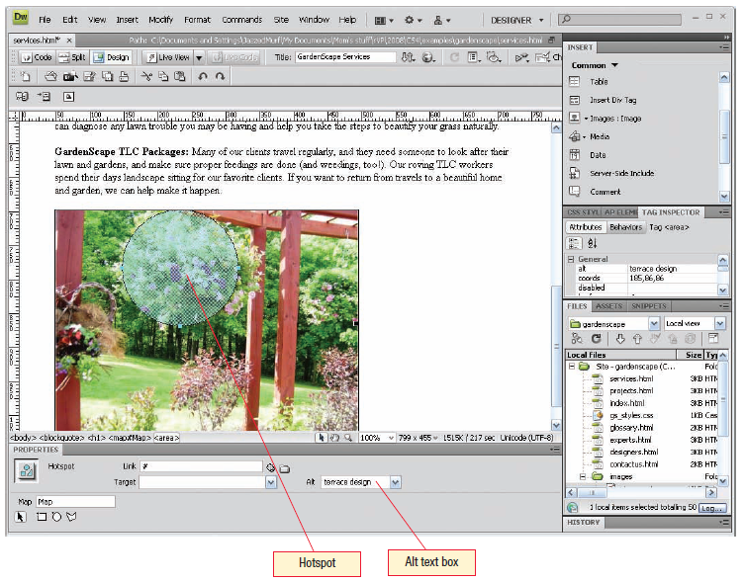
Image Maps
You can use an image to create an image map, which contains a hotspot that links the current page to another location. Image maps are creative ways to add both visual appeal and functionality to your Web site.
To create image maps, you use the hotspot tools on the expanded portion of the Property inspector to draw an area on the image.
Work with Graphic Elements and Templates : Lesson 4, Exercise 32

Slide 9
Create Image Maps
To create image maps, you use the hotspot tools on the expanded portion of the Property Inspector to draw an area on the image.
Read Pages 182 – 183 for more details

Slide 10
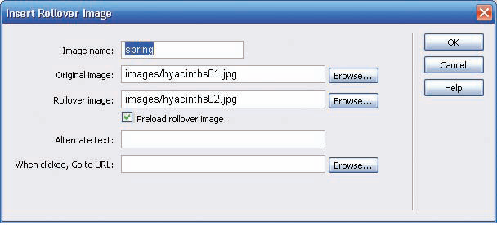
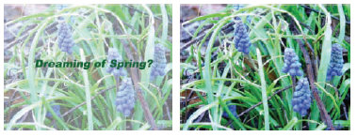
Rollover Images
A rollover image is composed of two images that are controlled by JavaScript. The original image loads with the page. When a site visitor hovers the mouse over the image, the original image is replaced by another.
Rollover images can be used in a number of ways on a Web site. Use them to show two different versions of an image or to display related images. Rollover images can also be used to create navigation buttons.
Work with Graphic Elements and Templates : Lesson 4, Exercise 32

Slide 11
Read Page 183 for the steps on how to Create a new rollover image.

Slide 12
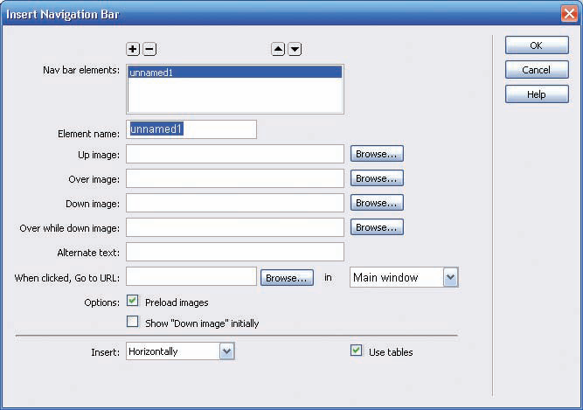
Navigation Bars
A navigation bar is a set of links to pages in a Web site. Navigation bars display text or image links horizontally or vertically in a group to make it easy for visitors to get to other pages in the site.
The links in a navigation bar are often Included inside a table structure to make it easy to position the links.
You can provide up to four images for each element in a navigation bar:
  Up —This image is the one that appears when the page opens.
  Over —This image appears when the visitor
  moves the mouse pointer over the element.
  Down —This image appears when the navigation bar element is clicked.
  Over While Down —This image appears when the visitor moves the pointer over the element after it has been clicked.
Work with Graphic Elements and Templates : Lesson 4, Exercise 32

Slide 13
Read Pages 184 – 185 for the details on Navigation Bars.
Take your time to read this before trying the exercises.
This is important for your final project.

Slide 14
Use the Assets Panel
The Assets panel is a tab in the files panel group that also includes the Files Panel.
It is divided into two panes:
  The lower pane is a list of asset files available for your site.
  The upper panel is a viewing window in which to inspect a selected asset.
Read Pages 185 – 186.

Slide 15
Assignment
Page 188
Gardenscape
Page 189
java2go

