Slide 1
Exercise 33 - Skills
Templates can help you easily maintain a uniform look and feel throughout your entire Web site
Dreamweaver provides flexible template design features.
You can control individual sections of your page without affecting the basic design.

Slide 2
Exercise 33 - Terms
Editable region – In a template, an area that an author can change in a page to which the template is applied.
Noneditable region – In a template, an area that is locked so that the designer cannot change its content.

Slide 3
Exercise 33 - Terms
Template – A collection of formats and page elements that can be used to give pages in a Web site a consistent look.

Slide 4
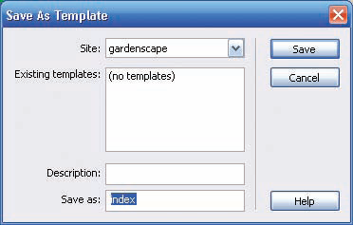
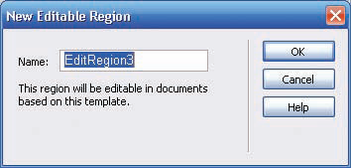
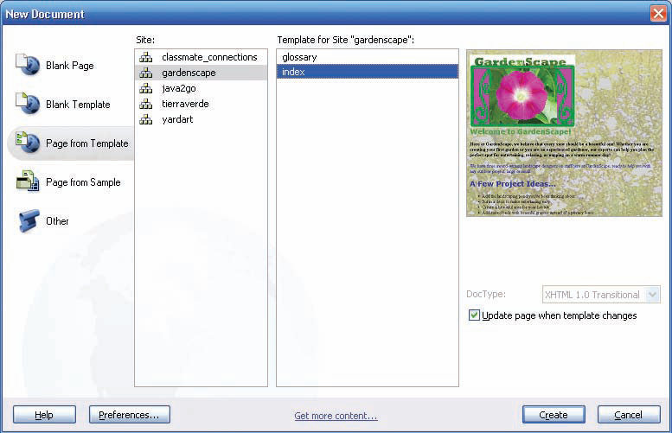
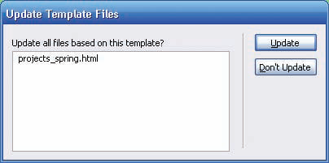
Templates
A template is a collection of formats and page elements that you can use to give pages in your Web site a consistent look.
For example, a template could include a background image or color, images, headings, and text styles and formats. Using a template can save you considerable development time.
When you create a template, you can specify non-editable and editable regions:
  Non-editable regions contain items that you want to include on each page, such as a copyright notice or a logo.
  Editable regions contain items such as text or headings that can change on a page.
Work with Graphic Elements and Templates : Lesson 4, Exercise 33
Notes:
As you create the template, you must give some thought to editable and non-editable regions. Non-editable regions are locked on any page created using the template. That is, an author will not be able to change anything in a non-editable region. This helps to protect items such as logos, official photographs, and the like from being changed without authorization, no matter who may work on your page.
All items on a template are non-editable unless you specify that they be editable.

Slide 5
About Templates
The value of creating and using templates is that you can easily adjust formats over an entire Web site.
When you modify a template, you can update all pages at once that use that template.

Slide 6
Create a New Template
You can create a template from a new, blank page or from an existing page that contains text and other page elements.
As you create the template, you must give some thought to editable and noneditable regions.

Slide 7
As you create the template, you must give some thought to editable and Noneditable regions.

Slide 8
The editable region name displays on the template page surrounded by a light blue box that has a tab containing the editable name.
In pages based on templates, the entire page is bordered in yellow with the template name in the upper-right corner.

Slide 9
Reading Assignment
Take the time to read and reread pages 190 – 194 on templates.
These can be very helpful when you create your Web site to have the consistent look that MAKES YOUR SITE LOOK GOOD.

Slide 10
Assignment
Pages 195 – 196
Gardenscape
Page 197
yardart

