Slide 1
Exercise 34 - Skills
The Assets panel’s library feature enables you to insert and change elements automatically on multiple pages in your site.
You can use the Design Notes feature to track your project.

Slide 2
Exercise 34 - Skills
Saving time really is a design skill, because the time you save by using the library to add and modify items automatically gives you more time to create new pages.

Slide 3
Exercise 34 - Skills
Design Notes help you keep track of design decisions you’ve made so that other designers or authors who work on your site will be able to be consistent with your style.

Slide 4
Exercise 34 - TERMs
Key – In the Design notes feature, an identifier for a set of information, such as status.
Library – A Dreamweaver feature that stores text, images, or other objects so that you can add them easily on any page in the Web site.
Library items – Objects and page elements stored in the Library.

Slide 5
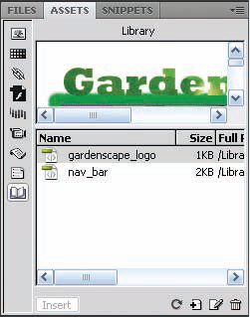
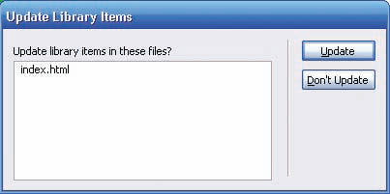
Working with the Library
The Library feature in the Assets panel is a wonderful tool that saves you time and enables you to use the same elements repeatedly—while still being able to update and change them in every Web page that uses the element in a Web site. This tremendously reduces creation time, especially when you are working with a team that has a variety of skills.
When you place a library item on a page, Dreamweaver inserts a copy of the HTML source code for that item into the document and adds an HTML comment containing a reference to the original, external item—a link from the page item to the library item.
You can modify that library item wherever it appears in the Web site by modifying the item in the Library. In this way, a library item differs from an item inserted from the other Assets panels.
Work with Graphic Elements and Templates : Lesson 4, Exercise 34

Slide 6
Using the library
You can store images, text, or other elements in the Library, and then use these library items on any page in a Web site.

Slide 7
Add items to the library
To view the library, click the library button in the Assets panel toolbar.
Library items display in the upper pane of the palette. Click the Library item's name in the lower pane to display it in the upper pane.
You can use the scroll bars if necessary to display the entire item.

Slide 8
Dreamweaver automatically creates a Library subfolder in the site’s root folder to contain the library items.
You can create library items from existing text or images by selecting the object in the document and clicking Modify>Library>Add Object to Library.

Slide 9
Read page 199
For more information on Adding items to the library.
Inserting Library Item on Page
Modify Library Item and Update Pages.

Slide 10
Use deign notes
Design Notes work much like comments in Word, but you have much more control over who sees your notes.
This is especially helpful when designing your site with sensitive data that must be shared only with your team members.

Slide 11
Add design notes to a page using the File>Design Notes command.
On the Design Notes dialog box's Basic info tab, you can specify the page's status, insert the current date, and add comments.
Read page 200 for more information on Use Design Notes and Viewing Design Notes

Slide 12
assignment
Pages 202 – 205
Gardenscape
Page 205
YardArt

