Slide 1
The Renaissance and Reformation
1.1 – The renaissance in Italy

Slide 2
What was the Renaissance?
A time of change, creativity, & return to Greek & Roman values (theme = cultural interaction)
Renaissance means “rebirth”
Occurs between 1300-1600
Begins slow process of moving from agriculture to urban society (themes = economics, interaction with environment)
New technologies help people better understand the world (theme = science & technology)

Slide 3
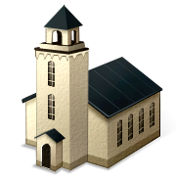

Pre-Renaissance View
What is your ultimate goal in life?
To get to heaven
How do you get there?
Do exactly as the Church says (theme = religious & ethical systems)

Slide 4
Renaissance View
Human experience & achievement = important (theme = religious & ethical systems)
It’s OK to enjoy life while on Earth
Bubonic Plague brings wealth
Humanism – intellectual movement of the Renaissance
Studied Humanities – same subjects as in Greece & Rome
Poetry
Language
Philosophy

Slide 5
Italy = Birthplace of the Renaissance
Renaissance begins in Italy
Close to Rome & Greece
Mediterranean Sea encourages trade
Trade encourages exchange of ideas
Italy divided into city-states

Slide 6
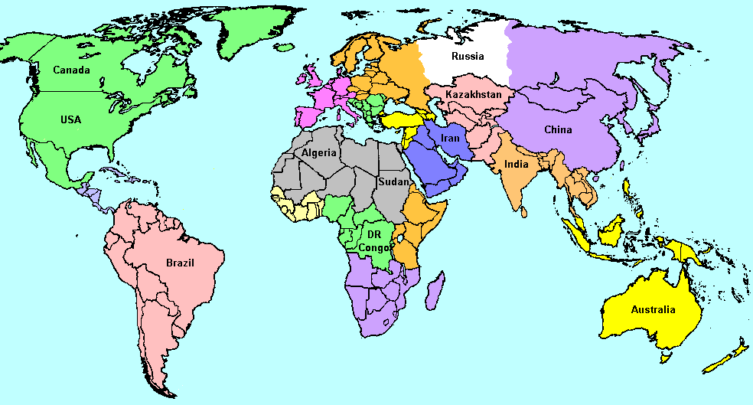

Slide 7
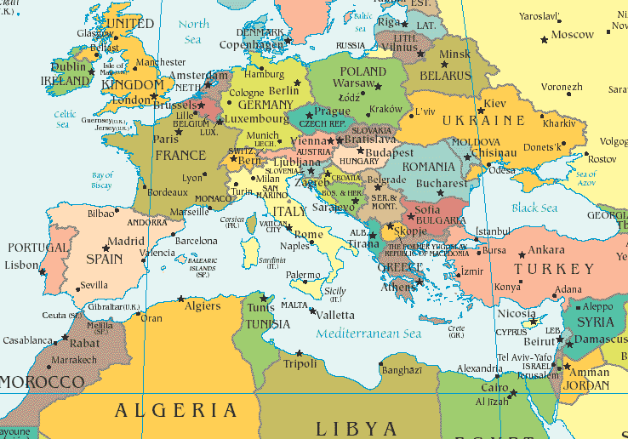

Slide 8
ITALY
City-States
Location
Close to Rome & Greece
Trade
Individual achievement
Goods
Ideas

Slide 9
City-States
Smaller areas inside Italy controlled by wealthy merchant families
Many families = patrons of the arts
Patron = financial supporter
The Medici family controls Florence
Medici family = uses banking and works behind the scenes (theme = economics)

Slide 10
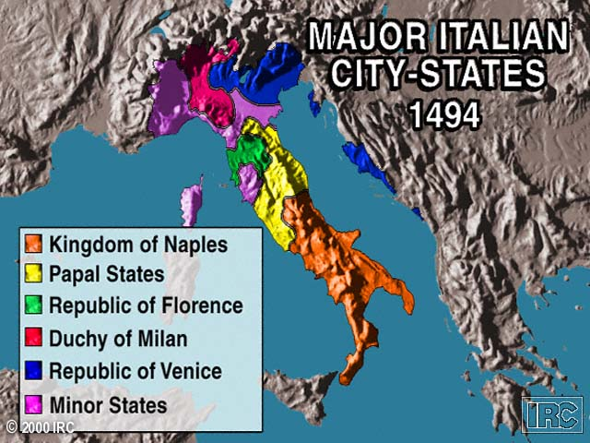

Slide 11
Renaissance Culture
New art techniques:
Portraits – highlights individuals
Greek & Roman themes – return to values
Perspective – use of size to present 3-D viewpoint

Slide 12
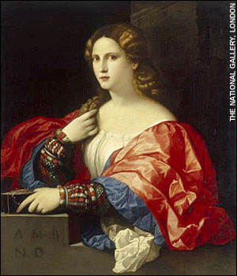
Portrait of a Woman c. 1525 C.E.
Palma Vecchio
Looks natural
Individual focus
Very detailed
http://www.flickr.com/photos/byray/2598179026/

Slide 13
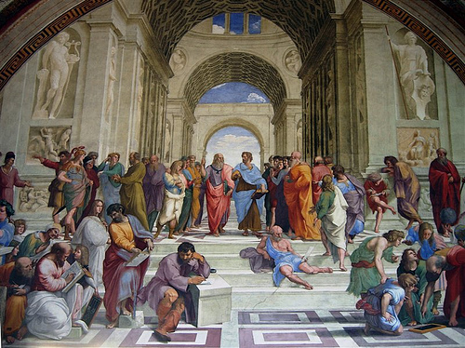
School of Athens
Raphael
c. 1510-1511 C.E.
Greek themes
Perspective
Realistic
http://www.flickr.com/photos/xiquinho/3482933474/

Slide 14
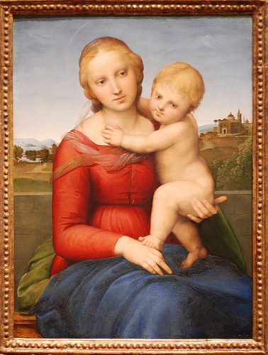
Small Cowper Madonna
Raphael c. 1505 C.E.
Individual
Religious theme (notice halo)
Perspective
Realistic
http://www.flickr.com/photos/byray/2598179026/

Slide 15
Renaissance Culture
Renaissance Man:
Well rounded
Knows about many subjects (politics, art, science, etc)
Athletic
Educated
Renaissance Woman:
Beautiful
Reserved
Her role is to inspire art, not create it

Slide 16
Renaissance Writers
Vernacular = native, common language
Authors used vernacular instead of Latin
What impact does this have?
More people can read the language – individuals gain power
Focuses on self-expression or individual viewpoints

Slide 17
Machiavelli & The Prince
Niccolo Machiavelli writes a famous book called The Prince
The Prince is a guidebook for rulers
Goal is to keep power
People are corrupt & selfish so a ruler must be more corrupt and selfish
Ruler might have to trick his own people for the good of the state

Slide 18

Machiavelli & The Prince
The ends justify the means
It’s good to get your subjects to like you
However, when forced to make a choice:
IT IS BETTER TO BE FEARED THAN LOVED
Niccolo Machiavelli
http://lagadin.files.wordpress.com/2007/12/machiavelli1.jpg

