Slide 1
1.2
The Northern Renaissance

Slide 2
Northern Renaissance
Cities rebuild as plague ends (1450s)
France and England have strong monarchs who are patrons of the Arts
Realism a key topic in paintings
  Flanders center of northern Renaissance art

Slide 3
Gutenberg’s Printing Press
Considered to be the greatest invention of millennium
Uses Chinese invention of movable block type
Old process too slow to satisfy thirst for knowledge

Slide 4
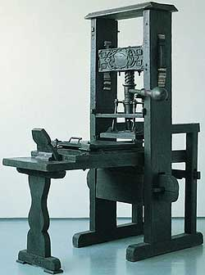
Gutenberg’s Printing Press
Johannes Gutenberg perfects process
Cuts production time of books from 1 book in 5 months to 500 books in 5 months
Animation of printing press
http://iml.jou.ufl.edu/projects/Fall04/Phillips/press.jpg

Slide 5
Authors reform society
Humanists criticize church
Focus of humanists = education
  Promote education of women and girls
Famous Humanists
  Erasmus – made fun of greedy scholars and arrogant priests
  Thomas More – writes Utopia
    Utopia = perfect society

Slide 6
Shakespeare
Shakespeare considered by many to be best playwright ever
Plays show understanding of human feelings
Romeo and Juliet, Macbeth, Hamlet, Othello

