Slide 1
Chapter 2.1
The Search for Spices

Slide 2
Quote Analysis
What do you think is the message of this quote from an Indonesian leader to a European trader?
“You may be able to take our plants, but you will never be able to take our rain.”

Slide 3
Motivations for Exploring
Europe discovered many luxury items during crusades (cultural blending)
Moluccas = island chain that provided most spices
Spices = most valued item
Preserved food
Adds flavor
Medicinal uses
Perfumes

Slide 4
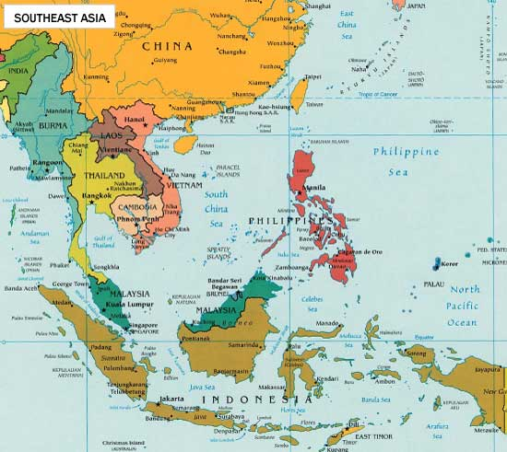
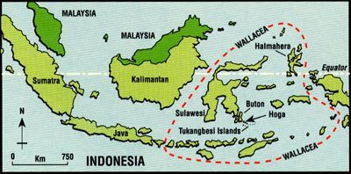
Map of Southeast Asia
Map of Indonesia & Molucca Islands

Slide 5
Motivations for Exploring
Arab and Italians dominate trade between Asian & Europe (economics, power & authority)
Other European countries want to gain direct access to Asia (economics, power & authority)

Slide 6
Portugal Takes the Lead
Prince Henry leads the way (science & technology)
Classes on navigation, cartography, shipbuilding, science of the seas
Bartholomeu Dias sails around southern tip of Africa
Vasco da Gama = 1st to explore eastern Africa and sail to India

Slide 7
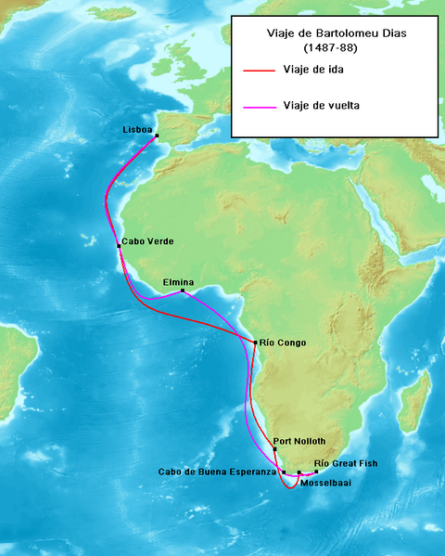
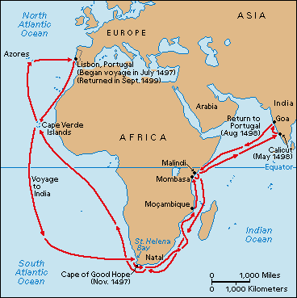
Route of Bartolomeu Dias
Route of Vasco da Gama

Slide 8
Treaty of Tordesillas
Columbus sails west & reaches Caribbean
People thought he reached India (including the Portuguese)
What is the impact of this?
Because Portugal already reached India, it was worried that Spain would take those lands
(power & authority, economics, empire building)

Slide 9
Treaty of Tordesillas
Tensions between Spain and Portugal increase
Pope Alexander VI offers solution
Draw a dividing line – called “Line of Demarcation”
East of the line is for Portugal
West of the line is for Spain
WHAT IS THE IMPACT OF THIS?
Spain gains land in all the Americas and has larger historical impact

Slide 10
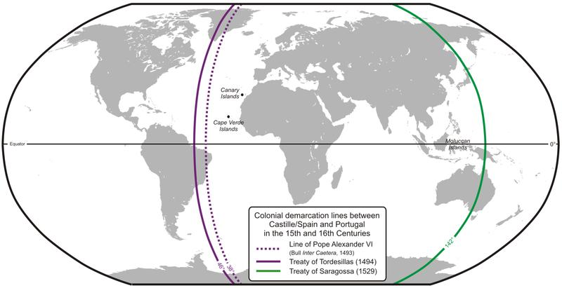
Line of Demarcation

Slide 11
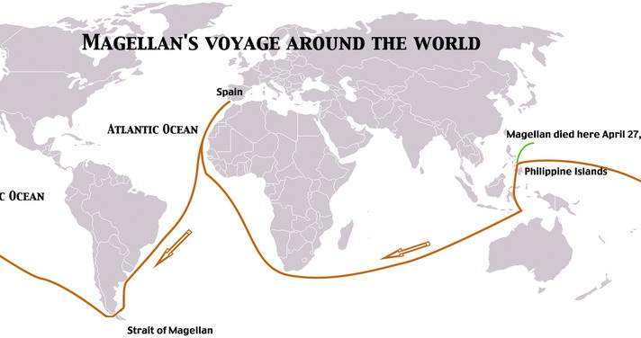
Portugal Takes the Lead
Portugal gains early successes from Treaty of Tordesillas
Breaks Muslim-Italian hold on trade in Asia
Magellan circumnavigates the earth

