Slide 1
2.2
Turbulent Centuries in Africa

Slide 2
Portugal’s Foothold
Portugal begins building forts along West African coasts to provide supplies & repair ships
Not true colonies – only enough men to run posts
Attacked international cities on East African coast to control important trade cities

Slide 3
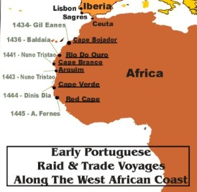

Slide 4
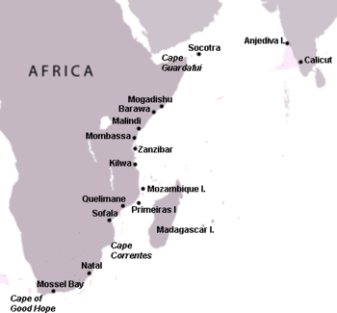

Slide 5
The Slave Trade
Slaves had been used through out history
Europeans seen slaves & most profitable & important product to trade
Slaves sold to work on plantations
European traders stayed on coast – relied on African tribes to provide slaves & bring to trading forts
Some African leaders tried to resist, but were unsuccessful

Slide 6
New African States
State = areas with independent governments
Slave trade = population decrease = some stated disappear
Slave trade = economic gains = new states created
Asante Kingdom = powerful kingdom in west Africa
Osei Tutu unifies neighboring tribes & leads Asante Kingdom
Kept power by claiming his power came from heaven
Tutu has monopoly on gold & slave trade
Uses rival European countries for protection

Slide 7
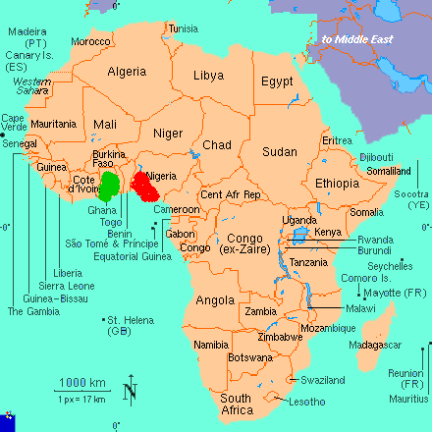
Asante Kingdom

Slide 8
European Expansion
The Dutch establish the 1st permanent settlement in Cape Town, South Africa
The Boers (Dutch farmers) didn’t respect locals
Boers = Calvinist = believed they were chosen
The French settle in Senegal
The British search for source of the Nile River

Slide 9
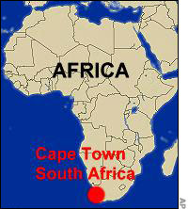

Slide 10
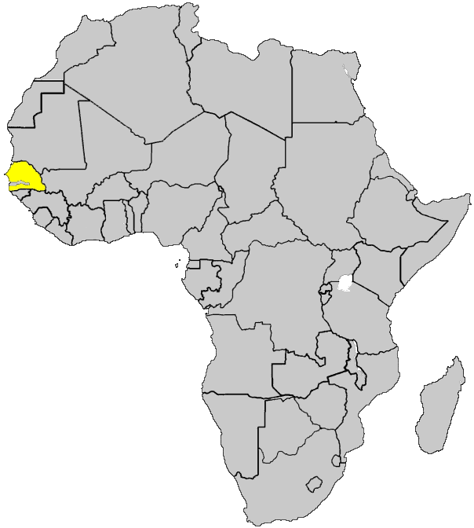
Senegal

Slide 11
