Slide 1
2.3
European influences in South & Southeast Asia

Slide 2
Portugal’s early control
Portugal gains early control because of Treaty of Tordesillas
Fight the Mughal Empire in India
Portugal establishes outposts to control trade
Portugal not very effective
  Too much resistance from Asians
  Not successful in converting Muslims and Hindus to Christianity

Slide 3
Dutch gain power
Dutch expand their influence
  Settlement at Cape Town = strategic
Dutch East India Company
  Sovereign powers
  Has own military, currency, ability to make war, can negotiate treaties
Dutch advantage over Portugal = establish close ties with local rulers
Control Indonesia from 1603-1949

Slide 4
Spanish control
Spain controls Philippines in 1521
  Names after King Philip II
Very successful in converting Filipinos to Catholicism
Important connection from Spanish colonies in America to Asia

Slide 5
Mughal Empire
Mughal Empire = larger, richer, & more powerful than any European empire
Its goods were highly sought after by Europeans
Allow European countries to build forts & warehouses
Downfall of the empire leads to fighting between countries
England emerges and controls India

Slide 6
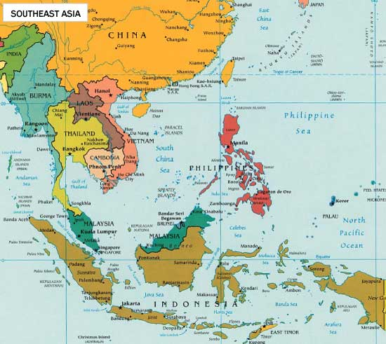

Slide 7
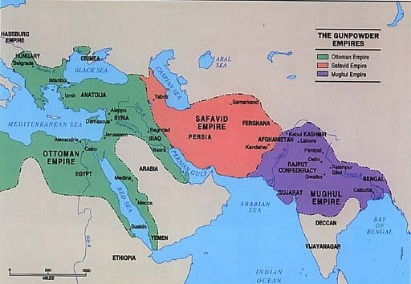
Muslim Empires

