Slide 1
Chapter 3.2
Spanish & Portuguese Colonies in the Americas

Slide 2
Ruling the Spanish Empire
Council of Indies created to pass laws in colonies
Spain’s king appoints viceroys to rule provinces
Winning the souls of natives just as important as gaining land (conversion to Christianity)
Spanish clothing, language, jobs forced on Native Indians
Colonies could only buy and sell to Spain
Church emhpasizes education & builds universities

Slide 3
Social Classes in the colonies
Peninsulares = born in Spain & moved to Americas
Creoles = born in the Americas; both parents were Spanish
Mestizo = born in the Americas; Spanish father & native mother
Mulattoes = born in Americas; Spanish father & African mother
African slaves
Native Indians

Slide 4
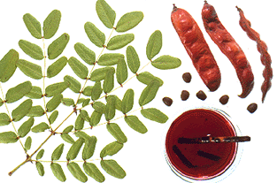
Brazil
Portugal grants land to nobles willing to develop it
No gold or silver
Biggest money maker = brazilwood (used to make red dye)

Slide 5
Challenging Portugal and Spain
Other European countries = jealous of Span & Portugal’s power
Other European countries illegally trade with Spanish and Portuguese colonies
Pirates attack Spanish treasure ships
privateers = pirates with authority to operate by European governments

