Slide 1
Site and Situation by Eleanor Joyce City of Salem Schools.
The student will analyze the patterns of urban development by
applying the concepts of site and situation to major cities in each region.

Slide 2
What is meant by site?
Site is the actual location of a city.

Slide 3
What is meant by situation?
Situation is another name for relative location—the location of a city with respect to other geographic features, regions, resources, and transport routes.

Slide 4
Examples of Site
Harbor sites: the site of a natural harbor
New York City
Alexandria, Egypt
Istanbul, Turkey
Island sites: the site of islands in strategic locations
Paris (originally located on an island in the Seine River)
Hong Kong
Singapore
Fall line sites: sites where a river meets a waterfall
Richmond, Virginia

Slide 5
Examples of Site
Confluence sites: cities located where rivers meet
Khartoum, Sudan
Pittsburgh, Pennsylvania
Hilltop sites: cities located on hilltops
Rome, Athens, Jerusalem

Slide 6
Examples of Site
Oasis sites: cities that developed in the desert where caravans stopped for water.
Damascus, Syria
Sites where rivers narrow
London, England
Quebec City, Quebec

Slide 7
Examples of Situation
Command of land between the Tigris and Euphrates rivers
Baghdad, Iraq
Command of straits and land bridge to Europe
Istanbul, Turkey
Focal point of religious pilgrimage
Mecca, Saudi Arabia;
Varanasi (Benares), India—
Cities that grew up along trade routes
Samarkand, Uzbekistan and Xi’an, China (the Silk Road)
Timbuktu, Mali (Trans-Sahara trade)
Singapore— (maritime trade)

Slide 8
Examples of Situation
Supply station for ships
Capetown, South Africa
Cities that grew up along the U.S. Transcontinental Railroad
Omaha, Nebraska
Sacramento, California
Cities that grew up along the Trans-Siberian Railroad
Novosibirsk, Russia
Vladivostok, Russia

Slide 9
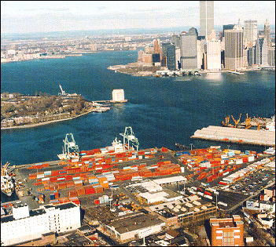
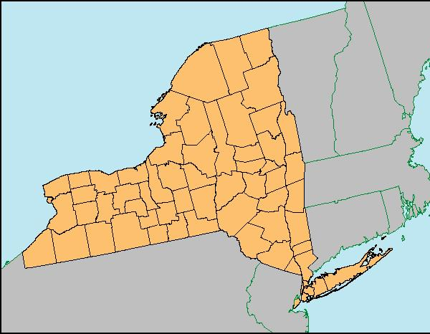
New York City became a major city because it is located on a natural harbor.

Slide 10
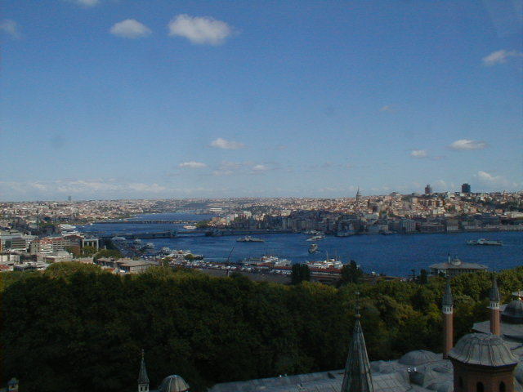
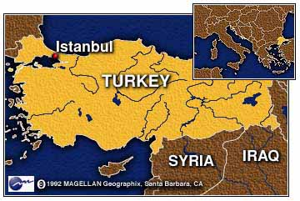
Istanbul, Turkey became a major city because it is located on a natural harbor.

Slide 11
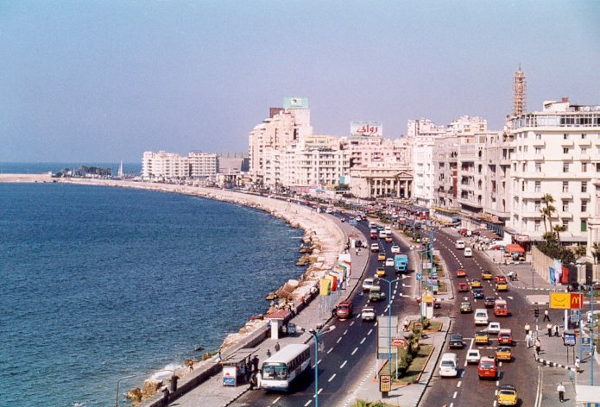
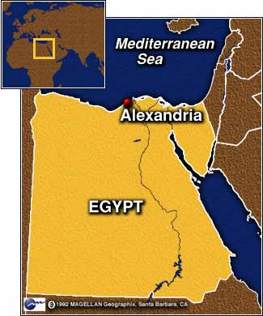
Alexandria, Egypt became a major city because it is located on a natural harbor.

Slide 12
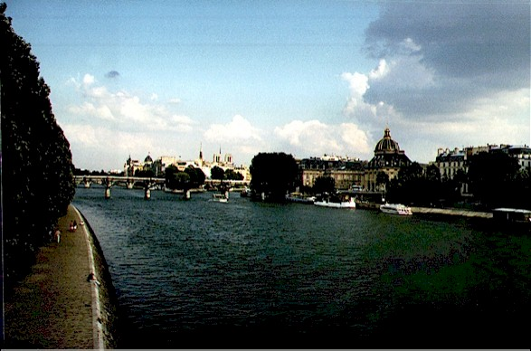
Paris, France became a major city because it is located on an Island in the Seine River.

Slide 13
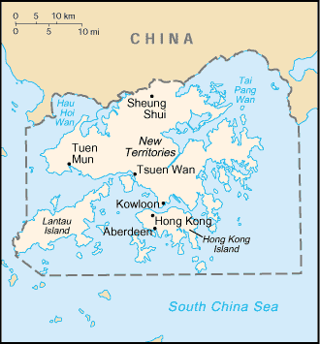
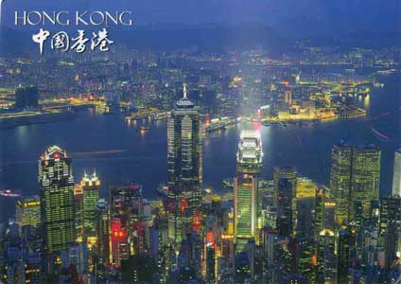
Hong Kong, China became a major city because it is located on an Island

Slide 14
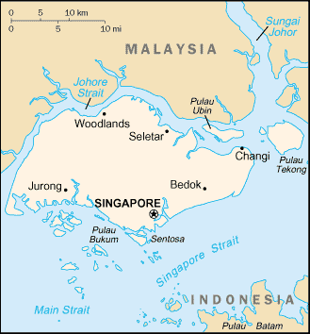
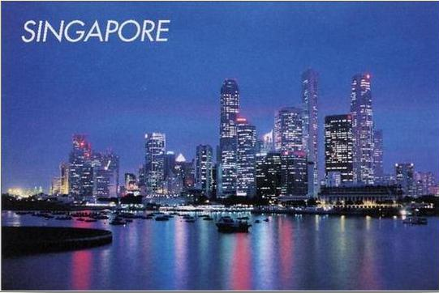
Singapore became a major city because it is located on an Island.

Slide 15
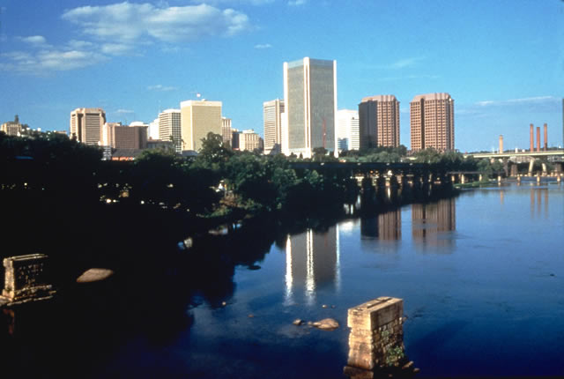
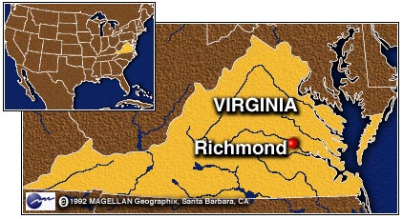
Richmond, VA became a major city because it is located on the fall line of the James River.

Slide 16
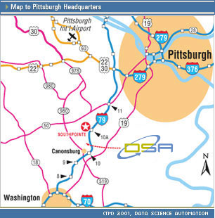
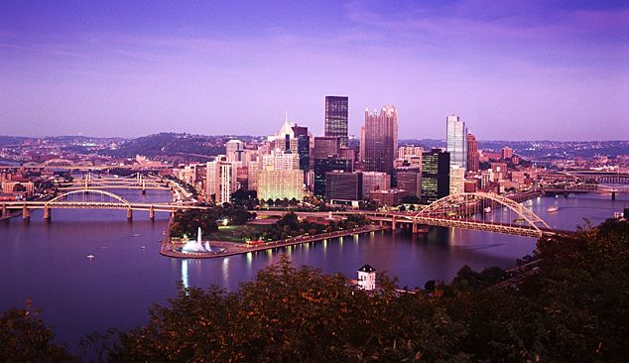
Pittsburgh, Pennsylvania became a major city because it is located at the site where three rivers converge (confluence or the Ohio River, the Allegheny River and the Monongahela River).

Slide 17
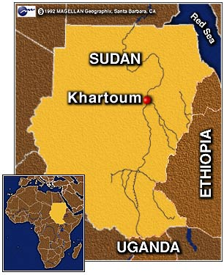
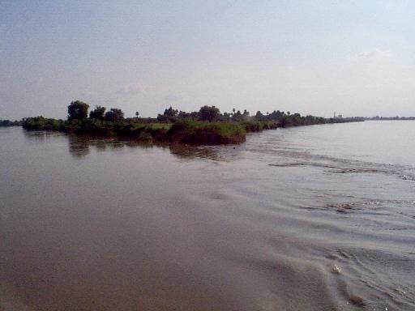
Khartoum, Sudan became a major city because it is located at the site where three rivers converge (confluence or the White Nile and the Nile Rivers).

Slide 18
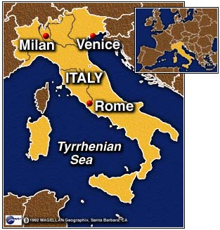
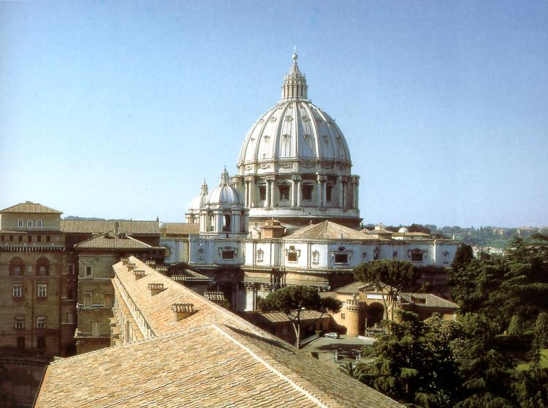
Rome, Italy became a major city because it is located at on a hill overlooking the city.

Slide 19
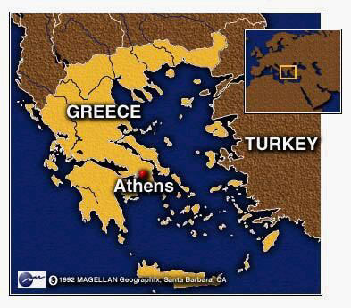
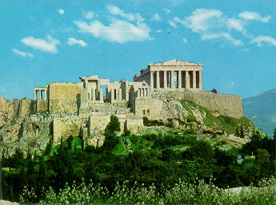
Athens, Greece became a major city because it is located at on a hill overlooking the city.

Slide 20
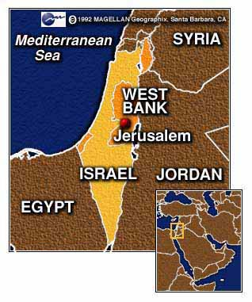
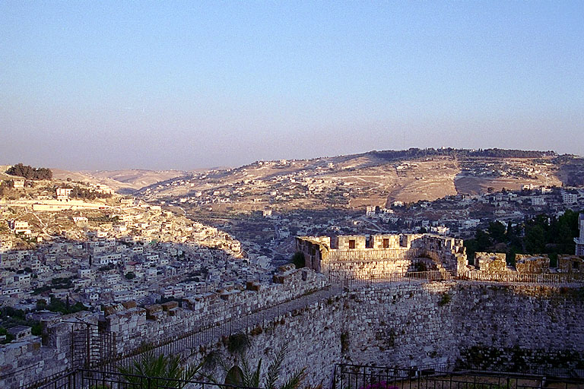
Jerusalem, Israel became a major city because it is located at on a hill overlooking the city.

Slide 21
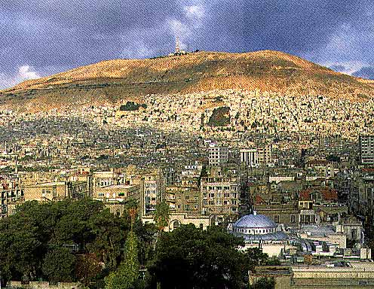
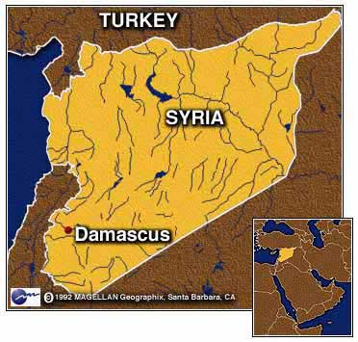
Damascus, Syria became a major city because it is located at the site of an oasis.

Slide 22
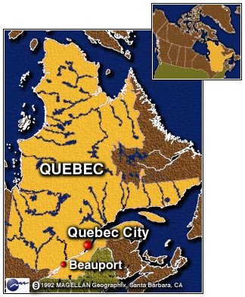
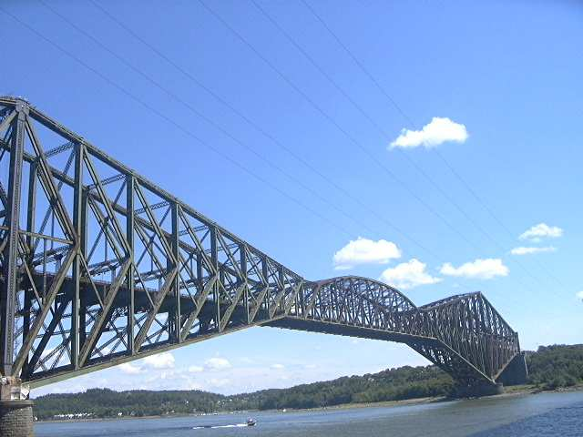
Quebec City, Quebec became a major city because it is located at the site where the St. Lawrence River narrows.

Slide 23
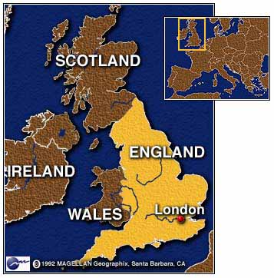
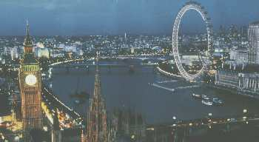
London, England became a major city because it is located at the site where the Thames River narrows.

Slide 24
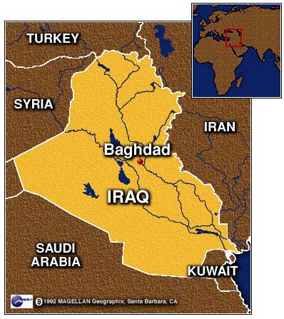
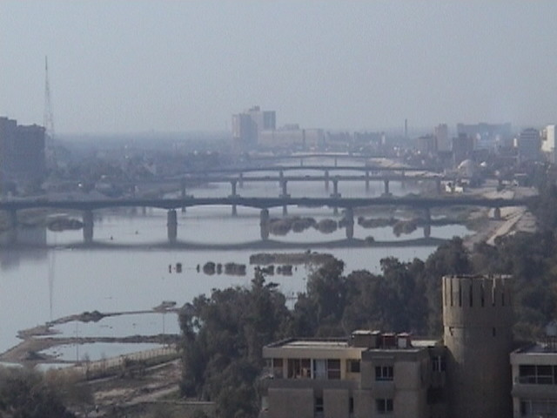
Baghdad, Iraq became a major city because it commands the land between the Tigris and Euphrates rivers

Slide 25
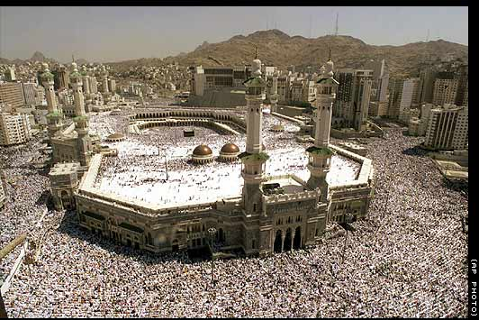
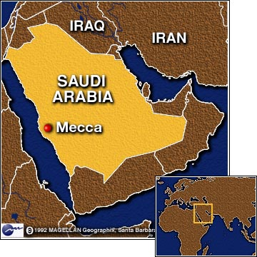
City of religious pilgrimage
Mecca, Saudi Arabia—Muslims-Hajj
Muslims on a Hajj to Mecca

Slide 26
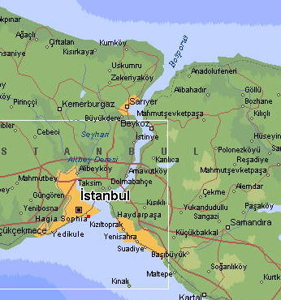
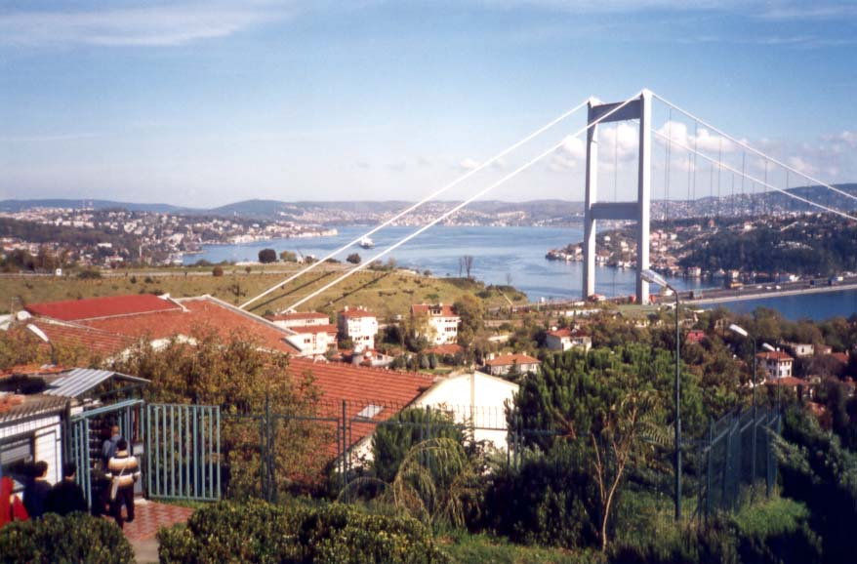
Istanbul, Turkey commands the straits and land bridge between Asia and Europe

Slide 27
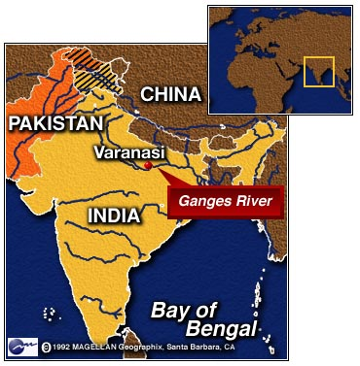
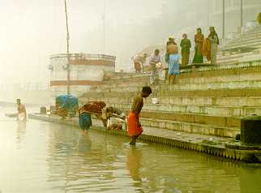
City of religious pilgrimage
Varanasi (Benares), India --Hindu
Hindus bathing in the Ganges River

Slide 28
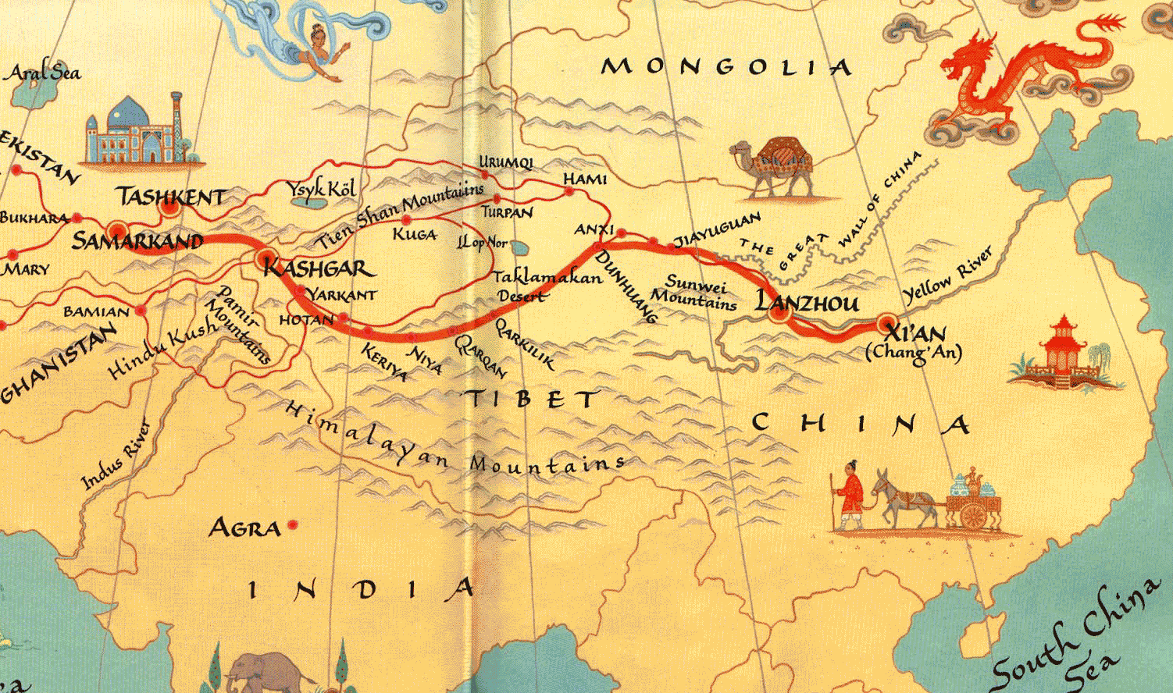
Samarkand, Uzbekistan and Xi’an, China developed along the Silk Road, an ancient trade route across Asia

Slide 29
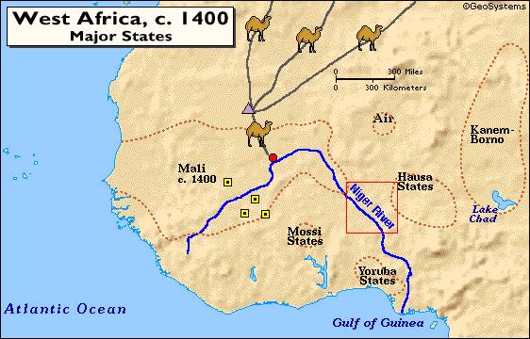

Timbuktu, Mali developed along the trans Sahara trade route where salt was traded for gold.
Timbuktu

Slide 30
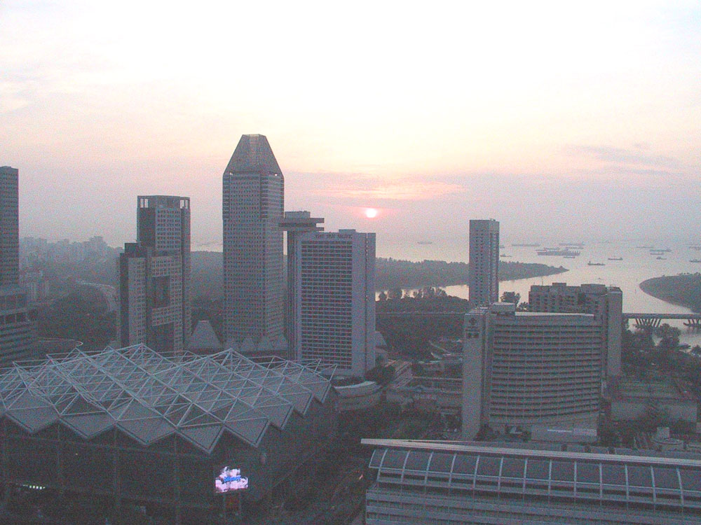
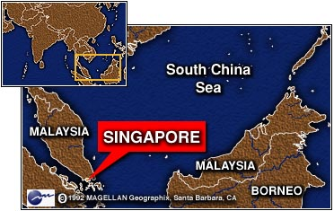
Singapore is the site of maritime (sea) trade because of it’s location on the tip of the Malay peninsula.

Slide 31
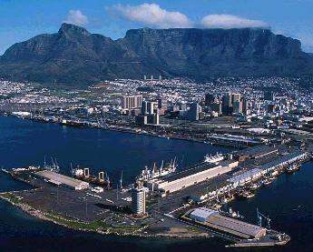
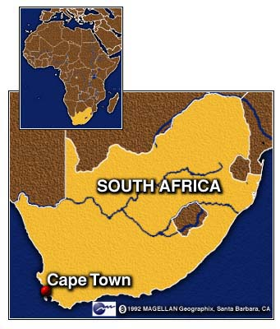
Capetown, South Africa grew up on the southern tip of Africa because it supplied ships when they traveled from Europe to Asia

Slide 32
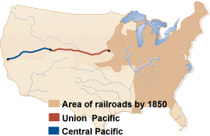
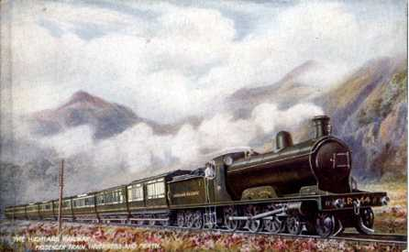
Omaha, Nebraska and Sacramento, California developed on the Transcontinental railroad in the USA
Omaha, Nebraska
Sacramento, California

Slide 33
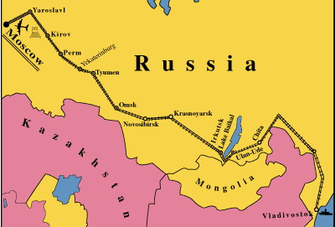
Novosibirsk, Russia and Vladivostok, Russia grew up along the Trans-Siberian Railroad

