Slide 2
Key Issues
Where did agriculture originate?
Why do people consume different foods?
Where is agriculture distributed?
Why do farmers face economic difficulties?

Slide 3
Where Did Agriculture Originate?
Invention of Agriculture
Prior to the advent of agriculture, all humans probably obtained needed food through hunting and gathering.
Origins of agriculture cannot be documented with certainty, because it began before recorded history.
Agriculture is deliberate modification of Earth’s surface through cultivation of plants and rearing of animals to obtain sustenance or economic gain.

Slide 4
Where Did Agriculture Originate?
Agricultural Revolution
The time when humans first domesticated plants and animals and no longer relied entirely on hunting and gathering was known as the agricultural revolution.
Agriculture originated in multiple hearths around the world:
Crop Hearths:
Southwest Asia:
Early crops: barley, wheat, lentil, and olive.
East Asia:
Early crops: Rice and millet.

Slide 5
Where Did Agriculture Originate?
Crop Hearths Cont’d:
Sub-Saharan Africa:
Early crops: Sorghum, yams, millet, and rice.
Latin America:
Early crops: Beans, cotton, potato, and most importantly maize (corn).

Slide 6
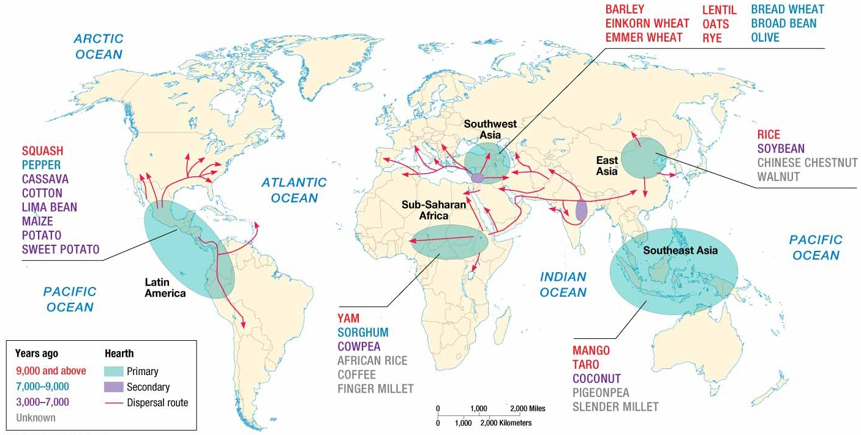
Notes:
FIGURE 10-3 CROP HEARTHS Agriculture originated in multiple hearths. Domestication of some crops can be dated back more than 10,000 years.

Slide 7
Where Did Agriculture Originate?
Agricultural Revolution
Agriculture originated in multiple hearths around the world cont’d:
Animal Hearths:
Southwest Asia:
Early domesticated animals: Cattle, goats, pigs, sheep, and dogs.
Central Asia:
Early domesticated animals: Horses
Notes:
Southwest Asia - May have been first to integrate cultivation of crops with domestication of herd animals by using them to prepare the land, and, in turn, were fed part of the harvested crop.

Slide 8
Where Did Agriculture Originate?
Comparing Subsistence and Commercial Agriculture
Subsistence agriculture is the production of food primarily for consumption by the farmer’s family.
Practiced primarily in developing countries
Commercial agriculture is the production of food primarily for sale off the farm.
Practiced primarily in developed countries.
Features that distinguish itself from subsistence agriculture include: lower percentage of farmers in labor force, highly mechanized, and larger farm size.
Notes:
Percentage of farmers in the labor force:
Developed countries: 5%
Developing countries: 44%
Use of Machinery:
Small number of commercial farmers can work relatively more land because of farming equipment.
Farm size:
Avg. Commercial: 418 acres in the U.S.
Avg. Subsistence: 2.5 acres in China

Slide 9
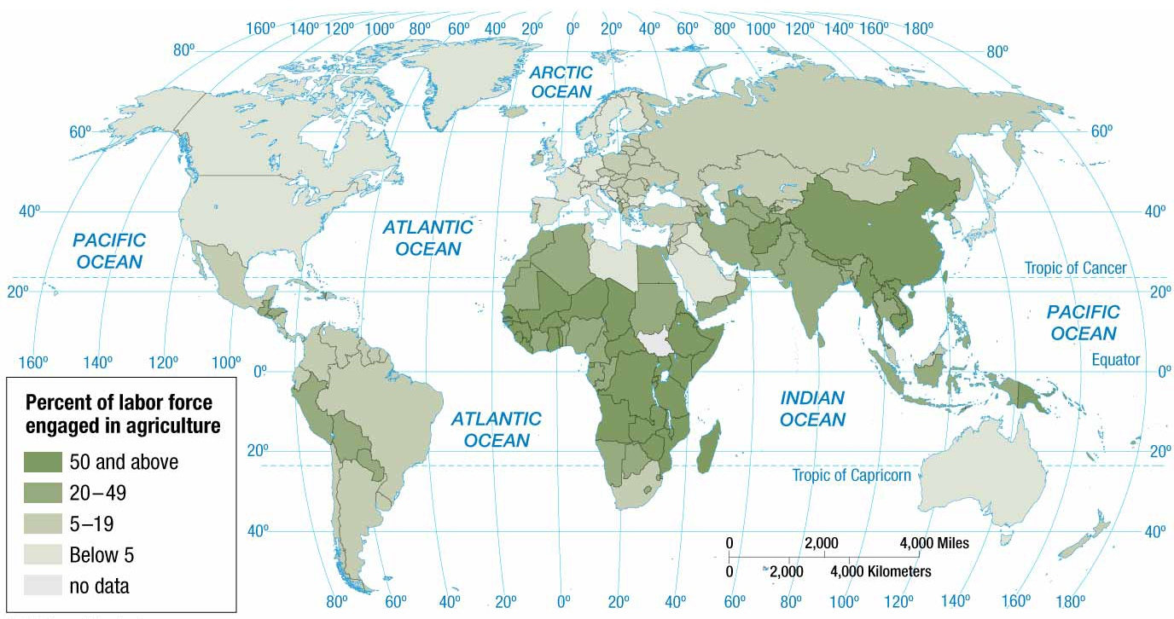
Notes:
FIGURE 10-6 AGRICULTURAL WORKERS The percentage of the workforce engaged in agriculture is higher in developing countries than in developed countries.

Slide 10
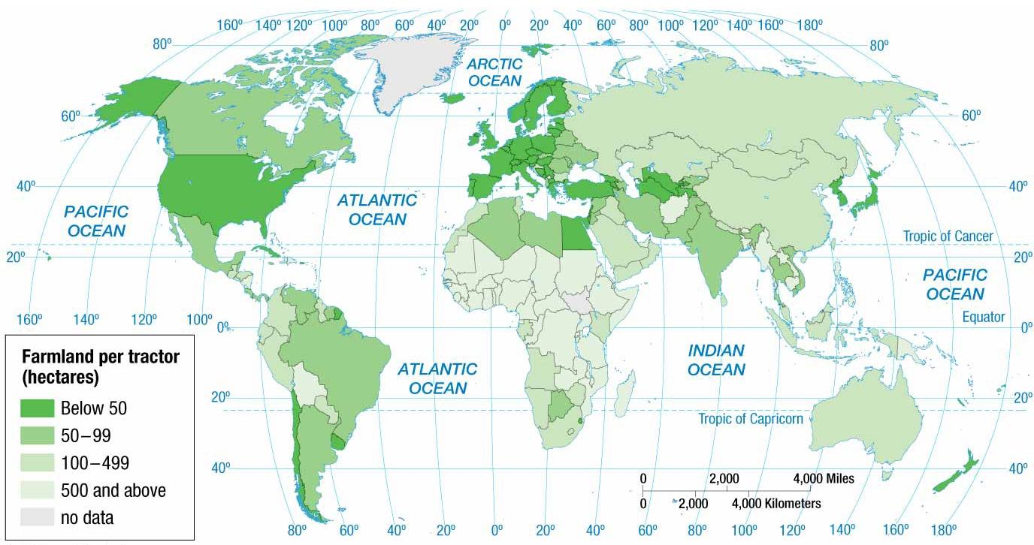
Notes:
FIGURE 10-7 AREA OF FARMLAND PERTRACTOR Farmers in developing countries have more hectares or acres of land per tractor than do farmers in developed countries. The machinery makes it possible for commercial farmers to farm extensive areas, a practice necessary to pay for the expensive machinery.

Slide 11
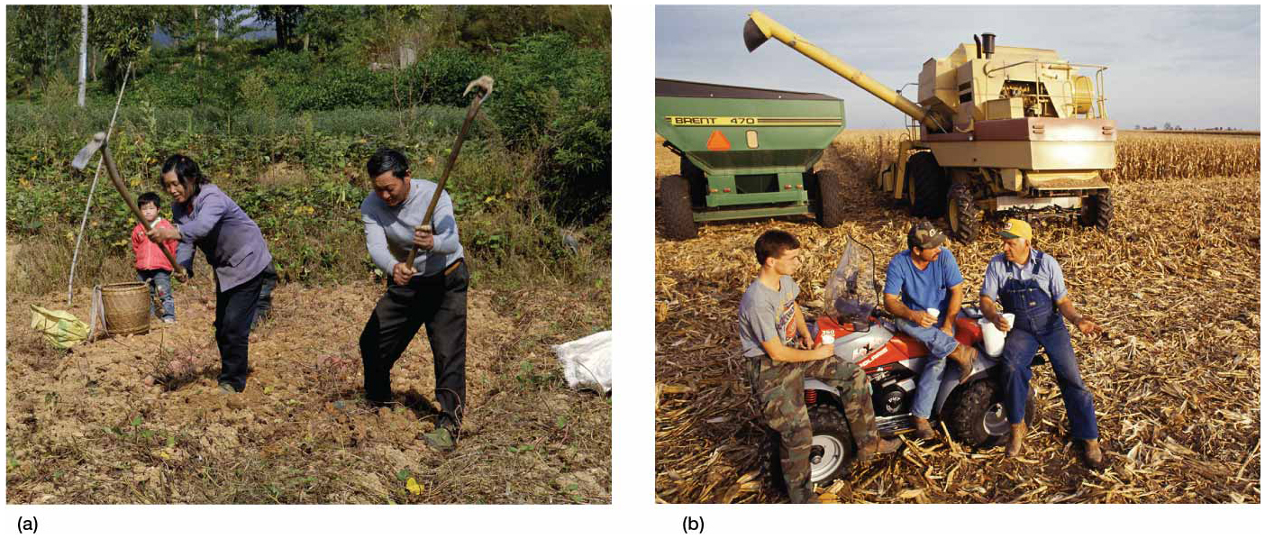
Notes:
FIGURE 10-8 FARM SIZE The average size of a family farm in China is much smaller than in the United States. (left) Family farm in Anhui Province, China. (right) Family farm in West Brooklyn, Illinois.

Slide 12
Why Do People Consume Different Foods?
Diet
Dietary energy consumption is the amount of food that an individual consumes.
Consumption of food varies around the world, both in total amount and source of nutrients, for two reasons.
Level of development
Physical conditions

Slide 13
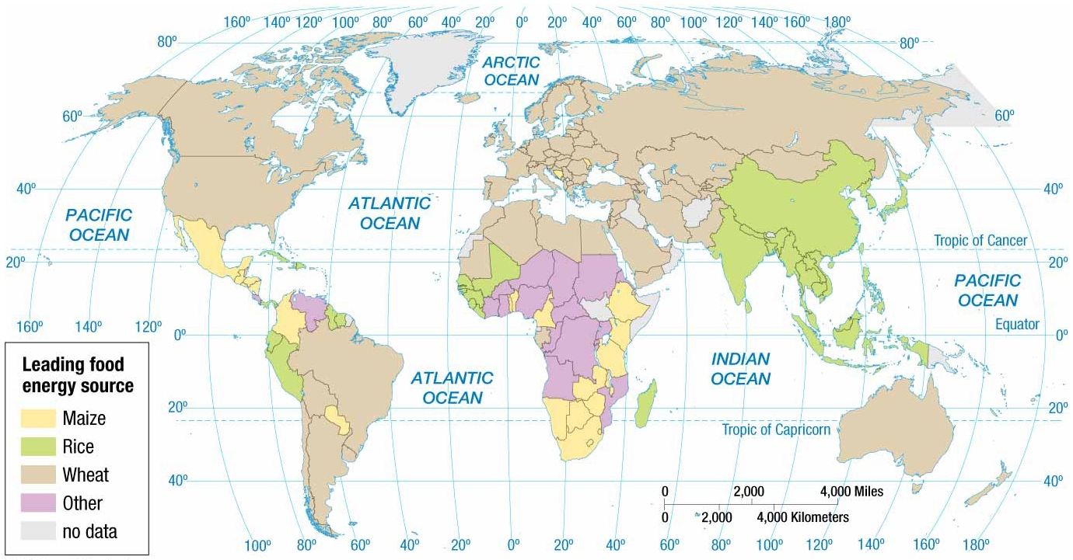
Notes:
FIGURE 10-9 DIETARY ENERGY BY SOURCE Wheat, rice, and maize are the three main sources of kilocalories.

Slide 14
Why Do People Consume Different Foods?
Source of Nutrients
Developed and developing regions typically differ most in their primary sources of protein consumed.
Developed Countries
Leading source of protein is meat products.
Beef
Pork
Poultry
Developing Countries
Leading source of protein is cereal grains.

Slide 15
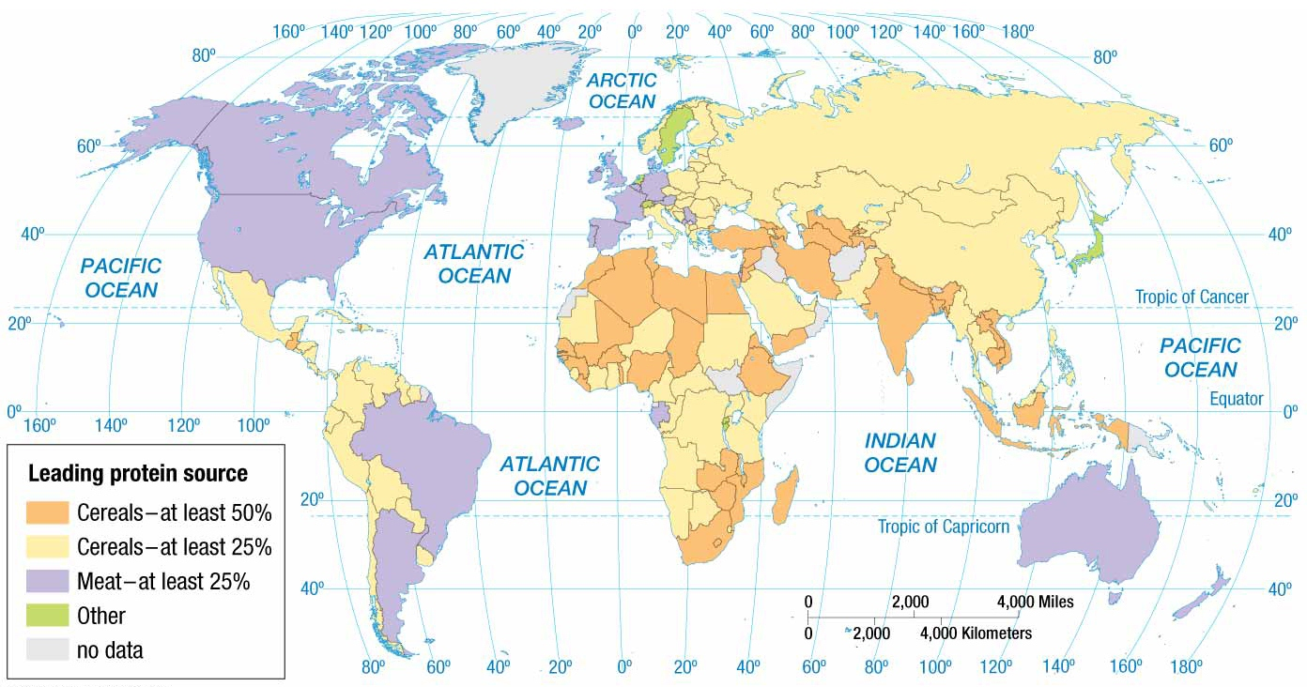
Notes:
FIGURE 10-11 PROTEIN BY SOURCE People get most of their protein from meat in developed countries and from cereals in developing countries.

Slide 16
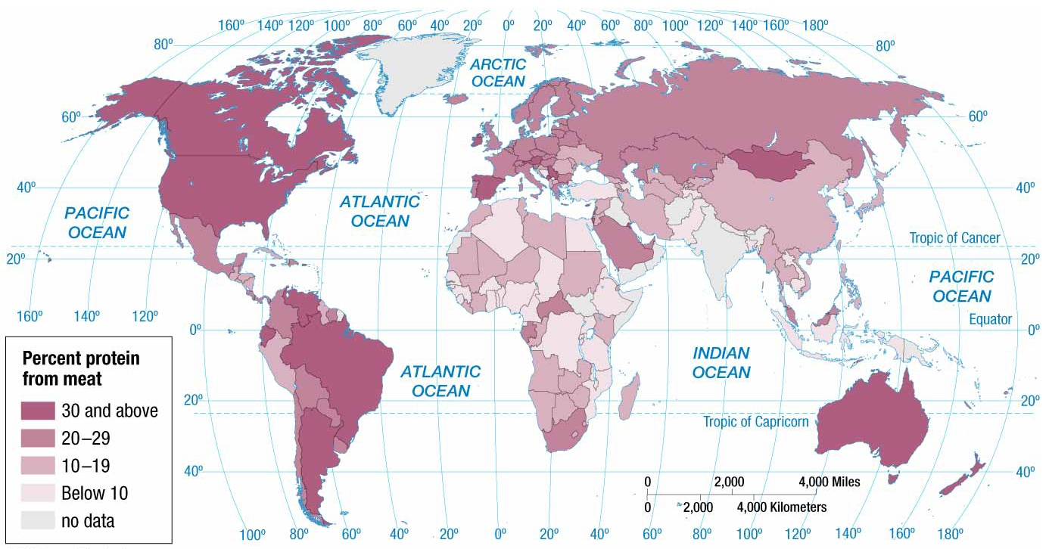
Notes:
FIGURE 10-12 PROTEIN FROM MEAT The percentage of protein from meat is much higher for people in developed countries than for those in developing countries.

Slide 17
Why Do People Consume Different Foods?
Nutrition and Hunger
Undernourishment is dietary energy consumption that is continuously below the minimum requirement for maintaining a healthy life and carrying out light physical activity.
UN estimates 850 million people in world are undernourished.
99% located in developing countries
Worldwide, the total number of undernourished people has not changed much in several decades.

Slide 18
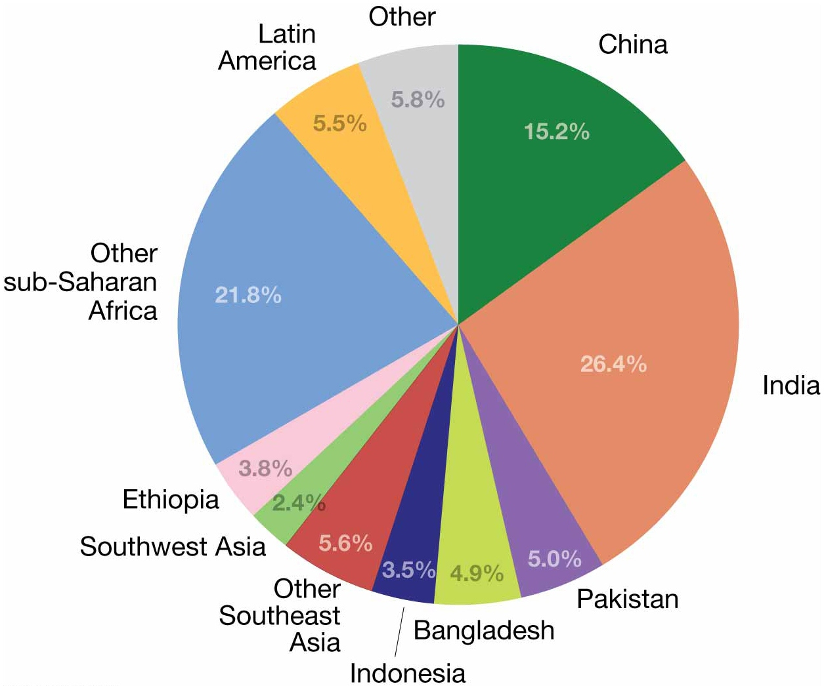
Distribution of under nourishment
Notes:
FIGURE 10-15 DISTRIBUTION OF UNDER NOURISHMENT More than half of the world’s undernourished people are in South Asia and East Asia.

Slide 19
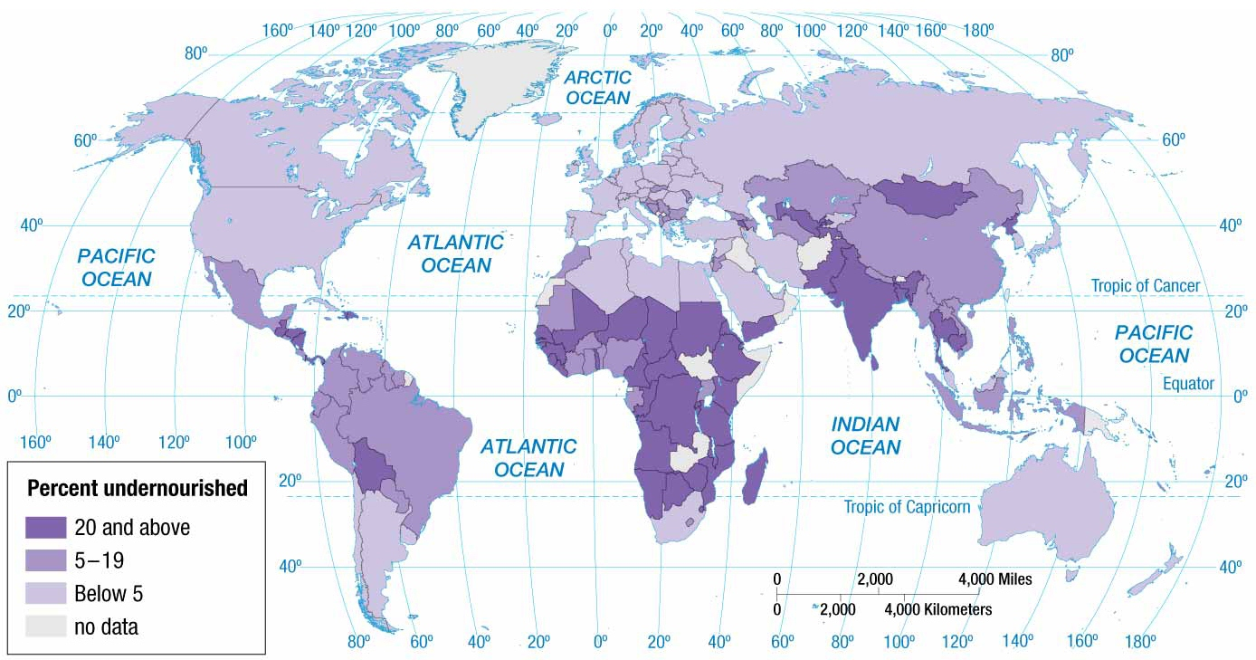
Notes:
FIGURE 10-16 EXTENT OF UNDER NOURISHMENT Less than 5 percent of the population is undernourished in developed countries compared to 15 percent in developing countries.

Slide 20
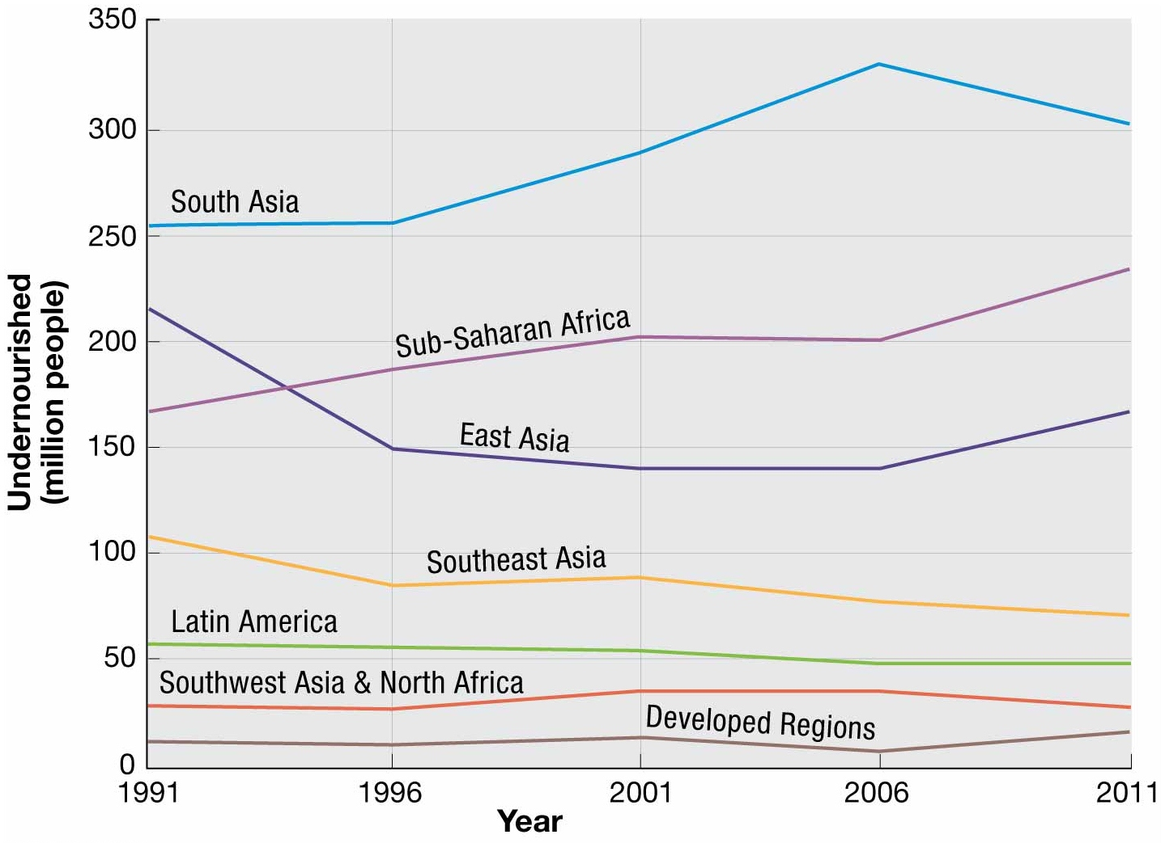
Change in under nourishment
Notes:
FIGURE 10-17 CHANGE IN UNDER NOURISHMENT South Asia has seen the largest increase in number of undernourished people.

Slide 21
Where is Agriculture Distributed?
Geographer Derwent Whittlesey identified 11 main agricultural regions, plus an area where agriculture was nonexistent.
5 present in developing countries
Pastoral Nomadism
Shifting Cultivation
Intensive Subsistence, wet rice dominant
Intensive Subsistence, crops other than rice dominant
Plantation

Slide 22
Where is Agriculture Distributed?
6 present in developed countries
Mixed Crop and Livestock
Dairying
Grain
Ranching
Mediterranean
Commercial Gardening

Slide 23
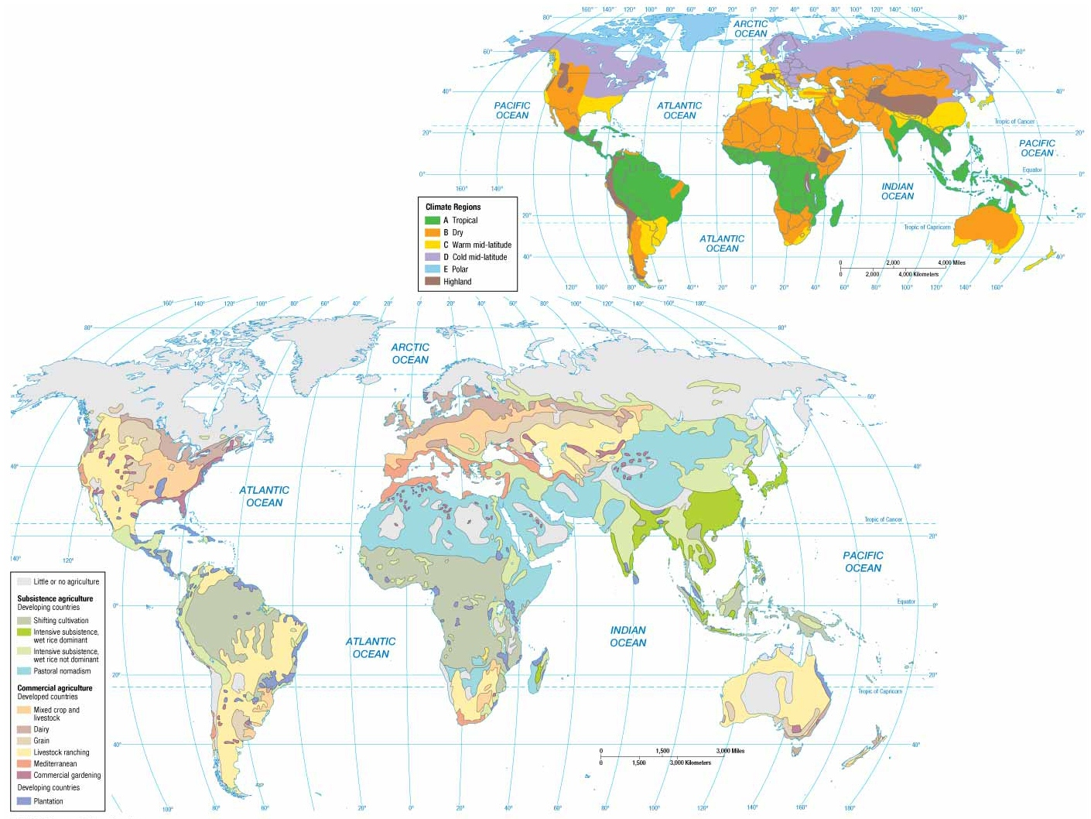
Notes:
FIGURE 10-18 AGRICULTURE AND CLIMATE REGIONS (right) The major agricultural practices of the world can be divided into those that are prevalent in developing countries and those that are prevalent in developed countries (upper right). Climate plays a large role in the practice of agriculture. Figure 1-40 is a more detailed version of the climate map shown here.

Slide 24
Where is Agriculture Distributed?
Agriculture in Developing Regions
Pastoral Nomadism
Pastoral nomadism is a form of subsistence agriculture based on the herding of domesticated animals.
Various approaches combine some reliance on sedentary agriculture with the herding of livestock.
Some pastoral nomads obtain grain from sedentary subsistence farmers.
More commonly, women and children of a nomadic group tend to crops at a fixed location.
Nomads may hire worker to practice sedentary agriculture.
Some nomads will remain in a place and cultivate the land only when rainfall is abundant.
Notes:
Nomad select the type and number of animals for the herd according to local cultural and physical characteristics.
Movement is motivated by the need to find water and forage. They use their keen knowledge of the landscape to guide their way.

Slide 25
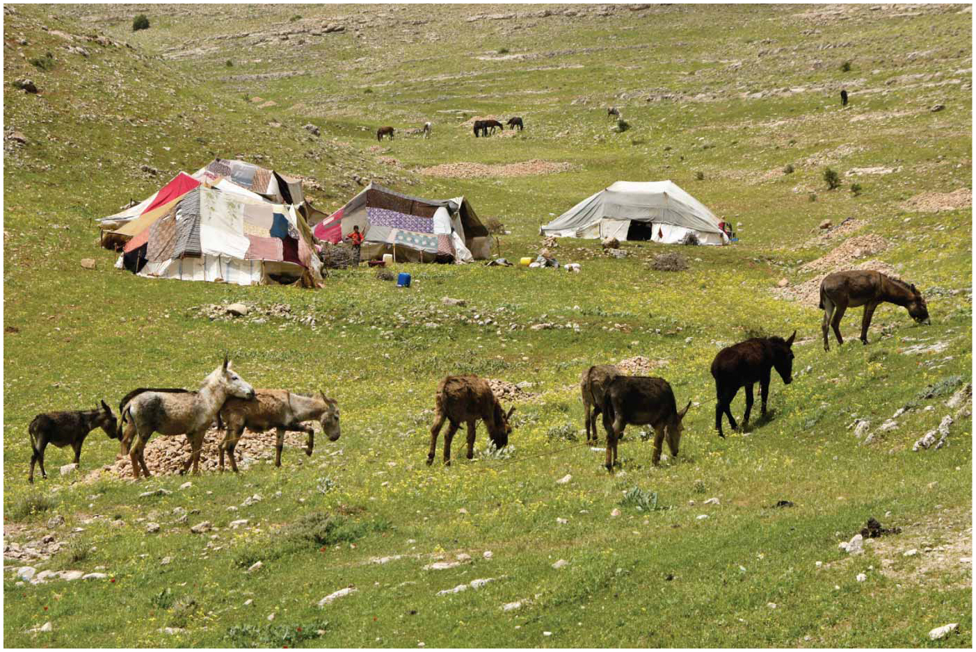
Notes:
FIGURE 10-20 PASTORAL NOMADISM: MOVEMENT Nomads pitch tents in Turkey.

Slide 26
Where is Agriculture Distributed?
Agriculture in Developing Regions
Shifting Cultivation
Shifting cultivation is characterized by two distinctive features:
Farmers clear land for planting by slashing vegetation and burning the debris.
Farmers grow crops on a cleared field for only a few years, until soil nutrients are depleted, and then leave it fallow for many years so the soil can recover.
Farmers return to a fallow site as few as 6 years
later or as many as 20 years later.
Land Ownership
Traditionally, land collectively owned by village.
Today, private individuals now own land, especially
in Latin America.
Notes:
Shifting cultivation is sometimes called slash-and-burn agriculture.

Slide 27
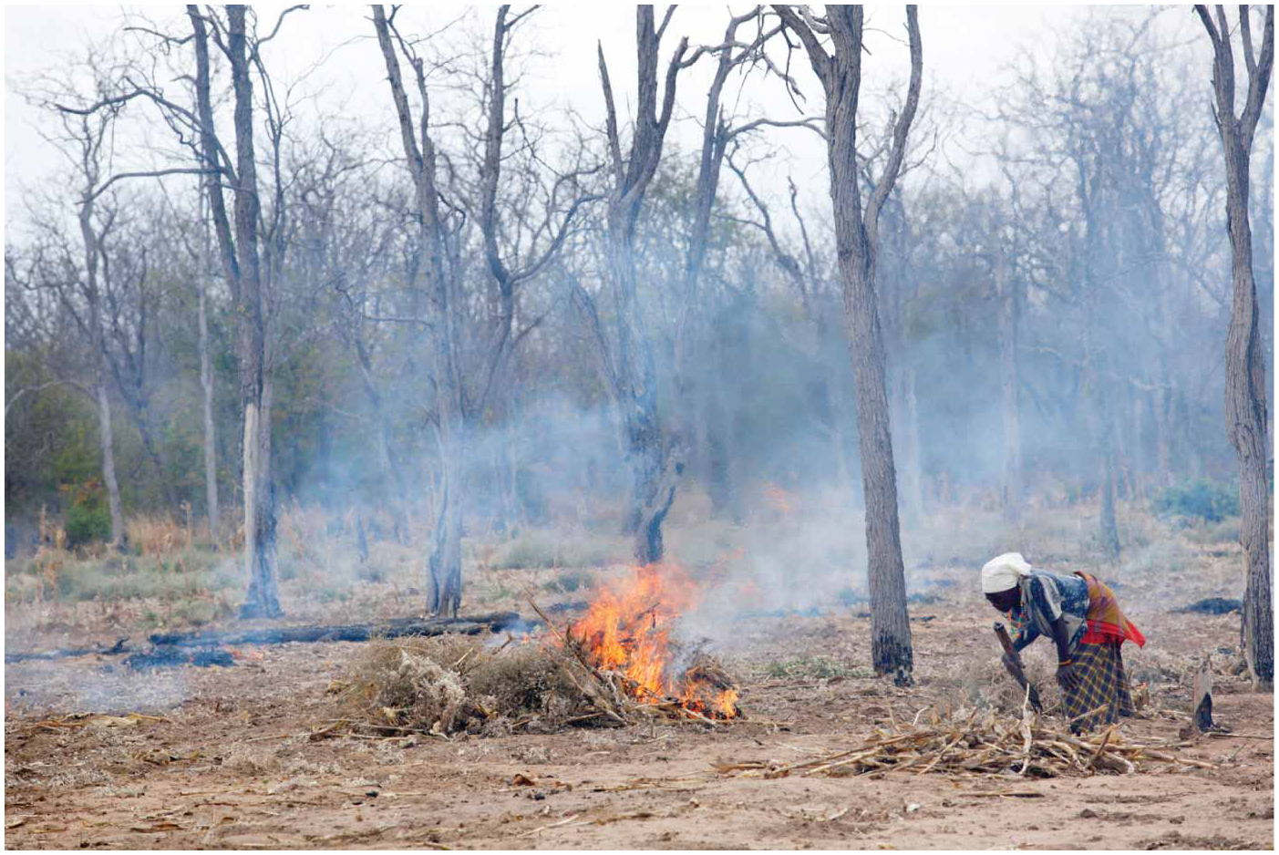
Notes:
FIGURE 10-21 SHIFTING CULTIVATION: SLASH AND BURN This field in Mozambique is being prepared through slash and burn.

Slide 28
Where is Agriculture Distributed?
Agriculture in Developing Regions
Intensive Subsistence Farming
Feeds most of the ¾ of the world’s people who live in developing countries.
Farmers work intensively to subsist on a parcel of land.
Most of the work is done by hand or with animals rather than machines.
Virtually all available land is used for production.
Parcels of land are much smaller than elsewhere in world.
Example
Wet rice: the process where rice is planted on dryland in a nursery and then moved as seedlings to a flooded field to promote growth.

Slide 29
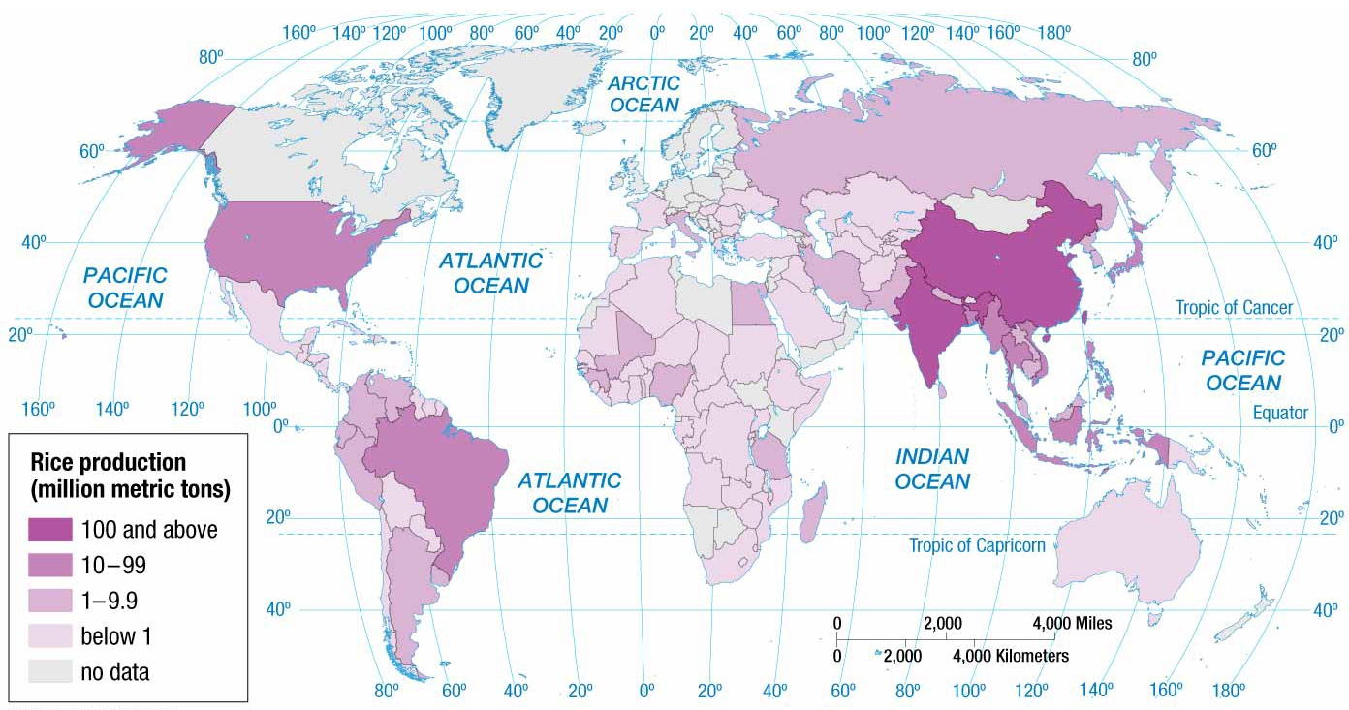
Notes:
FIGURE 10-24 RICE PRODUCTION China and India produce one-half of the world’s rice.

Slide 30
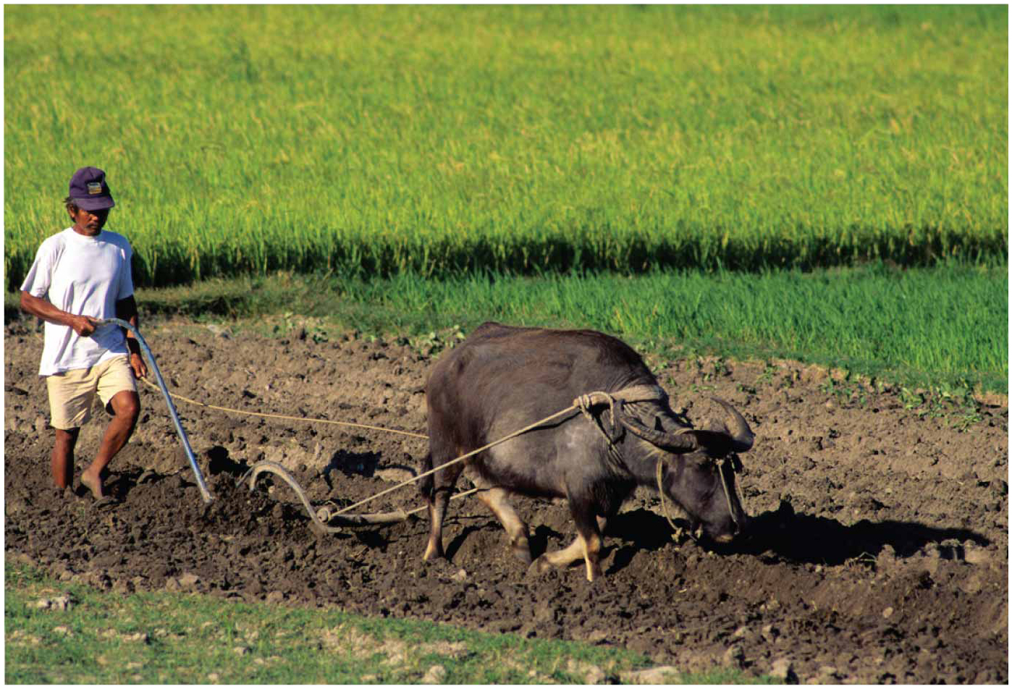
Notes:
FIGURE 10-25 GROWING RICE: PREPARING THE FIELD Plowing a field with a water buffalo in the Philippines.

Slide 31
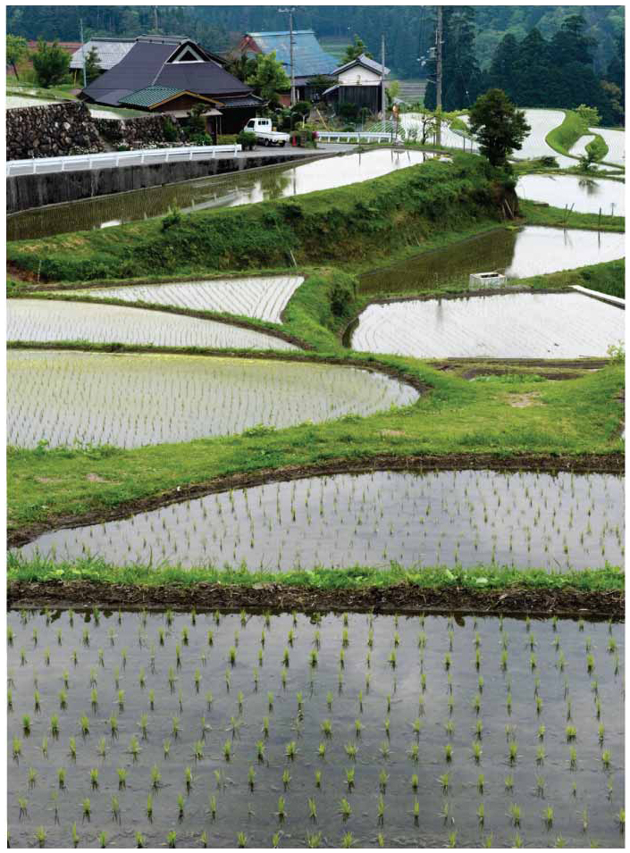
Notes:
FIGURE 10-26 GROWING RICE: FLOODING THE FIELD Flooded fields in Japan.

Slide 32
Where is Agriculture Distributed?
Agriculture in Developing Regions
Intensive Subsistence Farming
Intensive wet-rice farming is the dominant type of agriculture in the following places:
Southeastern China
East India
Much of Southeast Asia
Climate prevents farmers from growing wet rice in portions of Asia, especially where summer precipitation levels are too low and winters are too harsh.

Slide 33
Where is Agriculture Distributed?
Agriculture in Developed Regions
Commercial agriculture in developed countries can be divided up into six main types:
Mixed Crop and Livestock Farming
Dairy Farming
Commercial Gardening and Fruit Farming
Grain Farming
Mediterranean Agriculture
Livestock Ranching
Agribusiness is commonly used to refer to these types of farming listed, because the family farm is not an isolated activity but is integrated into a large food-production industry.

Slide 34
Where is Agriculture Distributed?
Agriculture in Developed Regions
Mixed Crop and Livestock Farming
Most distinctive characteristic is the integration of crops and livestock.
Most of the crops are fed to animals instead of humans.
Typical example devotes nearly all land area to growing crops but derives more than ¾ of its income from the sale of animal products. e.g. beef and eggs
Permits farmers to distribute the workload more evenly through the year, because crops require less attention, aside from planting and harvesting them.
Typically involves crop rotation, practice of rotating use of different fields from crop to crop each year to avoid exhausting the soil.

Slide 35
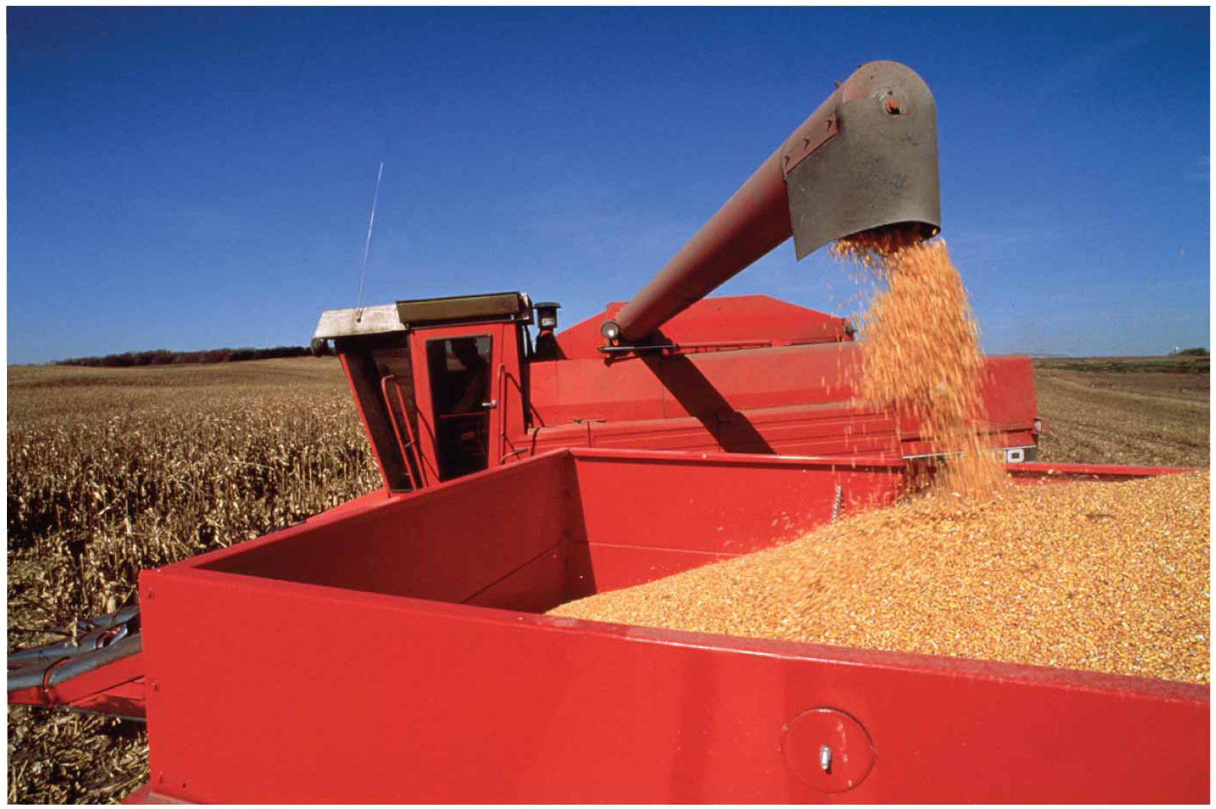
Notes:
FIGURE 10-34 MIXED CROP AND LIVES TOCK Harvesting corn in Iowa.

Slide 36
Where is Agriculture Distributed?
Agriculture in Developed Regions
Dairy Farming
Most important type of commercial agriculture in the first ring outside the large cities because of transportation factors.
Ring surrounding a city from which milk can be supplied is known as the milkshed.
Advancements in modes of transportation have increased the radius of milksheds to 500 km. (300 mi.)
Process
Dairy farmers typically sell their milk to wholesalers who later distribute it to retailers.
Retailers then sell it to consumers in shops or at home.
Notes:
Farmers also sell milk to butter and cheese manufacturers.
In the eastern U.S., virtually all milk is sold to consumers because of proximity to major metropolitan areas. e.g. New York, Philadelphia, and Boston.
Farther west, most of the milk in Wisconsin is processed into butter and cheese because of distance to major urban centers.

Slide 37
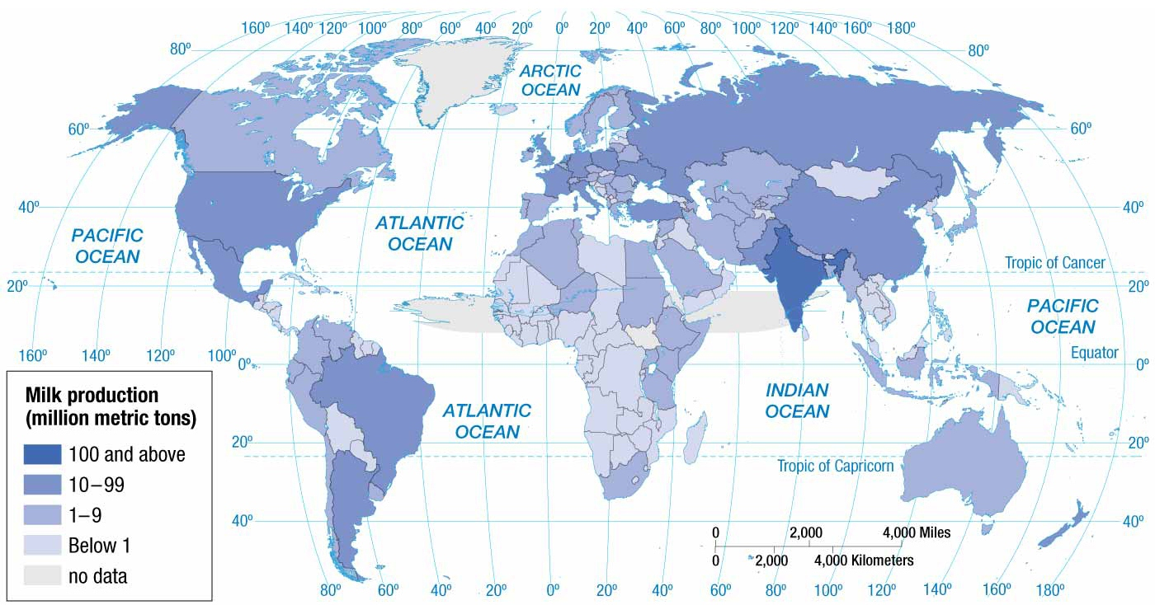
Notes:
FIGURE 10-38 MILK PRODUCTION India has replaced the United States as the world’s leading milk producer.

Slide 38
Where is Agriculture Distributed?
Agriculture in Developed Regions
Commercial Gardening and Fruit Farming
Predominant type of farming in southeastern U.S.
Commonly referred to as truck farming from the Middle English word, truck, meaning “bartering” or “exchange of commodities.”
Grow many of the following fruits and vegetables that consumers in developed countries demand:
Apples
Asparagus
Cherries
Lettuce
Mushrooms
Potatoes

Slide 39
Where is Agriculture Distributed?
Agriculture in Developed Regions
Commercial Gardening and Fruit Farming
Some of the fruits and vegetables are sold fresh to consumers, but most are sold to large processors for canning or freezing.
Truck farms are highly efficient large-scale operations that take full advantage of machines at all stages of the growing process.
Labor costs are kept down by hiring migrant farm workers.
Specialization in a few crops is common.

Slide 40
Where is Agriculture Distributed?
Agriculture in Developed Regions
Grain Farming
Distinguished from mixed crop and livestock farming, because crops are grown primarily for human consumption.
Farms sell their output to manufacturers of food products, such as breakfast cereals and bread.
Characteristics of a Typical Grain Farm
Heavily mechanized
Farms large in areal extent
Oriented to consumer preferences

Slide 41
Where is Agriculture Distributed?
Agriculture in Developed Regions
Mediterranean Agriculture
Every site practicing this form of agriculture borders a sea, and most are on west coasts of continents.
Prevailing sea winds provide moisture and moderate the winter temperatures.
Farmers derive a smaller percentage of income from animal products.
Most crops are grown for human consumption.
Horticulture, which is the growing of fruits, vegetables, and flowers, and tree crops form the commercial base.
Along the Mediterranean Sea, olives and grapes are two most important cash crops.
Approximately half of the land here is used to grow cereals.

Slide 42
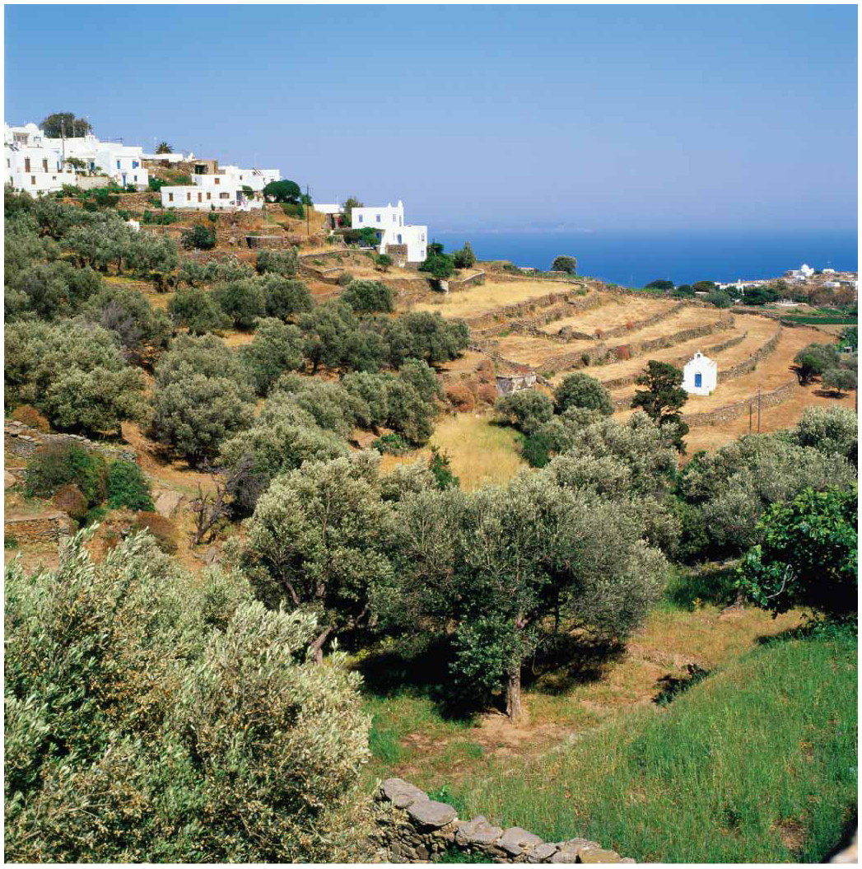
Nearly all olives are produced in countries that border the Mediterranean Sea or have similar climates.
Olive farm in Greece.
Notes:
FIGURE 10-41 MEDITERRANEAN AGRICULTURE Nearly all olives are produced in countries that border the Mediterranean Sea or have similar climates, including Sifnos, Greece.

Slide 43
Where is Agriculture Distributed?
Agriculture in Developed Regions
Livestock Ranching
Ranching is the commercial grazing of livestock over an extensive area.
Well suited for semiarid or arid land
Practiced in developed countries where vegetation is too sparse and soil too poor to support crops.
Historically, ranchers sought to move their cattle from Texas to Chicago, because the cattle were worth more money farther north.
Today, ranching has become part of the meat-processing industry where new methods of breeding and sources of water and feed are embraced.

Slide 44
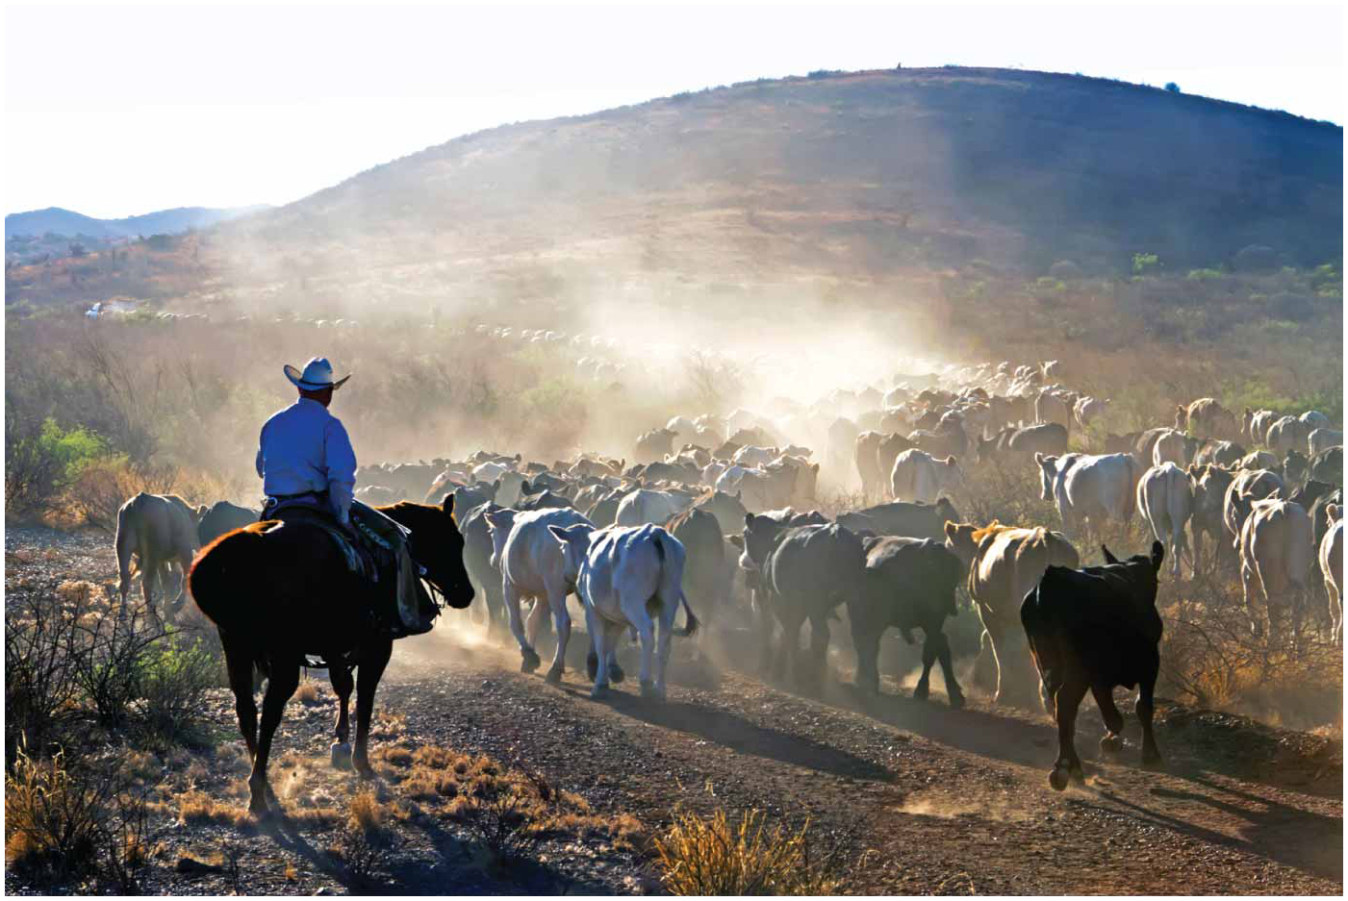
Notes:
FIGURE 10-42 RANCHING Cattle on a west Texas ranch are rounded up for shipping.

Slide 45
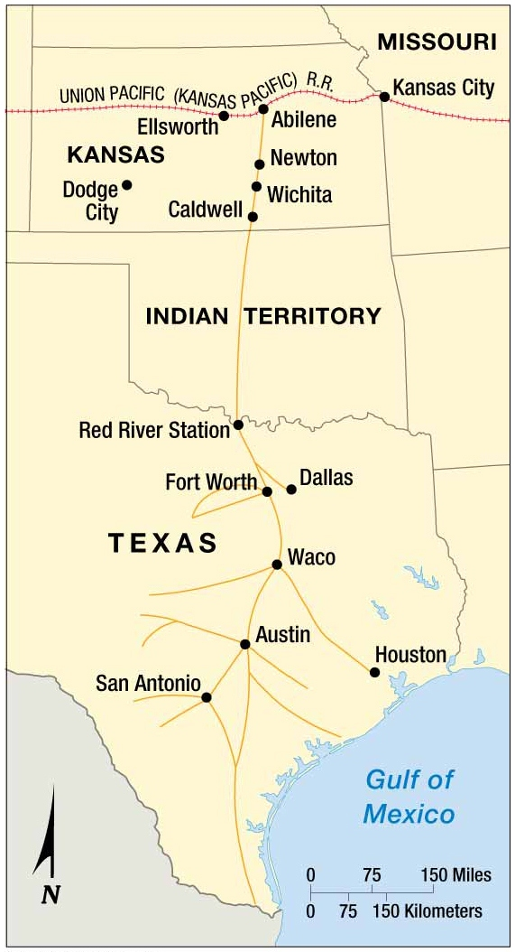
The Chisholm Trail
The Chisholm Trail was used to move cattle from Texas to railroad stations in Kansas during the 1860s & 1870s.
Notes:
FIGURE 10-43 CHISHOLM TRAIL The Chisholm Trail was used to move cattle from Texas to railroad stations in Kansas during the 1860s and 1870s.

Slide 46
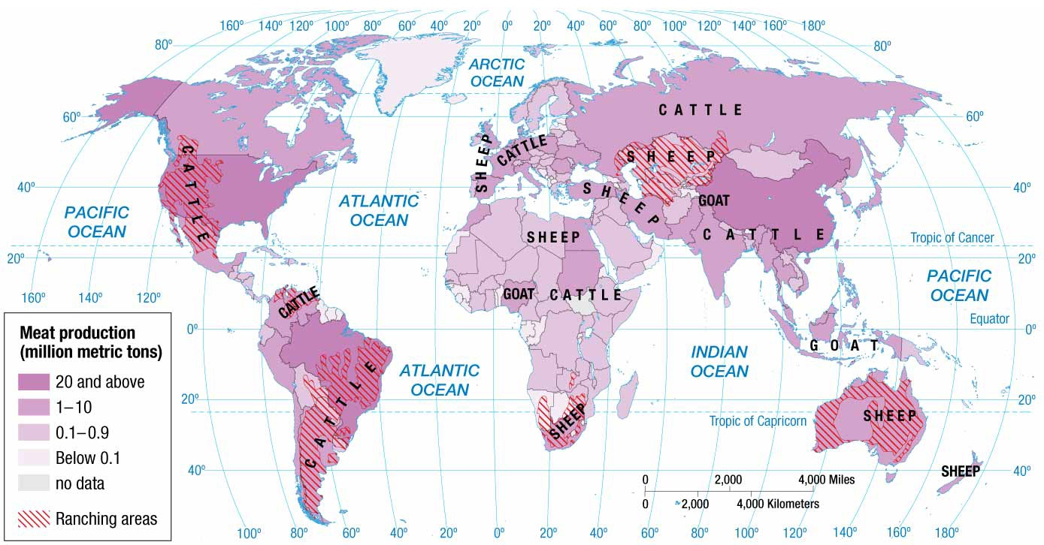
Notes:
FIGURE 10-44 MEAT PRODUCTION China is now the world’s largest meat producer.

Slide 47
Why Do Farmers Face Economic Difficulties?
Challenges for Farmers in Developing Countries
Subsistence farmers must feed an increasing number of people because of rapid population growth in developing countries.
Food supply increased through intensification of production via new farming methods and leaving land fallow for shorter periods of time.

Slide 48
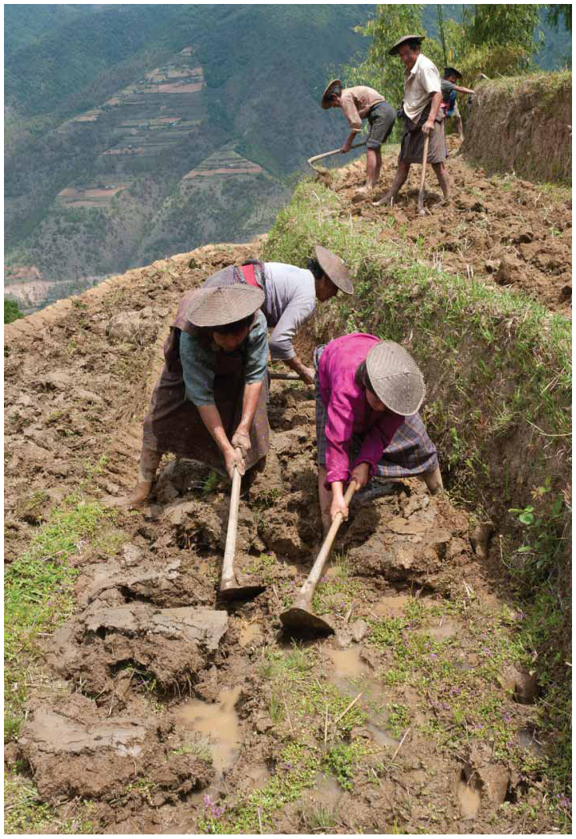
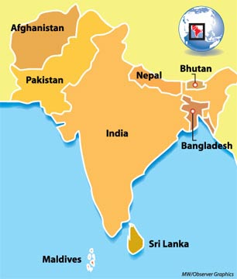
Hillsides in Bhutan are terraced into fields for intensive planting of rice.
Notes:
FIGURE 10-45 INTENSIVE FARMING METHODS Hillsides in Radi, Bhutan, are terraced into fields for intensive planting of rice.

Slide 49
Why Do Farmers Face Economic Difficulties?
Challenges for Farmers in Developing Countries
Subsistence farmers must grow food for export instead of for direct consumption due to the adoption of the international trade approach to development.
Consumers in developed countries are willing to pay high prices for fruits and vegetables that would otherwise be out of season locally.

Slide 50
Why Do Farmers Face Economic Difficulties?
Challenges for Farmers in Developed Countries
Overproduction in Commercial Farming
Commercial farmers suffer from low incomes, because they are capable of producing more food than is demanded by consumers in developed countries.
Demand is stagnant in developed countries because of low population growth.

Slide 51
Why Do Farmers Face Economic Difficulties?
Challenges for Farmers in Developed Countries
Overproduction in Commercial Farming
U.S. Government has formed policies that attempt to address excess production.
Farmers are encouraged to avoid producing crops that are in excess supply.
The government pays farms when certain commodity prices are low.
The government buys surplus production and sells or donates it to foreign governments.

Slide 52
Why Do Farmers Face Economic Difficulties?
Challenges for Farmers in Developed Countries
Importance of Access to Markets
Geographers use the von Thünen model to help explain the importance of proximity to market in the choice of crops on commercial farms.
Specific crops are grown in different rings around cities
1st ring: Highly perishable foods e.g. milk
2nd ring: Items more difficult to transport e.g. wood
3rd ring: Various crops and pasture lands
4th ring: Spacious lands for animal grazing.
von Thünen’s model can be scaled up for national and global markets.
Notes:
Farms located closer to market tend to select crops with higher transportation costs per hectare of output, whereas more distant farms are more likely to select crops that can be transported less expensively.

Slide 53
von Thunen Model of Agriculutre Land Use (1826)
Urban market
High transportation cost items
(vegetables, eggs, dairy, flowers)
Intensive land use – high land rent
Medium transportation cost items
(corn, soybeans, mixed farming)
More extensive land use – medium rent
Lowest transportation cost items
(forestry, wheat, livestock ranching)
Most extensive land use – lowest land rent
Notes:
DISCUSSION:
* Von Thünen developed his model in 1826. Is it still relevant today?
* Are transportation costs still an important factor in where certain products are raised today?

Slide 54
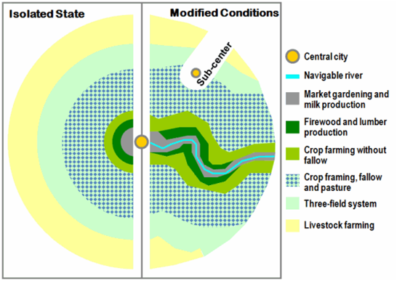
Von Thunen Model – isolated & modified

Slide 55
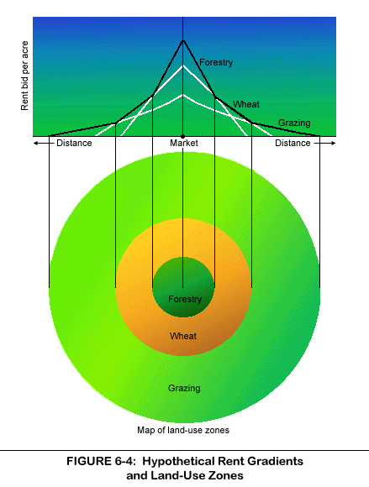
Rent of rings
Closer to the market = high rent
intense cost justifies rent
further away = lower rent
less labor drops cost

Slide 56
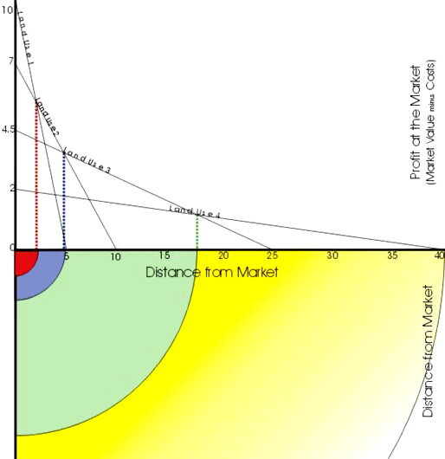
Rent of each ring

Slide 57
Why Do Farmers Face Economic Difficulties?
Strategies to Increase the World’s Food Supply
Four strategies are being employed to distribute food to everyone in the world:
Increasing exports from countries with surpluses
Expanding the land area used for agriculture
Expanding fishing
Increasing the productivity of land now used for agriculture

Slide 58
Why Do Farmers Face Economic Difficulties?
Strategies to Increase the World’s Food Supply
Increasing Exports from Countries with Surpluses
On a global scale, agricultural products are moving primarily from the Western Hemisphere to the Eastern Hemisphere.
U.S. remains the world’s leading exporter of grain
½ of the world’s maize (corn) exports.
Global share has decreased from 18 to 19 percent in the 1970s to 10 to 11 percent in the 21st century because of more rapid increased in agricultural exports from Latin America and Southeast Asia.

Slide 59
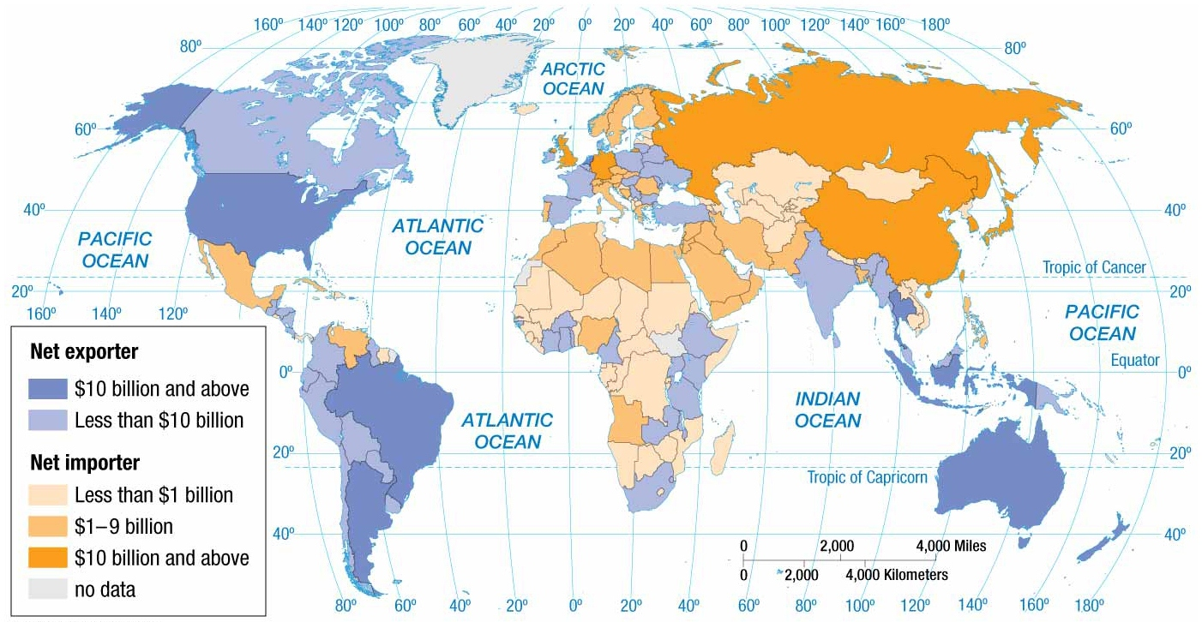
Notes:
FIGURE 10-54 TRADE IN AGRICULTURAL PRODUCTS The principal flow of agriculture in the world is from the Western Hemisphere to Europe and Asia.

Slide 60
Why Do Farmers Face Economic Difficulties?
Strategies to Increase the World’s Food Supply
Expanding Agricultural Land
Today, few scientists believe that further expansion of agricultural land can feed the growing world population.
Farmland in some regions is being abandoned for lack of water.
Other land degradation that makes land resemble a desert-like state caused by humans is known as desertification.

Slide 61
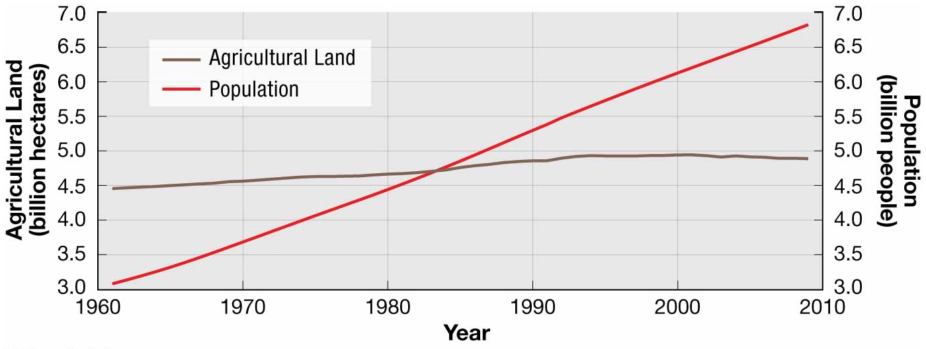
Notes:
FIGURE 10-55 AGRICULTURAL LAND AND POPULATION GROWTH Land devoted to agriculture has remained virtually unchanged since 1990, whereas population has increased by more than 50 percent.

Slide 62
Why Do Farmers Face Economic Difficulties?
Strategies to Increase the World’s Food Supply
Expanding Fishing
Aquaculture, or aquafarming is the cultivation of seafood under controlled conditions, whereas fishing is the capture of wild fish and other seafood.
Human consumption of fish and seas has increased from 27 million metric tons in 1960 to 110 million metric tons in 2010.
Global fish production has increased from approximately 36 to 145 million metric tons.
Only 2/3 of fish caught from the ocean is consumed directly by humans.
Notes:
Overfishing is a concern expressed by the UN. They estimate that ¼ of fish stocks have been overfished and ½ fully exploited, leaving only ¼ underfished.
Total world fish catch has remained relatively constant since the 1980s, despite population growth.

Slide 63
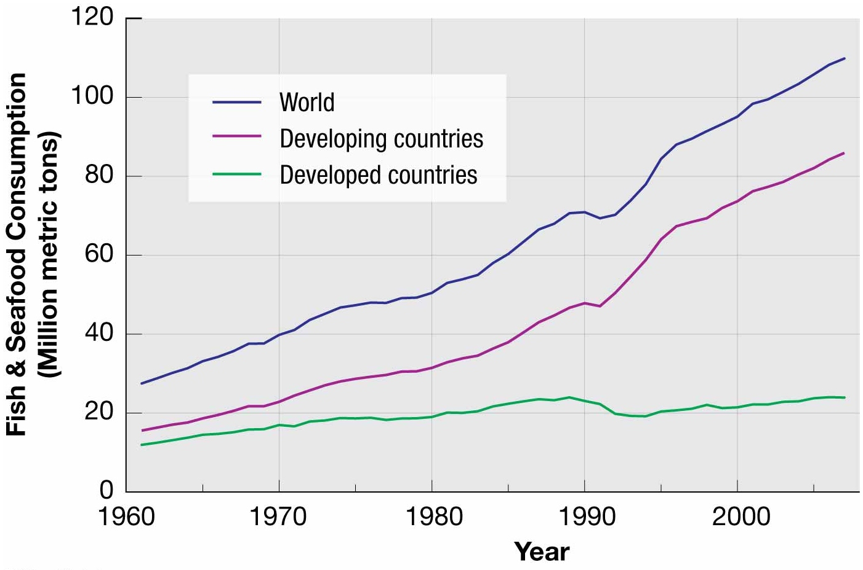
Notes:
FIGURE 10-57 GROWTH IN HUMAN CONSUMPTION OF FISH Human consumption of fish has increased in both developed and developing regions.

Slide 64
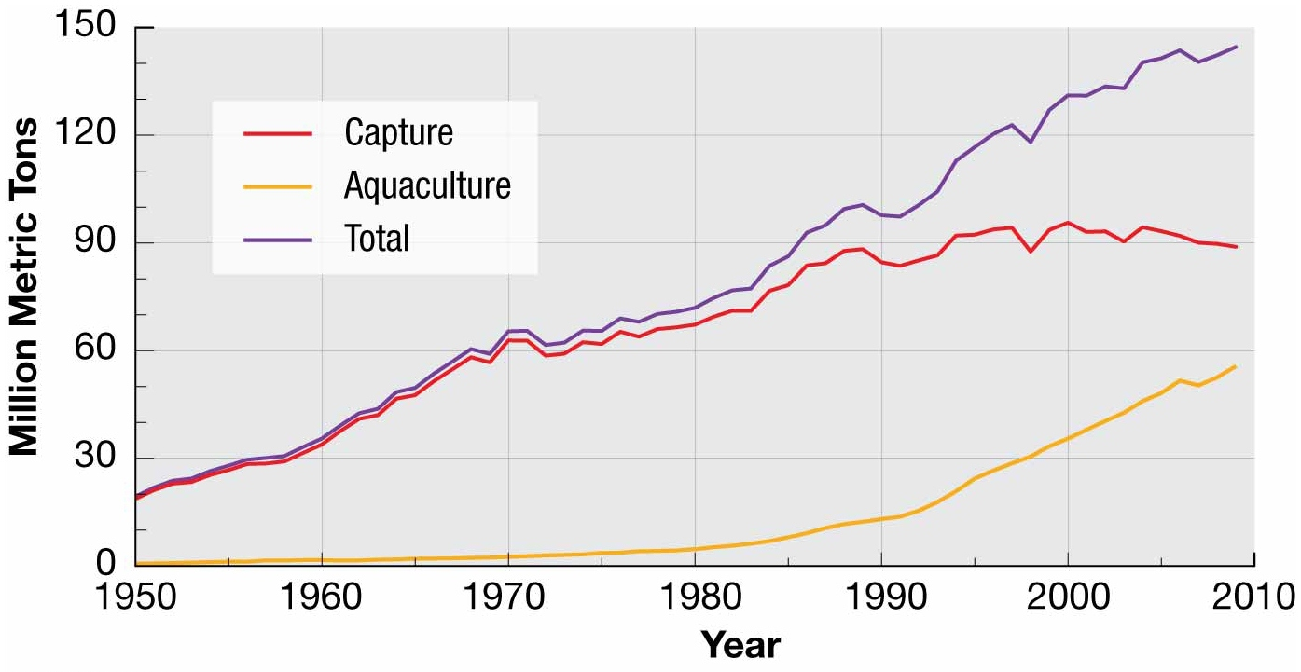
Notes:
FIGURE 10-58 GROWTH IN FISH PRODUCTION Increased fish production has come primarily from aquaculture rather than wild capture of fish.

Slide 65
Why Do Farmers Face Economic Difficulties?
Strategies to Increase the World’s Food Supply
Increasing Productivity
Invention and rapid diffusion of more productive agricultural techniques during the 1970s and 1980s is called the green revolution.
Introduced new higher-yield seeds
Expanded use of fertilizers
Green revolution allowed agricultural productivity to outpace population growth.
“miracle wheat seed”
“miracle rice seed”
“miracle high-yield maize (corn)”
Notes:
The new miracle seeds were diffused rapidly around the world.
The green revolution was largely responsible for preventing food crisis in these regions during the 1970s 1980s.

Slide 66
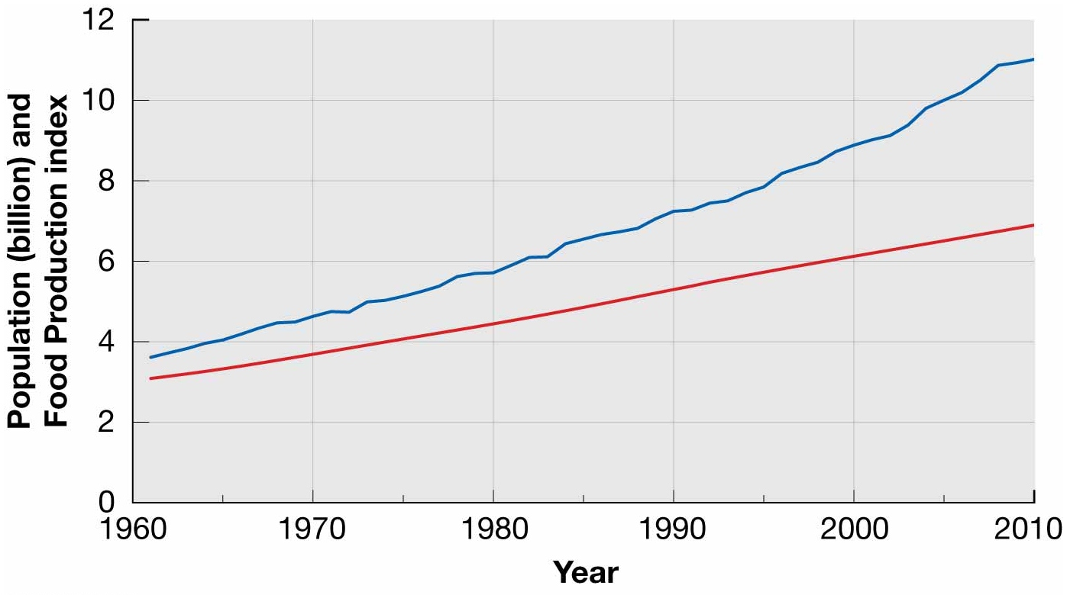
Notes:
FIGURE 10-62 POPULATION AND FOOD PRODUCTION World population has increased less rapidly than food production.

Slide 67
Why Do Farmers Face Economic Difficulties?
Strategies to Increase the World’s Food Supply
Sustainable Agriculture
Sustainable agriculture are agricultural practices that preserve and enhance environmental quality.
Three principal practices distinguish sustainable picture (and, at its best, organic farming) from conventional agriculture:
Sensitive land management
Limited use of chemicals
Better integration of crops and livestock

Slide 68
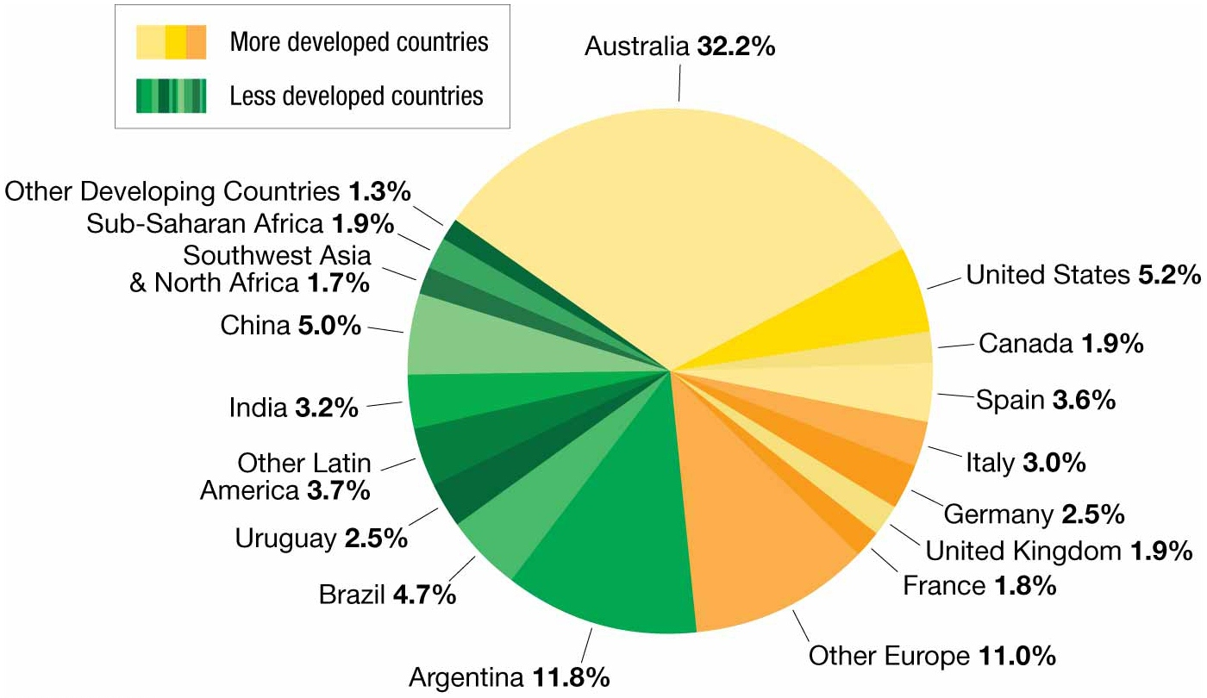
Distribution of organic farming
Notes:
FIGURE 10-66 DISTRIBUTION OF ORGANIC FARMING Australia accounts for nearly one-third of the world’s organic farming.

Slide 69
Summary
Prior to the development of agriculture, people survived by hunting animals, gathering wild vegetation, and fishing. Current agricultural practices vary between developed and developing countries.
Everyone needs food to survive. The amount of food and dietary composition of the food vary between developed and developing countries.

Slide 70
Summary
Most people in developing countries are subsistence farmers, growing crops primarily to feed themselves. Commercial farming is primarily practiced in developed countries.
Farmers face many challenges to meeting the dietary needs of a rapidly growing population when they are forced to rely on poorer quality land to farm, as a result of land degradation processes and suburban sprawl taking away prime farmland.

