Slide 1
Political Cartoons

Slide 2
Purpose of Political Cartoons
Political cartoons send a message
  Describe a situation
  Create discussion on a topic
  Create support for a topic
  Show disagreement on a topic
Use of art to connect with the public
Provides a mental picture of a situation
Political cartoon are METAPHORS!!!!!!
To be funny

Slide 3
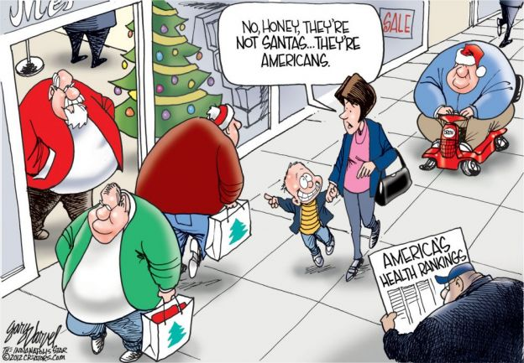

Slide 4
Describe the situation
  A mom and son Christmas shopping & a man reading a newspaper on America’s health
  Son thinks the fat men are Santas
What is the message?
  Americans are fat & unhealthy

Slide 5
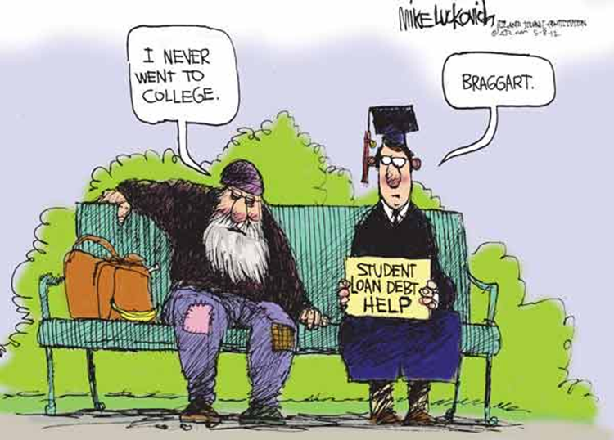

Slide 6
Describe the situation
  A homeless man & college grad asking for $$
What is the message?
  College degree = good job
  The college grad wasted money for ending up in same situation as homeless man

Slide 7
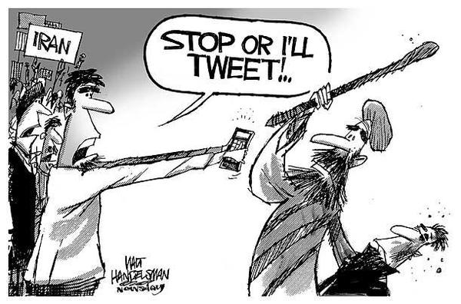

Slide 8
Describe the situation
  Arab man beating up someone
What is the message?
  People want to change Iran’s harsh way of life
  Social media is a force for change

Slide 9
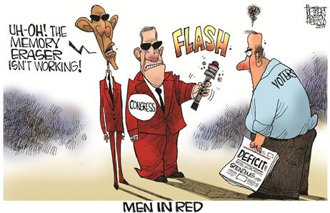

Slide 10
Describe the situation
  Men In Black spoof
  “Red” = bad budget
  Obama & Congress don’t want voters remembering bad budget
What is the message
  Voters not forgetting bad budget issues
  Pro Republican cartoon

Slide 11
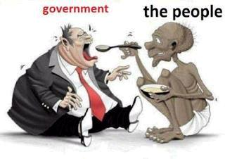

Slide 12
Describe the situation
  A impoverished minority man (public) is feeding an obese white man (government)
What is the message
  Rich, white politicians are making money off of poor minorities

Slide 13
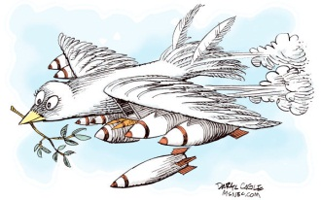
“It must be done”

Slide 14
Describe the situation
  A dove (peace) is shaped like a plane & is dropping bombs
What is the message
  Sometimes war is necessary to achieve peace
“It must be done”

Slide 15
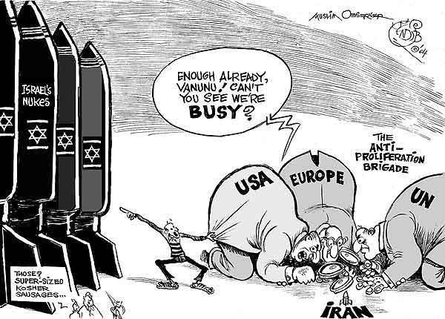

Slide 16
Describe the situation
  US, Europe, UN closely inspecting Iran’s small nuclear missile but miss Israel’s many big missiles
What is the message
  We are ignoring our ally’s many large weapons & looking @ enemy’s puny weapon

Slide 17
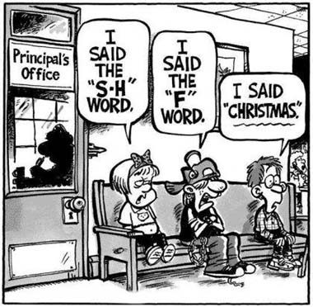

Slide 18
Describe the situation
  School kids in trouble for using bad language
What is the message
  The word Christmas = bad in a public school
  Christmas = time of joy & sharing
  Going too far in keeping religion out of public school

