Slide 1
III. Jobs in psychology
Applied psychologists vs. research psychologists
  Research psych: do research to investigate problems
    Ex: finding out if reading more helps keep minds sharp
  Applied psych: use/apply research to solve problems
    Ex: getting elderly people to read more to keep them sharp
Just about any job in psych. requires a masters degree

Slide 2
C. Special Areas in Applied Psychology
Experimental
Clinical
Counseling
Educational
Developmental
Personality
Social
Environmental
Industrial/ Organizational
Health
Consumer

Slide 3

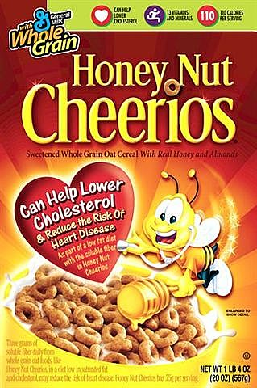






What do all cereal mascots have in common?

Slide 4

1. Experimental Psychologists
Conduct research on many areas:
  Learning, cognition, memory…
  biological basis of human and animal behavior
  Use hypothesis, Control…

Slide 5

2. Clinical Psychologists
Do a lot:
  Test, diagnose, & treat serious mental problems
  work as counselors for ppl w/"regular" problems (marriage...)
  do research
They are the most common type of psych.
Psychiatrists and psychologists (difference?)

Slide 6

3. Counseling Psychologists
Work in many places using a broad range of basic skills to handle everyday problems for mentally healthy
Can also help those in need (substance abuse, vocational therapy, common disorders)

Slide 7

4. Educational Psychologists
Conduct tests to assess students' abilities
Work in schools to accomm. students' strengths/ weaknesses
Study processes involved in educ. and acad. achievement
Ex: School counselors

Slide 8

5. Developmental Psychologists
Study how “nature” and “nurture” affect our development
Ex: what makes someone gay?
Ex: effect of physical contact on an infant’s development
Study other influences on: mental, physical, social, and personality devel.
Ex: Which has more influence: early or later life experiences?
Do we develop in stages or smoothly?
Ex: Object permanence
You’re closer to death now than when you started reading this.

Slide 9
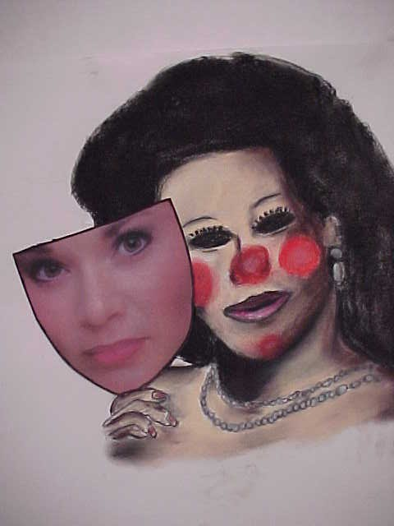
6. Personality Psychologists
Study how and why ppl. differ in personality
Ex: Extroversion, curiosity…
Ex: 7 approaches/ personality theories
Use various tests to determine personality
Ex: Rorschach test, MMPI (Minnes. Multiphasic Pers. Inventory)

Slide 10

7. Social Psychologists
They study how specific groups and society in general can influence individual behavior and outlook
Research focuses on attitudes, prejudice, conformity, obedience
Ex: Foot-in-the-door effect on normal people

Slide 11
8. Environmental Psychologists
Study relat. b/w behav./attit. and physical environment (seasons, bldgs, rooms…)
Ex: Noise → more stress; Light → less stress (Seasonal Affective Disorder)
Usu. work with engineers, city planners, architects, designers…
Ex: including artwork in the workplace or aesthetic public spaces in cities to reduce stress; staging a house to help it sell

Slide 12
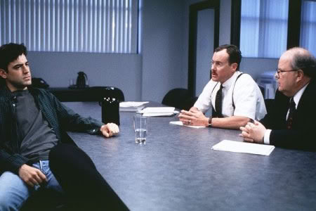
9. Industrial/ Organizational Psychologists
Try to improve people’s productivity & happiness at work & companies’ organization
Study issues in workplace: absenteeism, frustration, stigmas, performance appraisals, etc.
Create training courses, hiring procedures, surveys
Ex: Happy workers are better workers! (See: Google)
Ex: The Bobs in “Office Space”
“It’s not that I’m lazy. It’s just that I don’t care.”

Slide 13
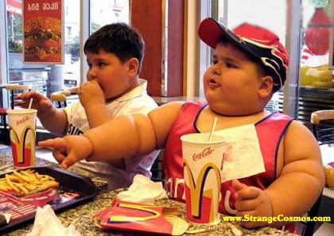
10. Health Psychologists
Promote good health habits
Focus on relat. b/w health/illness and biopsychosocial factors
Ex: benefits of healthy living (more happiness); how a pos. attit. affects health & recovery (Type A vs. Type B people); connection b/w disease & culture (diabetes & today’s youth)
How mental illnesses alter biol. functions (depression decreases immune sys.)

Slide 14

11. Consumer Psychologists
Study why people purchase a particular product/service/brand
Examine consumer attitudes, shopping behav. to better market products
Examine product packaging, placement, price, & how life changes affect purchases
Ex: Marketing research (cereal mascots are all… male)

Slide 15
The Artwork of Mental Patients
Using artwork as a research tool

Slide 16
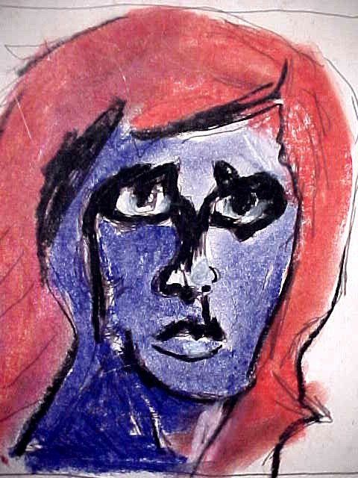
Self-Portraits: Joanne

Slide 17
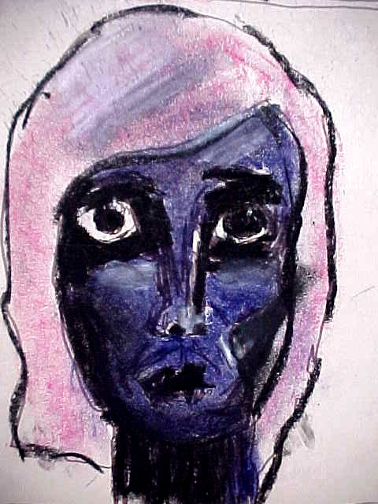

Slide 18
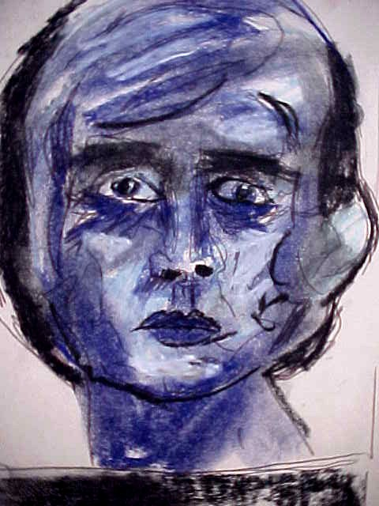

Slide 19
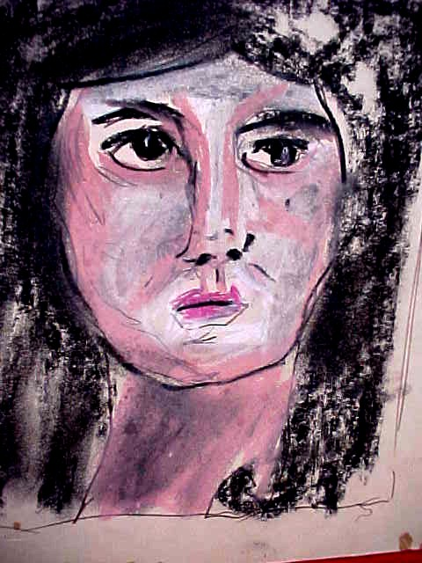

Slide 20
Review
If you were a psychologist, what general observations could you make about the artwork of mental patients?
How are colors important in the psychology of art? Remembering the drawings made by Joanne. Explain how her progression of self-portraits reflects her psychological improvement.

Slide 21

Gertrude

Slide 22
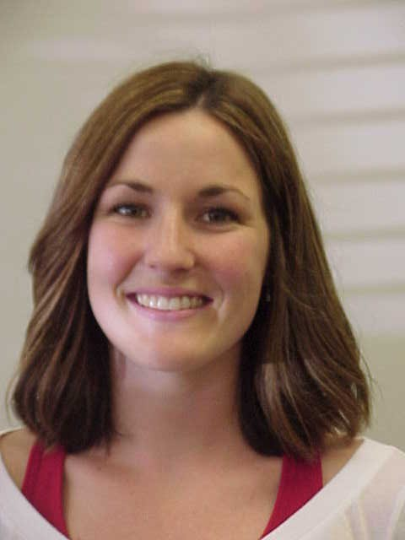
Kristen

Slide 23
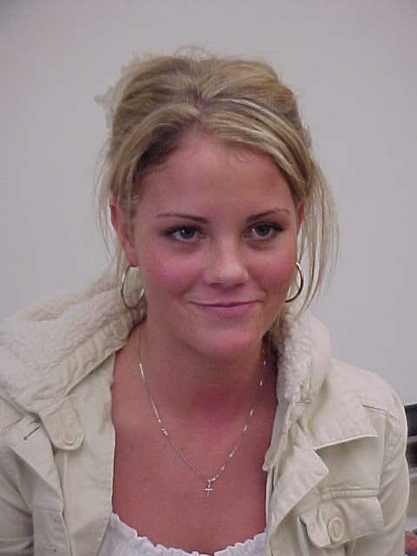
Ethel

Slide 24
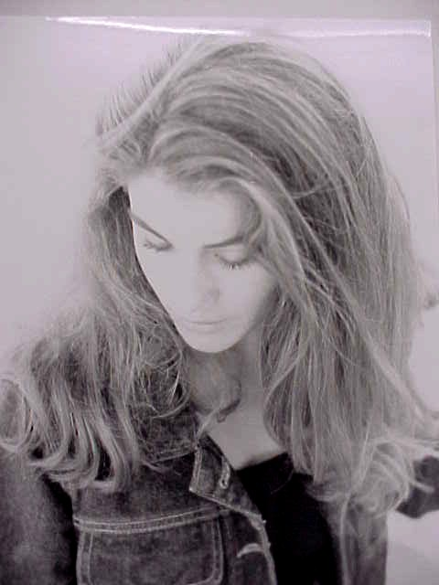
Christine

Slide 25
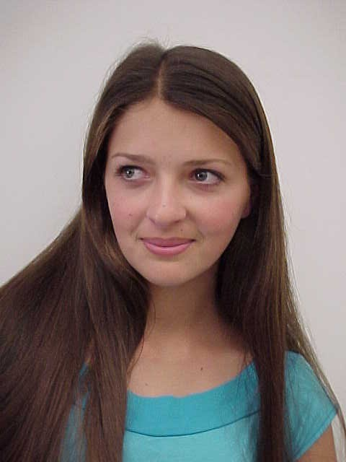
Maude

Slide 26

Prudence

Slide 27
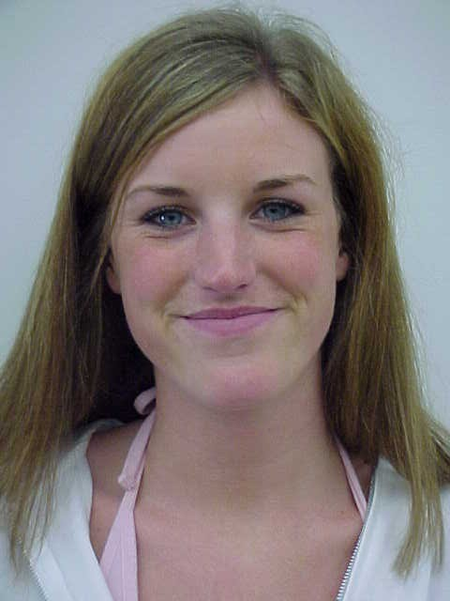
Matilda

Slide 28

Sheri

Slide 29
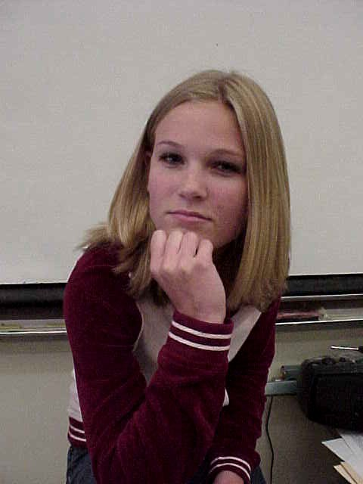
Megan

Slide 30

Gladys

Slide 31
Evaluation
Does the popularity of a woman’s name affect judgment of their physical attractiveness?

