Slide 1

Sensation & Perception
Notes:
Every day, our senses are constantly bombarded with information from the world around us. Our eyes and ears process a multitude of images, lights, and sounds. All kinds of substances end up in our mouths and on our tongues as we eat and drink. We feel all kinds of sensations, like warm winds blowing against our face. We smell both good and bad things, from the delicious scents in a bakery to the stench of tar on a freshly paved road. In this unit, you will learn about how our bodies transform these sensory stimuli into signals which the brain uses to create sensations of vision, hearing, touch, taste, and smell. Our five senses provide us with impressions of the world, which psychologists call perception.

Slide 2
An Introductory Activity
Researchers have found that our experiences influence our perceptions
Look at the following photographs or drawings and write a short description of each
Notes:
Note to teacher: Show students the drawings or photographs on the following slides and have them briefly write down what they think is the main point of each one. Next, show the pictures a second time and listen to their responses. Choose at least three or four students to read their responses for each photo. Typically, their interpretations will be quite different. Pose this question to the class: How can people look at the same picture and see things so differently?

Slide 3
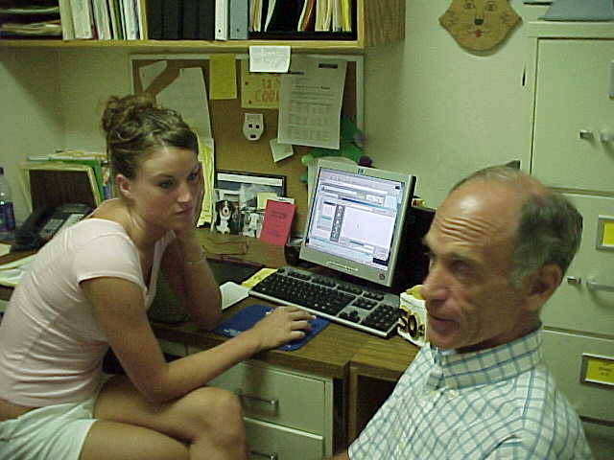
Notes:
This is a counselor with a student, but she is sitting at his desk.

Slide 4
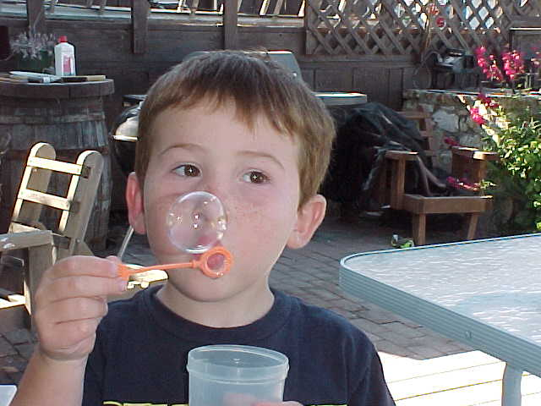
Notes:
No special notes.

Slide 5
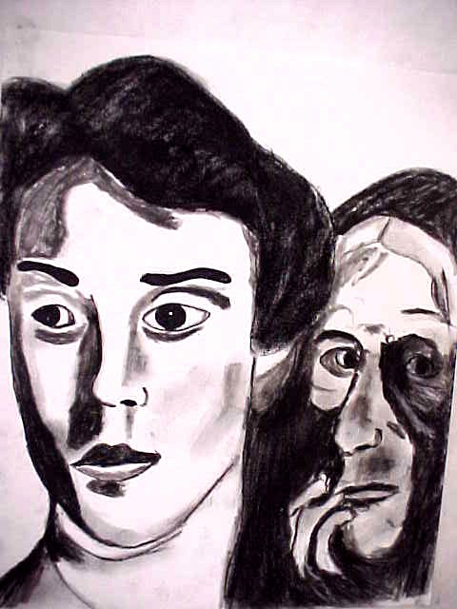
Notes:
This is part of the Thematic Apperception Test created by Henry Murray. The TAT is a personality test where the subject writes a theme about what he or she sees, answering questions like “What is happening?” “How will it end?” and “Who are these people?”

Slide 6
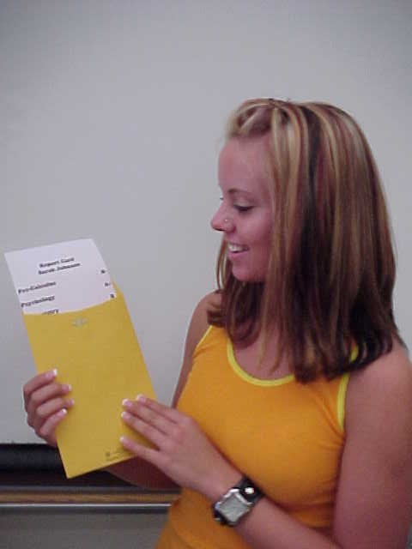
Notes:
A student with a report card.

Slide 7
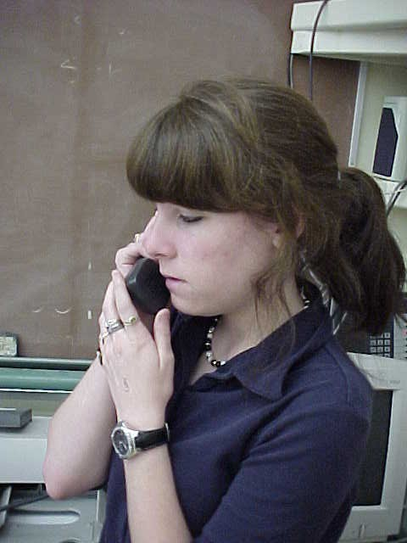
Notes:
A student talking on a phone in the front of the classroom.

Slide 8
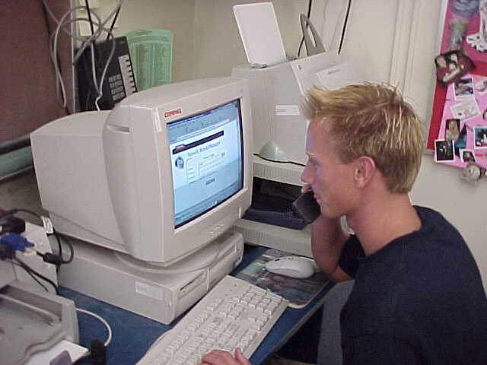
Notes:
A student working with a computer while talking on the phone.

Slide 9

Notes:
A student cramming for a test. Note the many books, cup of coffee, and the fatigued look on the student’s face.

Slide 10

Notes:
This slide shows a painting of a Vietnamese girl who is befriended by a GI serving in the Vietnam War. Note the soldier’s leg and the M-16 rifle in the background.

Slide 11
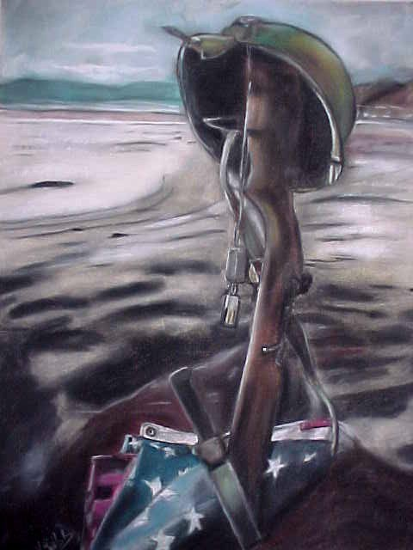
Notes:
This slide shows a painting commemorating D-Day. Note the inverted rifle, the dog tags hanging on the rifle, the bayonet, the flag, and the beach in the background.

Slide 12

Notes:
This slide shows a painting of three Blackfoot Indians.

Slide 13
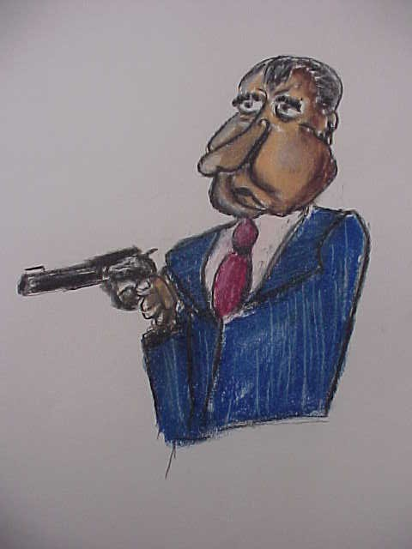
Notes:
This slide shows a cartoon version of Richard Nixon with a “smoking gun.”

Slide 14
mYeYeshURt

Slide 15
My eyes hurt

Slide 16
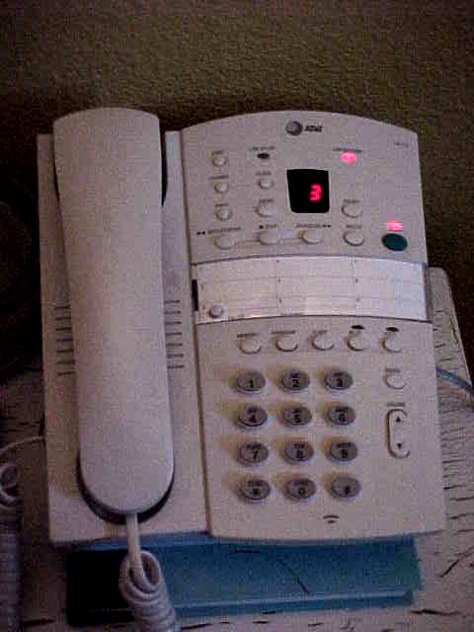
What Is Sensation?
It occurs when a stimulus activates a sensory receptor
A stimulus is measured by the following: size, intensity, duration, wavelength
Notes:
Bullet #1 A stimulus is any aspect or change in the environment to which an organism responds. Stimuli include things such as the ringing of a phone, a sore muscle, or a change in the temperature. The sense organs detect changes in energy, heat, light, sound, and physical pressure. Each of our sense organs contains specialized cells called sensory receptors which pick up information from our environment and relay it to the brain.
Bullet # 2 We can measure a stimulus by its size, how long it lasts (duration), and its intensity (strength).

Slide 17
What Is Perception?
The organization of sensory information into meaningful experiences
Psychophysics
Notes:
Bullet # 1 Perception is the organization of sensory information into meaningful experiences. To study perception, psychologists investigate the relationship between physical stimuli and sensory experiences.
Bullet # 2 The area of science known as psychophysics attempts to describe how we use our senses to detect things in our environment. Psychophysicists ask questions such as, “What is the relationship between color and wavelength?” and “If a light’s intensity changes, how will this affect a person’s perception of its brightness?”

Slide 18

What Is Meant by a Threshold?
Absolute threshold: the smallest amount of a stimuli that a person can reliably detect
Notes:
Bullet # 1 On a clear, dark night, from how far away can we detect the light from a single candle? How many drops of perfume do we need to spread through a small house before we can smell its fragrance? Each of these questions searches for what is known as an absolute threshold—the least amount of a substance needed to activate the sensory receptors.

Slide 19

Absolute Thresholds
Vision: a flame from a single candle 30 miles away
Hearing: ticking of a watch 20 feet away
Taste: one teaspoon of sugar in two gallons of water
Smell: one drop of perfume in a small house
Touch: the wing of a bee brushing your cheek
Notes:
Different people have different absolute thresholds for each of their senses. Some people are much more sensitive than others. For scientists to consider a specific level of a stimulus as an absolute threshold, people have to be able to detect it at least 50 percent of the time. Absolute thresholds differ between species as well: humans cannot see x-rays or microwaves; dogs can hear a dog whistle but humans can’t; humans hear only about 20 percent of what a dolphin hears; dolphins and bats have a superior sense of hearing; hawks and eagles have extremely sharp vision; and bloodhounds have an acute sense of smell.

Slide 20
Difference Threshold
The minimal difference in the magnitude of energy needed for people to distinguish between two stimuli
Weber’s law = the larger the stimulus the greater intensity needed to notice a change
Experts
Notes:
Bullet # 1 The difference threshold is defined as the minimal difference in the magnitude of energy needed for people to distinguish between two stimuli. You can also think of it as a “just-noticeable difference.” Difference thresholds apply to all of our senses.
Bullet # 2 According to the principle known as Weber’s law, the larger or stronger a stimulus the larger the change required for an observer to notice a difference. Psychologists experiment with variations in sounds, temperatures, colors, tastes, and smells in order to learn how each sense responds to stimulation. For example, the pain of an electric shock can be increased more than eight times by just doubling the voltage, but the a light’s intensity has to increase many times in order to merely double its brightness. Psychologists use the term “experts” to describe people who can detect extremely smallest changes in sensations. For example, food and wine critics are often “experts.”

Slide 21

Sensory Adaptation
Senses are most responsive to increases and decreases rather than ongoing unchanging stimulation
Our senses have the ability to adapt
Notes:
Bullets # 1–2 Our senses are most responsive to increases and decreases in stimuli, rather than to ongoing stimulation. For example, when you first enter a dark movie theater, you can’t really see anything except blackness. After a while, your eyes adjust to the light and you can pick out seats, faces, etc. Skin reacts similarly to cold water: you’re freezing when you first jump in, but after a while your body adjusts to the temperature change. Your sensitivity to noise also tends to decrease with time: after you have lived in a large city for a while you become less aware of the 5 a.m. train rumbling past your apartment or the constant noise of the traffic. All of these examples show that our senses have the ability to adapt.

Slide 22
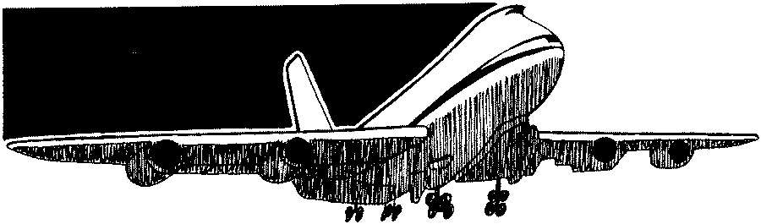
Signal-Detection Theory
The study of people’s tendencies to make correct judgments in detecting the presence of stimuli
Notes:
Bullet # 1 According to some psychologists, there is no sharp boundary between stimuli that you can perceive and stimuli you cannot perceive. Signal-Detection Theory tries to explain the relationship between sensitivity, motivation, and decision-making when detecting the presence or absence of a stimulus (Green & Swets, 1966). The best way to understand Signal-Detection Theory is to liken it to the job of a radar operator. The operator must be able to detect the difference on his screen between a plane and a flock of birds. Some radar operators may have better sensory skills than others. Some radar operators are probably more focused than others and are able to block outside distractions. Signal-Detection Theory takes into account the many factors that affect detection. It discards the idea of an absolute threshold because detection almost always involves competing signals or stimuli rather than just a single event.

Slide 23
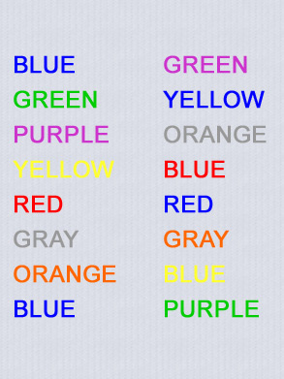
The Stroop Effect
A B
Notes:
Note to teacher: Ask for a volunteer to try this experiment. You may want to have a timer in order to show the class exactly how much longer it takes to read the words in column B. Ask the volunteer to do the following:
Recite the color of each word listed in column A. Now recite the color of each word listed in column B. It probably took you more time to name the colors in B. The Stroop Effect illustrates the difficulty of ignoring certain types of stimuli. In this experiment, the subject has to deal with receiving two stimuli at once: the word itself and the color of the word. When the two were the same, as in column A, it didn’t take that much time to recite them. However, when the two differed (as they did in column B), it caused competition and made the task more difficult.

Slide 24
Processing Stimuli
Preattentive process
  We process info from several stimuli at the same time
Attentive process
  We process info from one stimulus at a time
Notes:
Bullet # 1 Psychologists have defined two separate ways in which we process stimuli. The preattentive process extracts information automatically and simultaneously when presented with more than one stimulus. The Stroop effect is an example of how the preattentive process can act as an interference. In column B of the previous slide, it is very difficult not to read the word rather than the color of the word when the two are different. The preattentive process thus affects our ability to respond.
Bullet # 2 The attentive process considers only one stimulus at a time. All tasks require attention, but some tasks require more than others, which is where the attentive process comes in.

Slide 25



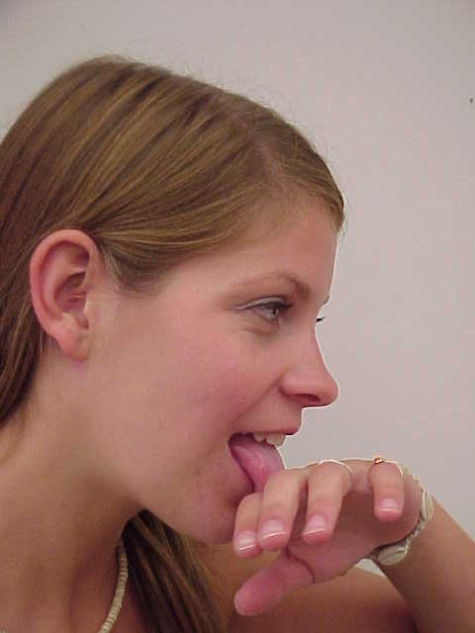
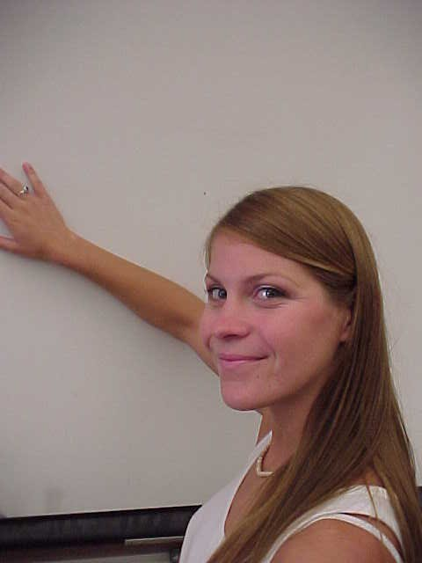
The Senses
Notes:
Most people believe humans have only five senses: vision, hearing, taste, smell, and touch. We also have two internal senses: vestibular and kinesthetic. In this next section, we will closely examine each of our senses.

Slide 26
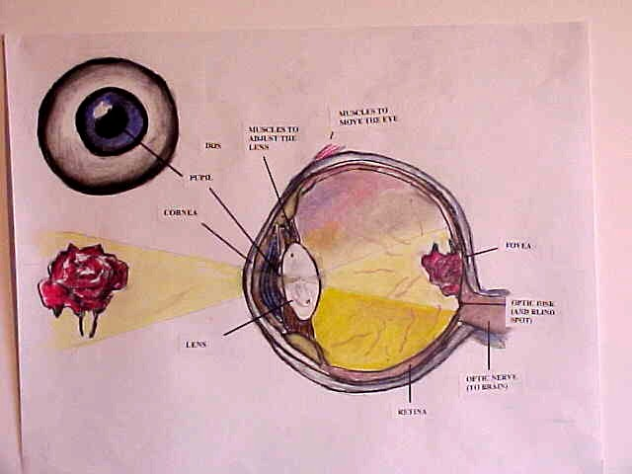
Vision
Pupil: the opening in the iris that regulates the amount of light
Lens: the flexible and transparent part of the eye that changes its shape to focus light in the retina
Retina: the innermost coating of the back of the eye
Notes:
Scientists have conducted more research on vision than on any of the other senses. Light enters the eye through the pupil and then reaches the lens, a structure which focuses light on the retina. The retina has two types of light-sensitive receptor cells called rods and cones. The rods and cones change the light into neuronal impulses. These impulses travel over the optic nerve to the occipital lobe of the brain. A muscle called the iris expands or contacts to regulate how much light enters the eye. It is usually blue or brown and gives the eye its color. The pupil is the black opening inside the iris. Bright light causes the iris to act reflexively and make the pupil smaller. In the dark, the iris opens to allow more light to enter the pupil.

Slide 27
Notes:
Light passes through the cornea, the pupil, and the lens. The light then falls on the retina, where images are reflected upside down (as with the rose pictured in the image on this slide).

Slide 28
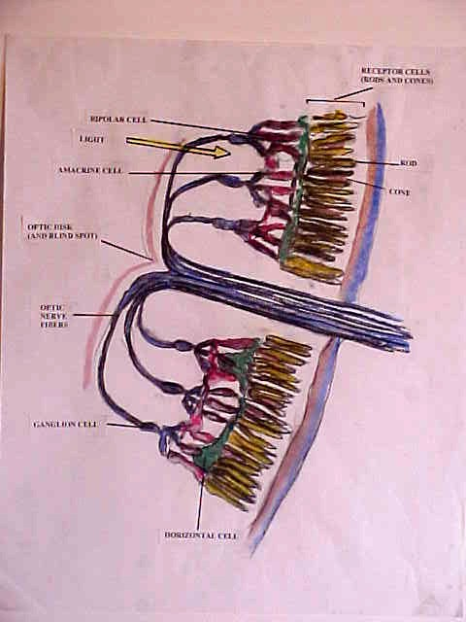
The Human Eye: Rods and Cones
Cones require more light than rods and work best in daylight
Rods are more important for night vision
Notes:
Bullets # 1–2 The diagram in this slide shows a close-up of the several layers of cells contained in the retina. Receptor cells nearest the back of the eye known as rods and cones are the parts of the eye that detect light. The other layer of cells in the retina receives signals from the rods and cones. They then feed the sensory data into many optic fibers, which eventually carry the data to the brain. Cones require more light than rods and they function best in daylight. Rods are much more sensitive to lower levels of light and play a larger role in night vision. There are many more rods (75 to 150 million) than there are cones (six to seven million). Only cones can sense colors.

Slide 29
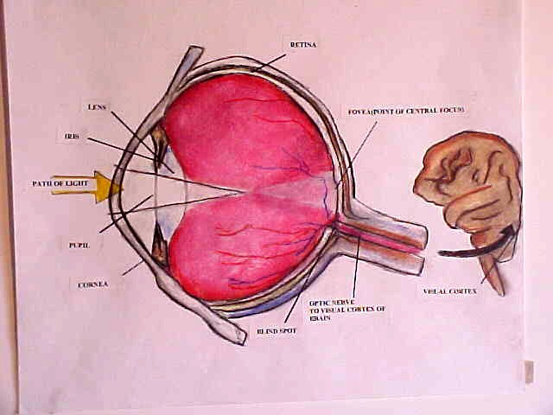
The Fovea and the Blind Spot
Fovea: the part of the retina that corresponds to the center of our gaze
Blind spot: the part of the retina where the optic nerve leaves the eye
Nearsighted vs. farsighted
Notes:
Bullet # 1 The fovea is the part of the retina that corresponds to the very center of our gaze. It gives us our sharpest vision. When we focus our eyes on an object, the image rests directly on the fovea. When we want to examine the small details of an object, we decrease the distance between it and the fovea, either by moving the object or moving ourselves.
Bullet # 2 The blind spot is the part of the retina where the optic nerve exits the eye. Because the blind spot has no rods or cones, we do not see images that form there.
Bullet # 3 Nearsighted people need to be close to objects to see details; farsighted people need to be far away. Both nearsightedness and farsightedness result from an abnormal shaping of the eye. Contact lenses, glasses, and surgery can all correct both conditions.

Slide 30
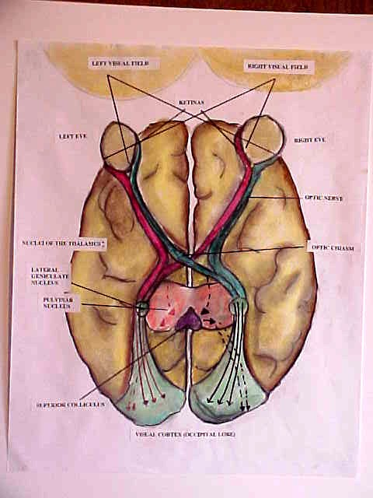
Visual Pathways to the Brain
Input from the right half of the visual field strikes the left side of each retina and is transmitted to the left hemisphere (shown in red)
Input from the left half of the visual field strikes the right side of each retina & is transmitted to the right hemisphere (shown in green)
Notes:
The nerve fibers from each eye meet at what is known as the optic chiasm. Fibers from the inside half of each retina then cross over to the opposite side of the brain.

Slide 31
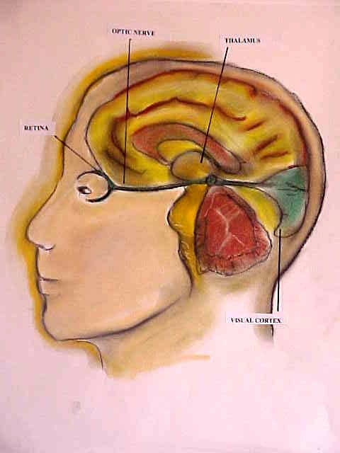
Notes:
The diagram in this slide shows how visual information coming from the retina along the optic nerve reaches the visual cortex as it passes through the thalamus.

Slide 32
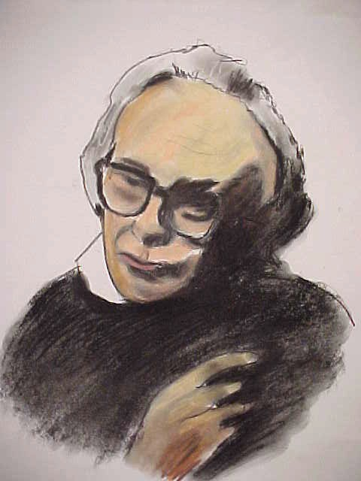
David Hubel
Won the Nobel Prize for his work on how humans transform sensory information
Planted electrodes in a cat’s visual cortex
Feature detection
Notes:
Bullet # 1 Researchers David Hubel and Torstein Wiesel won a Nobel Prize for explaining how we transform sensory information into visual experiences. They discovered that the visual cortex contains nerve cells that respond only when shown a line with a particular orientation (horizontal, vertical, or diagonal). Some of these nerve cells respond “only to lines that form right angles; others to dots of light that move from right to left across the visual field; and yet others, by dots of light that move from right to left across the visual field; and yet others, by dots of light that move from left to right” (Hubel & Wiesel, 1979).
Bullets # 2–3 Their experiment involved implanting electrodes into a cat's visual cortex. They then flashed the different visual stimuli on a screen within the cat’s field of vision and observed which cells fired in response to the different stimuli. They called these cells “feature detectors.”
Special note: We do not see a world just filled with shapes like rectangles, right angles, or triangles. The visual cortex makes sense of these symbols and transforms them into letters, faces, buildings, and other meaningful patterns.

Slide 33
Light
The visible portion of the electromagnetic spectrum
The colors we see are different wavelengths of light
We see color when light waves hit objects and bounce back to us at varying speeds
Notes:
Bullet # 1 Light is a form of electromagnetic radiation. Other forms of radiation include radio waves, microwaves, infrared, radiation, ultraviolet rays, X-rays, and gamma waves. Collectively, this radiation is called the electromagnetic spectrum

Slide 34
Color Deficiency
Occurs when a person’s cones do not function properly
Different types of color deficiency:
A. Some see certain colors
B. Totally color deficient
Notes:
Bullets # 1–2 People who suffer from color deficiency have cones that do not work properly. Many color deficient people can see some colors but have trouble distinguishing between red and green. Others cannot distinguish between yellow and blue. A few people are totally color deficient, and see the world only in black and white or shades of gray. About 8 percent of the general population falls into this category. Color deficiency primary afflicts males, and it is hereditary, passed from mothers to sons.

Slide 35
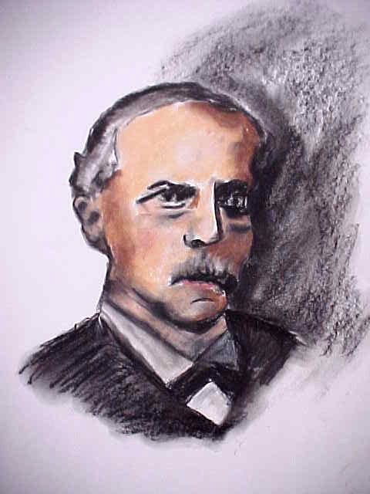
Color Vision
Color receptors in the retina transmit messages to the brain when visible lights having different wavelengths stimulate them
Hermann von Helmholtz
Notes:
Bullet # 1 The retina is a paper-thin sheet of tissue that forms the lining of the eye. It consists of a complicated network of receptor cells arranged in layers. The cells of the retina are sensitive to light.
Bullet # 2 Two 19th-century German scientists, Hermann Von Helmholtz (1821–1894, pictured in this slide) and Ewald Hering (1834–1918), made important early discoveries on color vision.

Slide 36
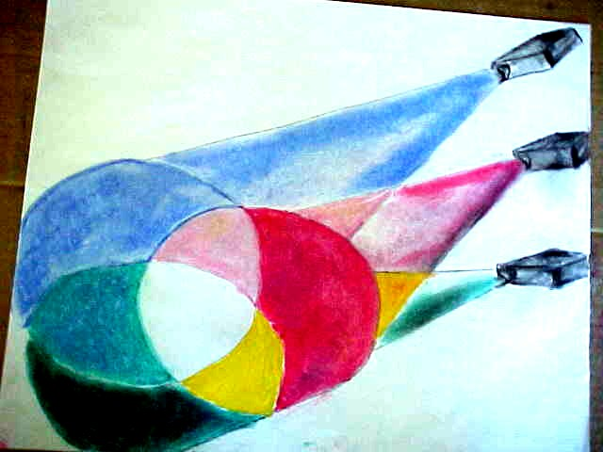
Thomas Young’s Work
The three primary colors of light (red, green, blue) combine to form white
Young showed that you could create any color of light by mixing these component colors and varying their brightness
Trichromatic theory
Notes:
Bullets # 1–2 Hering and von Helmholtz built upon the work of Thomas Young (1773–1829). Young showed that you could create any color of light by mixing the primary colors (red, green, and blue) and varying their brightness. This slide depicts the wide variety of colors that can be produced from the primary colors.
Bullet # 3 Helmholtz used Young’s conclusions to come up with what is known as trichromatic (three-color) theory. Helmholtz believed that the eye has three color receptors, also called cones. These three types of cones have differing sensitivities to different wavelengths of light. This allows us to see different colors.

Slide 37
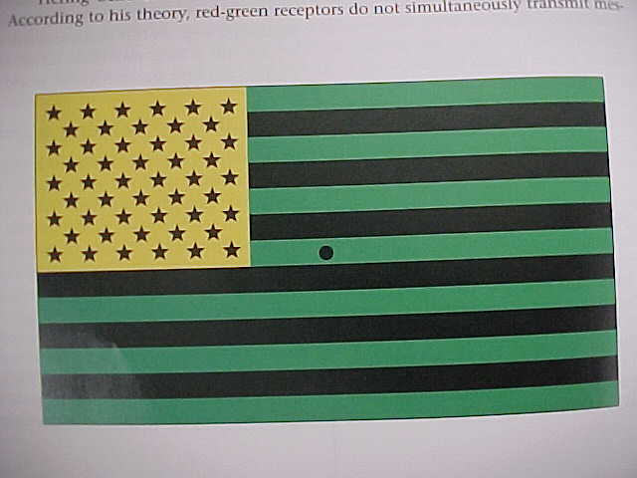
Afterimages
Notes:
Ewald Hering developed a different theory of color vision based on his work with afterimages. An afterimage is what you see if you stare at a visual stimulus for a while and then look at a blank white space.
Note to teacher: Read the following instructions to the class.
Look at the image on the left side of this slide. Stare at the dot in the center of the flag for about one minute, then shift your gaze to the white square on the right. You should see the regular colors of the American flag—red, white, and blue. This occurs because red is the afterimage of green, white is the afterimage of black, and blue is the afterimage of yellow. Hering believed that color vision arises from pairs of opposing processes. The receptors become fatigued, allowing complementary colors to predominate. Hering formulated what became known as opponent-process theory. Unlike trichromatic theory, opponent-process theory holds that color receptors in the retina correspond to sets of colors (red-green, yellow-blue, black-white) rather than to single colors.

Slide 38
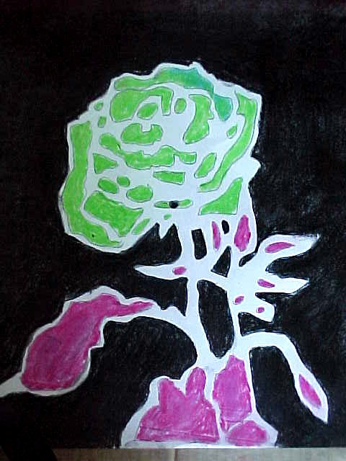
Complementary Afterimage
Notes:
This slide shows another example of an afterimage.
Note to teacher: Read the following instructions to the class.
Stare at the black dot in the center of the rose for about 60 seconds, then shift your gaze to the white rectangle. You will see an afterimage of the flower, but in complementary colors.
Note: Psychologists today believe that it takes both the trichromatic and the opponent-process theories to explain color vision.

Slide 39
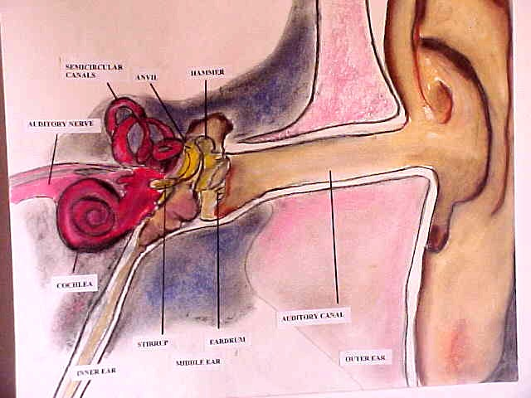
Hearing
Depends on sound waves or vibrations
Sound waves pass through various bones in the inner ear
Thin, hair-like cells move back and forth
Notes:
Bullets # 1–2 The fluctuations in pressure that constitute sound are actually produced by vibrations. For example, when we speak, our vocal cords vibrate producing fluctuations in air pressure that become sound waves. Sound waves pass through several different bones in the inner ear.
Bullet # 3 The inner ear is filled with thin, hair-like cells that move back and forth much like a field of wheat blowing in the wind. These cells change sound vibrations into neuronal signals that then travel through the auditory nerve to the brain.

Slide 40
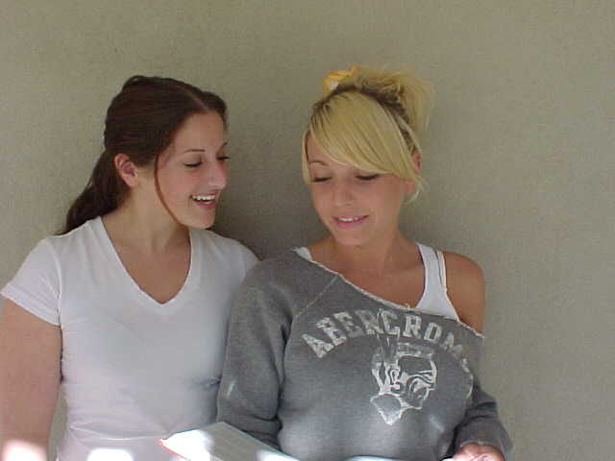
Loudness
Decibels: measures of loudness
Each 10-decibel increase makes a sound 10 times louder
Sound travels through the air at 1130 feet per second
Notes:
Bullet # 1 –2 Loudness (also known as amplitude) is measured in decibels. Each 10-decibel increase makes a sound 10 times louder. A normal conversation held between two people three feet apart measures about 60 decibels—10,000 times louder than a whisper, which only registers at 20 decibels. Sounds become painful to the human ear when they reach about 130 decibels. Normal conversation occurs at about 50 to 60 decibels, a ringing telephone measures 64 decibels, a lawnmower measures 90 decibels, a jackhammer measures 115 decibels, sitting in front of a speaker at a rock concert measures 120 decibels, and an airplane measures 140 decibels. Prolonged exposure to sounds at 80 to 90 decibels or higher can produce hearing damage.
Bullet # 3 Compared to the speed of light (186,000 miles per second), sound waves travel pretty slowly—1130 feet per second, or about 770 miles per hour. This explains why when you see lightning a mile away, it can take five seconds for the sound of the thunder it caused to reach your ears.

Slide 41
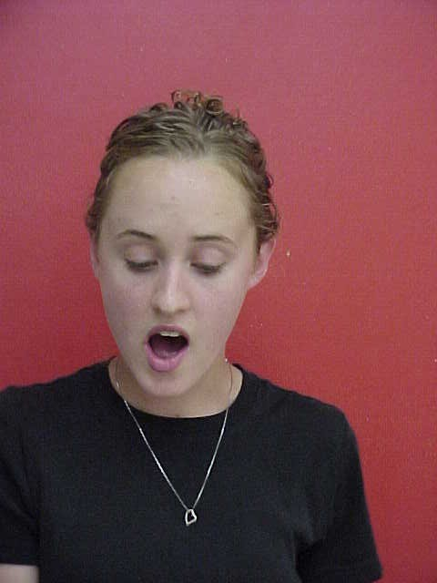
Pitch
The highness or lowness of a sound that corresponds to the frequency of a sound wave
The ear senses sound waves that vary from 20 to 20,000 cycles per second
Notes:
Bullet # 1 Even though sound travels more slowly than light, its vibrations occur many times a second. The frequency with which these vibrations occur provides information that the brain uses to perceive what is known as pitch—how low or high a sound seems.
Bullet # 2 Higher frequency sound waves are perceived as higher in pitch. Women’s voices usually sound higher than men's because their vocal cords tend to be shorter and vibrate more rapidly/at a greater frequency. Similarly, the shorter strings on a harp produce higher notes than the longer strings because they vibrate more rapidly.

Slide 42
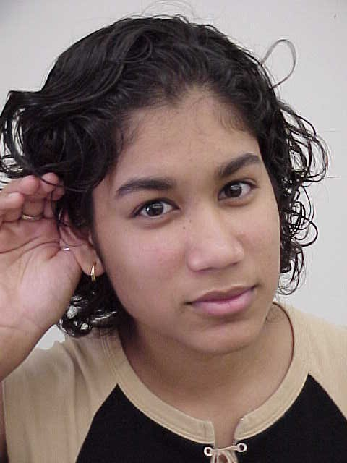
Hearing Loss
30 million Americans have hearing problems
2 million are deaf
Causes: birth defects, disease, advanced age, injury, overexposure
Notes:
Bullets # 1–2 Almost 30 million Americans have hearing problems, and about two million are considered deaf.
Bullet # 3 Many things can lead to deafness or hearing loss. Diseases like measles can cause deafness in infants. As people age, their hearing may start to deteriorate. Prolonged exposure to noises of 85 decibels and above can cause hearing loss. Even brief exposure to sounds of 120 decibels and above can cause damage.

Slide 43
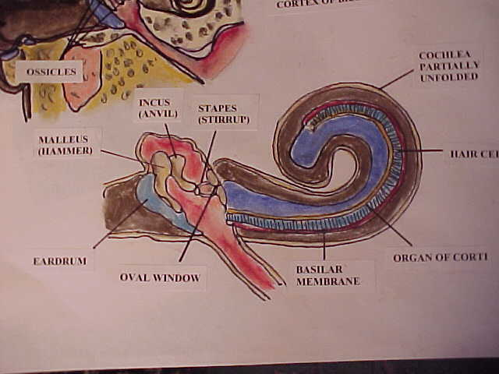
Types of Hearing Loss
Conduction deafness: caused by damage to the middle ear
Nerve deafness: caused by damage to hair cells or the auditory nerve
Notes:
Bullet # 1 The two main forms of hearing loss are conduction deafness and nerve deafness. Conduction deafness is usually caused by damage to the middle ear, such as a punctured eardrum. An injury to the ossicles can cause them to lose their ability to vibrate properly. People who suffer from conduction deafness can benefit from the use of hearing aids.
Bullet # 2 Nerve deafness is usually caused by damage to the hair cells of the inner ear or to the auditory nerve. Causes include loud noises, disease, and aging. The “ringing in your ears” sensation that occurs after exposure to loud noises may indicate damage to hair cells.
Note: Hearing loss in later years is not inevitable.

Slide 44
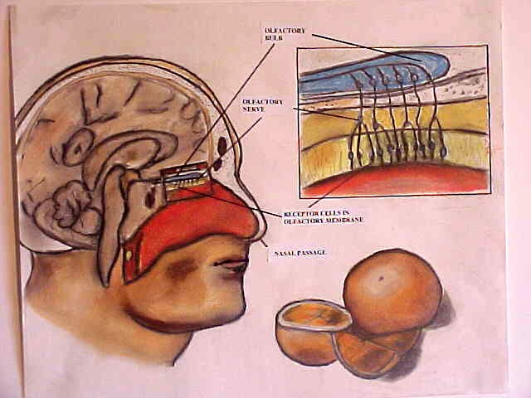
Smell and Taste
The chemical senses
Nerve impulses travel through the olfactory nerve to the olfactory bulb in the brain, causing sensation of specific odors
Notes:
Bullet # 1 Both the sense of smell and taste are considered chemical senses because the nose and mouth both contain receptors that are very sensitive to chemical molecules. For you to smell something, the right molecules must come in contact with the smell receptors in your nose.
Bullet # 2 We have over five million or more odor receptors in our nostrils that are capable of sensing about 10,000 different substances on the basis of the shape of their molecules. These molecules fit into particular odor receptors like a key fits into a lock.

Slide 45
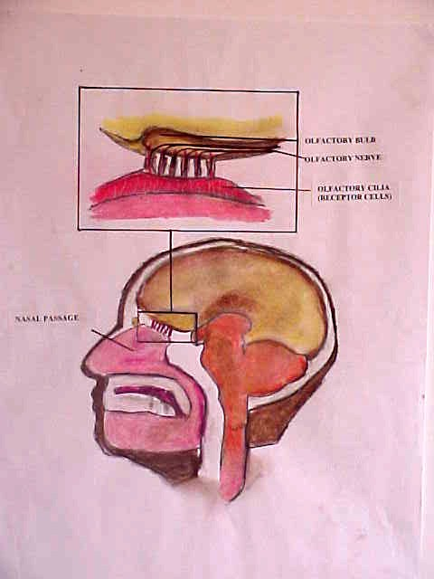
The Olfactory Bulb
Located in the front of the brain above the nostrils
Olfactory cortex is located in the temporal lobe
Connections to the limbic system
Notes:
Bullets # 1–2 Smell is the only sense whose input does not go through the thalamus on its way to the cortex of the brain. Instead, smell-related data travels through the olfactory nerve directly to the olfactory bulb, which is located in the front of the brain above the nostrils.
Bullet # 3 The limbic system in the brain is responsible for many functions that relate to emotion and memory. Connections between the olfactory system and the limbic system account for the relationship between odors and emotions, such as when someone's perfume or aftershave evokes strong feelings, or when the smell of homemade bread baking in an oven brings back certain childhood memories. Some psychologists believe odors are inborn: “Newborns lick their lips when they are presented with odors of honey, strawberry, vanilla, and chocolate” (Bartoshuk & Beauchamp, 1994).

Slide 46
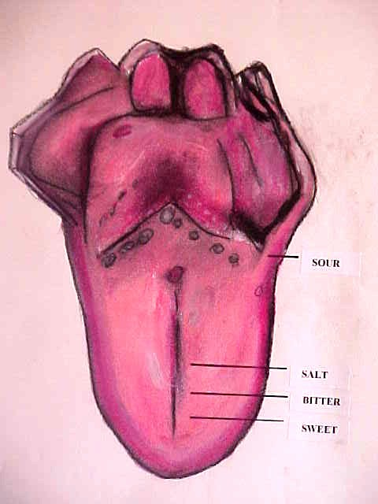
Taste
Four basic tastes: sweet, sour, salty, bitter
Food’s flavor results from these combinations: aroma, texture, temperature
Taste cells, taste buds
Notes:
Bullet # 1 Taste also contributes to our survival. We rely on taste to help us discriminate between fresh or spoiled or rotten food. The sense organs, however, are not perfect. Some poisonous substances can’t be detected by either taste or smell. Although thousands of different flavors exist, there are only four basic tastes: sweet, sour, salty, and bitter.
Bullet # 2 A food’s flavor results from a combination of its aroma, texture, and temperature.
Bullet # 3 Receptors called taste cells, located within openings in the tongue called taste buds, sense flavors and tastes. Most of our taste buds are located near the edge and back of the tongue. (Note: Other taste receptors lie on the roof of the mouth and throat. Taste receptors can regenerate quickly (7 to 10 days) if a person damages them by eating food that’s too hot in temperature.

Slide 47
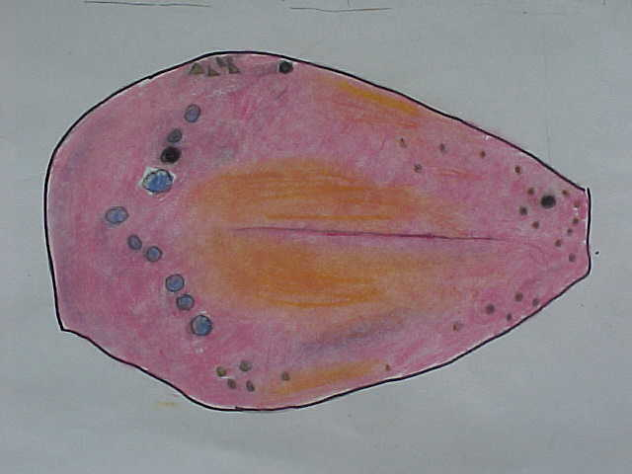
Supertasters
People who have greater taste sensibilities than others
Supertasters have two to three times more taste buds than normal
Notes:
Bullets # 1–2 “Supertasters” are people who have greater taste sensibilities than others, and they usually have two to three times more taste buds than normal. Psychologists have found both gender and ethnic differences in taste sensitivity. For example, Asian women are most likely to be supertasters, while white men are least likely to be supertasters (Carpenter, 2000). People who use a lot of salt may have a genetic trait that makes them “taste-blind” to salt.

Slide 48
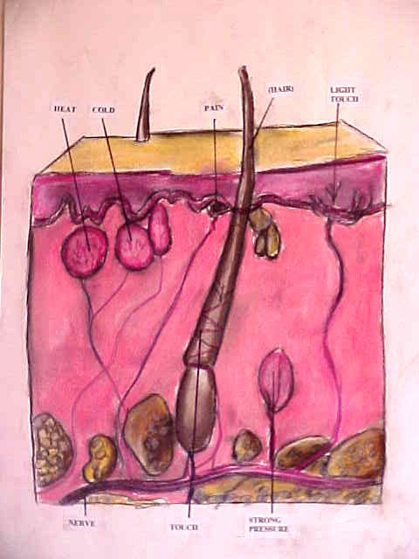
Skin
The skin is the largest sensory organ
Touch, pressure, warmth, cold, pain
1.5 million receptors for touch and pressure, somatosensory cortex
Notes:
Bullets # 1–2 Receptors found in the skin provide the brain with five kinds of information about the environment (touch, pressure, warmth, cold, and pain). Some skin receptors respond to just one type of stimulation such as pressure or warmth, while others respond to more than one.
Bullet # 3 The human body contains more than 1.5 million receptors for touch and pressure. These receptors send sensory information to the spinal cord and then to the somatosensory cortex in the brain, which processes the information. There are many touch receptors located near the surface of the skin. These receptors fire when the skin is lightly touched, caressed, patted, or stroked. Other receptors at deeper levels beneath the skin fire in response to pressure (see the diagram in this slide).

Slide 49
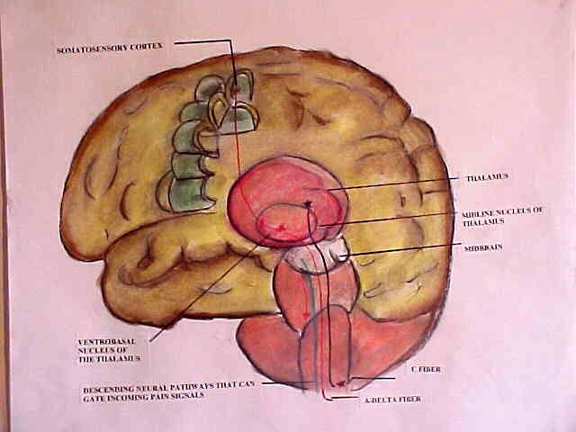
Pathways for Pain Signals
Receptors send pain signals to the brain along two pathways
Gate control mechanism: incoming pain sensations must pass through a gate in the spinal cord that can be open or closed
Endorphins, acupuncture
Notes:
Bullet # 1 The diagram in this slide shows the two pathways for pain signals to reach the brain: the fast pathway is shown in red, and the slow pathway is shown in black. Which pathway a pain signal takes depends on the nerve fiber it travels along: some nerve fibers are routed through the fast pathway, others through the slow pathway.
Bullet # 2 Psychologists Ronald Melzack and Patrick Wall developed what is known as “gate control theory.” They postulated that any incoming pain sensations must first pass through a “gate” in the spinal cord that can either be open or closed. This gate is not an actual structure, but rather a pattern of neural activity that inhibits incoming pain signals. Receptors in the brain can send signals that cause the gate to close.
Bullet #3 Pain researchers later focused on the secretions of endorphins (a natural version of morphine produced by the brain). Endorphin release may explain why many benefit from acupuncture, a traditional Chinese medical practice that involves inserting thin needles at key “points” in the patient’s body. The needles then help release or redirect the body’s natural healing energy, called chi. While many Western doctors (and even several HMOs!) accept acupuncture as a legitimate medical procedure, some psychologists believe acupuncture involves nothing more than the placebo effect

Slide 50
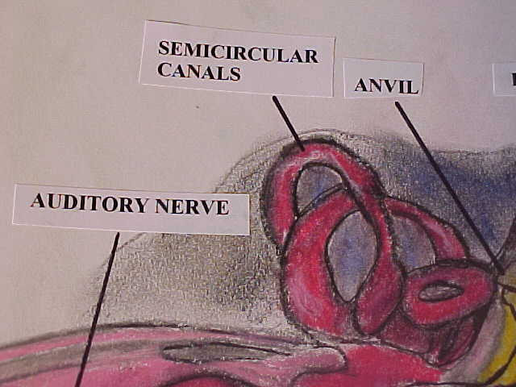

Kinesthetic
The sense of movement and one’s body is
vestibular sense
Receptors in muscles, tendons, joints
Semicircular canals
Notes:
Bullet # 1 Our kinesthetic sense lets us know about things like movement, body position, muscle functioning, and posture. It works with the vestibular and visual senses to maintain posture and balance.
Bullet # 2 Our muscles, joints, and tendons all contain receptors. When any movement occurs, these receptors send messages to the brain. Without kinesthetic receptors, our movements would be very jerky and uncoordinated. You would not be able to walk unless you looked at your feet, and it would be nearly impossible to perform more complex physical activities like playing a piano or doing gymnastics. Our vestibular senses monitor the position of our bodies in space and helps us maintain our balance.
Bullet # 3 The semicircular canals are three curved, tube-like structures in the inner ear that sense changes in the direction of the movement of our head. You probably know that if you spin around for a significant period of time and then stop, you end up feeling dizzy. This happens because the fluid in your semicircular canals keeps swirling for a while even after you have stopped spinning. (Note to teacher: see the diagram above the photo in the slide.)

Slide 51
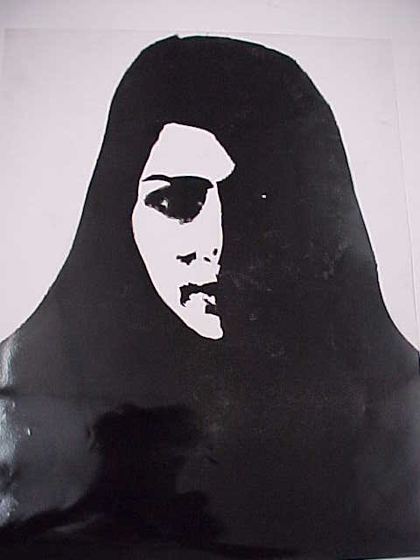
Perception
Notes:
Perception is the process by which your brain interprets sensory information and turns it into meaningful images of the real world. The airbrush painting in this slide shows only half of a young woman’s face. Through perception, your brain attempts to make sense of the missing details. Our brains bring order to the mix of sensations that we experience and organize those sensations into a coherent picture.

Slide 52
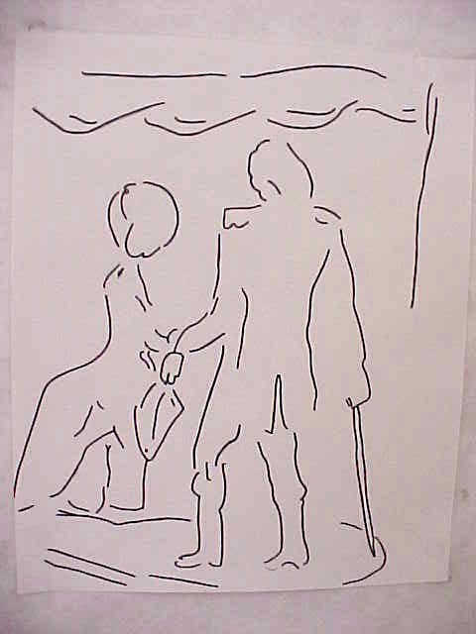
A Changing Picture
Notes:
Assume that this simple drawing is a poster for a circus act involving a trained seal. You will probably see a seal balancing a ball on its nose and a trainer holding a whip in one hand and a fish in the other.
Now, assume instead that this drawing shows a costume ball. Can you make out a costumed man and a woman? She is handing him a hat and he has a sword in his right hand.
This drawing shows how identical visual input can create very different perceptions. People perceive the world subjectively, not objectively.

Slide 53
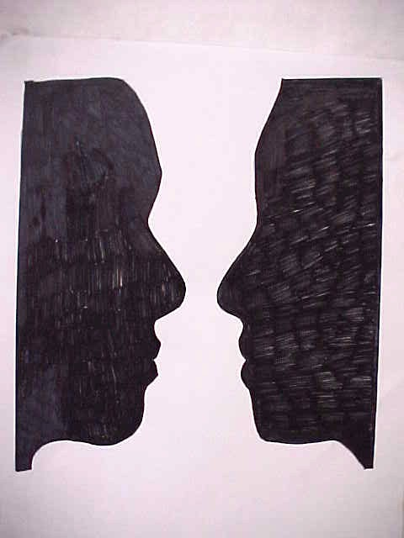
Defining Perception
An active process
The brain pieces together bits of sensory information in order to form orderly impressions or pictures
Gestalt
Notes:
Bullets # 1–2 People do not usually experience the world as a mass of colors and shapes. Instead, we see buildings, cars, faces, and other things. Through perception, the brain combines various sensory information in order to form orderly, coherent impressions and pictures.
Bullet # 3 What do you see in the illustration on this slide: a vase or two faces in profile? We invariably organize our experiences into “figure” and “ground” (background). The figure is the thing that is being looked at and the ground is the background against which it stands. Whether you perceive two faces or a vase in this drawing depends on which part of this drawing you see as the figure and which as the background. You cannot perceive it both ways at once. Gestalt is a German word meaning “form” or “shape.” Gestalt psychologists believe that perception is not simply the sum of our sensory information, and they also believe that the brain creates perception in a systematic, predictable manner.

Slide 54
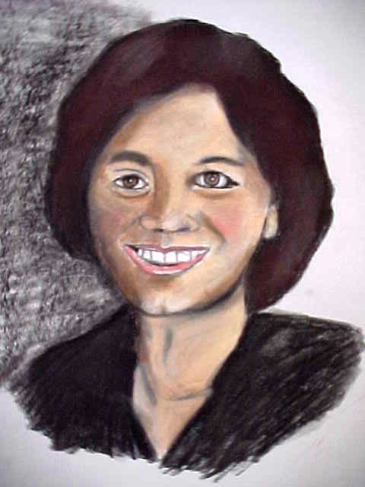
Gestalt Principle #1: Proximity
“Meaningful wholes seem to precede parts and properties, as the Gestalt psychologists emphasized years ago.” –Anne Triesman
Notes:
Bullet # 1 According to Gestalt psychologists, we tend to perceive a number of similar objects as a group or set. For example, we usually group together things lie in close proximity to one another.

Slide 55
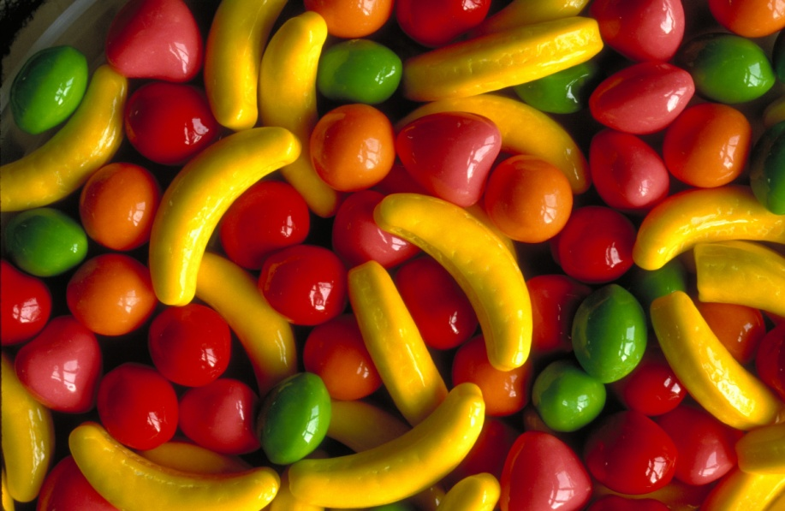
Gestalt Principle # 2: Similarity
When similar and dissimilar objects are mingled together, we see the similar objects as groups
Notes:
People tend to group objects that appear similar. Take a look at the candy in this picture. Did you perceive it as an undifferentiated mass, or did your mind seem to pick out the bananas, oranges, cherries, and other flavors one at a time?

Slide 56
Gestalt Principle # 3: Continuity
We tend to see continuous patterns, not disrupted ones
Notes:
Bullet # 1 We tend to perceive elements in ways that produce continuity. For example, when people view an image of several unconnected dots, their brains usually connect the dots in ways that lead the person to perceive a straight or partially curved line that follows a smooth path.

Slide 57
Gestalt Principle # 4: Simplicity
We perceive the simplest shapes possible
Notes:
Bullet # 1 Gestalt psychologists also believe that people not only tend to organize an unconnected mass of forms, they tend to do it in the simplest way possible. Consequently, our brains often lead us to perceive the most basic shapes, such as circles, ovals, squares, and rectangles.

Slide 58

Gestalt Principle # 5: Closure
Occurs when people see a familiar pattern or shape with some missing parts
Notes:
Bullet # 1 People often group elements together in order to create a sense of closure or completeness. We typically complete figures that have gaps in them, such as the one shown in the image in this slide.
Note: Though much of Gestalt psychology is no longer considered viable for current research, Gestalt ideas about perception have stood the test of time.

Slide 59
Perceptual Interference
Perceptions are not always based on sensory information
Perceptual interference: occurs when we fill in the gaps in what our senses tell us
"The Office" clip
"visual cliff" clip
Notes:
Bullets # 1–2 When you hear barking in your backyard, you usually assume it’s your dog. If you walk into a dark theater and sit down, you make the assumption that the seat will support your weight. If you drive your car up a steep hill and you can’t see over the top, you still assume that the road keeps going. Perceptual interference allows us to fill in the gaps in our sensory information.

Slide 60
Subliminal Perception
Sub (below); limen (threshold)
Subliminal messages
Congressional and FCC alerts
Notes:
Bullet # 1 In his book The Hidden Persuaders, Vance Packard laid out the theory of “subliminal perception.”
Bullet # 2 The word “subliminal” comes from the Latin sub, meaning “below the surface,” and limen, meaning “threshold.”
Bullet # 3 Subliminal messages are either auditory or visual images that lie below the absolute threshold of awareness. Psychologists define subliminal messages as ones that people will perceive less than a 50 percent of the time. One famous subliminal ad played on a movie screen for six weeks just before the feature. James Vicary, a New Jersey advertiser, created a spot that flashed the words “Eat Popcorn” and “Drink Coke” at the rate of 1/3000 of a second, once every five seconds—so quickly that none of the moviegoers even saw them. Vicary claimed that the ad boosted the sale of popcorn by 58% and Coke sales by 18%.
Bullet # 4 Congress soon called on the FCC to regulate subliminal ads and passed laws banning the use of subliminal messages in movies.

Slide 61

Subliminal Perception
The ability to notice stimuli that affect only the unconscious mind
Controversy and Brian Wilson Key
Notes:
Note to teacher: This slide gives a very rudimentary demonstration of how subliminal messages operate. Click once and the top bullet will flash for a moment on the screen. Click again and the second bullet will flash.

Slide 62
Subliminal Perception
The ability to notice stimuli that affect only the unconscious mind
Controversy and Brian Wilson Key
Notes:
Bullet # 1 According to some psychologists, many of the early studies done on subliminal messages were flawed because other factors could have contributed to the effects supposedly caused by the subliminal messages. For example, the movie ad might not have been the only reason sales of refreshments rose: variables such as room temperature in the theater could have affected sales of Coke, and the length of the movie could have helped increase the sale of popcorn.
Bullet # 2 Subliminal perception has become highly controversial, especially as it relates to sex, money, religion, and rock music. Brian Wilson Key has written a number of books in which he claims that magazine ads have sexual words and drawings embedded in them. The drawing in this slide is a reproduction of an actual ad that ran in Time magazine in 1971. If you look closely, you can see the word “sex” hidden in the ice cubes.

Slide 63
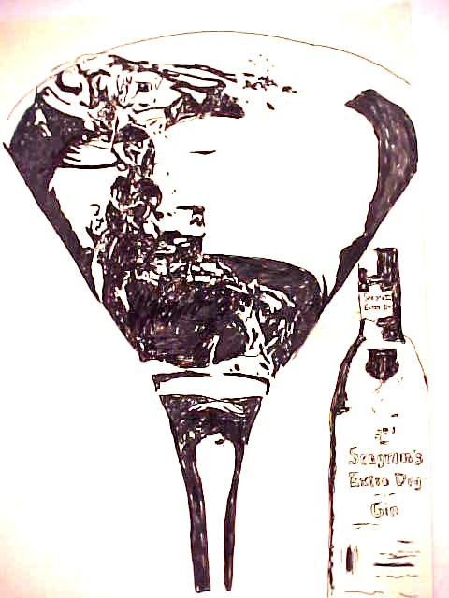
In the Eye of the Beholder
According to Key, advertisers routinely place subliminal stimuli in their ads
Subliminal self-help
Notes:
Bullet # 1 Many marketing executives claim that the ads they create contain no subliminal content and that people merely read things into the images they view, just like when you sometimes see familiar shapes when you look at clouds. Thomas Creed and other psychologists have contended that Key’s work amounts to little more than pseudoscience.
Bullet # 2 Today, you can find a plethora of subliminal self-help tapes designed to assist people in doing things like losing weight and quitting smoking. It has become a $50 million industry. If you look carefully at the drawing in this slide, you can see a couple dancing in the glass. In the 1980s, some religious leaders claimed that rock songs contained subliminal messages promoting devil worship. You had to play a record backwards in order to hear these messages, a technique known as “backward masking.” In the most famous alleged example of backward masking, two researchers named Vokey and Read claimed that when you played the Led Zeppelin epic “Stairway to Heaven” backwards, you could hear messages such as, “There’s power in Satan.” Others believe subliminal messages can be used to manipulate a person’s sexual urges.

Slide 64
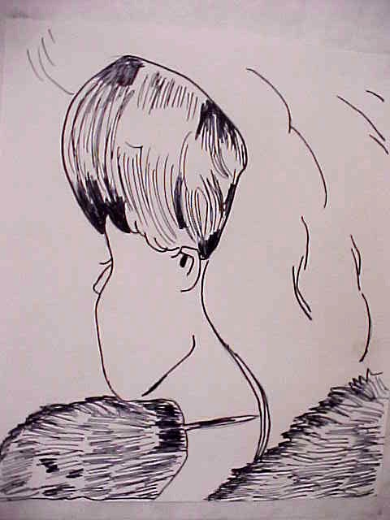
Two Types Of Stimuli
Distal
Proximal
Developing a perceptual hypothesis
Notes:
Bullet # 1 “Distal stimuli” refers to objects as they exist outside of our perception.
Bullet # 2 “Proximal stimuli” refers to the effects that distal stimuli have on our sensory receptors.
Bullet # 3 Psychologists believe people can bridge the gap between distal and proximal stimuli by generating a hypothesis or an educated guess (Gregory, 1973).
The drawing in this slide is a reproduction of a famous reversible figure. It depicts a young woman looking over her shoulder, but you might also see an old woman with her chin on her chest. The drawing is ambiguous because it doesn’t provide enough information for you to perceive it as either distal or proximal.
Note to teacher: Some students may not be able to see both the young woman and an old woman. Some hints you can give them: The young woman’s necklace forms the old woman's mouth, and the young woman’s ear forms the old woman’s eye. If your students need guidance in locating either of the faces, let them know that this demonstrates the common perceptual hypothesis that “people see what they expect to see.”

Slide 65
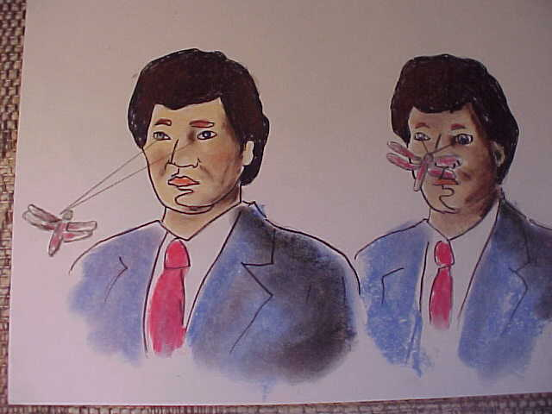
Depth Perception
The ability to recognize distance and three-dimensional images
Binocular vs. monocular cues
Retinal disparity and convergence
Notes:
Bullet # 1 Depth perception involves interpretation of visual cues that indicate how near or far away objects are.
Bullet # 2 In order to adequately perceive distance, people rely on a variety of clues which can be classified into two types: binocular and monocular (Hochberg, 1988). Because our eyes are set apart, each one sees a slightly different scene. Binocular depth cues offer clues about distance. Do you remember the old View-Master® (also known as a stereo viewer) you may have used when you were a child? It looked kind of like a pair of binoculars; you would insert a circular reel with slides on it, then you would look into the eyepieces and see a 3-D image. The viewer achieves the 3-D effect by depicting slightly different views of the same scene to each eye. Your brain then supplies three-dimensional depth to the scene.
Bullet # 3 “Retinal disparity” refers to the fact that objects within 25 feet of a person project slightly different images to each retina. Basically, the right and left eye each see distinct images that differ only marginally. The shorter the distance between an object and the person viewing it, the greater the disparity between the images seen by each eye. In other words, retinal disparity increases as objects get closer. “Convergence” occurs when the eyes move towards each other as they focus on closer objects. The more you have to converge your eyes together to focus on an object, the nearer the object is to you.

Slide 66
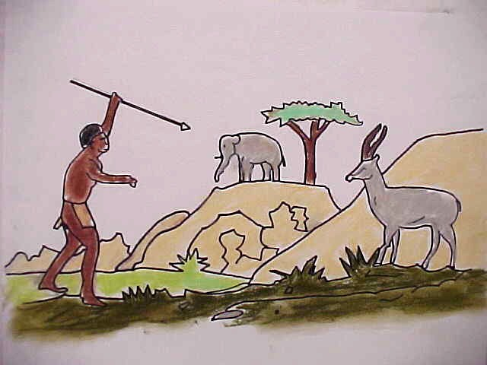
Monocular Cues
Depth cues about distance are based on the image one eye or the other sees
Six cues: interposition, height in plane, texture gradient, relative size, light and shadow, linear perspective
Notes:
Bullets # 1–2 Psychologists have identified six monocular cues that we use. “Linear perspective” is a depth cue that causes us to perceive parallel lines as converging in the distance. For example, when you stand on railroad tracks and look to where they disappear in the horizon, they seem to meet. A cue known as “texture gradient” can also provide information about depth. All things have textures; however, objects closer to us appear to have a more distinct texture than objects off in the distance. The further away you get from an object, the more its texture seems to “smooth out.” “Interposition” occurs when we assume that an object that comes between us and another object must be closer. “Relative size” means that closer objects appear to be larger. “Height in plane” means that the further away an object is from a person, the higher that object will appear in the person’s frame of view. Light and shadow also influence how we perceive objects: the way in which sunlight casts a shadow on an object can affect how we gauge the distance between ourselves and that object. Light and shadow can also affect how we perceive the texture of an object.
Cultural differences can also influence a person’s ability to perceive depth in two-dimensional drawings. In one study, a researcher named Hudson showed the drawing in this slide to various cultural groups in South Africa. He asked participants to tell him which animal the hunter was trying to kill with his spear. Most Americans would consider the elephant an unlikely target because we perceive it as far away from the hunter. However, many of the people in Hudson’s study did pick the elephant as the most likely target. Hudson concluded that these people had real trouble with depth cues, interposition, relative size, and height in plane. He found that many of those who participated in the study were Bantu, a rural people who had had very little exposure to depth cues because of the geography of where they lived.

Slide 67
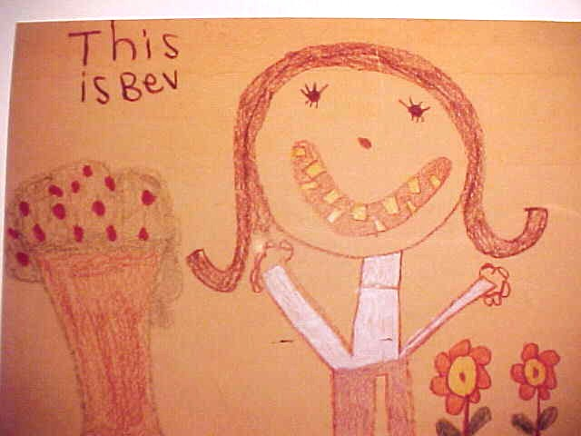
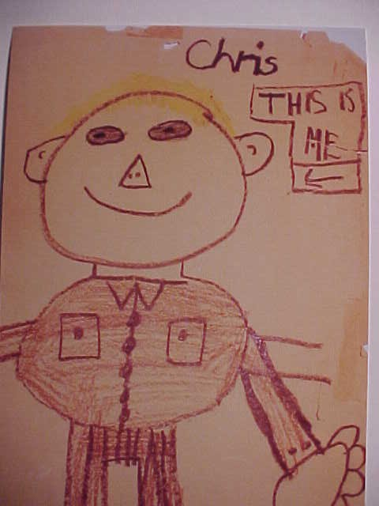
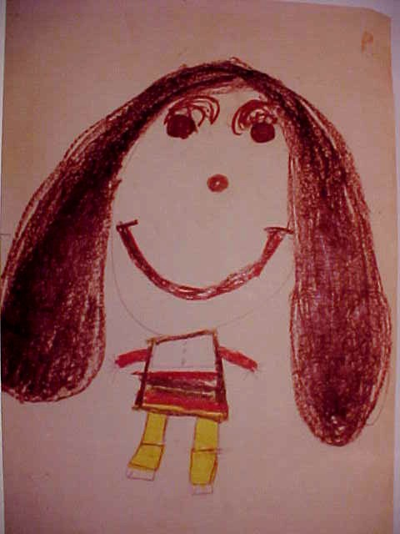
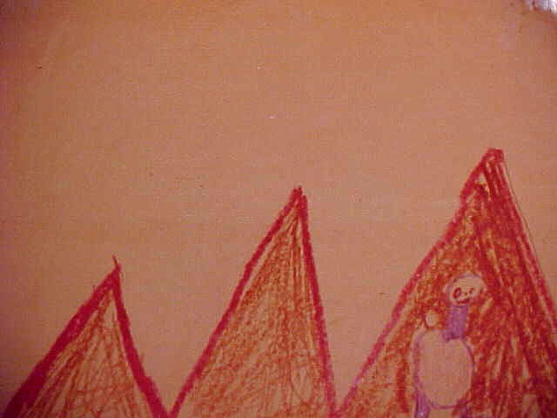
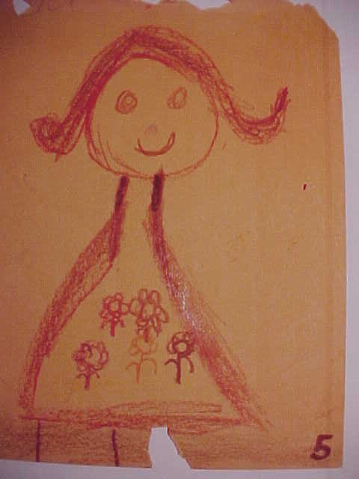
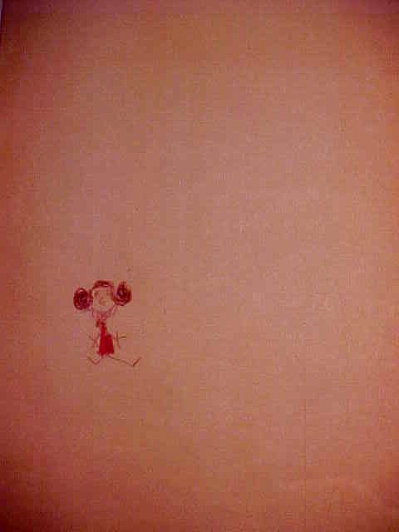

Notes:
The pictures in this slide were all created by elementary school students in the third and fourth grades. Many developmental factors play a role in shaping children's art. What do these pictures tell us about proportion, color, shape, and depth cues? (Note to teacher: Take some time to discuss this with the class.)

Slide 68
Optical Illusions
Perceptions based on inappropriate assumptions/discrepancy between the appearance of a visual stimulus and its physical reality
Muller-Lyer illusion
Notes:
Bullet # 1 In general, depth cues, perceptual constancy, and other Gestalt laws help most people see the world accurately. There are times, however, when optical illusions can result.
Bullet # 2 The famous Muller-Lyer illusion, shown in this slide, offers a simple example of an optical illusion. The two vertical lines are exactly the same length, although one appears longer than the other. The figure on the left looks like the outside of a building thrust in the direction of the viewer. The image on the right looks more like an inside corner thrust away. This makes the vertical line in the left figure seem closer. This illusion is based on size constancy and misperception of depth.

Slide 69

Another Illusion
Roger Shepard (1990)
The Ames Room
Notes:
Bullet # 1 The drawing in this slide is a re-creation of a drawing made by Stanford University psychologist Roger Shepard. The drawing creates an illusion similar to Muller-Lyer illusion: the second monster in the back seems larger than the first, even though they are the same size.
Bullet # 2 Psychologist Adelbert Ames designed a similar illusion called the Ames Room. The specially constructed room has a trapezoidal rear wall and a sloping floor and ceiling. This makes people standing in the right corner of the room appear giant, while those standing in the left corner look very small.

Slide 70

An Impossible Figure
Objects that can be represented in two-dimensional pictures may not be able to exist in three-dimensional space
Bottom-up processing
Notes:
Bullet # 1 At first glance, impossible figures look perfectly fine. As you look at them more carefully, however, you begin to notice that they violate the laws of geometry. This slide shows a reproduction of a drawing made by Roger Shepard. At first glance, the drawing seems all right. At second glance, you begin to perceive that the components of the image do not mesh together properly and add up to a sensible whole. You notice that although there are three columns, there are only two bases.
Bullet # 2 Psychologists view this illusion as resulting from what they call “bottom-up processing.” Initially, people perceive specific features of a drawing as reasonable, but when they try to assemble these features into a whole, they suddenly seem impossible. Illusions present what some psychologists call a “conspiracy of cues” designed to deceive the viewer.

Slide 71

Perceptual Set
Notes:
“Perceptual set” refers to the fact that our perceptions tend to be influenced by our preconceived notions and expectations. If you look first at figure C and then look at figure A, the drawings look like ducks. If you look first at figure B and then look at figure A, the drawings appear to be rabbits. How we interpret stimuli can depend on what past experience and beliefs have led us to expect.

Slide 72
Two Modes of Processing
Bottom-up
Top-down
Notes:
Bullets # 1–2 As discussed earlier, researchers Hubel and Wiesel (1979) showed that the visual cortex contains specialized receptors that respond to visual features like straight lines or angles. They also tried to find out exactly how the brain transforms bits and pieces of visual information into meaningful patterns. They identified two primary modes of processing: bottom-up and top-down. In bottom-up processing, our brain combines individual lines and angles to form patterns like the number 4. We do the same with letters to create recognizable words.
Bullet # 3 In top-down processing, the brain identifies patterns as meaningful wholes rather than individual pieces. This is why we sometimes think we recognize someone we see in the distance. As they get closer, we soon discover that we were wrong.

Slide 73
Extrasensory Perception (ESP)
The ability to gain information by some means other than the normal senses
Paranormal phenomena and parapsychology
Notes:
Bullet # 1 Many of us seem quite fascinated by things we cannot verify in sensory ways—in other words, things that we cannot see, hear, taste, touch, or smell. The notion of extrasensory perception (ESP) provides the basis for some great stories: people who can bend silverware using only their mind, people who claim to be able to find the bodies of crime victims by holding a piece of clothing worn by the victim, and people who can predict future events. Psychics, mind readers, psychokinetics (people who can move objects using their mind), and clairvoyants all claim that they possess some sort of ESP.
Bullet # 2 Paranormal phenomena are events that cannot be explained by physical, biological, or psychological means. The study of events like this is known as parapsychology.

Slide 74
The “Sixth Sense”
The major focus includes the following: Telepathy, clairvoyance, precognition, and psychokinesis
Notes:
No special notes. The following slides will discuss each of these forms of ESP.

Slide 75
Telepathy
Communication of thoughts from one mind to another that occurs without the use of our known senses
Notes:
Bullet # 1 Telepathy refers to the ability to project one’s thoughts into another person’s mind, read the contents of their mind, or perceive their thoughts or feelings without using normal sensory tools.

Slide 76
Clairvoyance
The ability to perceive objects and events without using the senses
Notes:
Bullet # 1 Clairvoyance refers to an ability to perceive events that lie beyond the range of one’s senses. People who claim to have this ability believe they can know what someone is doing across town at that very moment just by thinking about them. They also claim they can identify the contents of sealed envelopes.

Slide 77
Precognition and Psychokinesis
Precognition: the ability to foretell the future
Psychokinesis: the ability to move objects through mental effort alone
Notes:
Nearly all scientists remain skeptical about ESP because paranormal phenomena defy the laws of nature. Many cases that supposedly “proved” the existence of ESP later turned out to be hoaxes. At other times, strange events and occurrences initially labeled as paranormal have later been proven to be mere coincidence or random chance.

Slide 78
Theories of Perception:
Practical Applications
Aviation psychology
Human-computer interaction
Notes:
Bullet # 1 Many discoveries in the area of aviation psychology have resulted from studying accidents. Pilots need to make extremely accurate judgments— especially when landing their aircraft. Pilots sometimes have great difficulty determining how far they are from the runway and from what angle they need to make their approach. Experience plays an important role when landing at night or “flying by instruments.” Both these circumstances involve some impairment of bottom-up and top-down processing: pilots can no longer gather information directly from their own senses and instead need to rely solely on what their instruments tell them. Complicating things even further is the fact that the instruments found in a typical cockpit bear little resemblance to the real perceptual world. Misguided attempts to correct a plane’s altitude on descent have caused some horrific accidents.
Bullet # 2 Some psychologists who specialize in interactions between humans and computers are researching what can be done to make these interactions smoother. They use the results of their research to develop more “user-friendly” interfaces.

