Slide 1
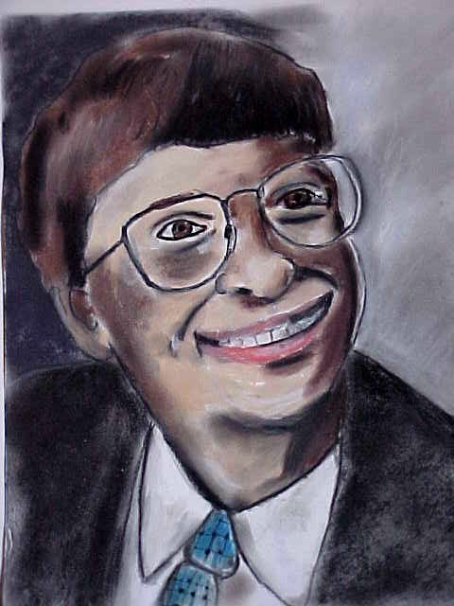
Motivation & Emotion
Notes:
Imagine how different your life would be if you inherited $10 million. How would your life change? If you were planning on going to college so you could get a good education and a job that paid well, would you still go? Is money the only thing that motivates us? Very few people ever attain great wealth. Bill Gates, the world’s richest man, is one obvious exception. Gates, the founder of Microsoft, could never hope to spend all of his wealth, yet he continues to be motivated to work and develop new ideas. Gates once remarked in an interview that he sees life as a continuous process of challenge and achievement.
Motives are needs, wants, interests, and desires that propel people in certain directions. In this presentation, we will examine what drives human behavior. We will look at several theories that try to explain motivation, and we will also investigate human emotions and the causes of stress.

Slide 2
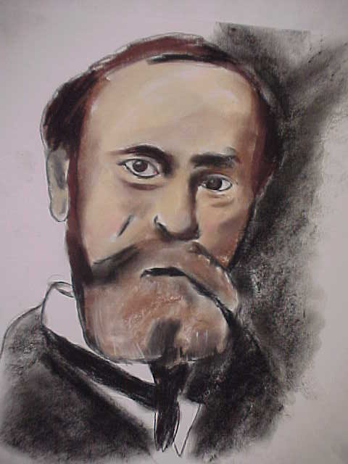
Instinct Theory
William James
Humans are motivated by a variety of instincts
Instincts: inherited tendencies that are not subject to reason
Notes:
Bullets # 1–2 In 1890, psychologist William James (picture in the drawing in this slide) identified 37 different instincts, including cleanliness, curiosity, parental love, sociability, sympathy, and jealousy. He believed that these instincts provided the basis for human behavior. Psychologists in the early 1900s gradually expanded James’s list until it contained more than 10,000 instincts.
Bullet # 3 Instincts are inherited, innate, and not subject to reason.

Slide 3
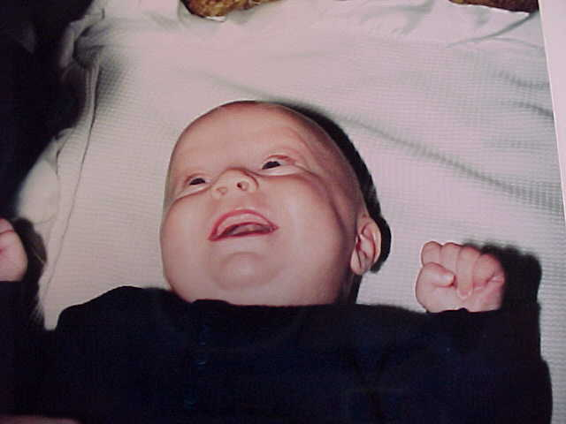
Instincts
Present at Birth
Sucking reflex
Facial expressions like smiling
Hunger, thirst, warmth
Helping, aggression, mate selection
Notes:
Bullets # 1–2 Most psychologists today believe that humans have very few instincts. They only consider something an instinct if it is innate, unlearned, and present at birth, such as the sucking reflex—a survival instinct. Facial expressions also seem to be instinctual; even newborns appear to smile.
Bullet # 3–4 Some psychologists also characterize hunger, thirst, and keeping warm as instincts. Evolutionary psychologists believe such behaviors evolved because they promoted survival of the species. Some also believe that helping, aggression, and even mate selection are instinctual and genetic. They believe we have an innate desire to create offspring so that our genes will survive in our children.

Slide 4
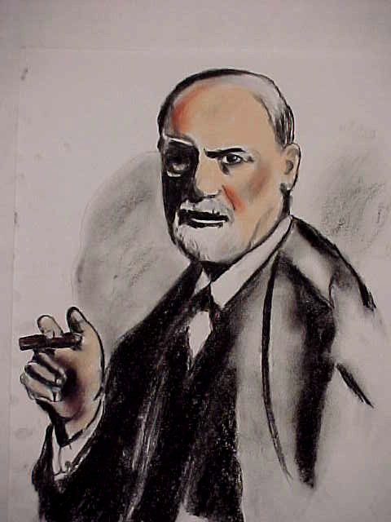
Freud and
Instinct Theory
Freud believed that instincts motivate human behavior
Motivation is caused by sexual and aggressive instincts
Notes:
Bullets # 1–2 Freud believed that humans had both survival instincts (which he called “Eros”) and death instincts (which he called “Thanatos”). He believed that instincts resided in what he called the “id,” and that the two most primary instincts were sex and aggression.

Slide 5
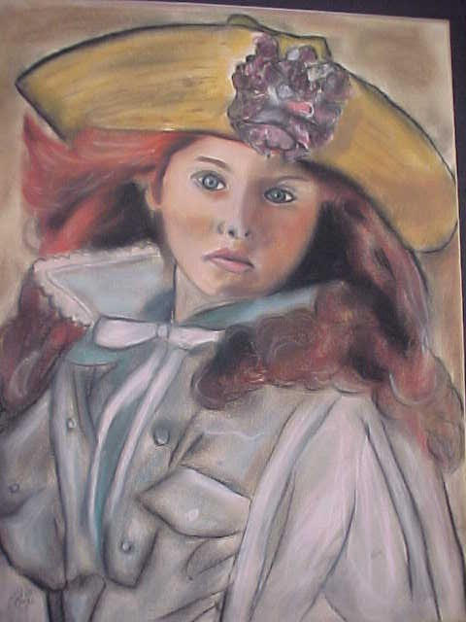
Today’s Views
Few psychologists today subscribe to instinct theory
Instinct theory leaves out the roles that learning and culture play
Notes:
Bullets # 1–2 The instinct theory of motivation fell out of favor by the 1920s. Lists identifying thousands of instincts merely labeled behavior without explaining what caused it. In addition, instinct theory completely ignored the effects of learning and culture on human behavior.

Slide 6

Evolutionary Theories
Motivation is a product of evolution
Survey of 10,000 men and women in 33 countries on six continents
What males want
What females want
Notes:
Bullet # 1 Evolutionary psychologists like David Buss (pictured in the drawing in this slide) believed evolution determines human motives because natural selection favors behavior that maximizes reproduction.
Bullets # 2–4 According to a survey of over 10,000 men and women in 33 countries on six continents, males prefer youth and good health in a prospective mate, while females generally prefer mature and wealthy mates (Buss, 1994). Since the survey garnered the opinions of people from many different cultures, evolutionary psychologists believe that the similarity of the men’s responses and of the women’s responses proved that such preferences had a genetic origin. On the other hand, critics of this survey did not see this conclusion as ironclad, and they still felt that culture could explain the similarity in preferences.
Special note: Evolutionary theories of human motivation still attract some attention in the psychological community.

Slide 7
Clark Hull –
Drive Reduction Theory
By the 1950s, drive reduction theory had replaced instinct theory
biological needs demand satisfaction (food, water, sleep)
Need: state of deprivation
Drive: state of bodily tension caused by a need
Notes:
Bullet # 1 By the 1950s, drive reduction theory had all but replaced instinct theory as the model for explaining motivation.
Bullet # 2 Clark Hull, the chief proponent of drive reduction theory, believed that humans have biological needs that demand satisfaction, such as the need for food, water, and sleep.
Bullets # 3–4 Hull defined need as a “state of deprivation,” and drive as “a state of bodily tension that arises from an unmet need.” “Drive reduction” refers to satisfying drives in order to reduce this tension.

Slide 8
Drive Reduction (cont.)
Homeostasis = balance
Body temperature, blood sugar, and oxygen levels
Habits
Notes:
Bullets # 1–2 Drives cause tension. In drive reduction theory, behavior comes from a need to eliminate this tension and restore the body to a state of balance called “homeostasis.” Any disturbance in homeostasis (such as changes in body temperature or in oxygen and blood sugar levels) gives rise to drives, which activate behaviors that will help the body return to a state of balance. For example, if our blood sugar level drops because we haven’t eaten in a while, we becomes hungry. Hunger motivates us to seek food; eating the food restores homeostasis.
Bullet # 3 Hull believed that when someone engages in a particular behavior that satisfies a drive, the body remembers this. Consequently when the drive arises again, the person will tend to respond with the same behavior. This is known as a “habit.”

Slide 9
Primary vs.
Secondary Drives
Primary (physiological, innate): hunger, thirst, sexual desire.
Secondary (psychological, result of experience): wealth, success, social approval
Relation between primary and secondary drives
Notes:
Bullet # 1 Primary drives are innate, inborn, and physiological in nature; they include things such as hunger, thirst, and sexual desire.
Bullet # 2 Secondary drives are psychological rather than physiological and arise as a result of our experiences. For example, we aren’t born with an innate desire to become wealthy; instead, we may acquire that desire because we learn that money allows us to more easily obtain things that satisfy our primary needs.
Bullet # 3 Hull believed that secondary drives are actually behaviors that we associate with the reduction of primary drives. As a result of this association, these behaviors become drives themselves.

Slide 10
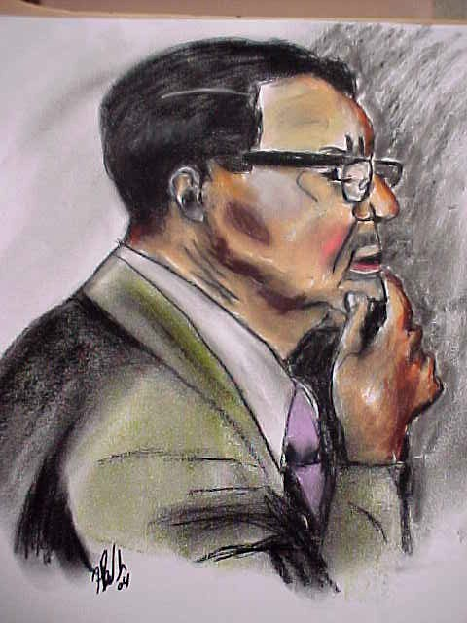
Harry Harlow
Challenged drive reduction theory
Claimed that Hull overlooked important factors
Notes:
Bullet # 1 Drive reduction theory focuses on drives that satisfy “survival” needs. Harry Harlow (pictured in the drawing in this slide) challenged the notion that all drives ultimately satisfy basic survival needs.
Bullet # 2 According to Harlow, Hull overlooked some very important factors in both animal and human motivation. For example, in drive reduction theory an infant becomes attached to its mother because the mother can satisfy the infant’s hunger and thirst. Harlow doubted this explanation for infant-mother attachment.

Slide 11
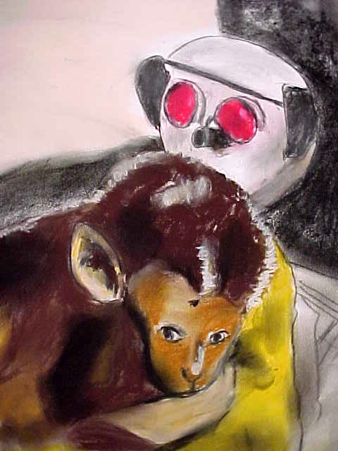
Harlow’s Experiment
He took baby rhesus monkeys away from their mothers and put them alone in cages with two surrogate “mothers”
One mother was equipped with a bottle, the other was covered with cloth
Notes:
Bullets # 1–2 Along with his wife Margaret, Harlow performed an experiment in which he took baby rhesus monkeys away from their mothers at birth. He then gave the babies a choice between two surrogate “mothers.” One was made only of wire, but it had a nursing bottle attached to it. The other “mother” was made from terrycloth but had no food delivery device attached. Most monkeys chose the terrycloth mother. Harlow saw this as proof that what he called “contact comfort” was as important as any basic need. Since both “mothers” had been heated, the monkeys didn’t simply choose the terrycloth one because of warmth. For some reason, the terrycloth one better satisfied the monkey’s intrinsic desire for physical contact and comfort. Harlow’s research highlighted the importance of “contact comfort,” especially for infants and children.

Slide 12
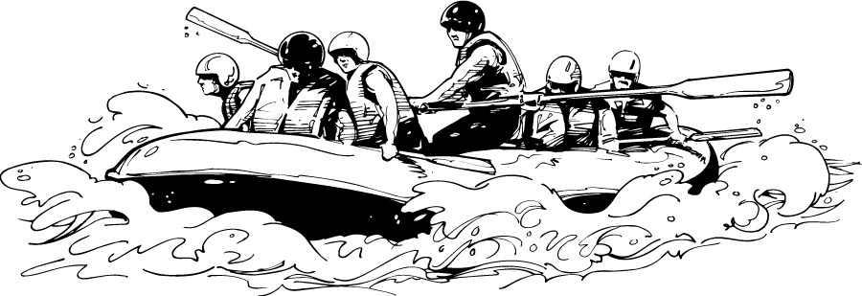
Arousal Theory
Risk-taking behavior
Motivation is linked to arousal
Personality types
Notes:
Bullet # 1 A different explanation for motivation, known as arousal theory, focuses on risk-taking behaviors. Activities such as river rafting, skydiving, and bungee jumping clearly don’t satisfy any survival need—in fact, many of them threaten a person’s survival. Still, people engage in these activities despite the dangers involved.
Bullet # 2 Because of this, some psychologists believe that motivation is somehow connected to what they call “arousal.” Arousal theory holds that people are motivated to act in ways that keep them at their own personal optimal level of arousal. Proponents of this theory see arousal as a physiological phenomenon that can be measured by tracking changes in a person’s brainwaves or heart and muscle tension.
Bullet # 3 Some psychologists believe that a link exists between arousal and certain personality types. These people are more susceptible to boredom than most and consequently tend to be “sensation seekers” (Zuckerman, 1979).

Slide 13
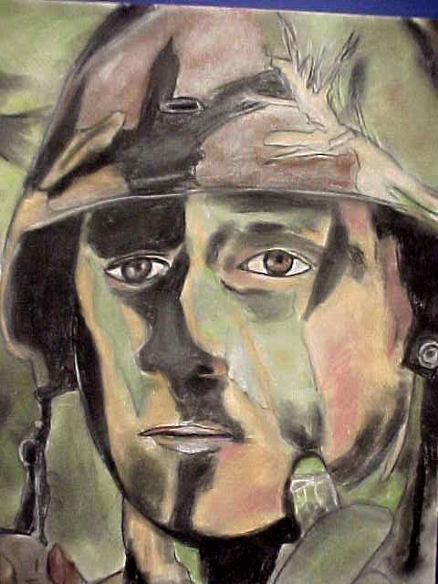
Manipulating
Arousal Levels
People perform best when under moderate arousal
Over-arousal can be detrimental
Arousal levels vary for different people
Notes:
Bullet # 1 “Sensation seekers” only comprise a small part of the population. Researchers have found that the majority of people perform best at moderate levels of arousal.
Bullet # 2 Over-arousal can hinder performance and even cause harm. For example, some research has suggested that between 75-85 percent of soldiers in combat become so over-aroused that they don’t even fire their weapons. Over-arousal can also interfere with intellectual and athletic tasks.
Bullet # 3 Most arousal theorists believe that we each find our own optimum level of arousal (Hebb, 1955). If a person’s arousal level is too low, they usually try to increase it. Boredom offers a good example: when people get bored, they generally try to raise their arousal level by engaging in more exciting behavior.

Slide 14
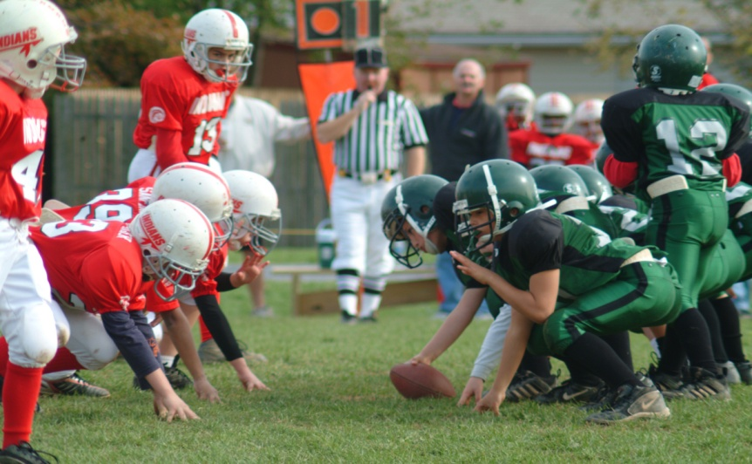
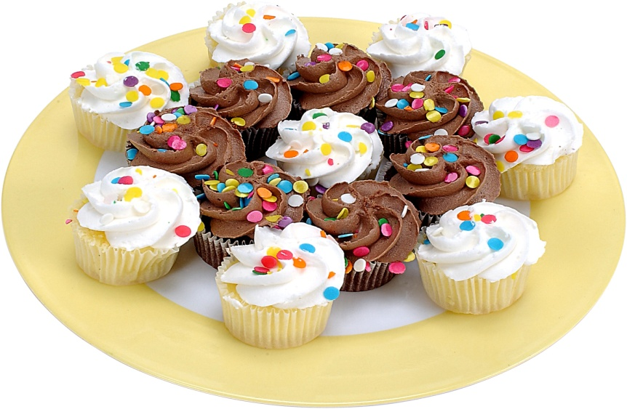
Intrinsic and Extrinsic Motivation
Intrinsic motivation: a desire to do something because you enjoy doing it
Extrinsic motivation: a desire to something in order to gain a reward or avoid a punishment
Notes:
Bullet # 1 Another theory draws a distinction between “intrinsic” and “extrinsic” motivation. Intrinsic motivation occurs when you enjoy doing a certain activity, such as playing football, painting, hiking, listening to music, etc. You don’t expect to receive and reward as a result of these activities; you do them just because you like to.
Bullet # 2 Extrinsic motivation occurs when you engage in a certain activity in order to gain a reward or avoid a punishment. For example, most adults are extrinsically motivated to go to work: they don’t particularly enjoy spending 40 or more hour a week at the office, but doing so gets them a reward—a paycheck. Another example: if your parents have ever told you at dinner, “Eat your vegetables or you won’t get dessert,” they are providing you with an extrinsic motivation to do what they want. Your reward—dessert!

Slide 15
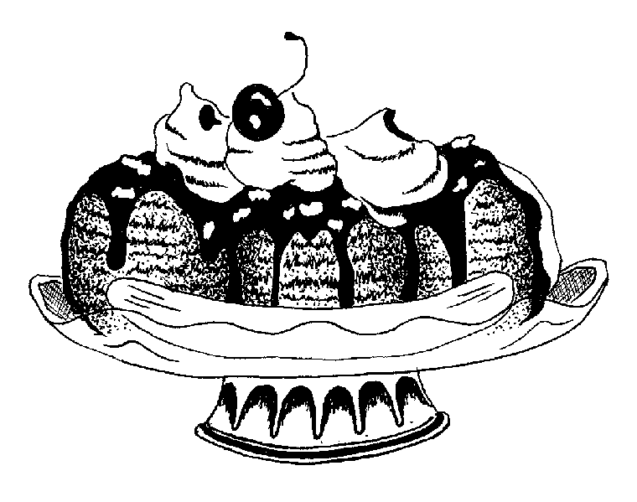
Incentive Theory
Rewards and punishments shape behavior
Incentive theory stresses the role of environment
Notes:
Bullet # 1 Incentive theory suggests that people act in order to obtain rewards and avoid punishments.
Bullet # 2 Possible incentives could include things such as a banana split, a cash bonus, an “A” on your report card, or even approval from your peers.
Bullet # 3 Drive reduction theory focuses on internal states; incentive theory stresses the role of the environment.

Slide 16
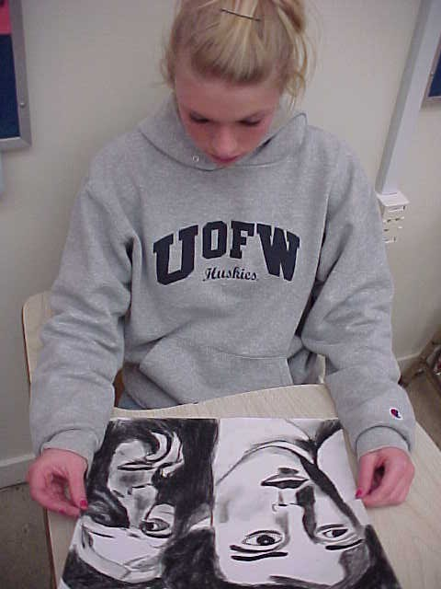
Biological vs. Social Needs
Biological motives vs. social motives
Henry Murray: social needs and the Thematic Apperception Test (TAT)
Notes:
Bullet # 1 Biological motives usually relate to bodily needs such as hunger, thirst, sex, body temperature, physical activity, and even aggression. Social motives, however, are much more diverse. According to researcher K.B. Madsen (1968, 1973), while we probably have fewer than ten biological motives, we have a multitude of social motives.
Bullet # 2 Psychologist Henry Murray created the Thematic Apperception Test (TAT), which measures human problems and needs. The test consists of 20 pictures. About half the pictures have normal drawings like the one you see Lindsey looking at in the photo in this slide. The other half has more bizarre images. Subjects have to come up with “stories” that describe the people and action in each picture. Murray theorized that these stories reveal an individual’s problems and needs. He concluded that humans have many social needs, including achievement, autonomy, affiliation, dominance, exhibitionism, and order.

Slide 17
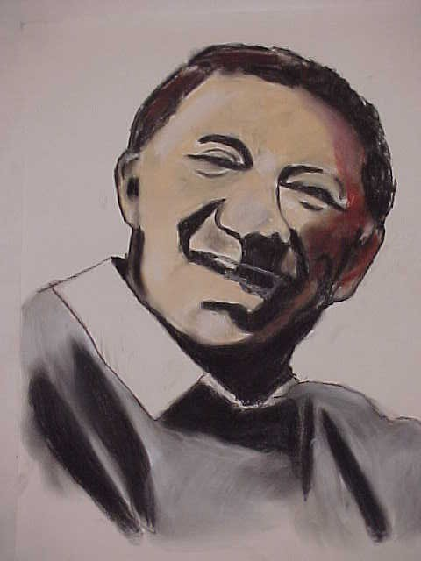
Arranging Needs
People have many competing needs
Motives are organized into a hierarchy
Basic needs must be met first
Notes:
Bullet # 1 Abraham Maslow, an important humanist psychologist, believed that people have many needs that compete with one another. For example, you may be very tired at this moment but your desire to excel in your psychology class (achievement) may be stronger; consequently, you remain awake and try to pay attention.
Bullets #2–3 Maslow believed that our motives are organized hierarchically, and that we must first satisfy our most basic biological needs before we satisfy our social ones.

Slide 18
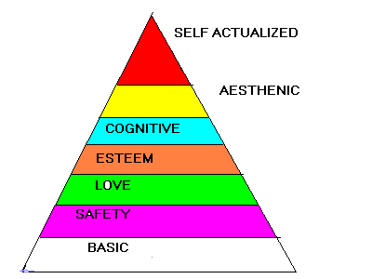
Maslow’s Pyramid
Basic needs are at the bottom of the pyramid
Tiers of needs
Self-actualization (fulfilling one’s potential)
Notes:
Bullet # 1 Maslow illustrated his theory by arranging needs in pyramid fashion, with basic needs like food, water, and warmth at the bottom. Before we can progress up the pyramid, we have to first take care of these basic needs.
Bullet # 2 The second level of Maslow’s pyramid contains needs relating to safety, security, and survival. After that comes love and esteem needs, followed by “growth” needs such as knowledge, understanding, and aesthetic appreciation.
Bullet # 3 The highest level of the pyramid represents what Maslow called “self-actualization,” or the need to fulfill one’s potential. Maslow believed that if people couldn’t fully use all of their talents they would become frustrated.

Slide 19
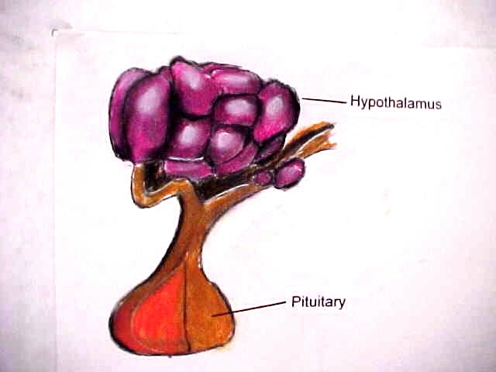
Motivation and the Brain
Hunger is controlled by the hypothalamus in the brain
ESB (electrical brain stimulation)
Notes:
Bullet # 1 Research with lab animals has suggested that hunger is controlled by the brain, specifically by the hypothalamus, a tiny structure that regulates many biological needs and emotions.
Bullet # 2 In some studies, researchers have implanted an electrode in the hypothalamus of animals (such as rats) and then stimulated the brain using electric current (ESB).

Slide 20
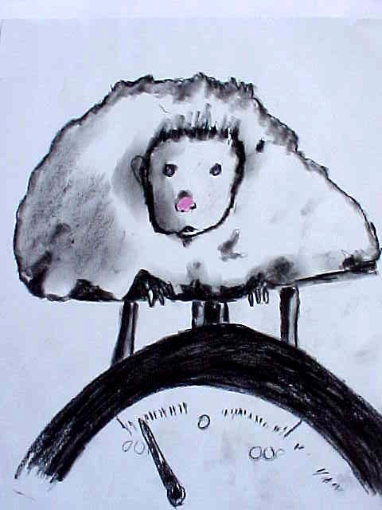
Animal Studies
Activation or destruction of the hypothalamus causes changes in eating habits
Ventromedial nucleus of the hypothalamus
Learned preference
Notes:
Bullet # 1 When a researcher would stimulate the lateral hypothalamus using ESB, lab animals would begin to eat almost immediately—even if they were already full. Terminating the ESB caused the animals to stop eating. Researchers also found that destroying the lateral hypothalamus caused the animals to ignore all available food, and many consequently starved.
Bullet # 2 The specific part of the hypothalamus that controls eating is known as the ventromedial nucleus. Stimulating the ventromedial nucleus leads to extensive overeating and obesity. Lab animals (such as the one pictured in the drawing in this slide) would often quickly triple their original weight.
Bullet # 3 Although humans do have some tastes that may be biological in nature (like affinities for sweet or sour foods), culture often dictates a person’s food preferences. For example, in the U.S. we don’t eat grubs, fried monkey brains, or dog meat, even though all these things are considered delicacies in some other cultures. Most of our tastes are therefore “learned preferences” that we develop through experience. Experience also contributes to the quantity of food people consume: most people tend to eat more when they’re with others.

Slide 21
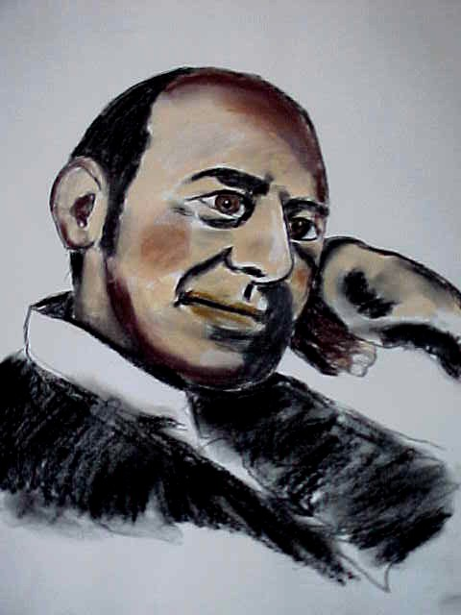
Stanley Schachter
Studied how external cues affect hunger
Notes:
In a 1971 study, psychologist Stanley Schachter and a colleague altered the clock in a room so that it ran either fast or slow. They wanted to mislead subjects as to the time of day. When Schachter offered overweight subjects crackers, they would eat twice as many if the clock showed that it was later in the afternoon than it actually was. Subjects of normal weight ate fewer crackers when they thought it was late because they said they did not want to spoil their appetite for dinner. In other studies, Schachter manipulated external cues such as how appealing the food appeared, the availability of the food, and how much of an effort it took to eat the food. He found all of these cues affected eating behavior.

Slide 22
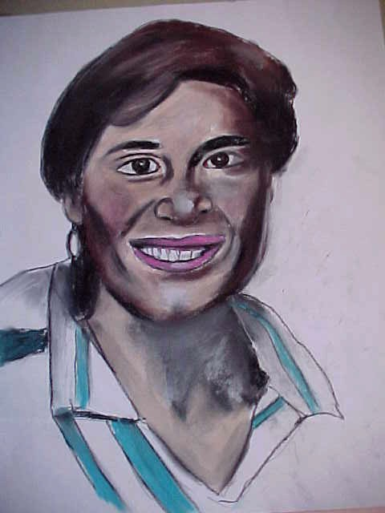
Sensitivity to External Cues
External determinants can elicit insulin secretions that can lead to increased appetite
Obesity factors
Genetic predispositions
Notes:
Bullet # 1 Judith Rodin (pictured in the drawing in this slide) questioned Schachter’s findings. Though she did believe that some people secrete insulin too readily in response to food-related cues, she also found that obese people do not overeat as much as many assume. She concluded that obesity depends on more than just sensitivity to external cues.
Bullets # 2–3 Other studies found that identical twins reared apart were far more similar in weight than fraternal twins reared together (Stunkard, Harris, Pederson, McClern, 1990). Another study involving more than 4000 twins concluded that genetic factors account for 61 percent of the variation in weight among men and 73 percent among women. Thus, genetic makeup seems to influence weight more than external factors.

Slide 23
Stress-Induced Eating
Stress leads many people to increase their eating
More common in women than men; more likely among chronic dieters
Notes:
Bullet # 1 Researchers Greeno and Wing (1994) found a correlation between eating and stress, concluding that many people deal with life’s problems by heading for the fridge. Stressful events often lead to physiological arousal, and a correlation exists between heightened arousal and overeating.
Bullet # 2 Stress-induced eating occurs more commonly in women and chronic dieters than any other groups.

Slide 24
Obesity and Health Issues
Coronary disease
Respiratory problems
Diabetes, arthritis, back problems
Digestive diseases
Notes:
If a person is 15 to 20 percent over their ideal body weight, he/she is considered overweight. American culture is obsessed with slimness, yet more and more people today seem to struggle with their weight. Some studies have suggested that at least 30 percent of all Americans are overweight. Obesity carries many health risks such as coronary disease, stroke, diabetes, respiratory problems, digestive irregularities, and even arthritis and back and joint problems. Other studies have found that at any given time, between 25 and 50 percent of all women are on a diet.

Slide 25
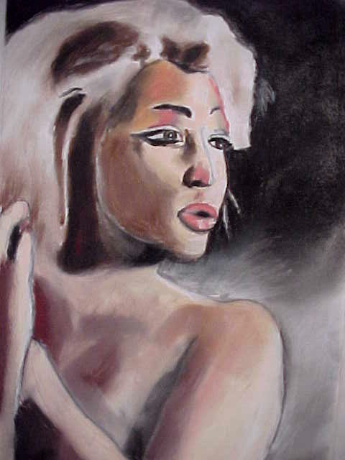
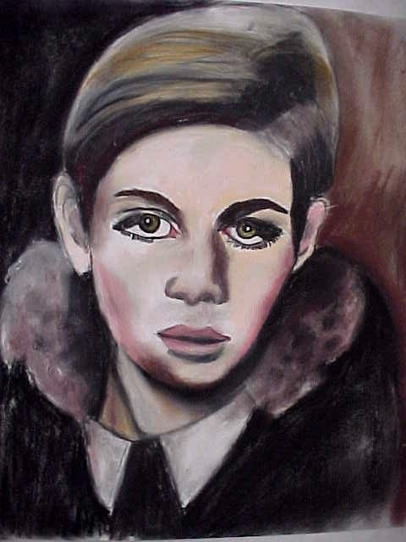
Risks
Associated With Dieting
Notes:
The paintings in this slide depict two women: on the left, Marilyn Monroe; and on the right, the model Twiggy. Social psychologists have studied how notions of ideal body image have changed over time. In the 1950s, many viewed the voluptuous Marilyn Monroe as the epitome of beauty, glamour, and sexiness. By the 1970s, however, Twiggy’s ultra-thin look had come into vogue. Today’s ideal female body type tends to look more like Twiggy than like Marilyn. Trying to lose weight in order to look like an ideal body type carries many risks. Most psychologists view moderate weight loss efforts as beneficial. Controlling diet and getting regular exercise produces both physical and psychological benefits. Anorexia nervosa is a form of self-starvation that results in a dangerously low body weight. Most anorexics have an intense fear of becoming fat and a distorted image of their bodies (American Psychiatric Association, 2000). More than 95 percent of the cases are women, typically adolescents or young adults.

Slide 26
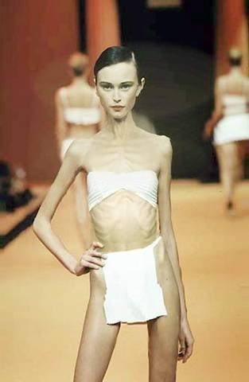
Anorexia:
Risks for Teens
Cardiovascular problems
Gastrointestinal problems
Disruption of the menstrual cycle
Death and suicide
Notes:
Bullets # 1–2 Anorexia nervosa is a dangerous medical condition that can cause severe complications—especially for teens. To begin with, many who suffer from anorexia have cardiovascular problems such as irregular heartbeat and low blood pressure. They also often develop gastrointestinal problems such as chronic constipation and abdominal pain.
Bullet # 3 Many young female anorexics suffer menstrual irregularities. Some, as a result of their extreme dieting behavior, render themselves incapable of getting pregnant.
Bullet # 4 Between 5 and 6 percent of all anorexics die from the disorder. Most of these deaths result either from suicide or cardiovascular episodes such as heart attacks. Karen Carpenter, a pop singer in the 1970s, died at the age of 32 from a heart attack caused by anorexia nervosa.

Slide 27

A Psychological Explanation
A desire to avoid full maturation
Wanting to stay a little girl
Social pressures
Notes:
Some psychologists believe that some young women who suffer from anorexia nervosa unconsciously want to avoid becoming a woman. They feel more secure and safe as little girls. Restricting their diets so severely allows them to avoid full maturity.

Slide 28
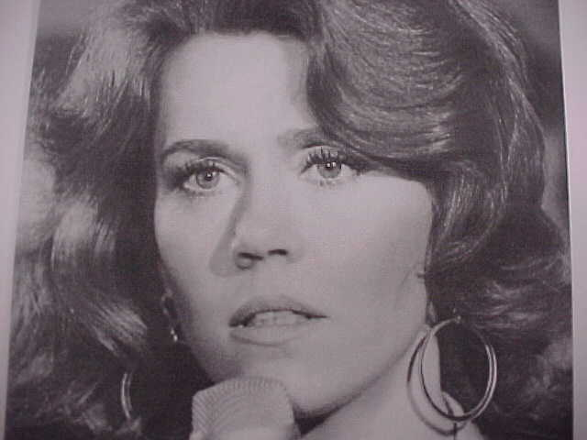
Bulimia
Binging and purging ritual
Obsession with weight
Begins in late adolescence
Complications
Notes:
Bullets # 1–2 Bulimia, an eating disorder related to anorexia, was first diagnosed in the 1980s. It involves a ritual known as “binging and purging.” The binging usually occurs as a response to stress, depression, or a drop in self-esteem. After gorging on as many as 20,000 calories at a time, purging begins. Bulimics try to rid themselves of all the calories from the binge by vomiting, fasting, using diuretics and laxatives, or other methods. Most of the time, bulimics treat their gorging and purging as secret, private rituals.
Bullet # 2 Like anorexics, bulimics also obsess about their weight. Unlike anorexics, bulimics tend to maintain a normal weight and rarely look different from ordinary people.
Bullet # 3 Bulimia often begins in late adolescence. Sufferers may alternate between bulimic behavior and strict dieting.
Bullet # 4 Bulimia can cause serious medical complications. Constant vomiting resulting from bulimia erodes tooth enamel and can also cause cavities. Repeated vomiting affects the salivary glands and can cause the stomach to ulcerate, or even to rupture, which results in death. Bulimia also tends to disrupt the body’s electrolyte balance. In addition, constant purging can cause an irregular heartbeat and even cardiac arrest.
Actress Jane Fonda (pictured in this slide) suffered bouts of bulimia throughout much of her life. She said the disorder “nearly destroyed my life”; she also commented, “For 25 years, I could never put a forkful in my mouth without feeling fear, without feeling scared.”

Slide 29
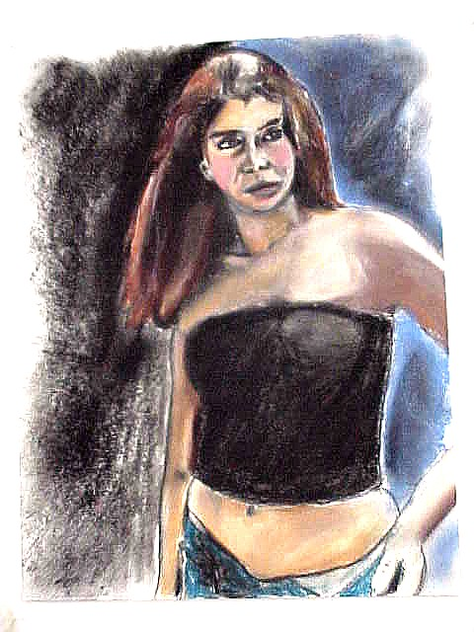
Causes Of
Eating Disorders
Societal pressures on young women
50% - 75% of adolescent girls are unhappy with their body image
Bombarded with images of slender models/actresses
Notes:
Bullet # 1 Our society often places unrealistic pressures on young women to be thin. These pressures can contribute to the development of both anorexia and bulimia.
Bullet # 2 According to one study (Rubenstein, Caballero, 2000), 50 to 75 percent of adolescent females are unhappy with their weight and body image. Consequently, dieting among teen girls has become a normative pattern.
Bullet # 3 The media constantly bombard teenage girls with images of ultra-thin models and actresses, creating distorted conceptions of ideal body type.

Slide 30
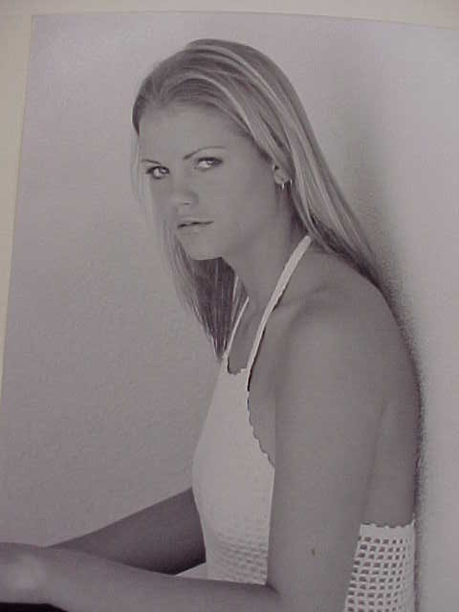
An Impossible Standard
The slenderizing of the ideal feminine form
Body mass index, Miss America Pageant
The gender gap
Cultural differences
Notes:
Bullets # 1–2 As societal pressures to be thin increase, so do the cases of anorexia and bulimia. The body mass index (BMI) measures body fat based on height and weight. The average BMI of contestants in the Miss America Pageant has steadily declined since the 1950s. In addition, more and more winners since 1950 fit medical definitions of “thin” and “undernourished.”
Bullet #3 Statistically, no real gender differences in obesity exist: 27 percent of women are considered obese, 24 percent of men. Most weight-based gender differences do not develop until mid-life.
Bullet # 4 Eating disorders occur much less commonly among African-American and Hispanic women, lending credence to the theory that such disorders develop due to pressures specific to a particular society or culture.

Slide 31

Sexual
Motivation and Behavior
Notes:
It’s easy to make the case that we live in a sex-obsessed society. Sexually charged images saturate magazines, TV shows, and movies. Advertisers use sex to sell everything from mouthwash to designer jeans to beer. This intense interest in sex reflects the importance of sexual motivation. In this next section, we will examine some of the factors that influence both sexual interest and sexual orientation. Sex in general may be essential for the survival of the species, but it is not essential to an particular individual’s survival. The human sex drive is also not on the same level as drives like hunger: you can live without sex, but you can’t live without food.

Slide 32
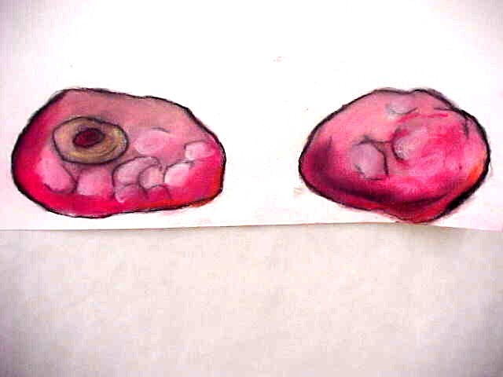
Hormonal Regulation
Hormones secreted by the gonads influence sexual motivation
Estrogens = female, androgens = male
Regulated by pituitary/hypothalamus
Notes:
Bullet # 1 Women’s ovaries and men’s testes secrete hormones that influence sexual motivation.
Bullet # 2 Estrogens are the primary class of gonadal hormones in females, and androgens are the primary class in males. In addition, each gender produces small amounts of the other’s hormones.
Bullet # 3 Both the pituitary gland and the hypothalamus in the brain regulate hormone balance. Androgen levels seem related to sexual motivation in both sexes; however, estrogen levels in women do not necessarily correlate with sexual interest.

Slide 33
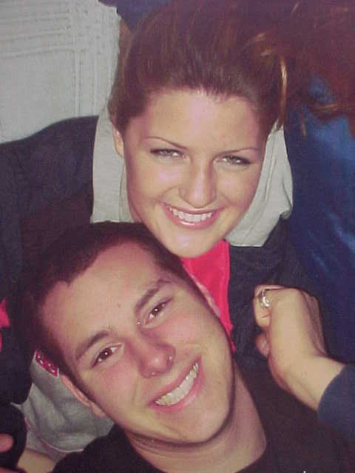
Attraction to a Partner
Availability and attraction
The Coolidge Effect
Evolutionary theorists
Notes:
Bullets # 1–2 According to some psychologists, many animals can revive a dwindling sexual interest by obtaining a new partner. This has been called the “Coolidge Effect,” named after former U.S. president Calvin Coolidge. According to a secondhand story, Mr. And Mrs. Coolidge once visited a farm, and Mrs. Coolidge was informed that a certain rooster on that farm had sex no less than 20 times a day. “Tell that to Mr. Coolidge,” she replied. When informed of the roosters’ feats, Mr. Coolidge asked if the bird had sex with the same hen all 20 times. The farmer said no, the rooster actually had sex with many different hens. Coolidge replied, “Tell that to Mrs. Coolidge.”
Bullet # 3 According to evolutionary theorists, the Coolidge effect makes sense because males want to maximize their reproductive success by having as many female partners as possible. Does the Coolidge effect apply to humans? According to one study (Buss & Schmitt, 1993), college-age men indicated that they would ideally like to have 18 sexual partners in their lives. In the same study, college women reported that four or five partners would be ideal.

Slide 34

Selectivity of Partners
Human selectivity is influenced by learning and experience
Physical beauty, personality, competence, values
Gender differences
Notes:
Bullet # 1 People differ significantly in what they consider attractive in a partner. People usually base their selection of a mate on things they’ve learned or experiences they’ve had.
Bullet # 2 Psychologists recognize that more than just physical attraction factors into mate selection. A potential partner’s personality, level of competence, and values can also influence sexual interest.
Bullet # 3 A number of psychological studies suggest that men and women want very different things in a mate. Men appear to be motivated by a desire for physical gratification, while women seem to be motivated by a desire to express love and emotional commitment (Carroll, Volk, Hyde, 1985).

Slide 35
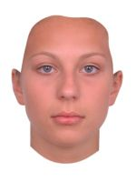
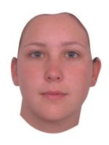
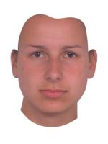
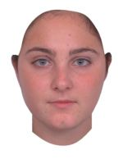
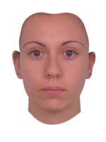
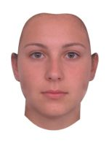
1
2
3
4
5
6

Slide 36
Achievement Motivation
The need for achievement
The need to master difficult challenges
The need to outperform others
Maslow’s work relative to achievement
Notes:
Bullets # 1–3 What motivates some people to work so hard? Psychologists have identified a number of reasons: the need for achievement, the need to master difficult challenges, the need to outdo or outperform others, or a desire meet one’s own personal standards.
Bullet # 4 In Maslow’s pyramid of needs, achievement lies at the fourth level, among the “esteem” needs.

Slide 37
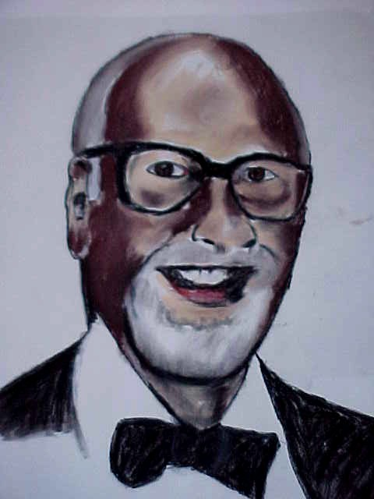
David McClelland
Three-needs theory of motivation
High achievers
Applications: individuals, societies, organizations
Notes:
Bullet # 1 In the 1940s, psychologist David McClelland helped develop the Thematic Apperception Test (TAT), an important tool for assessing personality. McClelland’s analysis of TAT results led him to conclude that human motivation results from three different needs: the need for achievement, the need for power, and the need for affiliation. The need for achievement (often abbreviated to “n-Ach”) involves a desire to solve problems more efficiently and to master complex tasks. The need for power (n-Pow) involves a desire to influence or control other people and to be in charge of or responsible for others. The need for affiliation (n-Aff) involves a desire to be part of a group and to establish warm, personal relations with others.
Bullet # 2 McClelland once said “People with a high need for achievement are not gamblers; they are challenged to win by personal effort, not by luck.” He conducted one experiment in which subjects were asked to throw rings onto pegs, much like the games found at most fairs. McClelland didn’t specify a distance from which to throw the rings, so most subjects threw from random distances. Some subjects, however, tested the difficulty of various distances and then settled on one distance from which to throw. That distance was far enough to pose a challenge, but not so far as to make it impossible to get a ring onto a peg. McClelland identified these subjects as high-achievers: results-oriented people who liked to complete complex but doable tasks in order to gain a sense of accomplishment.
Bullet # 3 McClelland believed the three-needs theory applied not only to individuals but to entire societies and organizations as well. He studied different cultures throughout the world, drawing examples from society’s literature and other stories to identify general motivations and needs. He concluded that not all cultures value achievement to the same extent. He also felt that positive economic development would be more likely to occur in a society that placed a high value on achievement than in one that did not. The most widespread application of three-needs theory has been in the business world. Each of the needs generally correlates to positions in a business or organization: the n-Ach workers form the backbone and increase productivity; the n-Pow workers tend to excel at management; and the n-Aff employees represent the “team players” who work well in groups.

Slide 38
Situational
Factors in Achievement
Motivation to achieve success
The probability of success
The incentive value
The fear of failure
Notes:
Psychologist John Atkinson elaborated upon McClelland’s original theory of achievement and motivation, initially identifying three “situational” factors: the strength of a person’s motivation to achieve success, a person’s own estimate of the probability of success relative to the task at hand, and the incentives involved (both tangible and intangible). Atkinson later added the fear of failure as another important situational factor.

Slide 39
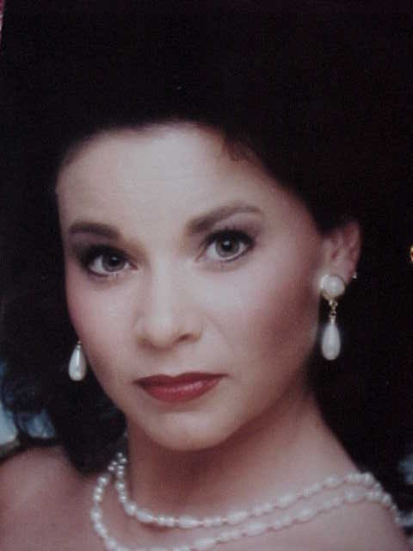
Gender Differences
Gender differences in achievement emerge early in life
Gender-role stereotypes
Notes:
Bullet # 1 Gender differences in motivation and achievement begin early in life, partly due to different rates of maturation and partly because of the different ways in which boys and girls learn to think of themselves and their performance. For example, one study (Martin, 2003) concluded that girls tend to have a stronger belief in the value of school, usually are more persistent than boys, and focus, plan, and study more effectively as well. Girls tend to be much more anxious than boys, however, while boys usually have a greater fear of failure. The study also found that popular images of masculinity and the perceived need to live up to these images play a significant role in boys’ motivation—or lack thereof—in school.
Bullet # 2 In some cultures, gender-role stereotyping discourages some women from achieving, while others may try to hide their success. Sometimes teachers and even parents can also contribute to gender-role stereotyping. In the U.S., while the “glass ceiling” that prevented women from reaching levels of power in organizations has pretty much disappeared, high-achieving women often find themselves having to choose between their career and starting a family—a choice that most men don’t face.

Slide 40
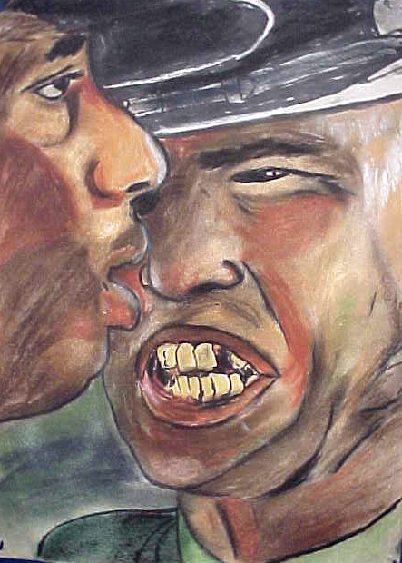
Emotions
Notes:
Psychologists define emotions as states that have physiological, cognitive, and behavioral components. Some view emotions as passions that happen to a person without willful intent. Emotions are often transitory and of relatively short duration, but they have the power to alter our thinking. Emotional experiences also depend on how we interpret a given situation. The English language has 550 words that reflect emotion (Averill, 1980). Look at this picture in this slide, which shows a drill instructor confronting a young recruit. What emotions do you think the young soldier is feeling? What do you make of the drill instructor’s body language and facial expression?

Slide 41
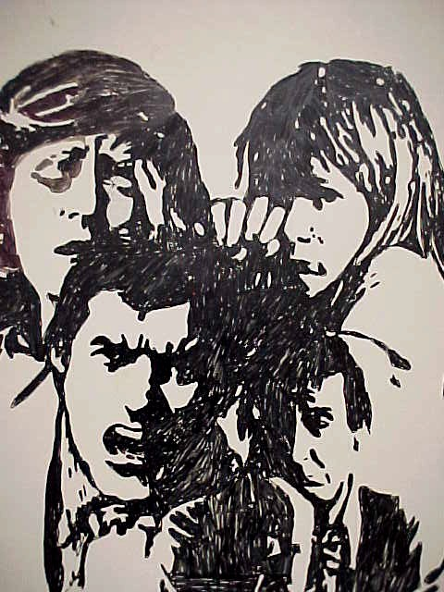
Elements Of Emotion
Cognitive (subjective)
Physiological
Behavioral
Notes:
Bullet # 1 Psychologists have broken emotions down into a number of components. First, emotion is a subjective, cognitive experience. People’s thinking or cognitive appraisal of the events in their lives can produce emotions.
Bullet # 2 Emotions can also affect the autonomic nervous system (which regulates glands and muscles) and cause physiological changes. For example, a frightening experience may make your blood pressure rise, cause your pupils to dilate, and switch on your “fight or flight” mechanism, releasing adrenaline into the bloodstream.
Bullet # 3 Emotions can also cause changes in behavior. People often reveal their emotions through overt expressions like clenched fists, smiles, frowns, etc. Body language can sometimes reveal emotions.

Slide 42
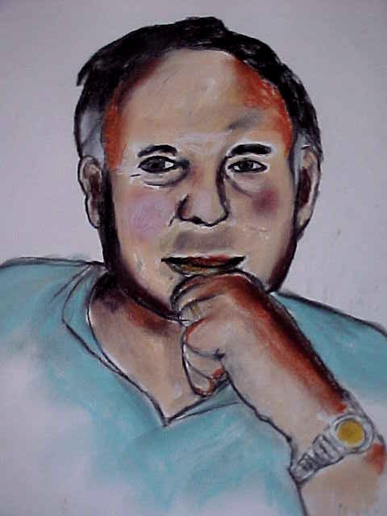
Facial Expressions
Facial expressions can reveal a variety of basic emotions
Six fundamental emotions: happiness, anger, sadness, surprise, disgust, fear
Cross-cultural comparisons
Notes:
Bullet # 1 Psychologists Paul Ekman (pictured in the drawing in this slide) and Wallace Friesen did extensive research into the ways in which facial expressions can reveal basic emotions.
Bullet # 2 Ekman and Friesen postulated that people can generally identify six fundamental emotions in facial expressions: happiness, anger, sadness, surprise, disgust, and fear. They also estimated that human facial muscles can create more than 7000 different expressions.
Bullet # 3 Ekman also conducted cross-cultural studies and found that people in many different cultures displayed these same basic six facial expressions. The countries he visited included Spain, Argentina, Japan, and New Guinea; in New Guinea, he encountered the Fore people, who had never had any contact with the outside world. He concluded that there may be a biological link between emotion and facial expression. Ekman also identified other facial expressions such as contempt, shame, guilt, and interest (1992).
Note to teacher: As your students look at the next series of slides, see how many of the six facial expressions they can identify.

Slide 43


Notes:
Happiness

Slide 44

Notes:
Sadness

Slide 45

Notes:
Anger, possibly disgust

Slide 46

Notes:
Surprise, possibly happiness

Slide 47
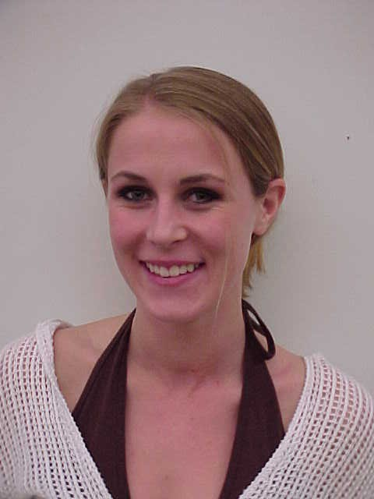
Notes:
Happiness

Slide 48

Notes:
Happiness

Slide 49
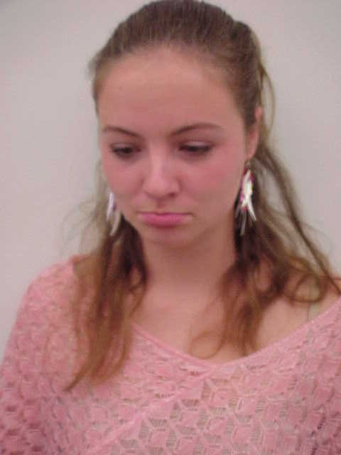
Notes:
Sadness

Slide 50
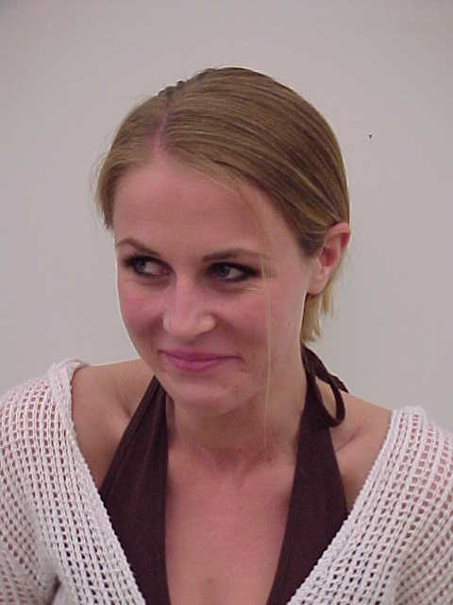
Notes:
Disgust

Slide 51
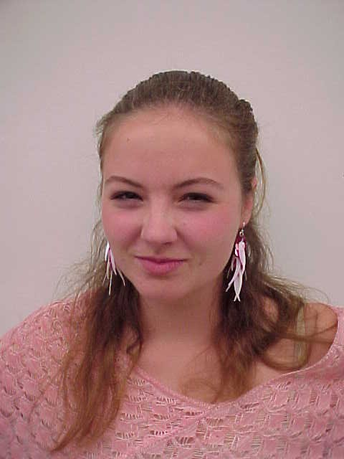
Notes:
Anger, possibly disgust

Slide 52
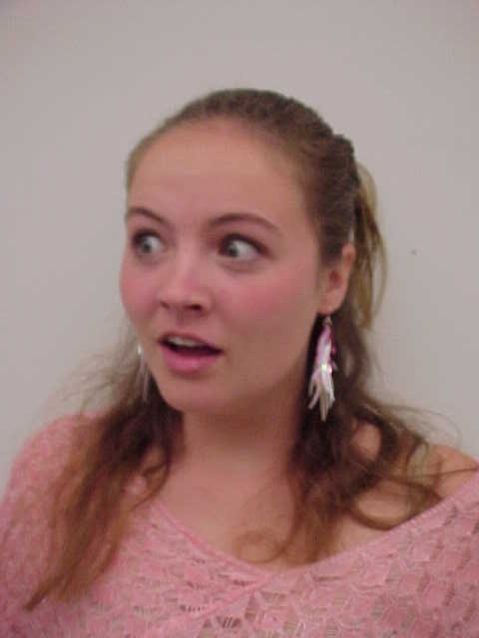
Notes:
Surprise, possibly fear

Slide 53

Notes:
Happiness

Slide 54
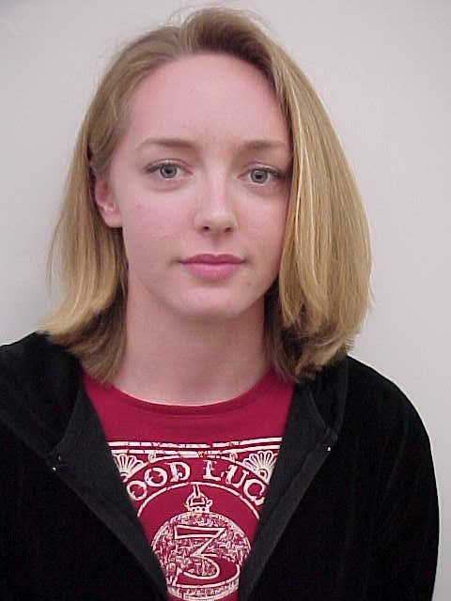
Notes:
Sadness

Slide 55
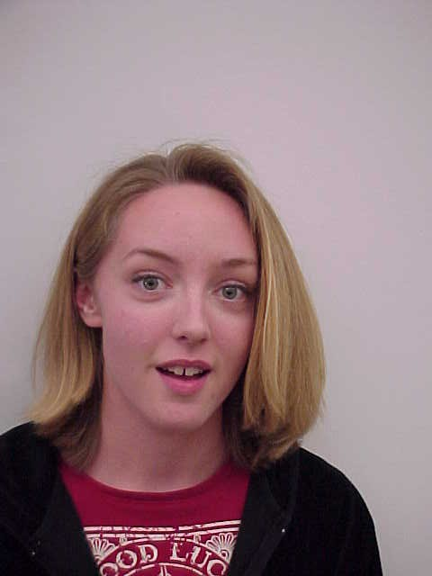
Notes:
Surprise

Slide 56
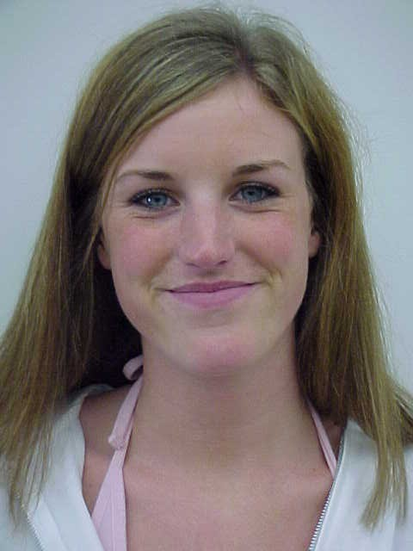
Notes:
Happiness

Slide 57
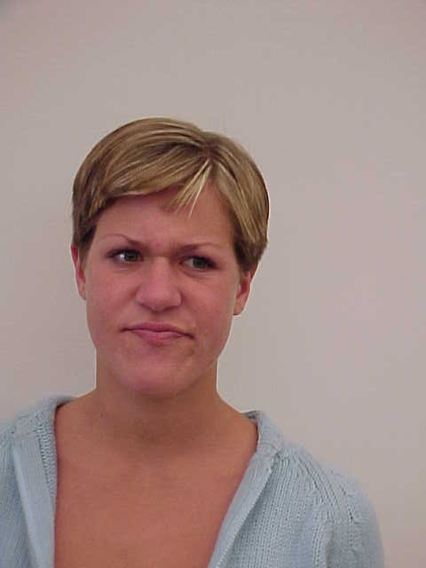
Notes:
Anger

Slide 58
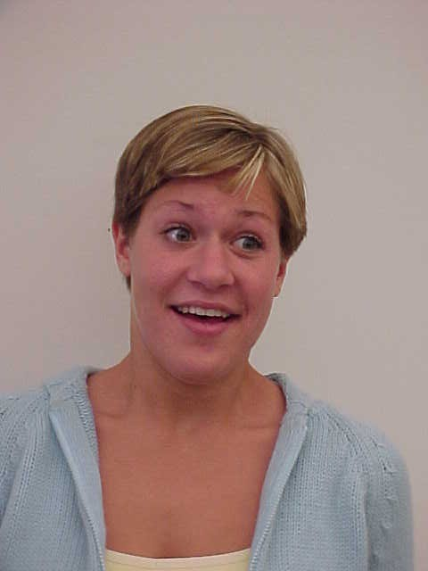
Notes:
Surprise

Slide 59
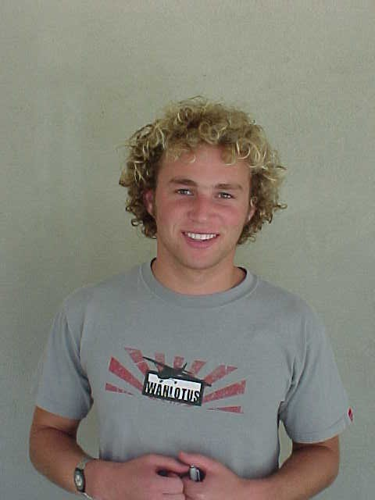
Notes:
Happiness

Slide 60
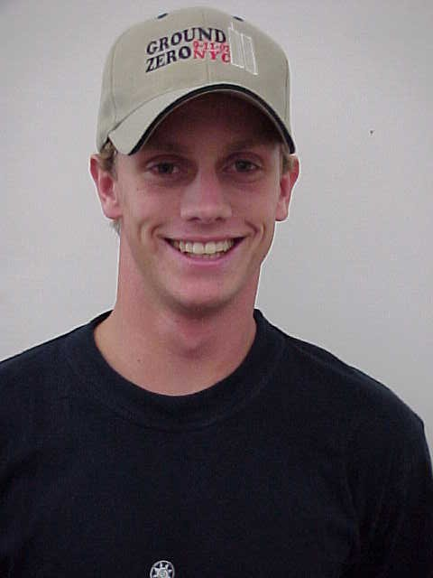
Notes:
Happiness

Slide 61


Notes:
We use the same muscle groups when we hold a pencil between our lips as we do when we smile. When we hold the pencil in our teeth, we use the same muscles as when we frown.

Slide 62
Theories of Emotion
James-Lange
Cannon-Bard
Schachter (Cognitive)
Notes:
Psychologists have proposed a variety of theories to explain emotion. Some theories focus on biology, others on society and environment. In the next few slides, we will examine each of the theories listed here.

Slide 63
James-Lange Theory
Stresses biological determinants of emotion
Stimulus happens
Body reacts
Person is aware something is wrong
Notes:
Bullet # 1 William James (pictured in the drawing in this slide), a 19th-century psychologist, developed a theory of emotions. At about the same time, Carl Lange came up with almost the exact same idea James had—hence the name of this theory. Their idea seems almost illogical. They claimed that when a person encounters a stimulus, it causes the autonomic nervous system to engage; only then does that person get a conscious feeling that something is wrong.
Bullet # 2 The James-Lange Theory stresses the biological determinants of emotion.

Slide 64
Cannon-Bard Theory
“Fight or flight” response
People who experience very different emotions (such as fear, anger, and joy) exhibit almost the same patterns of autonomic arousal
Something happens
Body & mind react at the same time
Notes:
Bullet # 1 Psychologist Walter Cannon found the James-Lange theory very troubling. In 1927, Cannon developed the idea of the “Fight or Flight” response. He believed that physical arousal could occur without the experience of emotion. He also believed that physiological changes happened too slowly to precede what we consciously observe.
Bullet # 2 Cannon felt that whatever the emotion, the autonomic response was nearly identical.
Bullet # 3 In 1934, Phillip Bard elaborated on Cannon’s theory by postulating that emotion occurs when the thalamus of the brain sends signals to the cortex (creating the conscious experience of emotion) and to the autonomic nervous system (creating physiological arousal).

Slide 65
Schachter (Cognitive) Theory
1. Something happens
2. Autonomic arousal
3. Cognitive interpretation
Notes:
Stanley Schachter (pictured in the drawing in this slide) theorized that emotion depends on two factors: autonomic (physiological) arousal and cognitive interpretations of that arousal. Schachter believed that both these factors had to be present for a person to experience an emotion. When we experience physiological arousal, we then use cognition to give a label to that arousal. Schachter believed that people look to situational cues to help label arousal. For example, say that you’re sitting at a stop light. You glance in your rearview mirror to see a car speeding towards you that doesn’t look like it’s going to stop in time. Your body senses an emergency situation and releases adrenaline, which starts your heart pounding: this is arousal. You then use situational cues to determine the nature of the arousal and cognition to label it: “I’m scared.” The arousal now joins with the cognitive label to create an emotion: fear.

Slide 66
James-Lange Theory | Cannon-Bard Theory | Cognitive Theory
Something happens | Something happens | Something happens
Body reacts | Body reacts AND emotion produced at same time | We THINK about what happens – then LABEL it
Emotion produced |  | Emotion produced

Slide 67
Evolutionary
Theories of Emotion
Predicated on the work of Charles Darwin
Emotions evolved before higher-order thinking
We have fundamental emotions: fear, anger, joy, disgust, surprise
Notes:
Bullet # 1 The limitations of the Cannon-Bard and James-Lange theories frustrated many psychologists. Schachter’s Two-Factor theory refocused attention on the evolutionary perspective—particularly on the ideas of Charles Darwin. Darwin believed that emotions develop because they have an “adaptive” value that increases the chances of survival. For example, fear would help an animal avoid danger. Darwin saw emotion as the product of evolution.
Bullet # 2 Many evolutionary theorists believe that emotion evolved before thought, and that thought does not significantly influence emotion. They hypothesized that emotions originate in the brain well before higher-brain functioning develops.
Bullet # 3 Three different evolutionary theorists (Tomkins, Izard and Plutchik) all came up with their own list of what they called “fundamental” emotions. Their lists were very similar: they all included fear, anger, joy, disgust, and surprise; sadness, guilt, and acceptance, however, did not appear on all three lists.

Slide 68

STRESS
Notes:
Psychologists use the term “stress” to describe the demands and pressures placed on a person to adapt or adjust to his/her environment. Stress is a major fact of life: it is as inevitable as death and taxes, yet the notion of stress has only arisen in the last 50 years. The last part of this presentation will focus on psychological and physiological reactions to stress. We will also look at the relationship between personality types and stress and at post-traumatic stress disorder (PTSD).

Slide 69

Psychological and Physiological Stress
Stress affects us both psychologically and physiologically
Stress can kill
Notes:
Bullet # 1 Sometimes the psychological effects of stress can be as harmful as the physiological ones. There are a whole series of physical problems that can arise as a result of stress, which we will discuss later in this presentation.
Bullet # 2 Stress can contribute factor to premature death.

Slide 70
Types of
Short-Term Stress
Anxiety
Anger
Fear
Notes:
Psychologist Hans Selye differentiated between two kinds of stress: “distress” and “eustress.” Distress is harmful; eustress can have positive implications. For example, how many of you play sports? Sports can cause a lot of stress, yet people still chose to participate in them. Getting married, going to college, or moving to a new town also offer examples of eustress. Distress is a state of emotional or physical suffering, pain, or discomfort. It results from stress that you usually don’t have much—if any—control over. The most common initial responses to short-term distress include anxiety or nervousness, anger, and fear. How a person responds to distressful events often depends on their individual personality type.

Slide 71
Symptoms of Short-Term Stress
Doubting one’s ability
Not thinking clearly
Overreacting
No joy from life
Feeling hemmed in
Notes:
Short-term stress manifests itself in many different ways: it can cause us to doubt our own skills and abilities; it can impair a person’s ability to think clearly; it puts us “on edge” and causes us to overreact to things; it depletes our zest for living and our capacity for enjoyment; and it can even cause us to feel “hemmed in,” claustrophobic, or trapped by circumstances beyond our control.

Slide 72
General
Adaptation Syndrome (GAS)
Three stages:
  1. Alarm reaction (fight or flight)
  2. Resistance (the body tries to fight off the stressor)
  3. Exhaustion (physical problems appear; psychological breakdown)
Notes:
Bullets # 1-2 Selye also developed a three-stage model describing how we react to psychological and physiological stress.
Bullet # 3 “Alarm reaction” is the first response to stress. The body senses a danger or threat and moves into “fight or flight” mode: it releases adrenaline into the bloodstream, causes muscles to tense, and speeds up our breathing and heart rate.
Bullet # 4 In the second stage, “resistance,” the body fights off the stressor. If the stress doesn’t get reduced quickly, however, signs of wear and tear begin to appear. If the body stays in “fight or flight” mode for too long, it affects our ability to think clearly. It also starts to drain us both physically and emotionally.
Bullet # 5 The longer the stress lasts, the more severe the physical and psychological consequences will be. In the final stage, “exhaustion,” the body starts to deteriorate. Physical problems can appear, ranging from acne and rashes, indigestion and ulcers, and major problems afflicting vital organs. The mind also starts to deteriorate: some people suffer nervous breakdowns, while others can lose touch with reality and develop severe mental disorders. All the ailments associated with exhaustion demonstrate that while the “fight or flight” response can prove useful at first, it can have extremely adverse effects in the long run.

Slide 73
Physical
Reactions to Short-Term Stress
Insomnia
Migraine headaches
Muscle aches and pains
Digestive Irregularities
Notes:
Short-term stress can produce a number of physical reactions, including insomnia, migraine and tension headaches, muscle aches and pains, and digestive problems. Too often people turn to medications as a way to relieve these stress-induced ailments: sleeping pills for insomnia, pain pills for migraines and muscle aches, and acid reflux tablets for stomach problems.

Slide 74
Behavioral Reactions to Stress
Nervous habits
Trembling
Pacing
Eating meals too quickly
Smoke/drink more
Tired for no reason
Notes:
Stress causes many changes in our behavior. Look at the list in this slide. Which of the following have you experienced?

Slide 75
More Behavioral Reactions to Stress
Changes in posture
Loss of interest in eating, grooming, sexual activity, personal relationships
Apathy
Notes:
We can gather clues about people’s physical and emotional reactions to stress by observing changes in how they look, act, or talk. Strained facial expressions, a shaky voice, tics or tremors, and jumpiness are all symptomatic of stress. Stress may cause some people to quit their jobs, drop out of school, or turn to alcohol or drugs. Many sufferers also lose interest in eating, grooming, and personal relationships (including family, friendly, romantic, and/or sexual ones).

Slide 76
Long-Term Stress
Does not necessarily cause mental illness
May contribute to suicide
Notes:
The longer a person remains afflicted with a particular stress, the greater the risk of developing physical and psychological problems. Long-term stress does not necessarily cause mental illness, but it can act as a trigger. In addition, a significant correlation exists between long-term stress and suicide.

Slide 77
Physical Reactions to
Long-Term Stress
Peptic ulcers
Hypertension
Arthritis
Asthma
Heart disease
Disruption of the immune system
80% of all disease is stress-related
Notes:
No special notes, although for bullet number six (immune system), you may want to mention that suppressing the body’s immune system makes a person more vulnerable to colds and viruses.

Slide 78




Long-Term
Behavioral Reactions to Stress
Alcoholism/
addiction
Unemployment
Increasing aggressiveness
Criminal behavior
Depression/
suicide
Notes:
In the long term, physical, psychological, and behavioral stress start to take their toll and can cause major changes in behavior. People may turn to alcohol and addictive drugs to temporarily escape from the stress. Workplace performance often begins to suffer, and as “burnout” approaches, previously reliable workers may become impulsive or even accident-prone. They also tend to take unscheduled (and often unapproved) time off; some eventually get fired. Long-term stress can also cause a person to become irritable, suspicious, and withdrawn. They may start to lash out at others, becoming much more aggressive and argumentative. Some people go on to commit criminal acts; others fall into deep depressions and may even attempt suicide.

Slide 79
Adolescent Stress
A parent, sibling, relative, or friend dying
Parents getting a divorce
Failing a subject in school
Being arrested
Abusing drugs or alcohol
Getting fired from a job
Hassling with parents
Troubles with weight
Moving to a new school
Notes:
This slide shows a portion of a list designed to help measure adolescent stress. The list contains life-changing events that cause different degrees of stress. Each event on the list is assigned a point total, with higher scores indicating greater levels of stress. As you move down the list the points decrease. For example, the death of a loved one receives 98 points while moving to a new school rates only 57 points. The higher a student’s overall point total, the more likely that student will become ill.

Slide 80
Personality Differences
Notes:
Psychologists have coined the term “cynical hostility” to characterize people who show frequent outbursts of anger, suspiciousness, resentment, antagonism, and distrust of others. Recent scientific evidence suggests that people with cynical hostility are more likely to develop heart disease (independent of factors like heredity, diet, smoking, and drinking). Differences in personality can affect the way our minds and bodies respond to stress.

Slide 81
Type A Personality
Coronary disease in 30s
Constant flow of adrenaline
Interaction with cholesterol
Blockage of arteries
Notes:
“There are two main types of human beings: ‘racehorses’ who thrive on stress and are only happy with a vigorous, fast-paced life style; and ‘turtles’ who in order to be happy require peace, quiet, and a generally tranquil environment.” —Hans Selye
Two psychologists named Friedman and Rosenman first coined the terms “Type A” and “Type B” personality in 1974. Type A personalities do everything in a hurry. They lose their patience easily and tend to be hostile and prone to anger when others fail to meet their expectations. They are always intense—even at play—and tend to have adrenaline flowing constantly through their systems. Type A’s also tend to have higher levels of cholesterol, which can lead to the blockage of important arteries. Not surprisingly, this combination of high cholesterol and elevated adrenaline levels mean that Type A personalities run a much greater risk of having a heart attack—they’re six times more likely to suffer one than Type B personalities. When Type B personalities have heart attacks, it usually occurs in their 70s, but Type A’s typically have heart attacks in their 30s.

Slide 82
Type A (cont.)
Prepared for fight or flight
Irritable/impatient
Move/eat rapidly
Free-floating hostility
Notes:
Types A personalities live in a constant state of “fight or flight” (mostly “fight”). They are usually irritable and impatient. They tend to do everything rapidly—they eat fast, move fast, and talk fast. They carry with them a kind of free-floating anger and hostility—negative emotions associated with a greater risk of cardiovascular problems.

Slide 83

Type A (cont.)
Tries to do two or more things at the same time
Feels guilty when not working
Very competitive
Very anxious about time, hates delays
Notes:
Type A people are often workaholics and multi-taskers. They get very competitive at just about anything they do, and they have no patience whatsoever for delays. Although being a Type A carries several disadvantages, our society—and especially the business and professional world—prefers Type A’s because of their energy and productivity. Some psychologists believe that personality types are environmentally produced; others emphasize the importance of a biological/hereditary component; and still others feel that personality type results from a combination of both “nature” and “nurture.”

Slide 84
Type B Personality
Notes:
Type B’s are the “turtles” of life. They take things at a slower pace. They manage to get tasks done without involving the same level of anxiety and anger that Type A’s do. Most psychologists believe that Type B’s live longer. They seem more patient, easygoing, friendly, less hurried, less competitive, and less easily angered.

Slide 85

“Shell Shock”/Delayed Stress/
Post-Traumatic Stress Disorder
Notes:
Until recently, people used terms like “shell shock” and “delayed stress” to describe any kind of stress that appeared months or years after a traumatic incident, such as the “flashbacks” often experienced by soldiers who have been in combat. Today, we use the term “Post Traumatic Distress Disorder” (PTSD) instead.

Slide 86

Post-Traumatic
Stress Disorder (PTSD)
A maladaptive reaction to traumatic events or stressors
Natural disasters, combat, accidents, sexual assault, life-threatening diseases, terrorist attacks
Notes:
Bullet # 1 People with PTSD have lingering problems or maladjustments that may last for years. Symptoms of “burnout” or PTSD often plague firefighters, police, emergency medical personnel, air traffic controllers, and others who work in particularly stressful environments (DeAngelis, 1995). Burnout accounts for about 11 percent of occupational disease claimed by U.S. workers.
Bullet # 2 Those who experience natural disasters, combat, or physical/sexual assault run a high risk of falling victim to PTSD. PTSD also often afflicts those diagnosed with life-threatening diseases and victims of terrorist attacks. Out of a sample of 255 adult survivors of the 1995 Oklahoma City bombing, 34 percent developed PTSD within six months of the attack (North, 1999).

Slide 87
PTSD Problems
Avoidance of cues associated with the trauma
Re-experiencing the event
Impaired functioning
Heightened arousal
Emotional numbing
Notes:
Bullet # 1 People with PTSD should probably avoid situations that remind them of the trauma they experienced. For example, a combat veteran might want to stay away from movies that depict war.
Bullet # 2 Some victims have flashbacks to the traumatic event, experiencing it again in frightening detail.
Bullet # 3 Other victims suffer from a increased general sense of anxiety. They often find that this anxiety impairs their ability to perform everyday tasks and obligations.
Bullet # 4 PTSD victims tend to remain in a perpetual state of arousal. They often appear unusually tense or “keyed up” and may also suffer from insomnia and night terrors.
Bullet # 5 PTSD sufferers experience what some have described as an “emotional numbing” and find it difficult to feel or express love.

