Slide 1
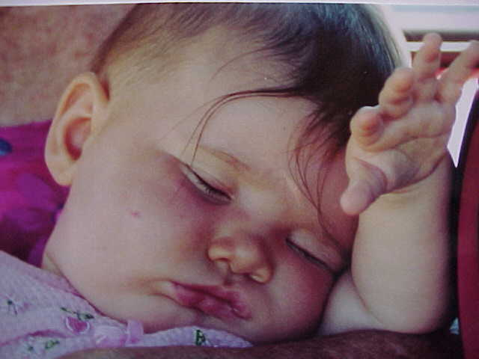
States of Consciousness
Notes:
Psychologists have been interested in studying consciousness since the times of William James. Humanist and cognitive theorists helped the concept of consciousness become a focal point in psychology.

Slide 2
Definition of Consciousness
State of awareness of ourselves and our world
It includes our thoughts, feelings, sensations, and perceptions
States of consciousness
Notes:
Bullet # 1 James’s ideas about consciousness strongly influenced modern thinkers. He characterized consciousness as a “state of awareness” which encompassed many things.
Bullet # 2 James believed that a part of this awareness includes our thoughts, feelings, sensations, and perceptions.
Bullet # 3 When psychologists use the phrase “states of consciousness,” they are referring to a spectrum of different conditions. Imagine a straight line with two endpoints: at one endpoint is full waking consciousness; at the other is complete unconsciousness. “States of consciousness” refers not only two the two endpoints, but to everything in between as well.

Slide 3

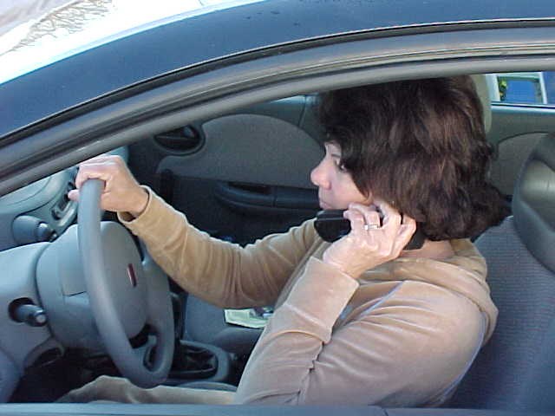
Levels of awareness
Focused awareness
  Athletes in the “zone”
Drifting awareness
  Day dreaming
Divided consciousness
  Allows multi-tasking
  Dangers
Notes:
Most psychologists believe that consciousness is selective. In other words, we have the ability to focus our consciousness. Athletes often experience a focused state of awareness in which they concentrate only on the immediate task at hand. They have learned to block out all external stimuli. They often refer to this state of mind as “being in the zone.” When we are focused, we are wide awake, fully alert, and fully engrossed.
* It’s pretty hard to always stay focused. After a while your mind begins to drift; this may lead to daydreaming, which is a form of consciousness during a waking state. People are more prone to drifting awareness when they are bored or not engaged in some activity.

Slide 4
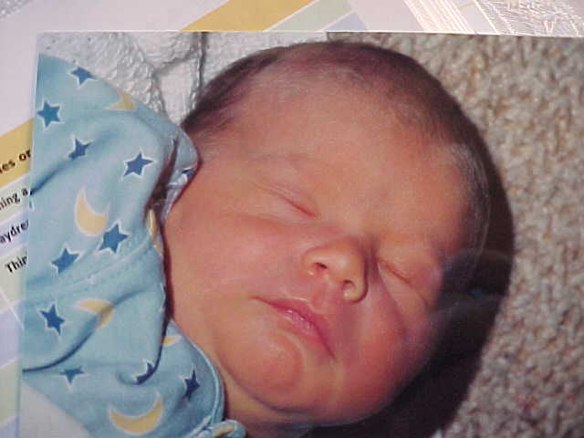
Unconsciousness
Both sleep and dreaming are examples of unconsciousness
Definition: lack of awareness of one’s surroundings or loss of consciousness
Notes:
The best examples of unconsciousness are sleep and dreaming. When a person lacks awareness of his/her surroundings, it is called a “loss of consciousness.”

Slide 5
Loss of Consciousness
Head trauma
Surgical anesthesia
Coma
Notes:
Bullet # 1 Head trauma can commonly cause of a loss of consciousness. For example, a boxer who is knocked out may be unresponsive for some time. The boxer usually awakens later with a headache but no real memory of the event.
Bullet # 2 Patients who have received a surgical anesthetic also can be defined as experiencing a loss of consciousness, since they are generally unresponsive to anything in their environment.
Bullet # 3 Someone who is in a coma also experiences a loss of consciousness and may be unresponsive for months or even years.

Slide 6
Altered States of Consciousness
Daydreaming
Meditation
Hypnosis
Drug use
Notes:
Altered states of consciousness occur when we daydream, meditate, undergo hypnosis, or use mind-altering drugs. Our most common form of consciousness (besides complete wakefulness) is sleep, which we will address next, followed by drug use, hypnosis, and meditation.

Slide 7
State of Consciousness | Level of Alertness | Examples or Features
Focused awareness | High; fully awake and alert | Learning a skill, watching an exciting movie
Drifting consciousness | Variable or shifting | Day dreaming; mind wanders
Divided consciousness | Medium; attention divided between activities; multi-tasking | Talking on the phone while driving; doing homework & watching tv
Sleeping or dreaming | low | Person unaware of surroundings but may respond to some stimuli
Deep unconsciousness | None | Complete loss of consciousness due to head blow, surgery, coma
Altered state of consciousness | Variable | Change in consciousness due to drug use, mediation or hypnosis

Slide 8
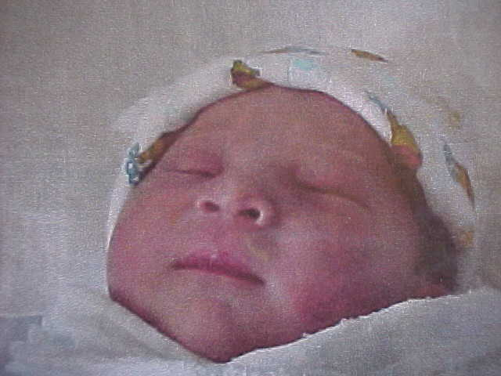
Sleeping and Dreaming
One-third of our lives we are asleep; hypothalamus
Circadian rhythms; melatonin
Jet lag
Notes:
Bullet # 1 We spend about one third of our lives sleeping. There is a major lack of consensus as to why we need to sleep but it is generally believed that it is necessary for both body and mind. The hypothalamus in the brain evidently contains a clock-like mechanism that is responsible for controlling the sleep-wake cycle.
Bullet # 2 Most of our bodily processes (including sleep, body temperature, hormone levels, blood pressure, and heart rate) follow a daily cycle. For humans, these cycles are known as “circadian rhythms,” which are close to 24 hours in length. Melatonin is a hormone that is produced by the pineal gland and helps control the sleep cycle. Exposure to darkness inhibits the production of melatonin, so people who live in the far northern regions of the world (which experience long periods with no daylight during the winter) sometimes suffer from Seasonal Affective Disorder (SAD), in which a lack of light can cause depression.
Bullet # 3 Any type of frequent time shift that disrupts the circadian rhythms is often referred to as jet lag. Also, any changes in the local time (such as switching to or from Daylight Savings Time) can cause a conflict with a person’s internal body clock. Jet lag can make it very difficult either to stay awake or to go to sleep, depending on whether you’ve lost or gained a day when traveling.

Slide 9
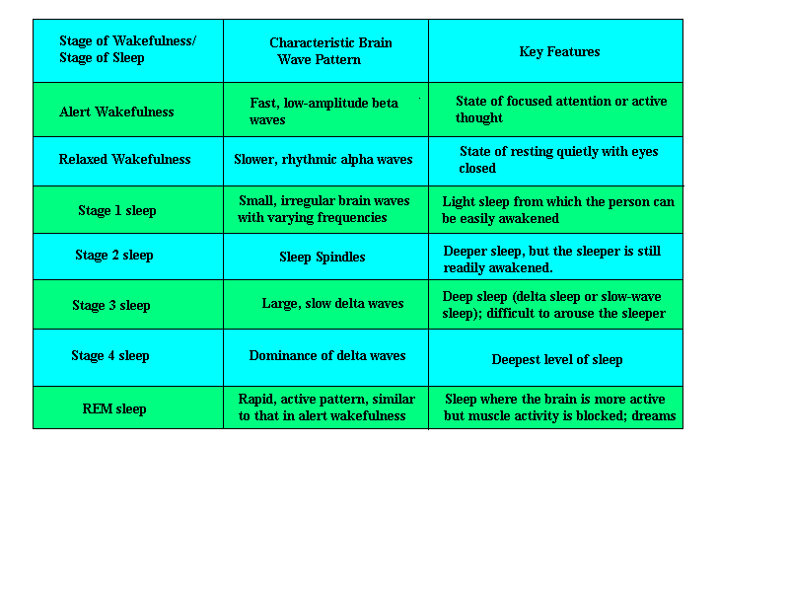
Wakefulness and Sleep
Notes:
This chart gives an overview of the stages of sleep, what brain wave patterns look like during that stage, and a key feature associated with the stage.

Slide 10
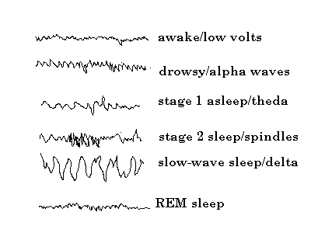
Brainwave Patterns
During Wakefulness and Sleep
Notes:
This chart shows the brainwave patterns associated with each stage of sleep or wakefulness. The EEG (electroencephalograph) is a reliable way to track the amount of electrical energy being emitted by the brain. A series of painless electrodes are attached to various sections of the scalp to receive input. At the top of the chart is a characteristic pattern from an EEG. It shows the amount of electrical energy associated with being awake. As a person begins to get drowsy, alpha waves are emitted. By stage 1 of sleep, theta waves are emitted. By stage 2, sleep spindles begin to form and by the last stage of sleep you can see the emission of slow delta-like waves. At the bottom of the chart are the brain waves of a person who is dreaming. You can see that REM sleep brainwaves actually resemble the brainwaves of a person who is completely awake. Because of this, REM sleep is sometimes called paradoxical sleep.
REM stands for rapid eye movement. Researchers discovered in the 1950s that when a person dreams, his/her eyeballs move. Tiny electrodes are attached to the eyelids to record REM sleep.

Slide 11
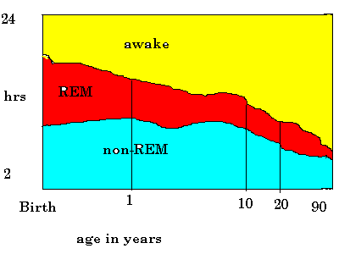
Changes in Sleep Patterns
Notes:
You can see from this chart that babies sleep quite a bit; consequently, they have a significant amount of REM time. As a person gets older, the amount of sleep that her or she needs decreases, along with the amount of REM time they need.

Slide 12
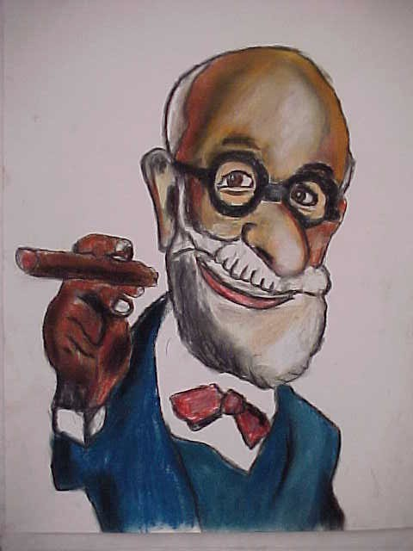
Freud and Dreams
Dreams = wish fulfillment
The royal road to the unconscious
Manifest versus latent
Symbols
Notes:
Bullet # 1 Sigmund Freud theorized that dreams represent a form of wish fulfillment. He also believed that dreams contain symbols that underlie wishes that are usually sexual and/or aggressive.
Bullet # 2 Freud called dreams the “royal road to the unconscious.” He believed that dreams need to be interpreted.
Bullet # 3 Freud felt that dreams had two levels: the manifest level (the dream at face value) and the latent meaning (the hidden or disguised form). Freud felt that the latent part of the dream used symbols to prevent any emotionally threatening material from waking the dreamer.
Bullet # 4 Freud believed that things like trees, skyscrapers, snakes, and guns were symbols of male genitalia because they were phallic-shaped, while enclosed objects like closets and purses symbolize the female genitalia.
Note: Other dream interpreters have very different views. Psychologist R.D. Cartwright has suggested that we use dreams to solve personal problems. Researcher Alan Hobson proposed a different model in which dreams are merely the by-products of neural activity and have no deeper meaning.

Slide 13
Sleep Deprivation
Need for sleep varies
The life cycle
Accidents
Notes:
Bullet # 1 One man reportedly stayed awake for 231 hours and was still lucid and capable of serious intellectual work. He wrote a beautiful poem after ten days with no sleep. He was an exception—most people need between seven and eight hours a night to feel completely rested and functional.
Special note: People using the drug Ecstasy often stay awake for hours on end. Users of speed (amphetamines) show similar patterns.
Bullet # 2 As people get older, they require less and less sleep.
Bullet # 3 Sleep deprivation causes or contributes to a significant amount of automobile accidents. Most of these accidents occur in the early morning hours when drivers are typically sleepy.

Slide 14
Sleep Disorders
Insomnia
Narcolepsy
Apnea
Sudden infant death syndrome
Sleepwalking
Night terrors
Notes:
No special notes. These disorders will be discussed in the slides that follow.

Slide 15
Insomnia
Insomnia affects 15% of the adult population
3 types:
  1. Trouble getting to sleep
  2. Trouble staying asleep
  3. Trouble returning to sleep after awakening
Notes:
Bullet # 1 Insomnia is the most common sleep disorder, affecting nearly 15 percent of the adult population.
Bullet # 2 Type 1 insomnia affects people in three different ways: some people have trouble falling asleep, others have trouble staying asleep, and a third group wakes early and cannot fall asleep again. Insomnia seems to affect women more than men. Insomnia also commonly occurs for people under stress.

Slide 16
Characteristics of Insomnia Sufferers
Higher levels of autonomic nervous system activity
Higher anxiety levels
More tension in the forehead
More concerned about physical complaints
Notes:
Bullet # 1 Insomnia sufferers seem to have higher levels of autonomic nervous system activity. The autonomic nervous system controls most of our involuntary actions like heart rate and respiration.
Bullet # 2 Most sufferers of insomnia seem to possess higher anxiety and worry levels. It stands to reason that when you are nervous and tense it is harder to get to sleep.
Bullet # 3 Worry and anxiety in general can cause tension in the forehead muscles, a factor that then contributes to insomnia.
Bullet # 4 People who focus too much on minor aches and pains also can have trouble falling asleep.
Note: You cannot force yourself to go to sleep. Many Americans use drugs to help them get to sleep.

Slide 17
Using Drugs to Induce Sleep
Sleeping pills and arousal
Habituation and tolerance
Notes:
Bullet # 1 Sleeping pills reduce arousal levels in the brain and work for only a short amount of time. Stronger types of sleeping medications use barbiturates, which can be quite dangerous if abused or taken improperly (i.e. with alcohol).
Bullet # 2 People who frequently use sleeping pills eventually develop a tolerance to the medication. As tolerance increases, a person needs to take more of the same drug for it to produce similar effects. This is a dangerous practice—one’s tolerance might build to the point that the person might take lethally high doses of medication.

Slide 18
Things You Can Do to
Sleep Better
Practice relaxation techniques
Avoid ruminating (worrying)
Establish a regular routine
Notes:
Bullet # 1 Insomnia sufferers can practice relaxation techniques, many of which are available on CDs or audiocassettes. These audio sessions usually have soothing noises (such as the sound of the ocean) in the background along with repeated directions about which muscle groups to relax.
Bullet # 2 Avoid ruminating or worrying about the day’s problems. It’s not conducive to sleep for your brain to be trying to come up with solutions to things.
Bullet # 3 Establish a regular bedtime. Stick to the schedule whenever possible. Your body’s clock is not used to constant changes. Workers who change to a swing shift (usually 4 p.m. to midnight) or a night shift often have a terrible time adjusting to their new schedules.

Slide 19
Narcolepsy
A mirror image of insomnia
Rapid onset of REM sleep
May last up to 15 minutes
Dangers
Notes:
Bullet # 1 Narcolepsy afflicts more than 150,000 Americans. It is characterized by a sudden sleep attack during the daytime hours. A narcoleptic may be involved in a conversation and then almost instantly be sound asleep or even fall to the floor.
Bullet # 2 Narcolepsy is related to an REM (rapid eye movement) disorder. Normal REM sleep takes place after a person descends through the stages of sleep. With narcoleptic, REM sleep begins immediately.
Bullet # 3 The duration of a narcoleptic episode is hard to gauge. It may last as long as 15 minutes or more. In some instances, attacks are preceded by vivid hallucinations.
Bullet # 4 Narcolepsy has many obvious dangers, such as if an attack occurs while a person is driving or even doing simple household chores. Narcolepsy tends to run in families. This photograph in the slide is of a man who suffers from narcolepsy; his father also suffered from this sleep disturbance.

Slide 20
Sleep Apnea
Stop breathing as many as 500 times a night
An anatomical deformity
Risks: hypertension, high blood pressure
Notes:
Bullet # 1 Sleep apnea is extremely dangerous. It affects more than 18 million American men, many of whom are usually overweight. The word “apnea” means “without breath.” A person who has sleep apnea may stop breathing as many as 500 times in one night.
Bullet # 2 Often apnea is caused by a structural abnormality such as an overly thick palate or enlarged tonsils that block a person’s airways. Apnea sufferers usually have no memory of when they stop breathing. These episodes can last for as long as 90 seconds. Surgery of the palate is sometimes helpful; so is elevating the head of one’s bed. In more extreme cases of apnea, a sufferer is hooked up to oxygen at night.
Bullet # 3 A common risk of apnea is hypertension and high blood pressure. Sufferers also usually snore very loudly because of restricted airways.

Slide 21

Nightmare Disorder
Disturbing nightmares that are very vivid and intense
Common themes: falling, fleeing
REM sleep
Notes:
Bullet # 1 Nightmare disorders often afflict children. People who suffer from nightmare disorders have elaborate, story-like dreams that feel extremely threatening.
Bullet # 2 Themes in nightmares often include falling or being pursued by an unknown attacker.
Bullet # 3 Most nightmares take place during REM sleep and usually occur late at night or early in the morning, when periods of REM sleep are longer in duration. Stress seems to be a contributing factor.

Slide 22
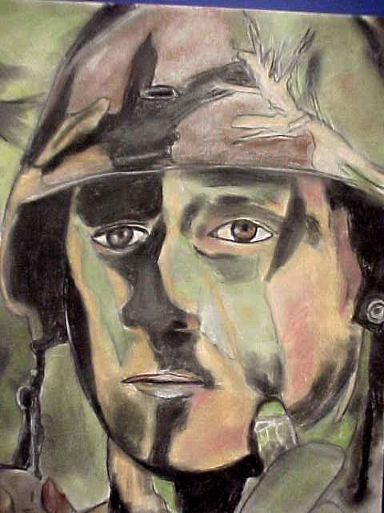
Night Terrors
More intense than nightmares
They occur in deep sleep, not REM sleep
Affects boys and men more
Delayed stress connection
Notes:
Bullet # 1 Night terrors are much more intense than nightmares.
Bullets # 2–3 Night terrors occur in deep sleep, not REM sleep. The disorder affects males more than females, and children more than men. Night terrors often begin with loud, panicky screams.
Bullet # 4 There seems to be an association between night terrors and victims of delayed stress, such as combat veterans. People who suffer from night terrors may sit up in bed with their hearts pounding, breathing rapidly. They may also talk incoherently and move wildly. Many attacks can occur over the course of a night. Tranquilizers can sometimes help.

Slide 23
Sleepwalking
More common among children than adults
Persistent sleepwalking is an indication of a sleep disorder
Occurs in deep sleep
Notes:
Bullet # 1 Sleepwalking occurs most commonly among children—about 5 percent of all children have a sleepwalking disorder. The sleepwalker remains sound asleep while moving about with their eyes open and an expressionless look on his/her face. Usually the sleepwalker has no memory of the episode. It is not harmful to awaken a sleepwalker.
Bullet # 2 Many children grow out of the disorder. If it persists, however, the child may have a serious sleep disorder.
Bullet # 3 Sleepwalking occurs in deep sleep, with episodes occurring typically during the dreamless, non-REM stage.

Slide 24
Sudden Infant Death Syndrome (SIDS)
Crib death or SIDS kills up to 7,000 children each year in the U.S.
Causes
Monitoring infants
Notes:
Bullet # 1 Sudden Infant Death Syndrome (SIDS) claims the lives of nearly 7,000 children in the U.S. each year. The number of children who die each year from SIDS (also known as crib death) seems to be growing.
Bullet # 2 The main cause of SIDS seems to be an immaturity of the central nervous system. Children born prematurely may also be more vulnerable. In addition, SIDS often occurs when a child already has an upper respiratory infection. There also exists a connection between a drugs and SIDS. Mothers who use drugs while pregnant often give birth to babies that are often much smaller and more susceptible to disease than normal children. Drug babies are also more likely to be born prematurely.
Bullet # 3 Today, there are a number of devices that hospitals and parents can use to monitor babies at risk for SIDS. Though such devices prevent many deaths, no real “cure” exists.

Slide 25
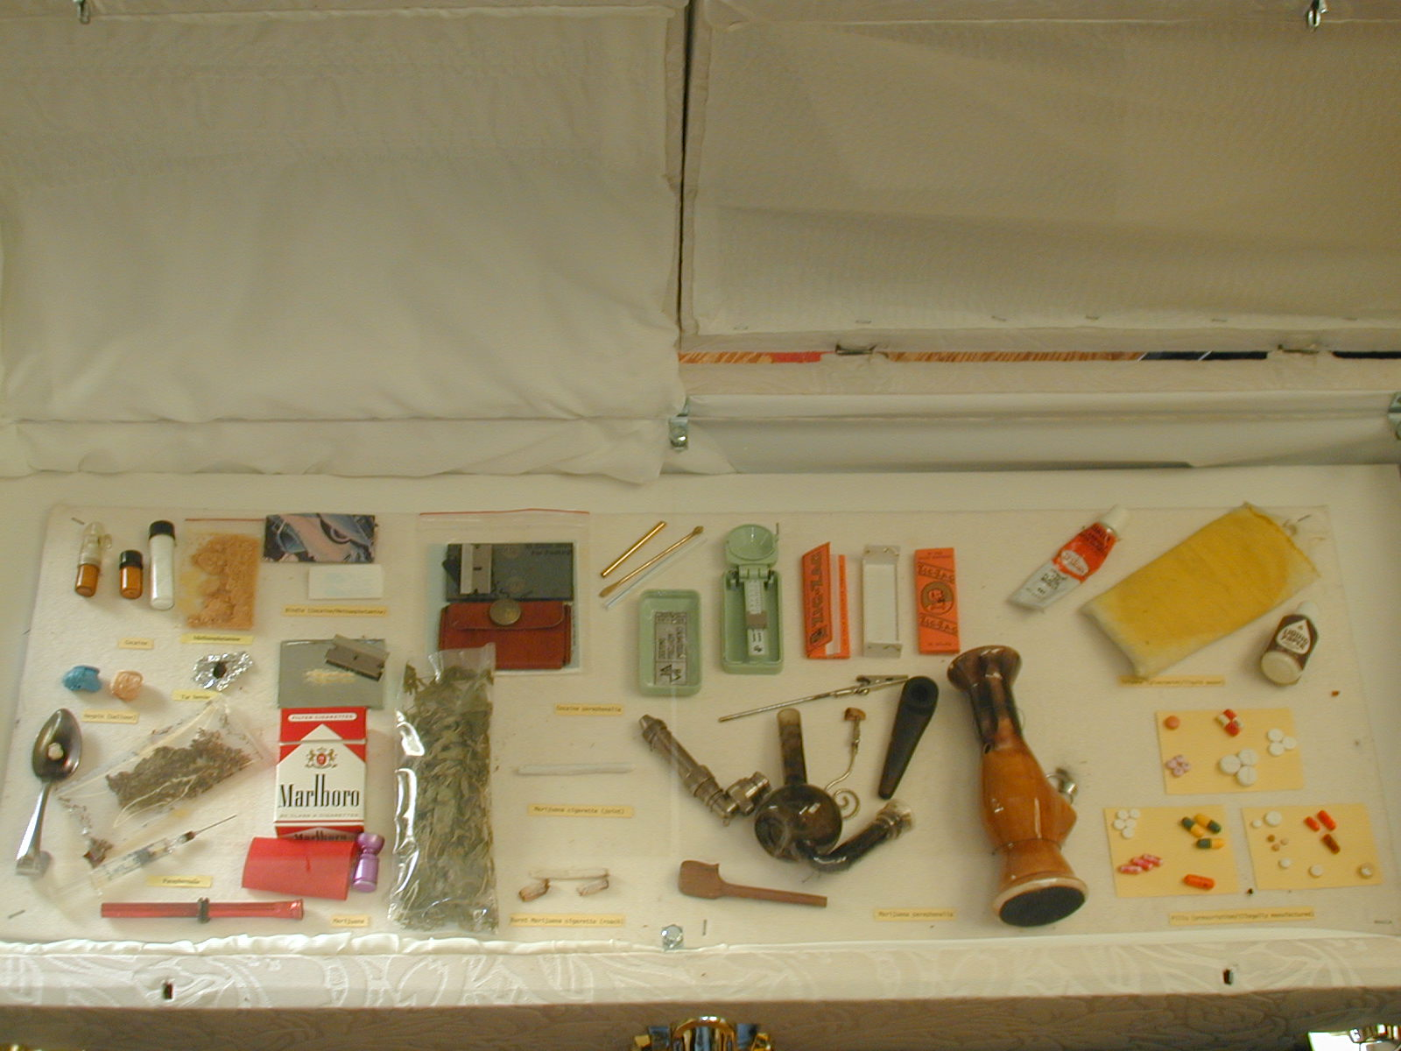
Altering
Consciousness through Drugs
Notes:
Most people who want to experience altered consciousness turn to drugs. They are more likely to pop a pill, smoke a joint, or down a six-pack than to practice meditation or undergo hypnosis. Psychoactive drugs like depressants, stimulants, and hallucinogens chemically alter a user’s mental state. In this section, we will explore some of these psychoactive drugs, focusing in particular on drug abuse and recreational drug use.

Slide 26
What is Considered Abuse?
3 criteria listed by the American Psychiatric Association
1. Pathological use
2. Impairment of occupational or social functioning
3. Lasts one month or more
Notes:
Bullet # 1 There is a fine line between use and abuse. The American Psychiatric Association issued 3 guidelines designed to illustrate the differences between use and abuse.
Bullet # 2 Drug abuse is usually defined as the pathological use of a substance. Using a drug for the wrong reason is considered abuse. For example, if you are using a depressant because you are in intense pain it is not considered abuse, as long as it has been prescribed by a physician. If you use it to achieve a state of altered consciousness, however, it is considered abuse.
Bullet # 3 Drug use is considered abuse if it affects a person’s ability to perform their job or deal with other people in normal, everyday situations. Also, if you are drunk and sleeping off a hangover on a regular basis you are considered to be abusing drugs. Some people abuse more than one drug at a time. These offenders are called polyabusers.
Bullet # 4 Abuse must last for at least one month before it is medically considered to be problematic.

Slide 27
Drug Dependence
Physiological dependence
Withdrawal/
abstinence syndrome
Tolerance
Notes:
Bullet # 1 A person’s body chemistry changes when they use a drug repeatedly. The body comes to depend on having a steady supply of the drug. This condition is known as physiological dependence.
Bullet # 2 When people who are physiologically dependent abruptly stop using the drug, they go through withdrawal (also known as abstinence syndrome).
Bullet # 3 A common sign of physiological dependence is increased tolerance, which indicates that a person has become physically habituated to the drug and needs to take larger and larger amounts of the drug for it to achieve the same level of effectiveness.

Slide 28
Physical Dependence vs.
Psychological Dependence
Physical dependence = caused by repeated usage that changes body chemistry
Psychological dependence = a pattern of habitual or compulsive use of a drug in order to satisfy a psychological need
Notes:
Bullet # 1 When a person who is physiologically addicted to a drug suddenly lowers their level of usage, withdrawal sets in. Withdrawal is often characterized by tremors (including DTs, which stands for delirium tremens), rapid pulse rate, sweating, nausea, and elevated blood pressure.
Bullet # 2 If a person’s dependence is strictly psychological, when they lower their usage level they don’t suffer from physical withdrawal. People who are psychologically addicted to a drug come to rely or depend upon it to reduce anxiety. Some drugs, however, can be both physiologically and psychologically addicting. Drugs like nicotine, alcohol, and heroin are psychologically and physiologically addicting. Drugs like marijuana are psychologically addicting.

Slide 29
Depressants
Alcohol
Opiates/opioids
Barbiturates
Slow the activity or the central nervous system
Notes:
Bullets # 1–2 Depressants are drugs that slow the activity of the central nervous system (which includes your brain and spinal cord). Alcohol is the most common CNS depressant. More powerful CNS depressants include all of the derivatives of the opium poppy as well as opiods, which are synthetic forms of opiates. Barbiturates and sleeping pills are also CNS depressants.

Slide 30
Alcohol
Alcohol is associated with lower productivity, loss of employment, and downward social mobility
Notes:
About one half of all Americans use alcohol. It has become a bedtime sedative, a cocktail party facilitator, and a tranquilizer any adult can get without a prescription. It has nearly always been America’s drug of choice. People under the influence of alcohol have a reduced ability to foresee the negative consequences of misbehavior and may be less likely to follow social and personal standards of behavior. People who have a drinking problem usually have a difficult time maintaining their jobs and keeping their family life intact.

Slide 31
The Effects of Alcohol
Alcohol is a CNS depressant
It deadens minor aches and pains
It impairs cognitive functioning
It reduces coordination and impairs information processing
Notes:
Bullets # 1–2 Before the advent of anesthetics, alcohol was used as a painkiller because it slows the activity of the central nervous system. Alcohol deadens minor aches and pains and also has some analgesic properties.
Bullet # 2 When consumed in sufficient amounts, alcohol interferes with normal cognitive functioning. People under the influence of alcohol often behave in irrational and unpredictable ways. Their thinking is not clear and they often make very poor choices. Alcohol also reduces coordination and affects motor skills. About one half of all automobile accidents are alcohol-related. Alcohol also impairs information processing, which makes it hard for a drunk person to remember things that happened while they were drinking.

Slide 32
Consequences of
Chronic Drinking
Heart disease
High blood pressure
Brain damage
Cirrhosis of the liver
Fetal Alcohol Syndrome
Notes:
Bullets # 1–2 In the long term, excessive drinking can damage the heart and blood vessels. Sustained abuse can even lead to cardiac arrest. High blood pressure is also associated with heavy drinking.
Bullet # 3 Excessive amounts of alcohol destroy the brain cells. Every time a person drinks, they damage brain cells. Since the brain has millions of cells, the damage from alcohol abuse may not be visible for many years. Chronic alcoholics eventually lose much of their cognitive functioning.
Bullet # 4 Chronic drinking also damages the liver, causing cirrhosis. Cirrhosis is actually caused by a lack of protein in a person’s diet. Alcoholics typically have lousy diets. If they have a few dollars in their pockets, they most likely will buy booze instead of food. Musician David Crosby had to have a transplant at UCLA a number of years ago because his excessive drinking and drug use during the 1960s and 1970s had destroyed his liver. Famous baseball player Mickey Mantle chronically abused alcohol; he eventually died from complications caused by liver disease.
Bullet # 5 Women who drink excessively while pregnant expose their baby to a variety of birth defects such as Fetal Alcohol Syndrome. Babies born with this syndrome often have facial deformities, heart problems, mental impairments, and stunted growth.

Slide 33
Treatment of Alcoholism
Detoxification/abstinence syndrome
Disulfuram/Anabuse
Alcoholics Anonymous
Behavior therapy, aversion therapy, instruction in social skills
Notes:
Bullet # 1 There are a number of ways to treat alcoholism, but first the alcoholic must undergo detoxification (detox), which takes about ten days. During this time, the alcoholic will suffer all of the physical symptoms associated with withdrawal, including involuntary muscle spasms, elevated blood pressure, nausea, and vomiting. Detox from alcohol can be quite brutal.
Bullet # 2 Sometimes the drug Disulfuram (also known as Anabuse) is used in detox. When this drug is mixed with alcohol, it causes severe nausea and vomiting. It thus gives alcoholics a strong incentive to complete the detox process. However, some have questioned the reliability and effectiveness of the drug.
Bullet # 3 Alcoholics Anonymous (AA) has been perhaps the most reliable method of treatment over the years. It has about a 75 percent effectiveness rate as long as the person stays with the program. A key part of the program involves making a public confession about the fact that you are an alcoholic.
Bullet # 4 Other techniques for treating alcoholism include everything from relaxation therapy to the use of electric shocks as aversion therapy. There are even classes which show alcoholics how to relate to one another without having to use alcohol.

Slide 34

What Is Hypnosis?
A form of altered consciousness in which a person becomes highly suggestible
A subject does not exercise critical-thinking skills
Notes:
Bullet # 1 Hypnosis is a trance-like state in which subjects become highly suggestible and even open to commands.
Bullet # 2 Since hypnosis causes such a narrow focus, hypnotized subjects rarely use their critical-thinking skills. Suggestions made by a hypnotist may seem silly or inappropriate to others, but not to the hypnotized subject
Not everyone agrees that hypnosis is an altered state. Some researchers believe that if people are simply given instructions and told to try their hardest they can do anything hypnotized people can do.
Note: Hypnosis is the most difficult state of altered consciousness to understand, even though scientists have studied it for over 200 years. Researchers have examined hypnosis in order to shed light on the relationship between health and disease, including possible links between the nervous system and the immune system.

Slide 35
What Hypnosis Is Not
It is not the same as sleep
It is not the same as a drug-induced state
It is not like any other altered state of consciousness
Notes:
Hypnosis is not like any other altered state of consciousness. Though it shares some similarities with sleep and drug-induced states, it is not equivalent to either. Hypnotized subjects are able to focus their attention on one tiny aspect of reality and ignore all other input. EEGs of people under hypnosis show large irregular delta waves that don’t occur in any other altered state of consciousness.

Slide 36
What Hypnosis Can Accomplish
Unusual feats of attention control
Psychosomatic regulation
Risk = Cognitive dissociation
Notes:
Bullets #1–3 Under proper circumstances, hypnosis allows unusual feats of focused attention by narrowing a subject’s perceptual field. Hypnosis has also been used to help people suffering from psychosomatic illnesses, which are physical problems caused by stressors in the environment. Hypnosis carries the risk of causing what is known as cognitive dissociation, or a “splitting” of one’s consciousness in which a person’s thoughts seem separated from their feelings. Dissociative disorders usually are accompanied by memory loss.

Slide 37
Components of the Unconscious Mind
Immoral urges
Shameful experiences
Selfishness
Fears, violent motives
Unacceptable urges
Notes:
According to Freud, immoral urges, shameful experiences, selfishness, fears, and unacceptable desires all reside in the unconscious mind. He felt that bringing these feelings to the surface (i.e. into the conscious mind) would help to improve the quality of life for his patients. Freud used hypnosis in much of his early therapy; however, he wasn’t much of a hypnotist. He later abandoned the technique for another that he called “free association.”

Slide 38
How Does It Work ?
Subject allows the hypnotist to guide and direct
A person may be made aware or unaware of certain things
A subject becomes highly receptive and responsive to suggestions
Notes:
Hypnosis is a trusting relationship. The subject must be willing to allow the hypnotist to temporarily guide and direct their thoughts. A hypnotist may make a subject either aware of things they wouldn’t usually notice, or unaware of things they usually would notice. Unfortunately, hypnosis has all too often been used for entertainment value—for example, a hypnotist may tell a subject that an onion he/she is eating is a succulent apple. However, hypnosis has important medical and psychological applications.

Slide 39
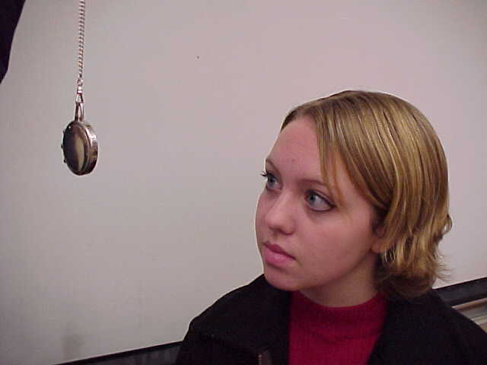
Inducing a Trance
Braid method
Eye method
Machine method
Notes:
A hypnotist induces a trance by slowly persuading the subject to lose interest in external distractions. The relationship between the hypnotist and the subject involves cooperation, not domination.
Bullet # 1 The most common technique for inducing hypnosis is the Braid method, named after the hypnotist who invented it. In this method, the hypnotist usually uses some sparkling object or ornament, such as a pocket watch suspended by a cord or chain. The subject then narrows their focus so that all they are concentrating on is the object.
Bullet # 2 The eye method requires the subject to be eyeball to eyeball with the hypnotist (about eight inches apart).
Bullet # 3 There is also a machine that spins a disk with spiraling concentric circles that seems to work quite well for hypnosis.

Slide 40
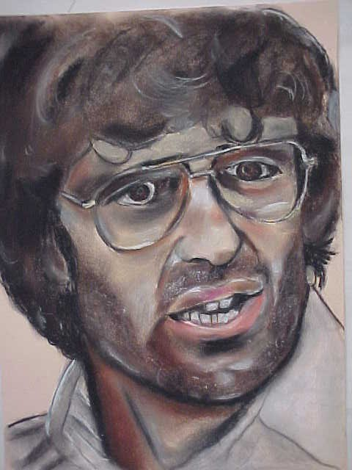
Can You Be Made to Do Something Against Your Will?
Notes:
Most psychologists believe that hypnotized subjects cannot be made to do something which goes against their basic character or morals. Any such suggestion would cause them to awaken immediately. Other psychologists have their doubts. For example, if you told a normally modest person to disrobe, they would automatically awaken. If you told the same person that their clothes were on fire, however, they might start to tear off their clothes in public—even though they would never do so under normal circumstances. Many psychologists believe clever persuasion can get people to do something against their will. This slide shows a portrait of Vernon Howell, aka David Koresh, leader of the Branch Davidian cult. He exercised tremendous power over his followers, and nearly 100 of them perished with him at their compound in Waco, Texas after a standoff with ATF agents. Cult leader Jim Jones convinced hundreds of his followers to commit suicide by ingesting cyanide-laced Kool-Aid. Charles Manson also wielded a similar power over his followers, convincing them to murder several people—including a pregnant woman.

Slide 41
Hypnosis, Part 2
Posthypnotic suggestions
Notes:
Hypnosis has tremendous value and potential, especially in the area of posthypnotic suggestions.

Slide 42
How Do Posthypnotic Suggestions Work?
Suggestions to remember when the trance has ended
Helps change unwanted behaviors (smoking, overeating)
Notes:
Bullets # 1– 2 Posthypnotic suggestions need to be repeated several times in order for them to work. While under hypnosis, the hypnotist continually makes suggestions about a subject’s specific unwanted behavior, such as smoking or overeating. It may take a number of sessions for the suggestions to become effective, and not everyone is a good candidate.

Slide 43
Value of Hypnosis
Anesthesia
Sensory manipulation
Extraordinary strength?
Age regression
Hyperamnesia
Notes:
Bullet # 1 Hypnosis has been used as an anesthetic for many procedures, even ones as serious as abdominal surgery and childbirth. Dr. Ernest Werbel, a San Luis Obispo surgeon, used hypnosis in his practice. He wrote a book about the value of hypnosis not just as an anesthetic but as a tool for post-surgical recovery. His patients did seem to recover faster than those who had received general anesthetics. However, not many doctors are trained to use hypnosis.
Bullet # 2 Hypnosis can also be used to manipulate sensory information. A subject in a deep hypnotic trance can be made to act as if any or all of his/her sensory input have been cut off completely, or be made to respond to sights, smells, sounds, or tastes that aren’t really there.
Bullet # 3 Under hypnosis, a young woman can be made to lift an object weighing 300 pounds. Hypnosis does not make a person any stronger than normal, but it can motivate someone to perform as if their life depended upon it.
Bullet# 4 In theory, a person under hypnosis could be taken back or “regressed” to a past event, such as their sixth birthday party. The subject would be able to remember the guests, the presents, and even the taste of the cake. If the subject was asked to write their name, they would write it the way they did in the first grade. The extent of the regression is limited; for example, a regressed patient who was reliving his sixth birthday party was asked by the hypnotist, “What time is it?” Thr patient looked at his watch and replied “4 p.m.”—an action few first graders would take, since not many children that age wear watches or even know how to tell time.
Bullet # 5 Hyperamnesia involves retrieving lost memories. In theory, hyperamnesia could have great value for a psychotherapist trying to examine a subject’s repressed memories that have caused current forms of maladaptive behavior.
Though some hypnotized patients seem to be able to recall repressed memories, in actuality, we tend to confuse memories of things that happened to us with things we read or saw, imagined, or that never really happened. An unwary hypnotist can even cause harm by leading a subject to believe that an imagined past is actually a repressed memory. Such situations have occurred in accusations of child abuse; people who want to prove the abuse really happened ask leading questions that eventually convince the highly suggestible, hypnotized subject that lead him or her to create false memories of abuse.

Slide 44
Dangers of Hypnosis
Dissociation
Conversion symptoms and psychosomatic illnesses
Notes:
Bullet # 1 Dissociation refers to an unusual change in one’s self-identity. It involves a process whereby specific mental information (e.g. memories, ideas, feelings, perceptions) are lost to conscious awareness and become unavailable to voluntary recall.
Bullet # 2 Therapists commonly use hypnosis to treat conversion disorders, in which a subject has ailments (such as allergic reactions, hysterical blindness and deafness, and visual or auditory hallucinations) that have no physical cause. Although these conversion symptoms are psychosomatic in nature, they cause real physical suffering. Though hypnosis frequently helps alleviate conversion symptoms, it sometimes results in symptom substitution—for example, psychological problems don’t disappear but simply manifest themselves in a different way.

Slide 45
Best Subjects Poor Subjects
Teens or those in their early 20s
Above average IQ
85% of this group can be hypnotized
Introverted
Hysterical
Introverted
Hysterical
Insane
Stubborn
Notes:
To get the greatest depth of a trance it will require between 8 and 12 sittings.
Bullet # 1 Teens and young adults make the best subjects for hypnosis because they have been conditioned to be obedient to authority.
Bullet # 2 It is almost impossible to hypnotize someone who is retarded or has subnormal intelligence.
Bullets # 3– 5 About 85 percent of these prime subjects can be hypnotized. The difficult subjects that make up the other 15 percent include students of hypnosis (who are far too aware of the process to achieve a trance), bullheaded stubborn people, the insane, highly introverted people, or people prone to hysteria.

Slide 46
Meditation
A set of techniques intended to create an altered state of consciousness
Helps reduce anxiety and tension
Focus is provided by a word, sound, or object/mantra
Alpha waves
Notes:
Bullet # 1 Meditation is a set of techniques intended to help a person achieve inner peace and tranquility.
Bullet # 2 Supporters of meditation claim that the technique reduces anxiety and tension and improves the quality of life.
Bullet # 3 Common meditation techniques require strict focusing, much like in hypnosis. The focus can be a single word, a sound, or an object. The goal of meditation is to stop thinking about any one specific thing. Some mediators focus on their own breathing or slowly repeat a “mantra,” which is a soothing word or phrase. Typically during meditation, muscles relax and breathing and heart rate slow down.
Bullet # 4 Most forms of meditation produce alpha waves that can be measured by an EEG. These waves are similar to those produced in stage 1 of the sleep cycle.

