Slide 1
Chapter 6
The 1893 World Fair

Slide 2
History of the World Fair
Purpose of Fair:
  Show human advancements
  Entertainment
  Unveil inventions
  Share international culture
1851 Fair in London
1853 Fair in New York
1876 Fair in Philadelphia – 100 yr anniversary of United States
1889 Fair hosted by Paris – presents Eiffel Tower

Slide 3
History of world fair
Chicago “needs” fair to help rebuild
  Fire
  Haymarket bombing
400th anniversary of Columbus
New York logical place to hold Fair
  Chicago seen as too simple, unsophisticated
  “Windy City” = term used to describe self-promotion of Chicago

Slide 4
Chicago wins world fair
Chicago raises $10 million to host fair & wins bid
Frederick Law Olmstead & Daniel Burnham = architects to oversee World Fair
Jackson Park (7 miles south of city hall) chosen as location for Fair
Called the “White City” because of white buildings that occupied main fairground
Manufacturers and Liberal Arts Building = largest building in the world

Slide 5
Chicago’s world fair
Deal made with pickpockets:
  $10 immediate fine to police
  Released between 8 pm – 4 am
Keeps the Fair safe and secure – won’t ruin Chicago’s image
Fair was used to further promote Chicago

Slide 6
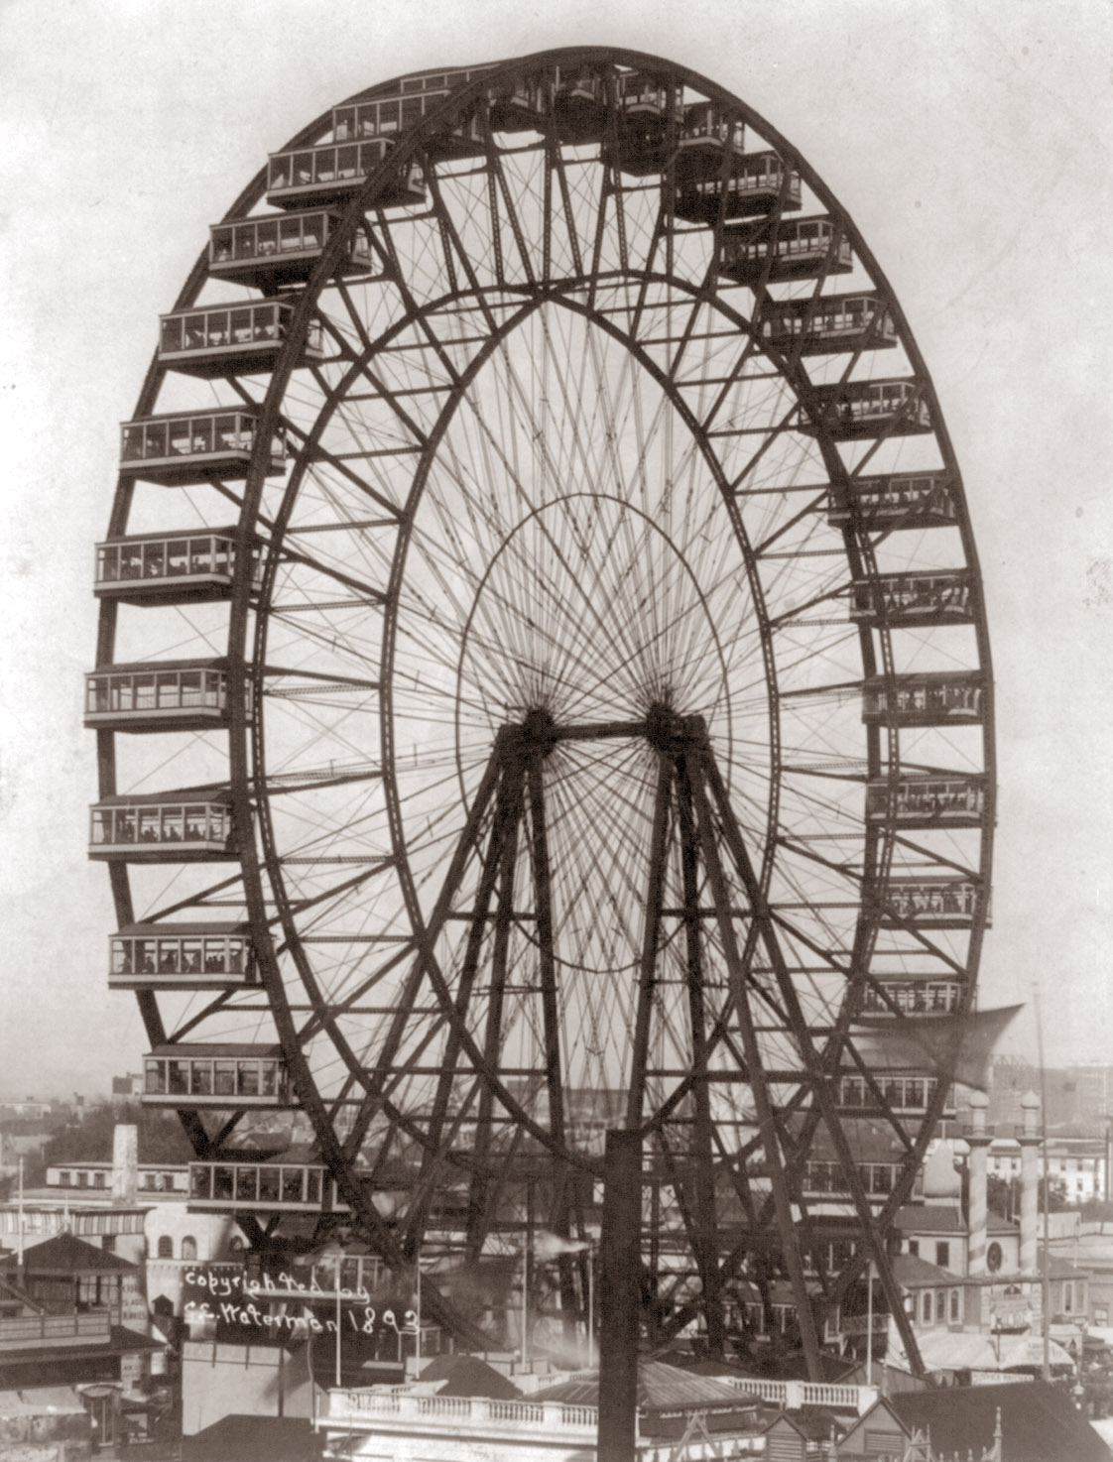
Chicago’s world fair
Structure created to rival Eiffel Tower:

Slide 7
Chicago’s world fair
After Fair, buildings used by homeless
Police & protesters clash at fairgrounds
  Fire burns down most buildings
Two buildings still remain from World’s Fair:
  Museum of Science and Industry
  Art Institute

