Slide 1
Chapter 6 – The Fire

Slide 2
Chicago = fire trap
City is built almost entirely of wood
  Buildings
  Sidewalks
  Streets
  Bridges
Few fire-resistant materials used
Little space between buildings – many buildings touching
Wooden bridges neutralize natural fire breaks
Roofs covered with tar and pine chips
  Both flammable and chips break off and blow during fires

Slide 3
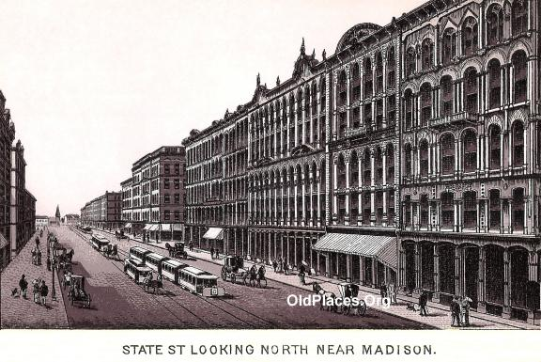

Slide 4

Chicago = fire trap
Hay & straw kept in large quantities
Homes use open flame for heating and cooking
Only solution = demolish all and rebuild – NOT FEASABLE
Fires common in large cities

Slide 5
Fire department
Used steam-powered pumps – not very effective
1871 = 185 firefighters
Rapid response, not technology used to combat fires
Each station has spotters and when a fire is seen message is relayed to closest station
Speed was most important way to combat fires

Slide 6
The perfect storm
Oct. 7 – huge fire west of downtown
  Half of fire brigade works on fire
  Largest fire in Chicago’s history (until that point)
  Burns 20 acres
Sunday, Oct. 8 @9:00 pm – fire starts in O’Leary’s barn
Cow kicks lantern?
Firemen exhausted from Oct. 7 fire
Very dry summer/fall
20 mph wind spreads flames
Spotter incorrectly locates fire – calls wrong
department

Slide 7
The fire
By 11:00 pm fire declared out of control
Fire creates high winds which add to spreading of flames
Chaos ensues
  Panic in streets
  Horses run wild
  Families separated
  Looting of stores
  Bridges collapse from weight of people
Fire seen in Indiana
Fire seen from house next to A.H. library

Slide 8
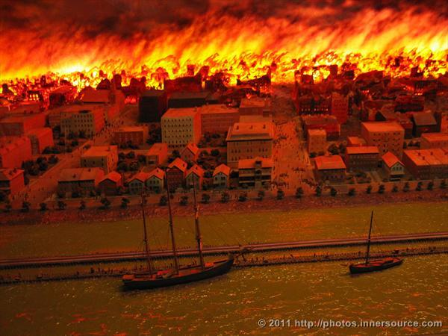
The Fire
Fire hydrants out of water by 7:00 am, Oct. 9 due to city waterworks burned to ground
Only rain can extinguish fire
High temps break glass and melt iron
Rain begins night of Oct. 9 & blaze extinguished Tuesday, Oct. 10

Slide 9
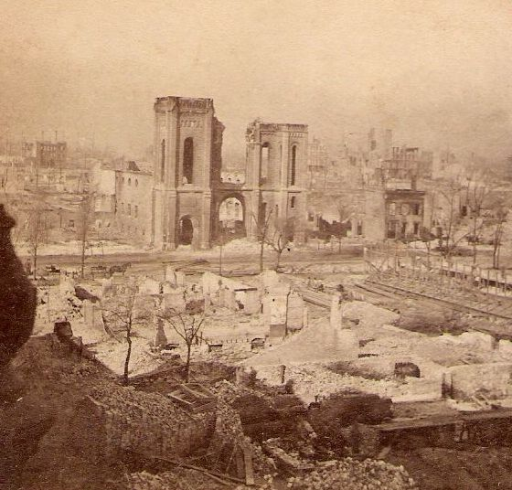
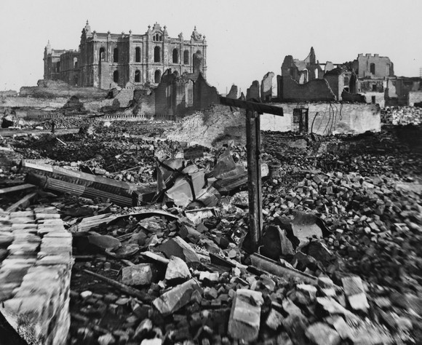

Slide 10
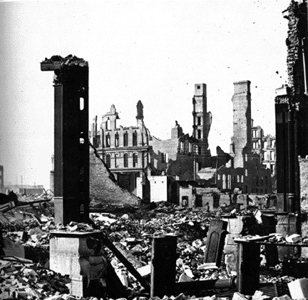

Slide 11
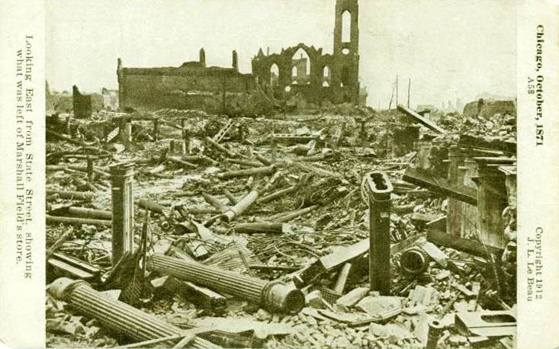

Slide 12
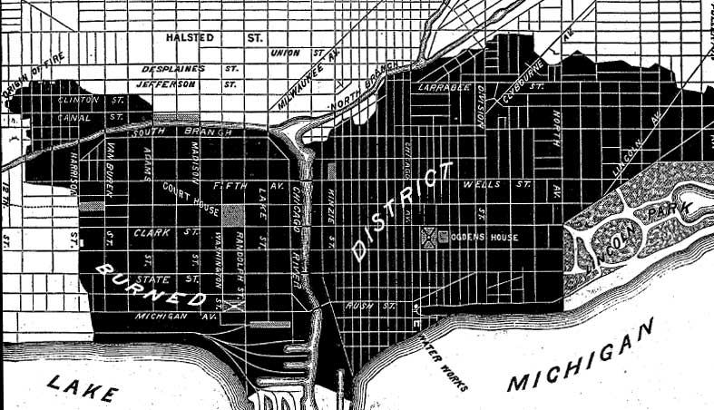
aftermath
Fire was 4 miles long, 1 mile wide

Slide 13
The aftereffects
Timeline of Chicago Fire
Chicago rebuilt in 2 years
Lumber yards, stock yards, grain elevators not touched by fire
Chicago so important to nation, many donations received from all over U.S.
Some thought fire was karma
  Temperance Union
  Sherman’s “March to the Sea”

Slide 14
The aftereffects
Rebuilt downtown now planned
  Downtown to be commercial, not residential
Skyscrapers built to maximize use of space
Better laws and building codes passed
Relief assistance to victims
  funds distributed by independent agency (Relief and Aid Society)
  Worth determined by Relief and Aid Society – business owners more like to get $$
  Bias towards poor and immigrants

