Slide 1
City of Big Shoulders
Ch. 1 – The Early World of Chicagou

Slide 2
Early Settlements
Chicagou means “the wild-garlic” place
Very swampy land – not good for farming
Short growing seasons
Illiniwek (Illinois) Indians inhabited land, but not very populated
Was originally a place to “pass-through”
Most settlements were west and south – warmer and closer to Mississippi River

Slide 3
Around 1650 Illinois Indians decimated by tribes of Iroquois Nation
Miami Indians migrate to area from Ohio
French missionaries come to area late 1600s
1800s Miami move out and Potawatomi move in from Green Bay area
Chicagou NEVER site of major settlement
  Warmer, drier, less windy area preferred for settling
Access to Chicagou is via St. Lawrence River and Great Lakes

Slide 4
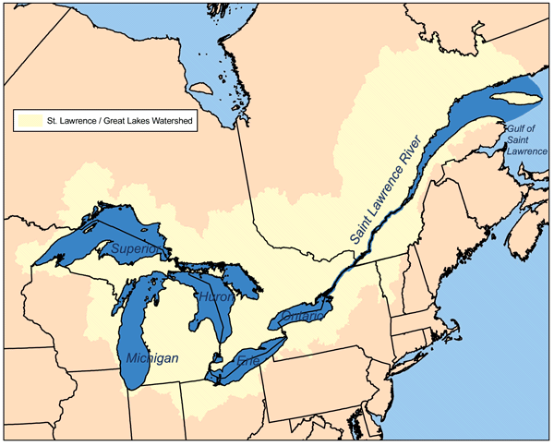
Map of St. Lawrence River
http://www.icsd.k12.ny.us/sabbatic/images/stories/geography/Grlakes_lawrence_map.png

Slide 5
Marquette & Joliet
Differences between French & English colonization of North America
  English = concentrated population & self-reproducing
  French = est. trading & missionaries
Jacques Marquette (missionary) wants to convert natives
Louis Joliet (explorer) wants to map & claim new territory

Slide 6
Marquette & Joliet
Joliet’s orders = find the “great river” out west (Mississippi)
Find Mississippi River in Wisconsin & travel south to Arkansas River
Current too strong to travel north, so take alternate route back – end up in Lake Michigan
Marquette & Joliet = 1st white men to see Chicagou

Slide 7
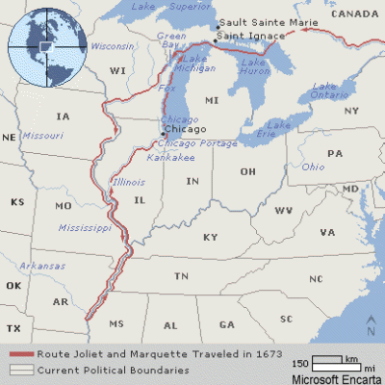
1673 Route of Joliet and Marquette
http://www.robinsonlibrary.com/america/uslocal/gulf/missriver/graphics/marq-jol-map.gif

Slide 8
Chicagou’s saving grace: a mini-continental divide
East of swamp: rivers flow towards Atlantic Ocean
West of swamp: rivers flow to Mississippi River
Before RRs, water travel most efficient
Impact of this?
  Chicagou allows water “gateway” to western frontier
Access from Atlantic Ocean is via St. Lawrence River then through Great Lakes

Slide 9
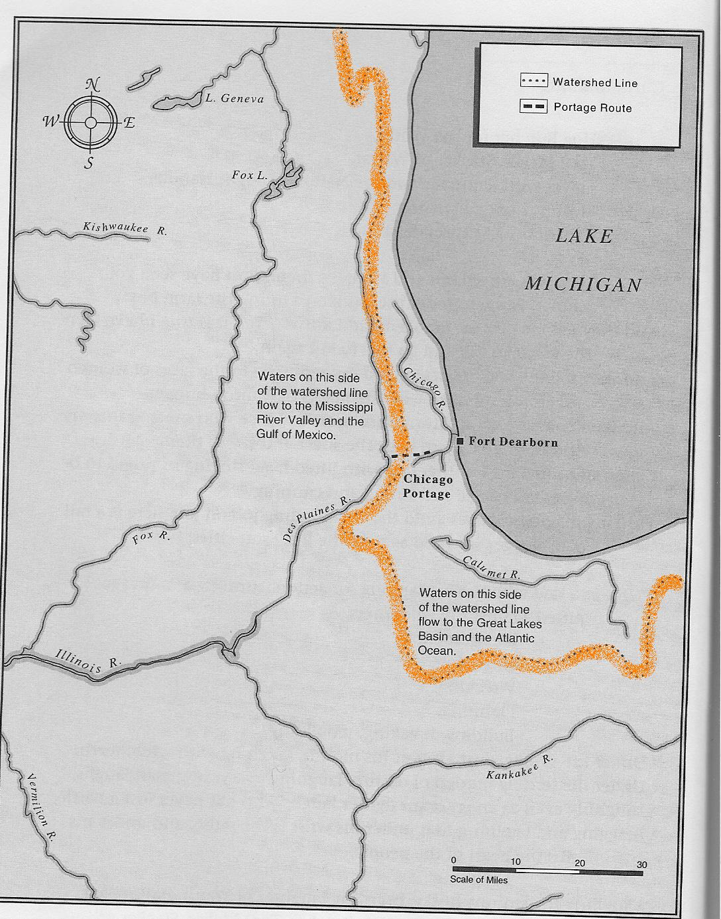
Rivers to the west of the line flow to Mississippi River Valley.
Rivers to the east of the line flow towards Atlantic.
City of Big Shoulders pg. 4

Slide 10
Louis Joliet
Joliet recognizes possibilities and writes to France suggesting a canal be built from Chicagou to Mississippi River
Proposal rejected (2 major reasons)
  Can’t imagine people living in such poor area
  Not enough people in America to build canal
Atlantic seaboard controlled by English; French control Chicagou and have access to western frontier
Impact = French control English expansion out west; Control Mississippi River Basin to New Orleans (Louisiana Territory)

Slide 11
Chicagou’s development problems
France doesn’t develop Chicagou
  Natives don’t want European settlements (like 13 colonies)
  French better @ sending trappers and missionaries than establishing permanence
  Est. forts experience problems (limited contact, Native attacks)
  France controls huge territory (Canada, Great Lakes) – those areas very profitable, so Chicagou not needed
  Profits in Canada & Great Lakes take priority over halting British

