Slide 1
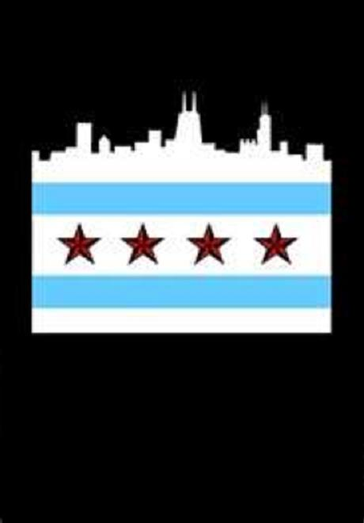
Chicago Basics

Slide 2
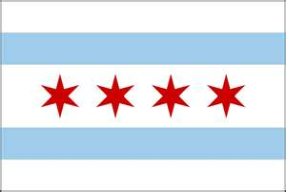
Chicago’s Flag

Slide 3
Chicago’s Flag
Designed in 1917 by Wallace Rice
Chicago’s flag consists of 3 white stripes and two light blue horizontal stripes
There are 4 red six-pointed stars on the middle white stripe
The stars represent 4 major events in Chicago:
  Fort Dearborn
  1871 Chicago Fire
  1893 Columbian Exposition (World’s Fair)
  1933 Exposition (World’s Fair)

Slide 4
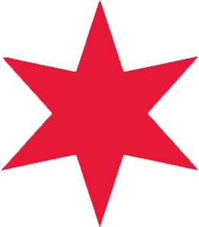
Chicago’s Flag
The original flag only had 2 stars representing Fire and 1893 Columbian Exposition
The 3rd star added in 1933 for the 1933 Exposition
The 4th star was added in 1939 for Ft. Dearborn
Each point on the star represents ideals, values, or history of Chicago area
The stars represent events in chronological order, even though they were not added as such

Slide 5
Chicago’s Flag
The 3 white stripes represent the 3 areas of the city: North, West, & South (from top to bottom)
The middle stripe = largest because the West Side is the largest area of the city
Top blue stripe = North branch of Chicago River and Lake Michigan
Bottom blue stripe = South branch of Chicago River and Great Canal

Slide 6
Chicago’s streets
Chicago’s streets are laid out as a grid
The start of the grid is @ State St. (0 E/W) & Madison Ave. (0 N/S)
8 city blocks = 1 mile
Blocks are counted in hundreds
State St. runs N-S and n-s streets are numbered as to how far east or west it is from State St.
Madison Ave. runs E-W and e-w streets are numbered as to how far north or south it is from Madison Ave.

Slide 7
Chicago’s streets
Major streets are @ numbers divisible by 8.
  Chicago Ave. = 800 N.
  North Ave. = 1600 N.
  Avenue C. = 4000 E.
  Kedzie Ave. = 3200 W.
Secondary streets run halfway between major streets
  Kinzie = 400 N.
  Damen = 2000 W.

Slide 8
Chicago’s streets
Southside E-W streets differ slightly for 3 miles
1st mile = 12 city blocks (Roosevelt Rd.) – 1200 S.
2nd mile = 10 city blocks (Cermak Rd./ 22nd St.) – 2200 S.
3rd mile = 9 city blocks (31st St.) – 3100 S.
From here it goes back to 8 blocks = 1 mile
Starting w/9th St. most streets are named for number/location
  61st Street = 6100 S.
  124th Street = 12400 S.
On the Southside a street designated as “place” = street ½ way between full blocks
  E 42nd Place = ½ block between 42nd St. & 43rd St.

Slide 9
Chicago Streets
Even numbered addys are on the N or W side of street
Odd numbered addys are on the S or E side of street
“Letter towns” = implementation of a N-S avenue naming system where street names assigned letter of the alphabet in relation to IL/IN border
Each letter = 1 mile from IL/IN border
  Starts with North Lawndale neighborhood AKA: K-town (11 miles from border)
Not started for early letters due to established residences
True for letters K, L, M, N, O, & P
  No Q because part of O’Hare & outside city

Slide 10
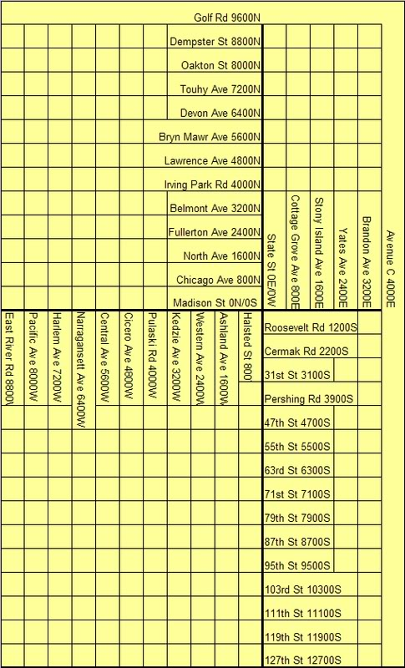

Slide 11
Expressways
Chicagoans don’t refer to expressways in terms of direction (e.g. North, South, East, or West)
Chicago expressways are either “inbound” (going into the city) or “outbound” (going out of the city)
I-90: NW Tollway (Jane Addams Tollway) (Rockford to O’Hare)
I-90/94: Kennedy Expy (O’Hare to Circle Interchange)
Dan Ryan (I-94) (Circle Interchange to I-57) then turns into Bishop Ford (80/94) to Indiana
I-94: Wisconsin to IN
I-94: (Edens) = Lake Cook Rd to Kennedy
I-294 (Tri-state): Lake Cook Rd. – turns into I-80/94 @ IN border

Slide 12
Expressways
I-55 (Stevenson): Runs from LSD to County Line Rd. in Burr Ridge – continues as I-55 until St. Louis
I-290 (Eisenhower or Ike): Rt. 53 to Circle Interchange through western suburbs
I-355 (Rt. 53 from Woodfield to Lake Cook Rd.): Woodfield to I-55 (Joliet/Lockport area)
Elgin-O’Hare: neither runs to Elgin or O’Hare. 6-mile expressway from Schaumburg to Hanover Park
I-190: 3-mile expressway that connects O’Hare w/Kennedy

Slide 13
Expressways
I-88 (E-W Tollway/Reagan Memorial Tollway): Starts @ 1-290/294 exchange and goes to western IL
I-80: Runs from IN border to western IL

Slide 14
Community Areas
Chicago has 77 community areas
Community area = defined areas w/boundaries for census & data-gathering purposes
Community areas may be subdivided by neighborhoods which can be fluid and change over time
  Near West Side = Little Italy, University Village, Greek Town,
  Armour Square = Chinatown
Neighborhoods often created ethnically (e.g. Little Italy, Humbolt Park (Puerto Rican), North Park (Swedish)

