Slide 1
14.2 - Totalitarianism

Slide 2
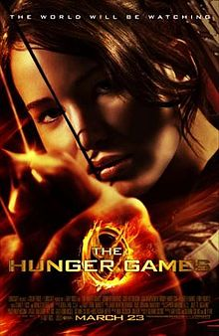
Totalitarianism
A government that has total, centralized, state control over all aspects of its citizens’ lives.

Slide 3
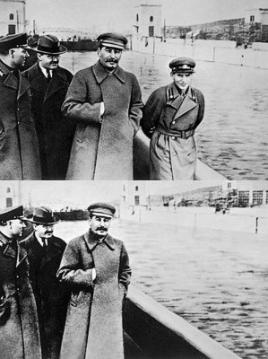
Police Terror
Using force and violence to force obedience & crush opposition
UNDER STALIN:
The Great Purge – Stalin holds fake trials for those who threaten his power
Executes or sends them to labor camps

Slide 4
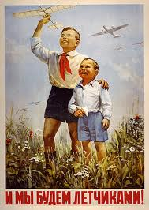
Indoctrination
Government instructs people on what to believe, to mold their thoughts
UNDER STALIN:
Government controls schools from nursery to college
State controls what material is covered
Controversial teachers fired

Slide 5
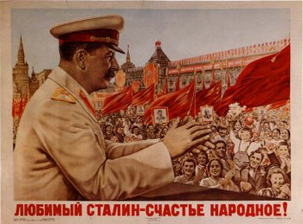
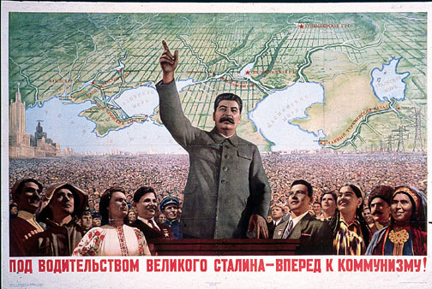
Propaganda & Censorship
Biased or incomplete information used to sway peoples’ beliefs
UNDER STALIN:
State controls all media (radio, books, films, art, music)
Uses all media to spread his messages

Slide 6
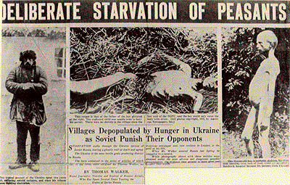
Persecution
Blaming religious or ethnic groups for the country’s problems, then terrorizing them.
UNDER STALIN:
Group of farmers called Kulaks, seen as a threat to Stalin
He takes their land and food, sends them to exile. 6 million die in famine, others murdered.

Slide 7
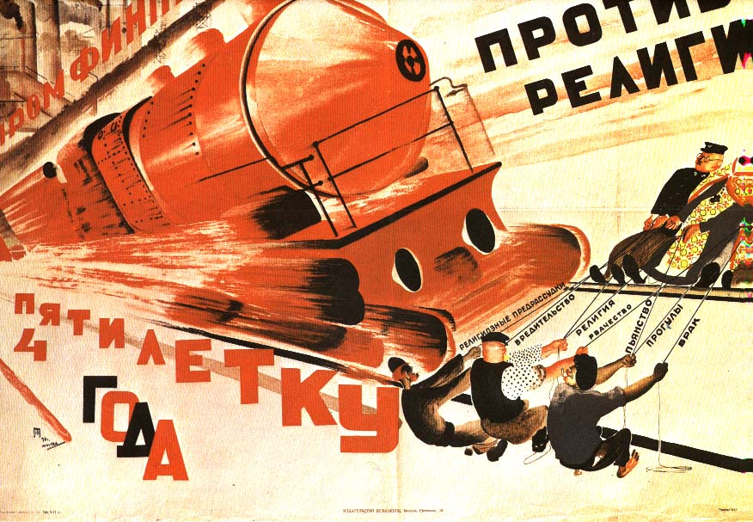
Stalin’s “Improvements”
5 Year Plans – 3 sets of plans would bring Russia into the industrial world
Industrialization occurs rapidly, but workers conditions do not get better
Collective farms – state controlled and operated -> causes famine

