Slide 1
Monetary Policy
The bimetalism debate in the late 1800s
Notes:
http://www.measuringworth.com/uscompare/

Slide 2
Monetary Policy
Since the beginning U.S. currency was issued as “Representative money” backed by the gold and silver owned by the U.S. treasury.
  Exception: Greenbacks—issued during the Civil War—were fiat (authorized by govt., but not convertible into gold or silver) money.
Value of Silver set a mint value in relation to gold value = 16:1 ratio in 1837
By the mid-1800s silver became unused as a monetary object b/c its market value > mint value.
Silver owners no longer chose to sell their silver on the market instead of deal with the U.S. Treasury.

Slide 3
Gold Resumption Act of 1873
The U. S. Treasury discontinued silver coinage
  European governments moved to gold standard.
  Discovery of silver in the west = decline in value.
Many blamed the Panic of 1873 on the demonetization of silver (b/c several NY financial companies failed).
Bimetalism advocates called it the “Crime of 73”

Slide 4
Monetary Stances
Proponents of Greenbacks and Silver advocated more $$ in circulation.
Gold Proponents wanted less.
More $$ = inflation in currency = devalued
Debtors like this b/c they could repay their debts for less (creditors obviously hated this).

Slide 5
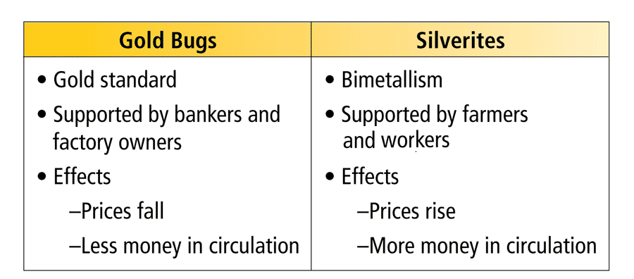
The debate over monetary policy was
an important issue of the day.
Those who wanted a gold standard were on one side.
Those who wanted to
use silver—including the Populist Party—were
on the other.

Slide 6
Key Monetary Legislation
Resumption Act of 1875 – mandated U.S. Treasury issue specie in exchange for greenback currency.
Bland-Allison Act (1878)
  Required U.S. Treasury to mint $2-4 million worth of silver each month.
  Failed b/c the treasury did not mint the maximum and the supply of $$ in circulation did not increase.
Sherman Silver Purchase Act (1890)
  Treasury required to purchase the maximum domestic production of silver.
  Problem: Silver that was purchased was not coined.
  Repealed in 1893 when depression hit (panic occurred when people were trading in their silver for gold)
Gold Standard Act (1900)
  U.S. went back to a sole gold standard
  Will remain this way until 1975 under the Bretton-Woods Agreement when the U.S. officially left the gold standard
  Currently use fiat money = based on faith of U.S. credit worthiness.

