Slide 1
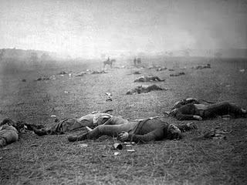
Images of the Civil War
Gettysburg, July 1863

Slide 2
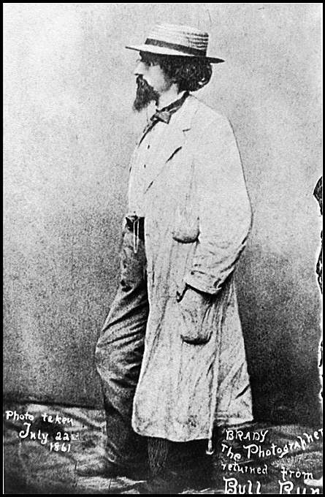
Matthew Brady
"From the first, I regarded myself as under obligation to my country to preserve the faces of its historic men and mothers."
1841 – Studied photography under Samuel B. Morse
1844 – opened a studio in NYC
1856 – opened portrait studio in Washington D.C. to photograph the nation’s leaders and foreign dignitaries.
1861 – planning to document the war on a grand scale he organized a corps of photographers to follow the troops in the field.
July 22, 1861
Notes:
Morse: artist who developed the telegraph in 1835.
http://memory.loc.gov/ammem/cwphtml/cwbrady.html

Slide 3
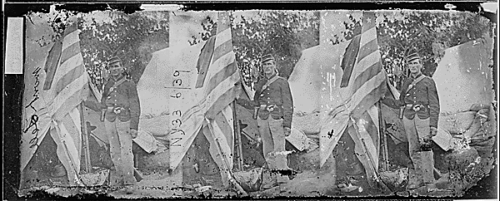
Colors of the 23rd New York Infantry

Slide 4
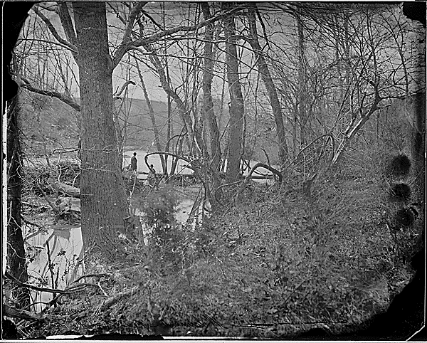
Wilderness, near Chancellorsville, VA

Slide 5
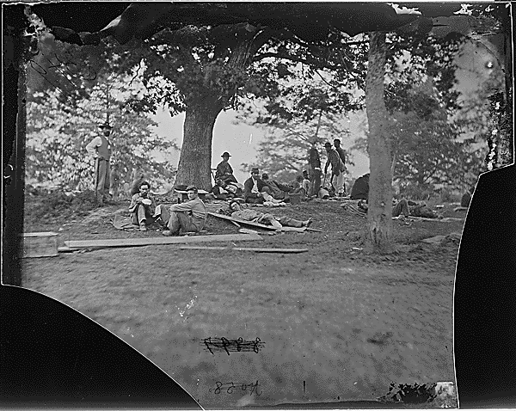
Wounded Soldiers under Trees, Marye’s Heights, Fredericksburg after the Battle of Spotslyvania, 1864

Slide 6
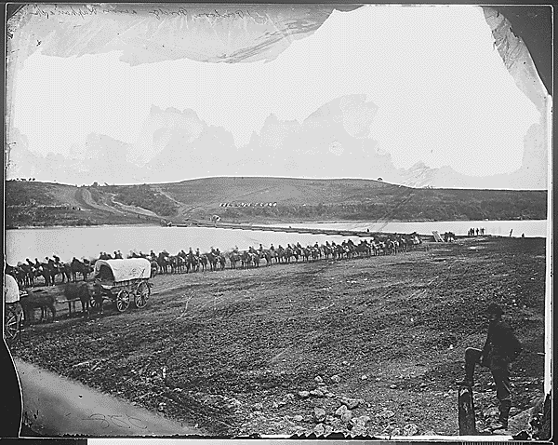
Pontoon across the Rappahannock River, VA, Calvary Column

Slide 7
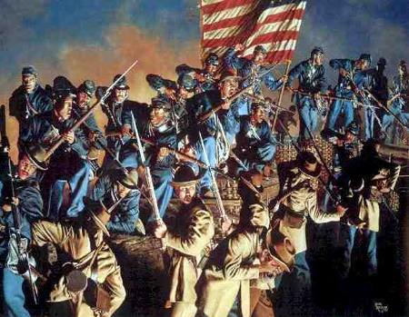
The Old Flag Never Touched the Ground by Rick Reeves, 2004
Fort Wagner, South Carolina
July 18, 1863
Notes:
Fort Wagner, South Carolina -- July 18, 1863
The 54th Massachusetts Volunteer Infantry Regiment was recruited in the spring of 1863 by Governor John Andrew, who had secured the reluctant permission of the War Department to create a regiment of African-American soldiers. Like all Massachusetts Civil War soldiers, the 54th's men were enlisted in the Massachusetts Volunteer Militia. These Guardsmen would serve as a test case for many skeptical whites who believed that blacks could not be good soldiers. The battle that proved they could was fought on Morris Island, at the mouth of Charleston Harbor. Following three days of skirmishes and forced marches with little rest, and 24 hours with no food, the regimental commander, Colonel Robert Gould Shaw, requested the perilous honor of leading the attack of Fort Wagner, a sand and palmetto log bastion. As night fell, 600 men of the 54th advanced with bayonets fixed. Despite withering cannon and rifle fire, the men sustained their charge until they reached the top of the rampart. There, Colonel Shaw was mortally wounded. There, also, Sergeant William Carney, who had earlier taken up the National Colors when the color sergeant had been shot, planted the flag and fought off numerous attempts by the Confederates to capture it. Without support, and faced with superior numbers and firepower, the 54th was forced to pull back. Despite two severe wounds, Sergeant Carney carried the colors to the rear. When praised for his bravery, he modestly replied, "I only did my duty; the old flag never touched the ground." Carney was awarded the Medal of Honor for his actions, the first African-American to receive the award. The 54th Massachusetts suffered 270 casualties in the failed assault, but the greater message was not lost: some 180,000 African-American soldiers followed in the footsteps of these gallant Guardsmen, and proved that African-American soldiers could, indeed, fight heroically if given the opportunity.

Slide 8
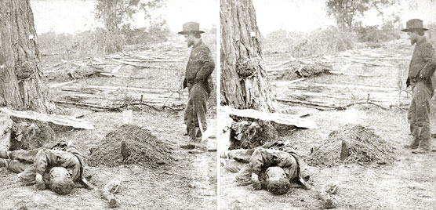
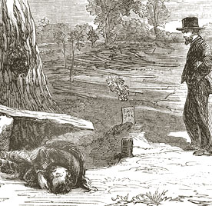
"A Contrast: Federal buried, Confederate unburied, where they fell on the Battlefield of Antietam"
By Alexander Gardner (an employee of Matthew Brady’s
Notes:
When war threatened the nation in the spring of 1861, thousands of soldiers flocked to Washington, D.C., to defend the capital. Photographers followed in their footsteps capturing camp scenes and portraits of untested, jubilant greenhorns in their new uniforms. It so happened that Alexander Gardner had just opened a new studio in the capital for the most notable photographer of his era - Mathew Brady. Gardner also took advantage of the coming storm to increase his business. All of the early war photographs were taken in studios or tents. No one had produced images in the field.
It wasn’t until September of 1862 that the first true images of war were produced. Antietam was the first battle to depict the grim and bloody truth of civil war through the lens of photographer Alexander Gardner and his assistant James Gibson. Gardner made two trips to Antietam. The first was just two days after the battle, the second, two weeks later when President Abraham Lincoln visited the battlefield.
During both of his trips, Gardner moved across the battlefield taking advantage of another new photographic technique that increased the impact of war images – stereograph. Two lenses capture two simultaneous photographs, and when seen through a viewer, the mind creates a three-dimensional image. Parlors were filled with cards and viewers as stereo views became the rage in America. Of the approximately ninety images Gardner took at Antietam, about seventy were in stereo, adding a new, horrific view of the American landscape to home collections.
Newspapers could not reproduce photographs, but woodcuts from the Antietam images spread across the country. Gardner’s original images were put on display in New York City at Brady’s gallery. New Yorkers were shocked and appalled. The New York Times stated that Brady was able to "bring home to us the terrible reality and earnestness of war. If he has not brought bodies and laid them in our door-yards and along streets, he has done something very like it…"

