Slide 1
ABSORPTION, METABOLISM
ENERGY BALANCE

Slide 2
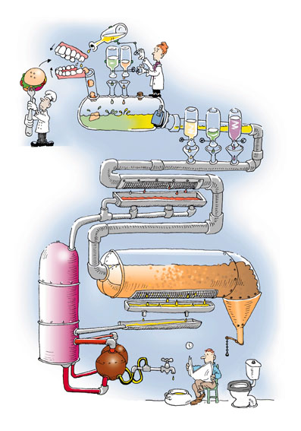
DIGESTION
24 HOUR
FOOD PROCESS

Slide 3
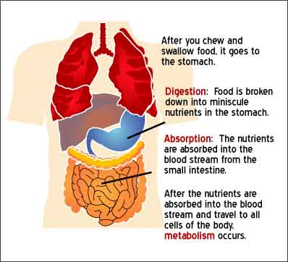
THE BOTTOM LINE

Slide 4
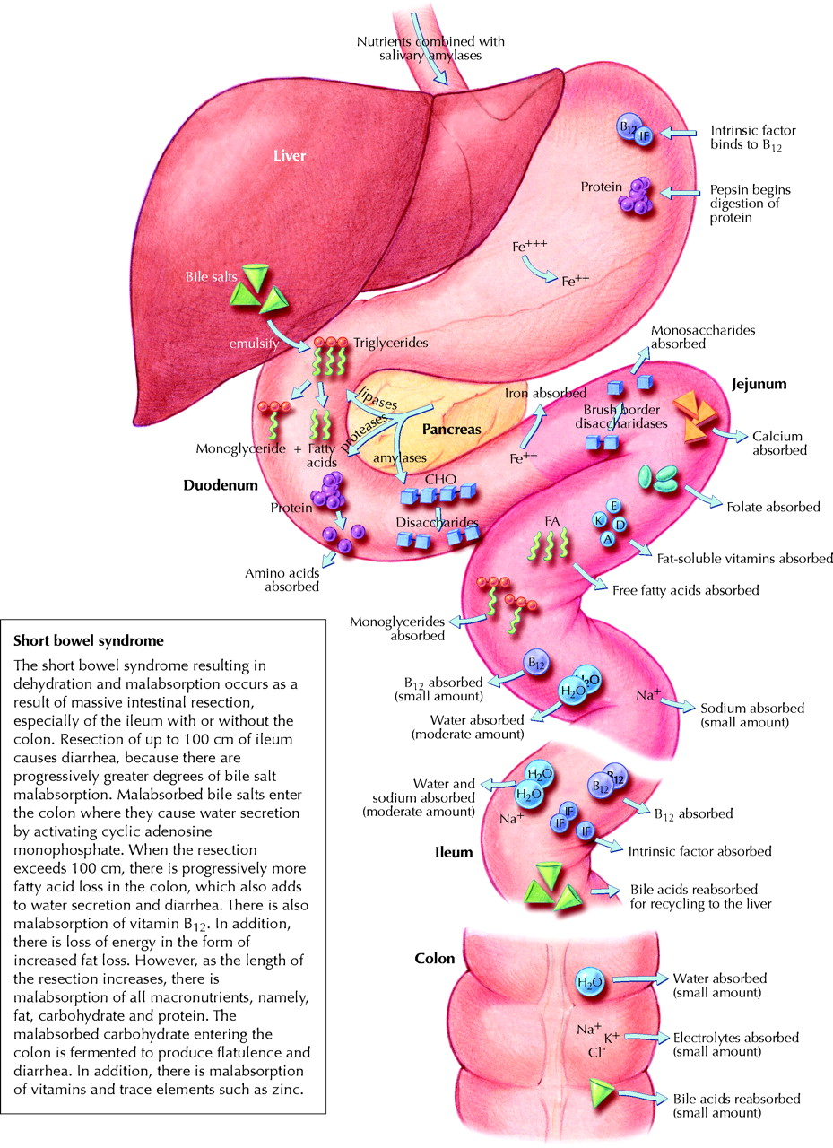
Enzymes are secreted
Beginning in the mouth
And ending in the large
Intestine……
The absorption that occurs at the cellular level beginning with the small intestine allow nutrients to be carried via the blood stream or
Lymphatic system
To working storage
Units.

Slide 5
Metaba…what???
Metabolism is the sum of chemical reactions occurring within a living cell to maintain life. Two types of metabolism are catabolism and anabolism. Catabolism= breaking large down large substances into smaller pieces (large carbs and proteins into smaller building blocks…mono(single)saccharides and amino acids. Anabolism is the opposite where cells build from small to large.

Slide 6
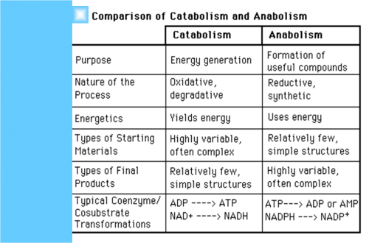
Two types of cell metabolism

Slide 7
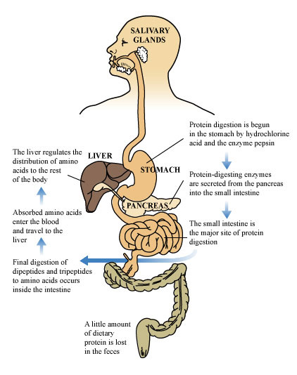
Protein Pathways

Slide 8
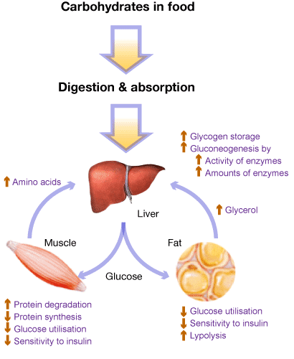
Carbohydrate Pathways

Slide 9
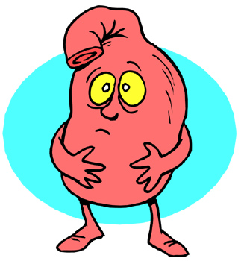
What’s going
on in there?

Slide 10
When digestion is completed, food has been changed into simple end products ready for cell use.
We know that carbohydrates are reduced to simple sugars, glucose, fructose and galactose. Fats are transformed into fatty acids and glycerides. Protein foods are changed into single amino acids. Vitamins and minerals are liberated. With a water base for transport and supply of electrolytes the end products are ready for absorption.

Slide 11
Where does it occur?
The point of absorption for many nutrients especially the vitamins and minerals are the determining factor in how much is actually kept for use in the body. While the normal GI tract is quite efficient, not all nutrients are absorbed due to : 1) amount available,2) competition between nutrients for absorption sites, and 3) the form in which it is present ( can it be readily absorbed?).

Slide 12
4 Absorption Processes
Absorption processes are classified as:
Simple diffusion - movement of particles moving from area of greater concentration to lesser concentration (like a balance system). This type if diffusion does not require assistance.
Facilitated diffusion - similar to above but utilizes a a protein channel for carrier assisted transport (large items)
Active transport - the force by which the particles move across the gradient. This transport usually requires a transport partner ( glucose and Na++).
Pinocytosis - the penetration of larger materials by attaching to thicker cell membrane and then engulfed or swallowed by the cell.

Slide 13
What comes next?
Once digestion is complete, cellular absorption and resulting transport of macronutrients are in the blood, they now can be converted into energy and storage for later use.

Slide 14
Putting those nutrients to use
The Krebs cycle is the hub of energy formation in the cell. The combination of processes ensure that the body has energy from ATP adenosine triphosphate. The production of ATP is dependant upon needed energy. Ie; less is produced during sleep and rest.
The body prefers to use glucoses as it’s number one source of fuel/energy. Protein can be used for energy but is rather insufficient and results in excess nitrogen waste (and we know what that means!) the body will only use protein for energy when glucose and fatty acids are in low supply.

Slide 15
Just how much fuel?
If the amount of food consumed, digested, absorbed,transported is greater than what the body needs, the remaining energy is stored for later use. The body has a unique way of storing excess and not wasting it. Energy or KILOcalories..carbs have 4kcal/g, fat has 9kcal/g and even alcohol 7kcal/g can be used as fuel/energy.

Slide 16
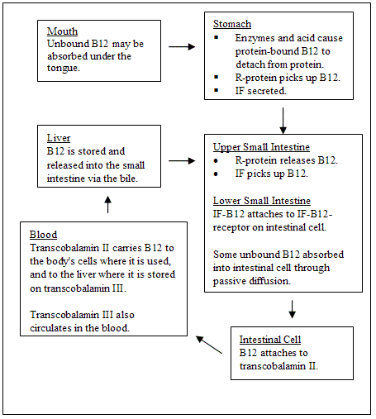

Slide 17
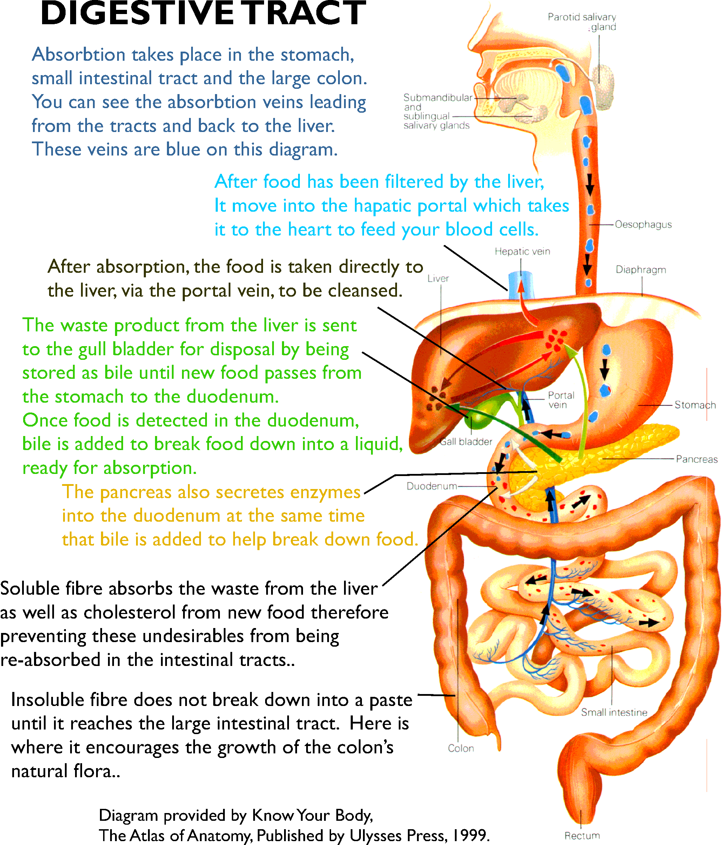

Slide 18
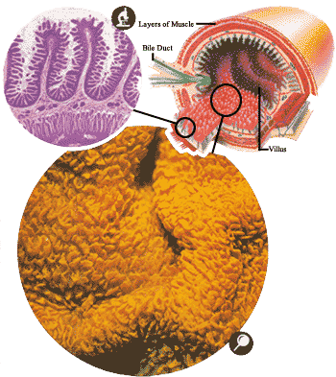
Tiny micro villi
are extracting their
Specific nutrients
For transport

Slide 19
The small intestine contains so many ridges and fingers (called villi) to absorb the nutrition chemicals that, were it smooth, it would have to be 600 times longer to accomplish the same task!
The large intestine is 5-6 feet long and 2.5 inches in diameter and, among other things, reabsorbs 2 gallons of fluids into the body to avoid dehydration.

Slide 20
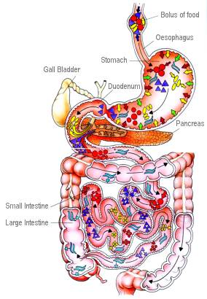
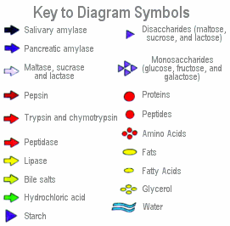

Slide 21
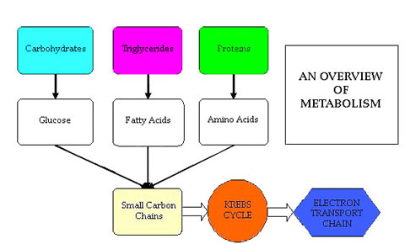
ENERGY
Use of energy (burning of fuel for function) is measured by CALORIES. In nutrition calories are the measure of the amount of energy in a food used by the body to fuel activity (gallons of gas). Energy balance is a function of calorie intake versus calorie output.

Slide 22
STORAGE
Excess from carbs,protein and fats are stored in our adipose tissue,triglycerides are also stored here. Contrary to popular belief excess protein is not stored in the muscles. The body will take what it needs (amino acids) to build needed functional and structural proteins but the rest is broken down into that darned nitrogen, and carbon that is then converted for extra glucose or stored in fat. It looks like a lot of the excess “stuff” gets stored in FAT ☹

Slide 23
Breakdown of Food and Fat
The digestive process breaks down food by chemical and mechanical action into substances that can pass into the bloodstream and be processed by body cells.
Certain nutrients, such as salts and minerals, can be absorbed directly into the circulation. Fat, complex carbohydrates, and proteins are broken down into smaller molecules before being absorbed.
Fat is split into glycerol and fatty acids; carbohydrates are split into monosaccharide sugars; and proteins are split into linked amino acids called peptides, and then into individual amino acids.

Slide 24
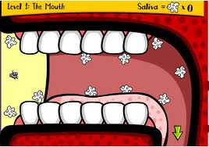
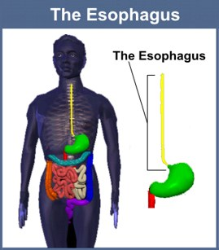
Mouth and esophagus
Food is chewed with the teeth and mixed with saliva. The enzyme amylase, present in saliva, begins the breakdown of starch into sugar. Each lump of soft food, called a bolus, is swallowed and propelled by contractions down the esophagus into the stomach.

Slide 25
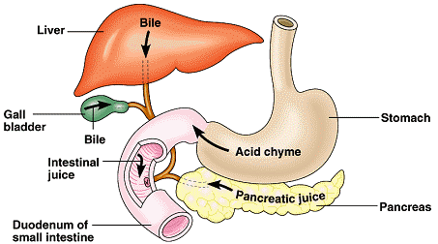
Stomach
Pepsin is an enzyme produced when pepsinogen, a substance secreted by the stomach lining, is modified by hydrochloric acid (also produced by the stomach lining).
Pepsin breaks proteins down into smaller units, called polypeptides and peptides. Lipase is a stomach enzyme that breaks down fat into glycerol and fatty acids. The acid produced by the stomach also kills bacteria.

Slide 26
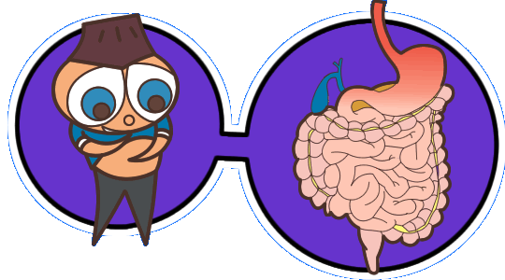
Duodenum
Lipase, a pancreatic enzyme, breaks down fat into glycerol and fatty acids. Amylase, another enzyme produced by the pancreas, breaks down starch into maltose, a disaccharide sugar. Trypsin and chymotrypsin are powerful pancreatic enzymes that split proteins into polypeptides and peptides
Small Intestine
Maltase, sucrase, and lactase are enzymes produced by the lining of the small intestine. They convert disaccharide sugars into monosaccharide sugars. Peptidase, another enzyme produced in the intestine, splits large peptides into smaller peptides and then into amino acids.

Slide 27
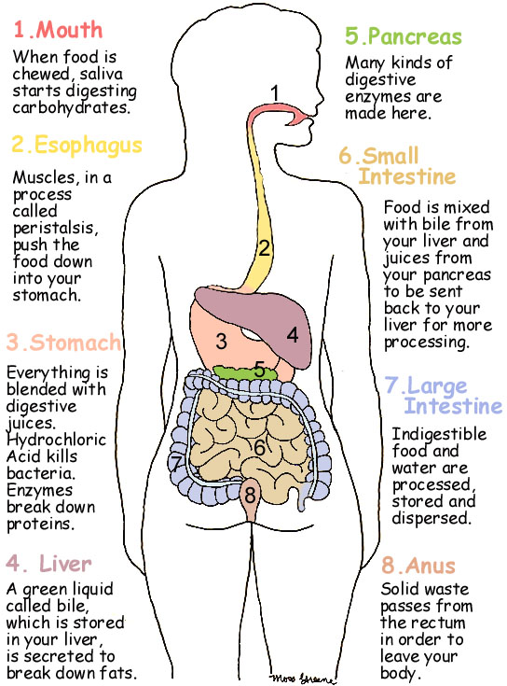
Large Intestine
Undigested food enters the large intestine, where water and salt are absorbed by the intestinal lining. The residue, together with waste pigments, dead cells , and bacteria, is pressed into feces and stored for excretion.

Slide 28
The stomach contains 35 million digestive juice glands that begin to break down the complex protein molecules of the food into amino acids. A series of muscles in the stomach churn the food so that it is mixed with the acid, yet the acid does not digest the stomach!
Then the ring muscles in the stomach begin a series of peristaltic contractions of their own so that every 20 seconds they force some of the chyme (partly digested food) into the small intestine.

Slide 29
Were it not for the small intestine, we would starve because at this point only simple sugars and a few starches are ready for use by the body. The small intestine is 23 feet long and 1 inch in diameter. It too contains muscles that not only keep the chyme moving in one direction, but also turn it three ways so that the chemicals added mix into the chyme and the digested molecules are absorbed into the blood stream.
At the beginning of this trip, three additional fluids are added to the chyme. The pancreas adds pancreatic juice that breaks down fats, carbohydrates, and proteins. A pint of bile from the liver (stored in the gall bladder) breaks down fatty substances. The small intestine itself produces intestinal juice that helps with final digestion of carbohydrates, fats, and proteins. A total of 3 quarts of these enzymes are produced each day.

Slide 30
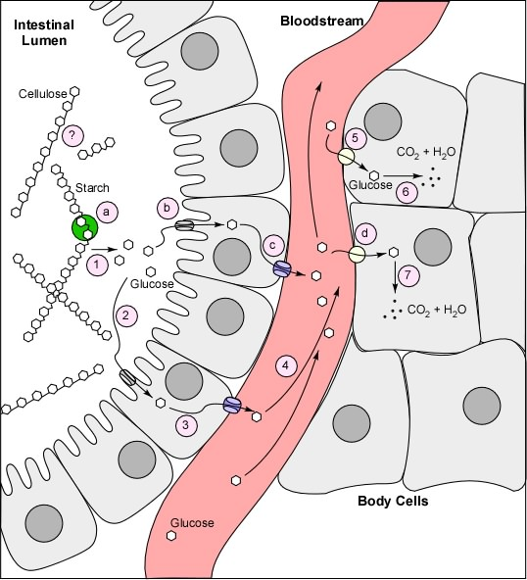
Cellular
activity

Slide 31
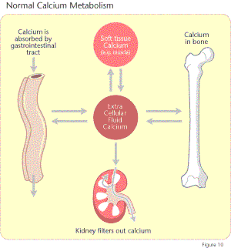

Slide 32
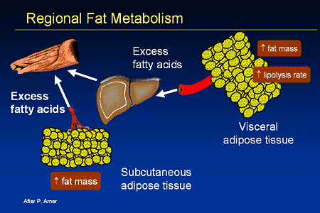

Slide 33
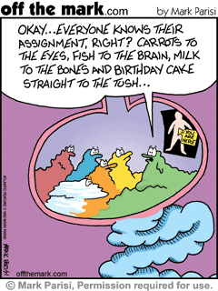

Slide 34
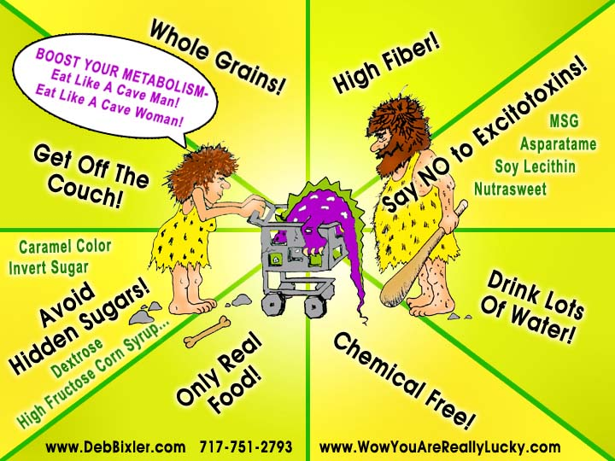

Slide 35


Slide 36
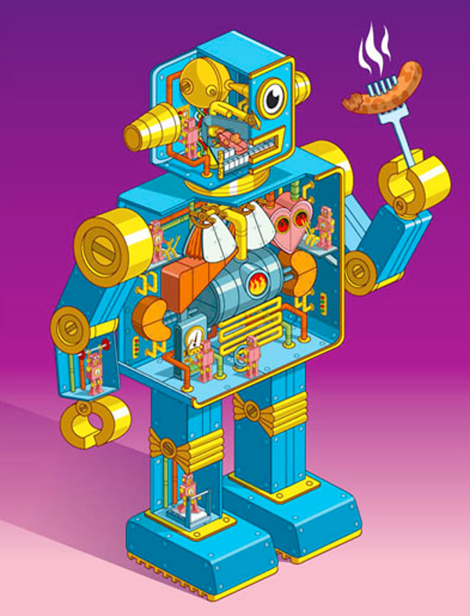
Measuring
Energy
How do we measure energy?
CALORIE = amount
of heat produced when
food is burned (metab)
In your body cells!!

Slide 37
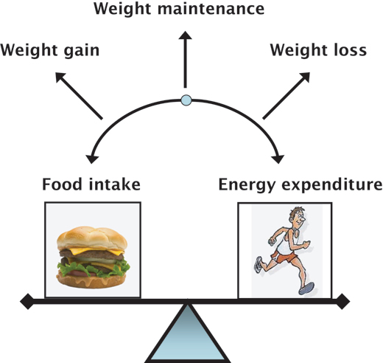
The overall picture!!!

Slide 38
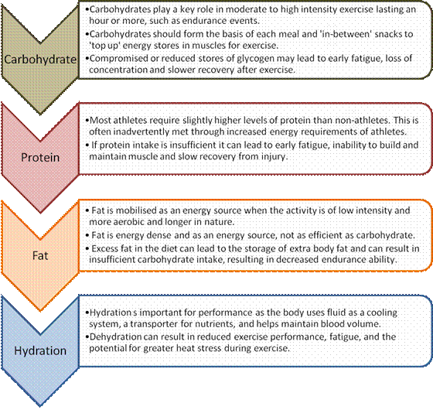

Slide 39
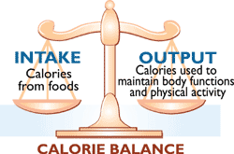
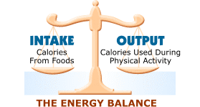
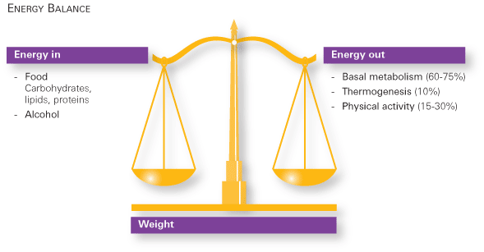

Slide 40
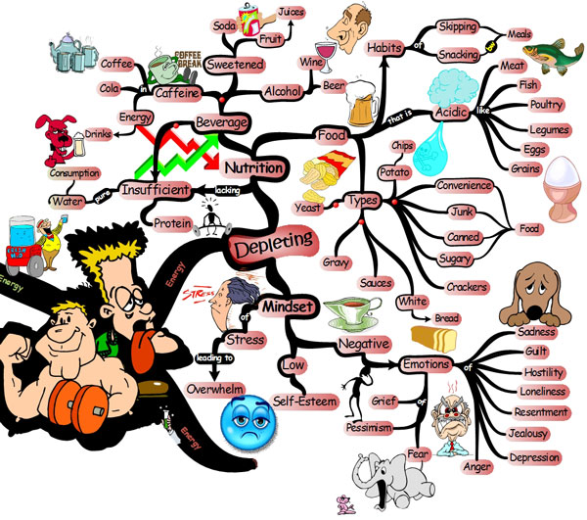

Slide 41
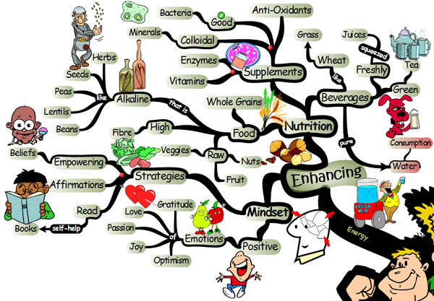

Slide 42
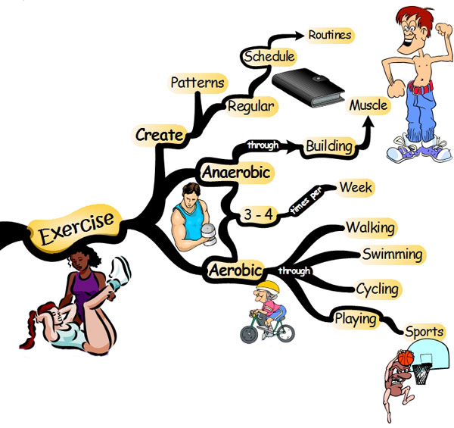

Slide 43
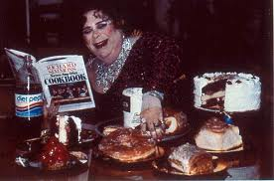
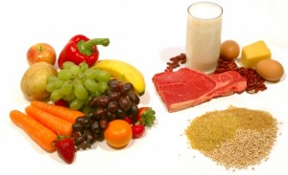
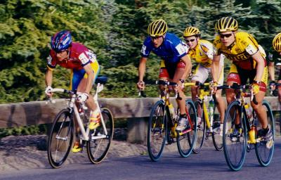
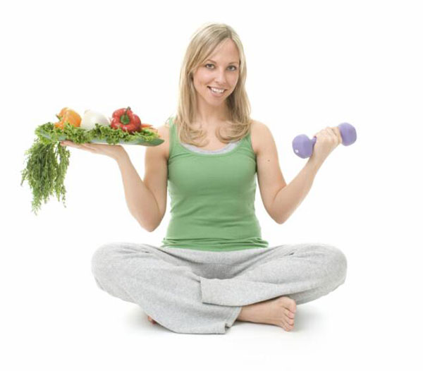
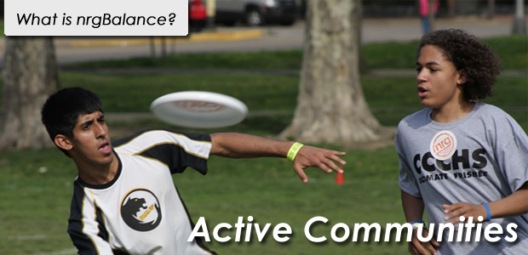

Slide 44
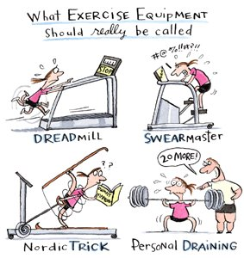
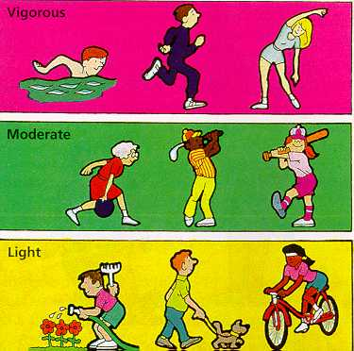

Slide 45
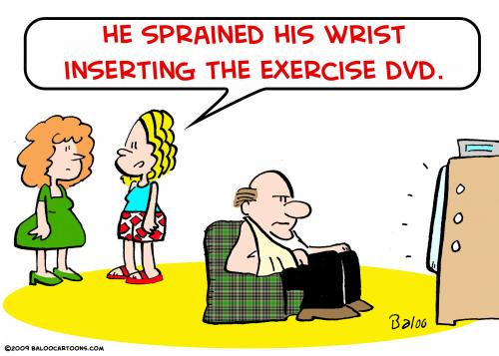
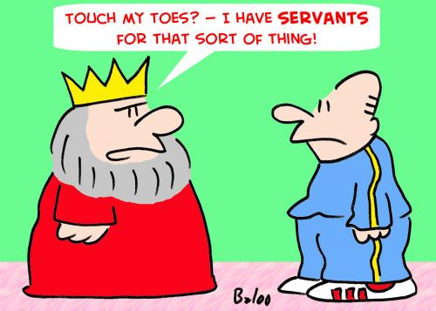
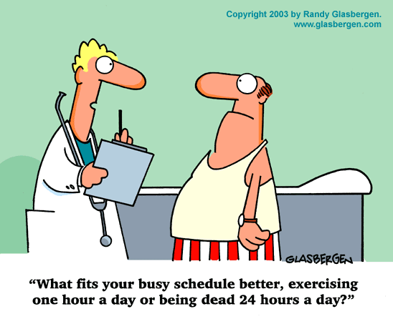

Slide 46
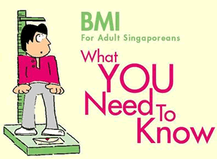
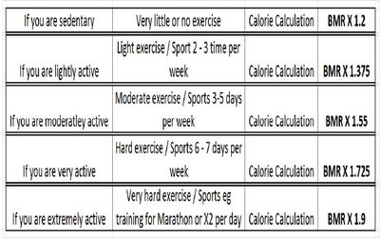

Slide 47
What is BMI?
BMI stands for Body Mass Index. It is used a measure of body fat in adults and help assess whether you are at risk for weight-related health problems. A healthy BMI for adults is between 18.5 and 22.9.
______Your Weight (kg)_______
BMI =
Height (meters) x Height (meters)
BMI values DO NOT APPLY TO children, pregnant women, people with muscular build (little body fat) eg athletes, elderly and those who have lost a lot of muscle mass.

Slide 48
Why do I need to know my BMI?
Recent studies have shown that some Asian population, including Singaporeans have higher proportion of body fat compared to Caucasians of the same age, gender and BMI. The risk for heart disease and diabetes starts from BMI values of 23. The table below shows your risk:
If your BMI is between 23.0 and 27.4 kg/m²,
you are at moderate risk of developing these chronic diseases :
heart disease
high blood pressure
stroke
diabetes

Slide 49
If your BMI is 27.5 kg/m² and above,
you are at high risk of developing these chronic diseases:
heart disease
high blood pressure
stroke
diabetes
If your BMI is less than 18.5 kg/m²,
you are at risk of developing problems such as:
nutritional deficiency
osteoporosis.
How do I achieve a healthy BMI of 18.5 to 22.9?
BMI below 18.5kg/m²
Eat a well balanced diet, including high-energy and nutrient-rich food, and exercise regularly
BMI above 23kg/m²
Eat a well balanced diet, low in fat, and engage in regular physical activity to lose weight gradually.

Slide 50
Reduce your risk – Eat healthily
You gain weight and increase your BMI if you consistently consume more calories than you use up through physical activity.
Avoid high-calorie foods like cakes, pastries and soft drinks.
Avoid snacking.
Eat in moderation.
Use healthier cooking methods ( eg. Steam, grill, bake, stir-fry with minimum oil) to prepare your meals.
Eat a healthy balanced diet with at least 2 servings of fruit and 2 servings of vegetables everyday.

Slide 51
Reduce your risk: Get Moving!
Regular physical activity helps you
use up excess calories which would otherwise be stored as fat
build healthy bones, muscles and joints
manage stress and anxiety
feel good about yourself
Start with moderate-intensity physical activity (eg.brisk walking, leisurely cycling, taking stairs rather than elevator) for 30 minutes a day, at least 5 days a week or more.
The 30 minutes of physical activity can be broken up into 10minute bouts throughout the day.
As your fitness level improves, do vigorous physical activity (eg. jogging, soccer, basketball, scrubbing floors at home) for 20 minutes a day at least 3 times a week.

Slide 52
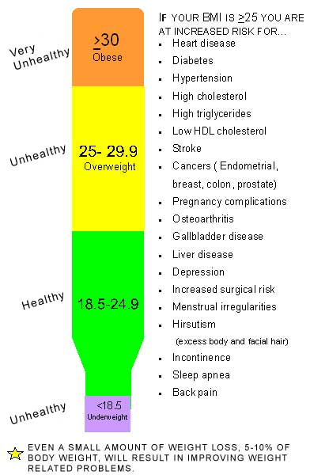

Slide 53
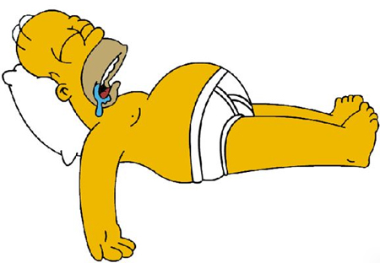
Hmmm……need we say more?

