Slide 1
Urdu Language and Culture

Slide 2
What do you know about Urdu?
In groups of 3 talk about what you already know about Urdu and make a list.

Slide 3
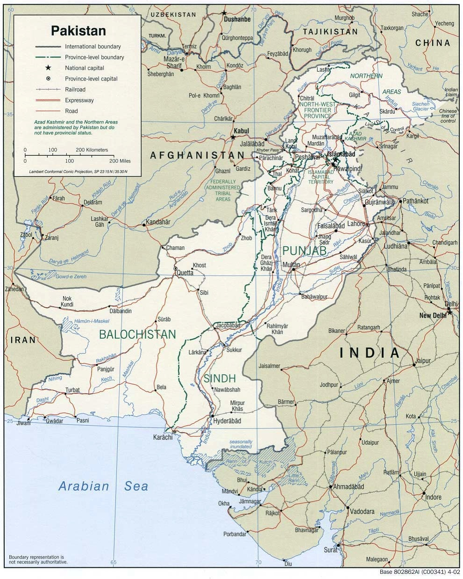

Slide 5
Key phrases in Urdu

Slide 16
Listening to Urdu
http://www.bbc.co.uk/languages/other/guide/urdu/key_phrases.shtml

Slide 17
The Urdu Alphabet
http://www.bbc.co.uk/languages/other/guide/urdu/alphabet.shtml

