Slide 1
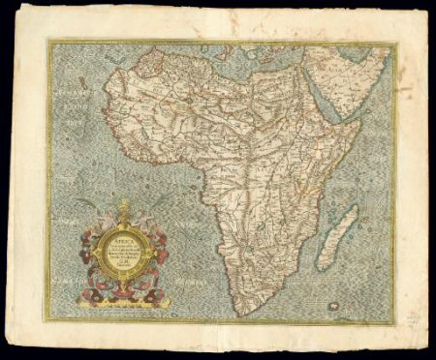
Early Voyages of Exploration
Chapter 3 Lesson 4

Slide 2
Anticipation Guide
Predict whether the following statements is true or false:
Giovanni Caboto was the first European to see the Pacific Ocean from the Americas.
Amerigo Vespucci identified South America as a continent.
Vasco Nunez de Balboa sailed across the Atlantic Ocean and landed in present-day Newfoundland.
One of Ferdinand Magellan’s ships was the first ship to sail around the world.

Slide 3
That’s Not Asia
Christopher Columbus thought that he reached Asia.
Because he thought he reached Asia, he called the people he met Indians.
Until Columbus died in 1506, he kept saying he found a new water route to Asia, but other explorers proved him wrong.

Slide 4
After news of Columbus’ voyages spread throughout Europe, every monarch in Europe wanted to send ships across the ocean to find the great riches of Asia.
In 1497 an Italian named Giovanni Caboto went on a voyage paid for by England.
He landed in present-day Newfoundland (Canada).
When he returned to England, he claimed he found Cathay, the land of the Great Kublai Khan.
The English made him a hero and gave him the English name, John Cabot.

Slide 5
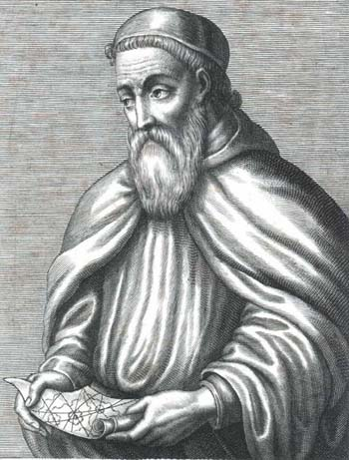
Vespucci’s Voyages
Amerigo Vespucci from Florence, Italy did not believe Columbus found the Indies.
in 1499, Vespucci was ordered by the king of Spain to sail to a place south of where Columbus landed.
Two years later the king of Portugal sent Vespucci on another voyage. This time he sailed down the coast of South America from present-day Venezuela to Argentina.

Slide 6
Vespucci Challenges Columbus
On his voyages, Vespucci looked for signs that he had reached Asia.
Vespucci did not see anything that Marco Polo described through his books about his travels to Asia.
Vespucci realized that the Earth was larger and Asia was smaller than what most people thought.
If Asia were as far east as Columbus claimed, it would cover half the earth, and Vespucci knew that could not be true.

Slide 7
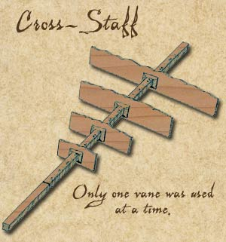
Vespucci Challenges Columbus
Most sailors used a cross-staff to measure distances. Vespucci found a new way of measuring distances east and west.
Vespucci concluded that Columbus and Caboto did not sail to Asia.
The land they found had to be
another continent- the
“New World”

Slide 8
The New World
A German cartographer named Martin Waldseemuller drew a map of the new continent, using Vespucci’s findings.
He decided to name the new land for Amerigo Vespucci.
In 1507 America appeared on a map for the first time.

Slide 9
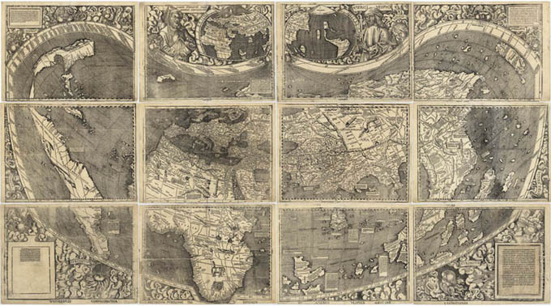
World Map- 1507

Slide 10
Balboa reaches the Pacific
On September 25, 1513, a group of explorers climbed up a mountain. It was on the west coast of what today is called the Isthmus of Panama.
Vasco Nunez de Balboa quickly climbed the last few feet of the mountain peak and saw a big blue sea- the Pacific Ocean.
Now Balboa had come upon a huge ocean on the western side of what Columbus had said was Asia.
This proved that Vespucci was right and Columbus was wrong. Columbus did not reach Asia, but a new continent instead- America.

Slide 11
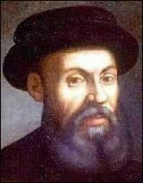
Around the World
In September of 1519, five ships and 250 sailors set out from Spain into the Atlantic Ocean. Ferdinand Magellan, a Portuguese explorer, led the fleet.
Magellan was sent by the King of Spain to find a new way to reach Asia by sailing west around the Americas.

Slide 12
Magellan’s Voyage
Magellan sailed to what is now Brazil and then south along South America’s eastern coast.
For months he sailed up rivers into the middle of the continent, hoping to find a river that would go all the way to the ocean on the other side. But he never did, and each time he sailed back to the coast.
Finally, in the fall of 1520, three of Magellan’s ships sailed through what is now known as the Straight of Magellan, near the southern tip of South America.
They found the same ocean Balboa found and named is Pacific, meaning “peaceful”

Slide 13
Around the World
In March 1521 the ships reached what are today called the Philippine Islands and stayed there for several weeks.
On April 27, Magellan was killed
On September 9, 1522, the 18 starving sailors that were left returned to Spain.
One of Magellan’s ships, Victoria sailed around the world!

Slide 14
Anticipation Guide- What did you Learn?
Giovanni Caboto was the first European to see the Pacific Ocean from the Americas.
False
Amerigo Vespucci identified South America as a continent.
True
Vasco Nunez de Balboa sailed across the Atlantic Ocean and landed in present-day Newfoundland.
False
One of Ferdinand Magellan’s ships was the first ship to sail around the world.
True

