Slide 1
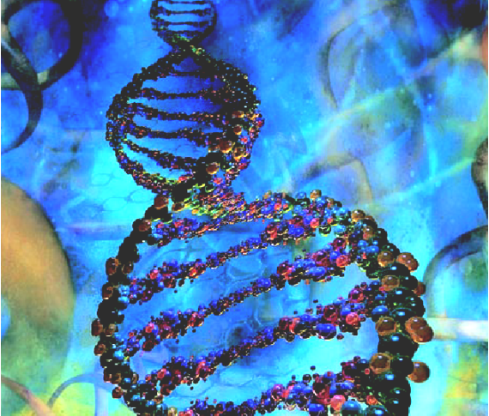
DNA, Transcription, and Translation….

Slide 2
Why Should We Learn About DNA?
To understand how genes are inherited and expressed.
To understand the evolution of the Earth’s diversity and protect it.
To understand the relationships between species.
To understand the many uses of DNA technology –like DNA fingerprinting, cloning, and gene therapy.
And.... Because I said so.

Slide 3
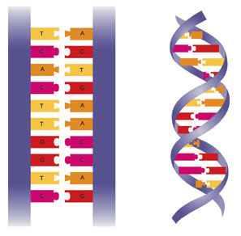
DNA Molecule of Heredity
A. Structure
    DNA is a double helix– two strands twisted around each other, like a winding staircase
    The DNA molecule is made up of Nucleotides.

Slide 4
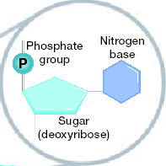
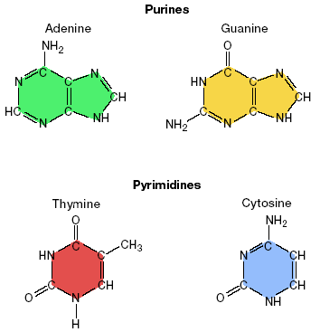
DNA Molecule of Heredity
A. Structure
DNA (polymer) is a long molecule made up of Nucleotides (monomers)
A Nucleotide consists of:
  Deoxyribose (a 5-carbon sugar)
  a phosphate group
  One of 4 Nitrogenous bases (contain nitrogen)
    Adenine (A)
    Guanine (G)
    Cytosine (C)
    Thymine (T)
PURINES
PYRIMIDINES
The Deoxyribose and the Phosphate group are always the same, but the nitrogen base has 4 different possibilities

Slide 5
B. Chargaff’s Rules:
CHARGAFF (1949):
discovered that the % of Cytosine and Guanine were about the same in DNA; the same was true about Adenine and Thymine
  This suggests BASE PAIRING……….. that the amount of A in any DNA sample always equals the amount of T in the sample.
  A= T and G=C
Source of DNA | A | T | G | C
Streptococcus | 29.8 | 31.6 | 20.5 | 18.0
Yeast | 31.3 | 32.9 | 18.7 | 17.1
Herring | 27.8 | 27.5 | 22.2 | 22.6
Human | 30.9 | 29.4 | 19.9 | 19.8

Slide 6
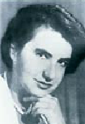
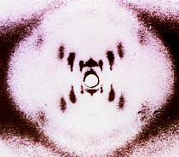
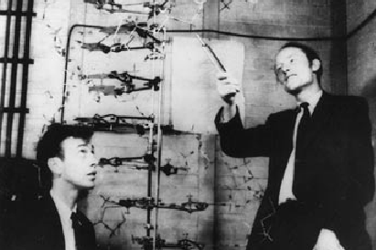
History (cont.)
2. Wilkins and Franklin(1952): took X-Ray photographs of DNA which suggested a twisted, helical structure, 2 strands, and bases in the center
3. Watson and Crick (1953): using all the research to date, created a model of DNA structure:
Their model was a Double Helix with 2 of nucleotides that had their bases facing each other (like rungs of a ladder)

Slide 7
C. DNA Replication: Copying DNA
Making more DNA during the S Phase of the Cell Cycle (in the nucleus)
The Enzymes (Helicase) “unzip” and unwind the double helix to break the nitrogen bonds.
DNA Polymerase ( an enzyme) moves along the two (2 )strands and pairs complementary bases to the exposed nitrogen bases.
DNA Polymerase remains attached until 2 new DNA strands are created; it “proofreads” the strands to minimize error in the process.
Mutagens – Things in the environment that can change the structure of DNA.

Slide 8
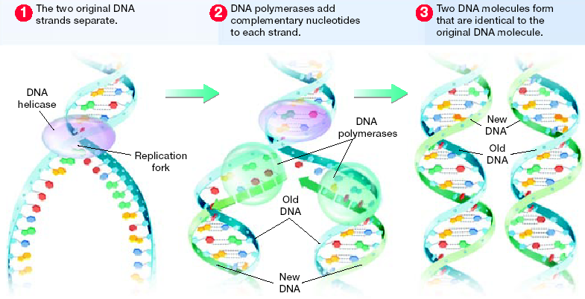
DNA Replication (cont.)
Diagram of DNA Replication: http://www.johnkyrk.com/DNAreplication.html

Slide 9
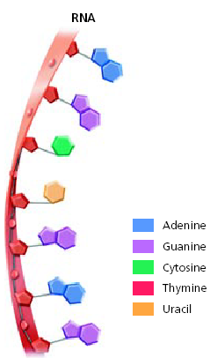
From Genes (DNA) to Proteins
RNA: Ribonucleic Acid;
Made from DNA blueprint
Used to determine the order of the Amino Acids
Single-stranded
RNA (polymer) made of nucleotides (monomer):
-Ribose = 5 C sugar + Phosphate group + N Base
4 bases: Cytosine (C),Guanine (G),
Adenine (A),Uracil (U) –
In RNA there is NO THYMINE;
it is replaced by Uracil (U).
    So, any (A) in strand will
    bind with (U) in RNA
    ( instead of a T if it was binding
    with another strand of DNA)

Slide 10
B. Gene Expressions:
Protein Synthesis: Using genetic information in DNA to Make Proteins
2 Stages in making proteins:
Transcription – using DNA template to make mRNA strand (an RNA copy is made from a gene)
Translation – using mRNA strands to create polypeptides (RNA work together to assemble Amino Acids into a protein).
DNA
Transcription
RNA
Translation
Protein

Slide 11
Central Ideas:
DNA has the instuctions for the order of the Amino Acids which make up the Proteins that make up the traits of any organism.
DNA
RNA
Proteins

Slide 12
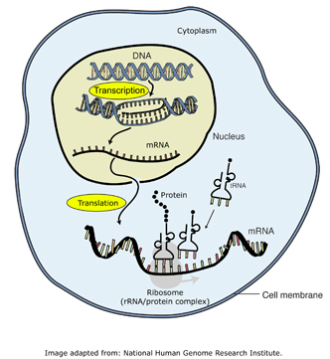
Transcription:
Basically, the DNA is kept safe in the nucleus while the RNA is sent out to the cytoplasm to direct the synthesis of proteins.

Slide 13
Transcription:
How it’s done: (This happens in the Nucleus!)
  Transcription begins with Helicase (another enzyme) binding to a region of DNA called a promoter, and then unwinding the double helix and separating a section of the 2 DNA strands
  RNA polymerase then moves along one strand of the separate DNA like a train on a track, binding complementary RNA nucleotides to the exposed DNA strand. This occurs until a specific “code” sequence is reached.

Slide 14
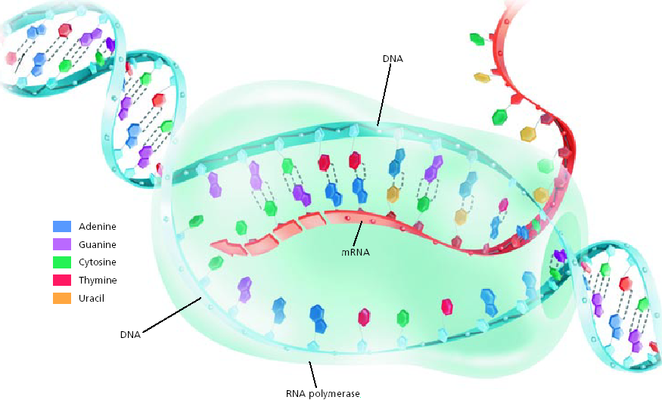
Transcription (cont.)

Slide 15
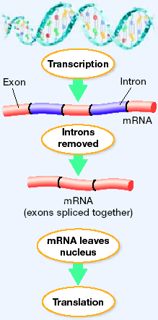
Transcription (cont.)
3. Once produced, the RNA polymerase then detaches from the DNA and floats free.
4. This process forms a single strand of Messenger RNA (mRNA)—a form of RNA that carries the code for making proteins from a gene and delivers it to the site of translation (the ribosomes)
5. The mRNA passes out of the nucleus and into the cytoplasm of the cell for translation to begin.
6. Lastly, the two (2) DNA strands rejoin.

Slide 16
The Genetic Code
Codon – every 3 nucleotides in mRNA that specify a particular amino acid
  The order of the bases (letters) in a codon determines which amino acid will be added to the protein that is being built
  The order of the amino acids determines which protein is made!!

Slide 17
More genetic code
Genetic code – the amino acids and “start” and “stop” signals that are coded for by each of the possible mRNA codons.

Slide 18
Codons in mRNA
“Start” codon = AUG (Methionine)
“Stop” codons = UAA, UAG, and UGA
Example:
mRNA Strand:
U-C-A-U-G-G-G-C-A-C-A-U-G-C-U-U-U-U-G-A-G
methionine glycine threonine cysteine phenylalanine STOP

Slide 19
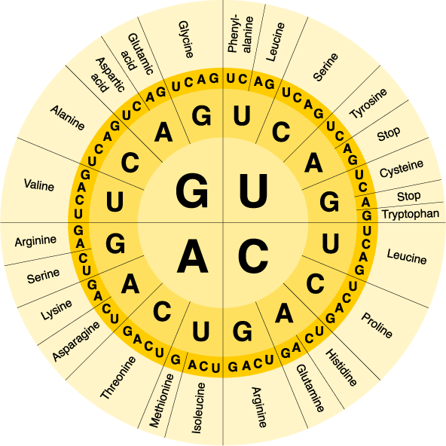
Genetic code table
Example: decode the following mRNA
CUG AUU UUU GCA GAC GAG UAU UGA
GAC UAA AAA CGU CUG CUC AUA ACU

Slide 20
Practice!
DNA | mRNA codon | Amino Acid
ATC
TAC
GAT
CCG
UAG
Stop!
AUG
Start –
Methionine
CUA
Leucine
GGC
Glycine

Slide 21
3. Translation
The Goal of Translation is to “translate” these mRNA codons into their amino acids to form a polypeptide.
How it’s done:
  1. mRNA strand attaches to a ribosome (rRNA)
  2. Each mRNA codon passes through ribosome
  3. Free-floating Amino Acids from cytosol are brought to ribosome by tRNA
  4. Each tRNA has an anticodon to match up to mRNA codons
  5. Amino Acids are joined as tRNA keeps bringing them
  6. Polypeptide chain grows until “stop” codon is reached

Slide 22
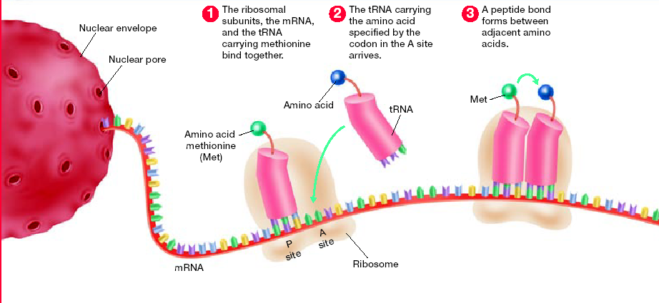
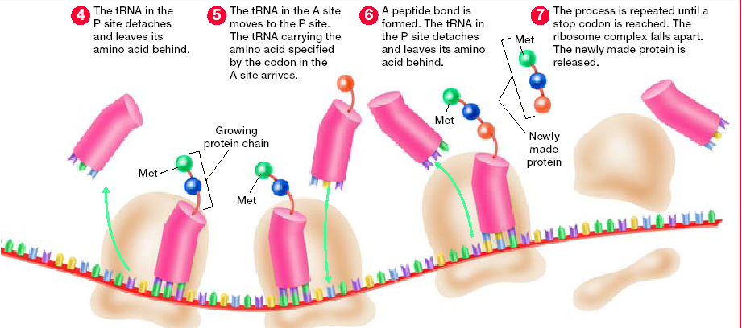
Translation (cont.)
Translation

Slide 23
Mutations
Mutations – a change in the DNA of a gene
  any change in the DNA code can result in the wrong amino acid being put in when the protein is being built; even one wrong amino acid is enough to disrupt the protein’s function

Slide 24
Types of mutations
Point mutation – a single nucleotide changes
Insertion – a chunk of DNA is inserted into a gene (often the result of transposons)
Deletion – segments of a gene are lost
Transposition - 2 genes switch places with each other

Slide 25
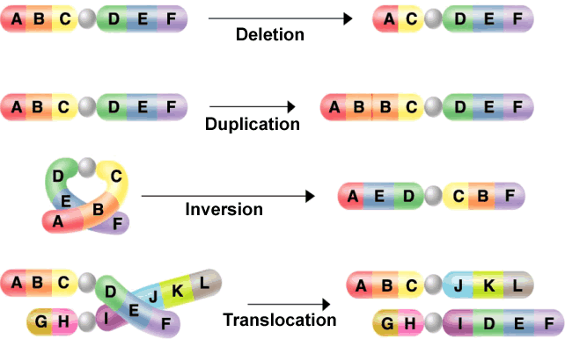
Chromosomal Mutations

Slide 26
Types of mutations
Frameshift – any mutation that causes a gene to be read in the wrong 3-nucleotide sequence
  Frameshifts are usually the result of insertions or deletions (even if it is only one or two nucleotides)
  Example: THE CAT ATE
  THE ATA TE

Slide 27
Causes of Mutations
Internal
  Mistakes in DNA replication
External
  Radiation, chemicals, high temps
  Mutagens: chemicals that cause mut.
Mutations in body cells only affect that person
Mutations in sex cells can be passed to offspring→ population

