Slide 1
Quadratic Equations
Notes

Slide 2
What is a Quadratic Equation?
A quadratic equation is a polynomial with a degree of 2
it is the product of 2 linear equations.
(2x + 1)(2x + 1) = 4x² + 4x + 1

Slide 3
What is a linear Equation?
A linear equation
  is a polynomial with a degree of 1.
  2x + 1

Slide 4
What is a Square number?
A square is a number multiplied by itself.
A square root of a number ‘a’ is the number you multiply by itself to get ‘a’.
Unless otherwise stated, “the square root” is the positive square root, not the negative.

Slide 5
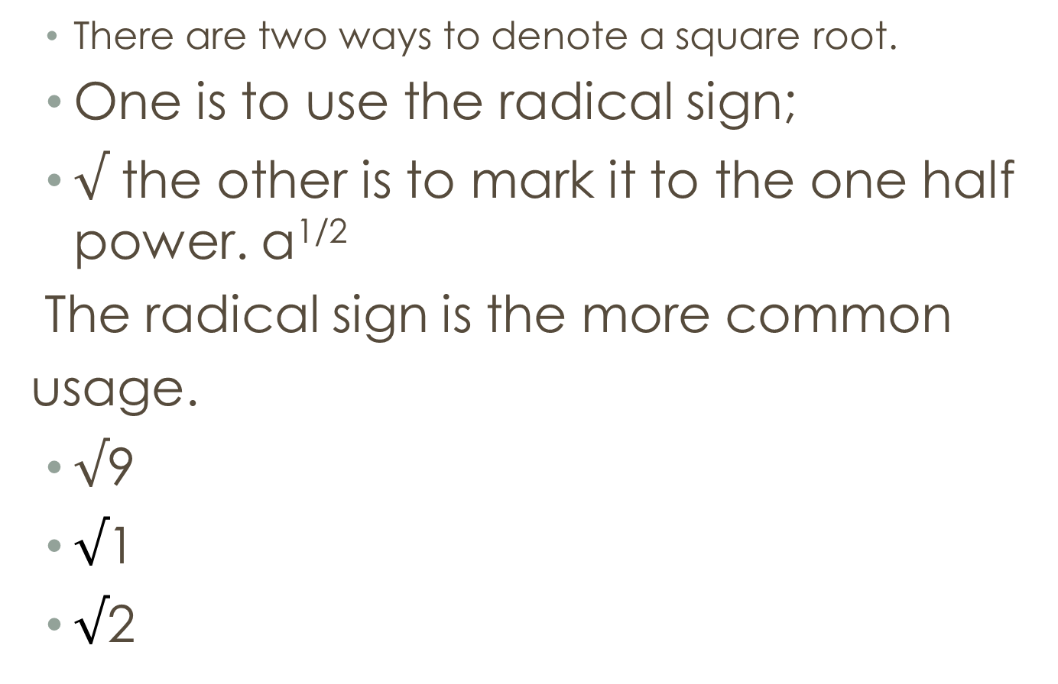
How do you denote a Square?
There are two ways to denote a square root.
One is to use the radical sign;
$√$ the other is to mark it to the one half power. a^{1/2}
The radical sign is the more common
usage.
$√$9
$√$1
$√$2

Slide 6


=$√$9 = 3
3×3 =9
(−3) ×(−3) =9
−3 =−$√$9≠$√$− 9

Slide 7
What is a square root?
A square root operation is the reverse of squaring.
A perfect square is a number that is the product of a
whole number multiplied by itself.

Slide 8
What is the foild Method?
FOIL is a method multiplying two binomials. It stands
for First, Outside, Inside, Last.
(2x + 1)² = (2x + 1) x (2x + 1) =
(2x) x (2x) + (2x) x 1 + (2x) x 1 + 1 x 1 =
4x² + 2x + 2x + 1 =
4x²+ 4x + 1

Slide 9
What is the standard form of a Quadratic
Standard quadratic form is
Y = AX² + BX + C,
Where:
a is the coefficient of x to the second power
b is the coefficient of x to the first power
c is the constant

Slide 10
A parabola is the graph resulting from a quadratic
equation.
The vertex is the point where the graph turns and
changes directions. Here is the parabola for the graph
y = x2
+ 2x - 2.

Slide 11
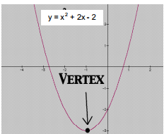
What is a Parabola
A parabola is the graph resulting from a quadratic
equation.
The vertex is the point where the graph turns and
changes directions. Here is the parabola for the graph
y = x²+ 2x - 2.

Slide 12
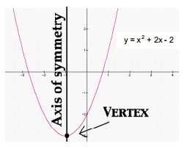
What is the Axis of Symmetry?
The axis of symmetry is a vertical line drawn through
the vertex. It cuts the parabola exactly in half.

Slide 13
How do Parabolas vary?
If the value for a is positive or greater than zero, then
the parabola opens upward and its vertex is at the
bottom.
If the value for a is negative or less than zero, the
parabola opens downward and the vertex is at the top.
Additionally, the closer the value for a is to zero, the
wider the parabola grows; as a gets further away from
zero, the parabola gets more and more narrow.

