Slide 1
EOC:Perpendicular and Parallel Lines

Slide 2

Slopes of Parallel and Perpendicular Lines
Objectives:
1. Discover the relationships between the slopes of parallel lines and perpendicular lines.

Slide 3
Lesson Goals
I can identify perpendicular and parallel lines
I can calculate the slope of parallel and perpendicular lines

Slide 4
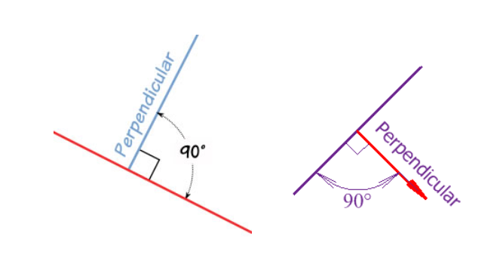
Vocabulary
Perpendicular
  It just means at right angles (90°) to.
    The red line is perpendicular to the blue line in both these cases:

Slide 5

Vocabulary
Parallel
  Lines are parallel if they are always the same distance apart (called "equidistant"), and will never meet. (They also point in the same direction). Just remember:
  Always the same distance apart and never touching.

Slide 6
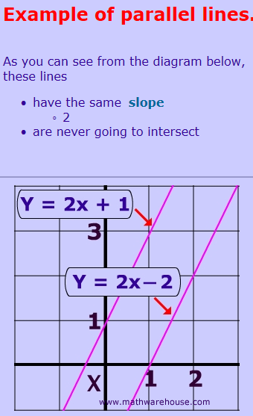
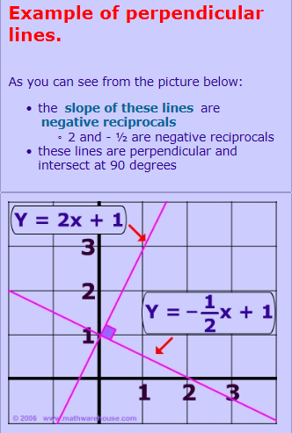
Parallel & Perpendicular Lines

Slide 7
What type of lines do lines “p” and “q” look like?
parallel lines
Y
p
X
q

Slide 8
Calculate the slope of each.
Y
p
X
q

Slide 9
slope of p = slope of q = =
Y
p
X
q

Slide 10
What do you notice about the slopes of these two lines?
The slopes are congruent.
: Parallel Slope Conj.
In a coordinate plane, two lines are _____________if and only if their slopes are ____________.
parallel
congruent

Slide 11
Are these lines parallel?
NO – Slopes are not ≅
a
Y
b
X
slope a = -
slope b = -

Slide 12
Are these lines parallel?
YES – Slopes are ≅
Y
c
slope c =
d
X
slope d = =

Slide 13
Perpendicular Slope Conjecture:
Two nonvertical lines are _____________ if and only if their slopes are
perpendicular
opposite (or negative) reciprocals of each other.

Slide 14
You will be shown the slopes of two lines. Tell whether each pair of lines are parallel, perpendicular, or neither.

Slide 15
slope of line r = slope of line s =
These lines are parallel.

Slide 16
2. slope of line t = slope of line u =
These lines are perpendicular.

Slide 17
3. slope of line t = slope of line u =
These lines are parallel.

Slide 18
4. slope of line t = slope of line u =
NEITHER!! Slopes are not congruent or opposite reciprocals of each other.

Slide 19
5. slope of line t = slope of line u = 7
Perpendicular.

Slide 20

Activities/Assessments
Rags To Riches
http://www.quia.com/rr/864452.html
Quia Quiz
Algebra: Parallel Perpendicular Slope Quiz
http://www.quia.com/quiz/3697535.html

