Slide 1
OPERATIONS WITH A Matrix
(Matrixes)
EOC Review

Slide 2
Lesson Goals
• To understand how to name a matrix
• To become comfortable using matrix terminology
• To be able to add two matrices
• To be able to multiply two matrices

Slide 3
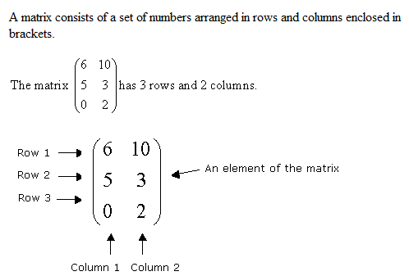
What is a matrix?

Slide 4
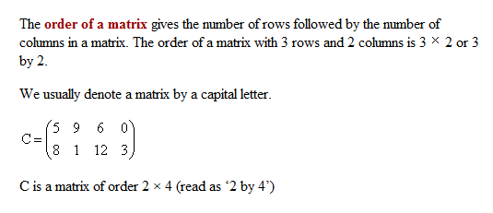
What is the order of a matrix?

Slide 5
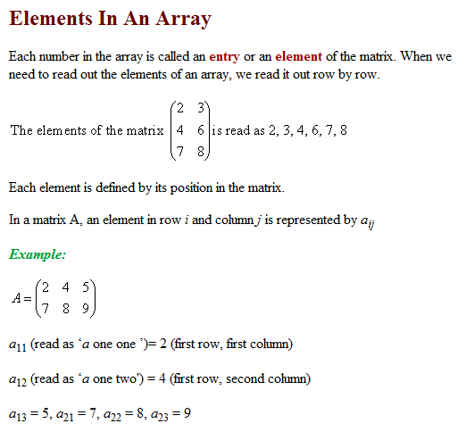
What is a matrix element?

Slide 6
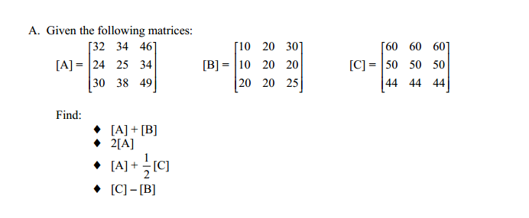
White Board Practice

Slide 7
Assessments
Adding Matrices Self Check Quiz
http://www.etap.org/demo/algebra2/alg2l1_1pe1.htm
Subtracting Matrices
http://www.etap.org/demo/algebra2/alg2l1_2pe1.htm

Slide 8
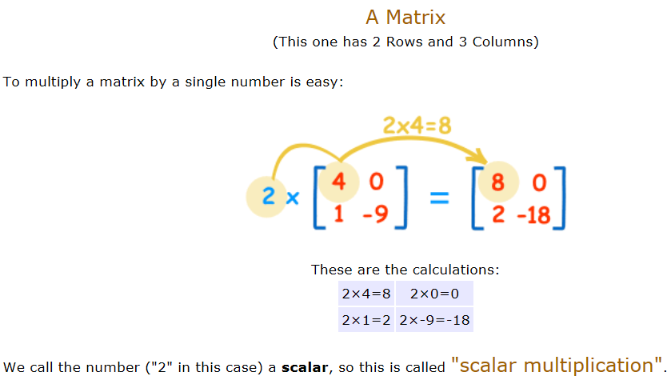
Multiplying Matrices

Slide 9
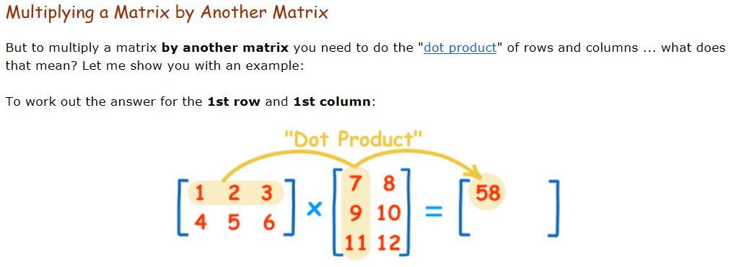
Multiply a Matrix by a Matrix is Tricky

Slide 10
Examples:
2(3) + -1(5)
2(-9) + -1(7)
2(2) + -1(-6)
3(3) + 4(5)
3(-9) + 4(7)
3(2) + 4(-6)

Slide 11
Dimensions: 2 x 3 2 x 2
*They don’t match so can’t be multiplied together.*

Slide 12
*Answer should be a 2 x 2
2 x 2 2 x 2
0(4) + (-1)(-2)
0(-3) + (-1)(5)
1(4) + 0(-2)
1(-3) +0(5)

Slide 13
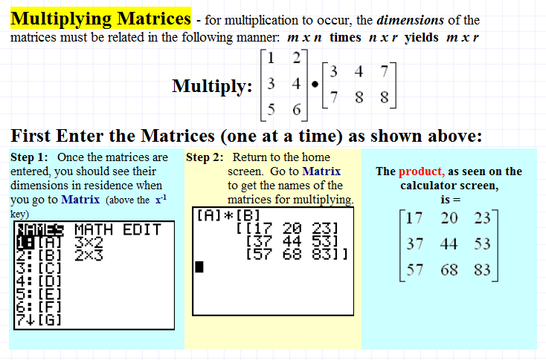
Calculator Directions -Multiply

Slide 14
Practice Problems- Save the Trees!
Go to www.hsunlimited.com/worksheets/matrix-multiplication
Create a Practice worksheet. Try on calculator. Scroll down to check your answer!
http://www.hsunlimited.com/worksheets/matrix-multiplication

Slide 15
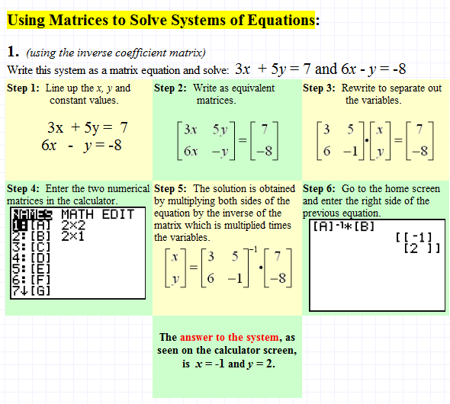
Solving System of Equation With Matrix

Slide 16
Create some Practice Problems
http://www.hsunlimited.com/worksheets/createworksheet.php

