Slide 1
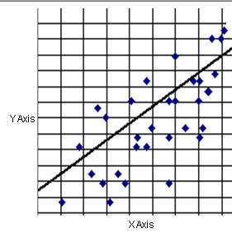
EOC Review Line of Best Fit

Slide 2
Lesson Goals
I can plot data on a scatter plot.
I can calculate the line of best fit

Slide 3
Lines of Best Fit
When mathematical models are used in the real world, we often don’t have data that fall on perfect lines.
Most of the time we want to find the line of best fit (or the line that best fits the data).

Slide 4
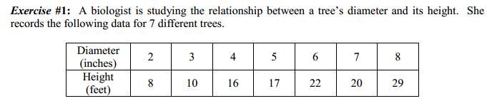
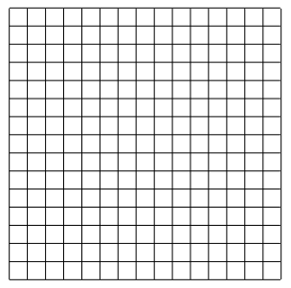
Exercise 1
(a) On the grid provided, create a scatterplot of the
data. Use the diameter as the independent
variable and the height as the dependent
variable.
(b) Draw a line of best fit through the data. As a
guide, try to have as many points of data fall
above the line as below the line.
(c) Write two ordered pairs that lie on your line.
(d) Determine the equation of your linear function using the two ordered pairs from part (c)
(e) Using your linear function from part (d), estimate, to the nearest foot, the height of a tree given that
its diameter is 14 inches. (This type of calculation is called extrapolating; we are using a model to
predict outside of our data set.)

Slide 5
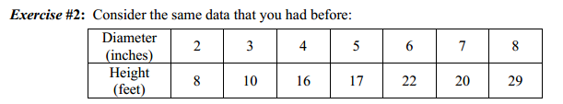
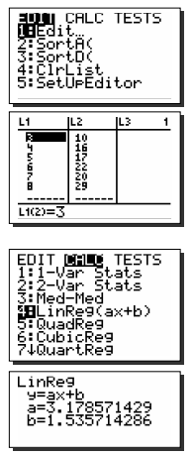
Exercise 2 Calculator
(a) Enter the data into your calculator as follows.
Step 1 – Hit the STAT button and go to the Edit submenu.
Step 2 – Enter the Diameters under L1 and the Heights under L2.
When working with a data set, always place the independent
variable in L1 and the dependent variable in L2.
(b) Find the equation for the line of best fit. Round your coefficients to
the nearest tenth. Also, define what each variable, x and y, represent.
Step 1 – Hit the STAT button and go to the CALC submenu.
Step 2 – Go the choice 4 – LinReg(ax+b). Hit ENTER twice.

Slide 6
Partner Activity
Work with a partner to complete your piece of worksheet.

Slide 7
Assessment
Online Self Checking Quiz
Homework - Complete Problems
Pearson Online Self Checking Quiz
http://www.phschool.com/webcodes10/index.cfm?fuseaction=home.gotoWebCode&wcprefix=ata&wcsuffix=0607
Line of Best Fit HW

